Slide 1
Granular Synthesis

Slide 2
Examples

Slide 3
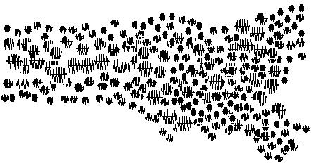

Slide 4
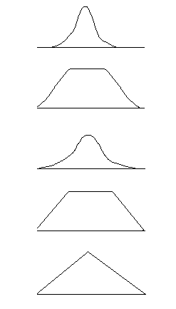

Slide 5


Slide 6


Slide 7
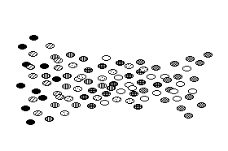

Slide 8
github.com/sebpiq/pd-rpi-workshop

