Slide 1

Add BPM in your business web applications with Bonita Open Solution
Add conference logo here !
Frédéric Bouquet
Sébastien Prunier

Slide 2




Frédéric Bouquet
Consultant & Trainer at Bonitasoft
BPM & Bonita Evangelist, Community manager
Opensource, Groovy & Java enthusiast
*JUG, *Camp and Devoxx* addict
www.espacedefouille.org
@bouquetf

Slide 3

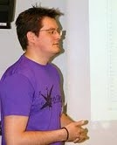
Sébastien Prunier
Software Engineer at Mosica
BPM & Bonita Open Solution enthusiast
Recently changed my opinion on Javascript :-)
*JUG, *Camp and Devoxx* addict
sebprunier.wordpress.com
@sebprunier

Slide 4
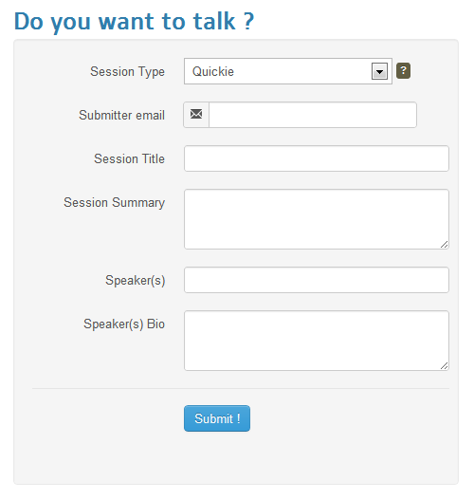

How to become a speaker ?
Call For Paper !

Slide 5

Nice application, but …
No e-mail confirmation after submission
No user management (staff, admin)
No back-office (paper validation process)
People can submit spam
…
Ok, we can imagine some feature requests now !

Slide 6
The solution
B
P
M
S

Slide 7
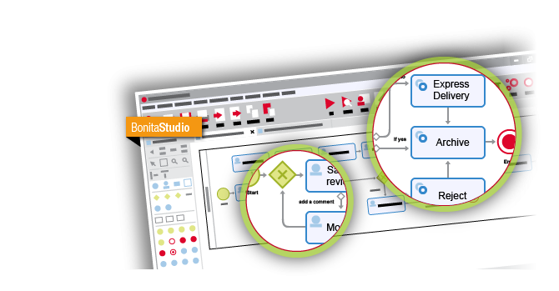
Bonita Open Solution
Draw …

Slide 8
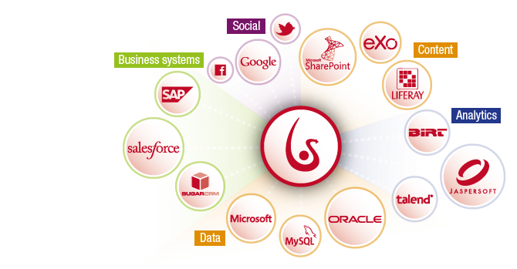
Bonita Open Solution
Connect …

Slide 9
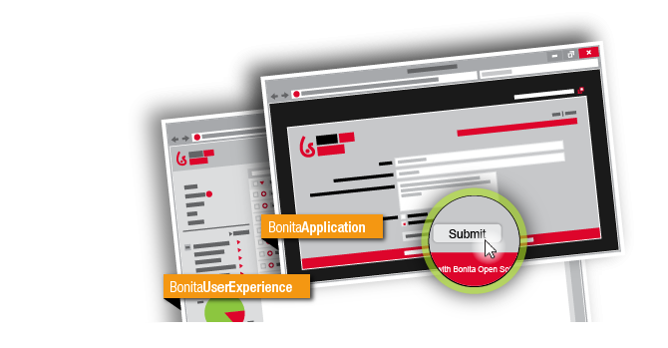
Bonita Open Solution
and Run !

Slide 10
What are we going to do ?
Draw a « Paper validation » process
Draw application forms
Implement some feature requests
Connect the « Call For Paper » application to the process
Use the User Experience
Talk about advanced features

Slide 11
Global architecture
Create new process instances
Call For Paper Application
Paper validation Process
Update application data
Process data
Application data
(papers, votes)

Slide 12
Paper Validation Process
Validate paper is well formed
Vote for paper
Notify submitter
Send an acknowledgment

Slide 13
Feature request #1
Send an acknowledgment to the submitter

Slide 14
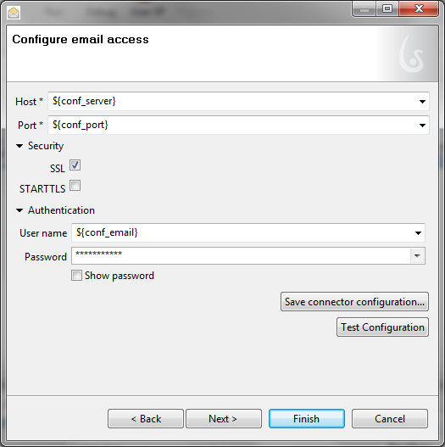
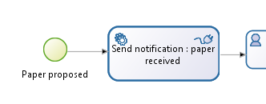
Feature request #1 Solution
Create a task to notify the user
Add a connector to send the email

Slide 15
Feature request #2
Check paper
is well formed

Slide 16
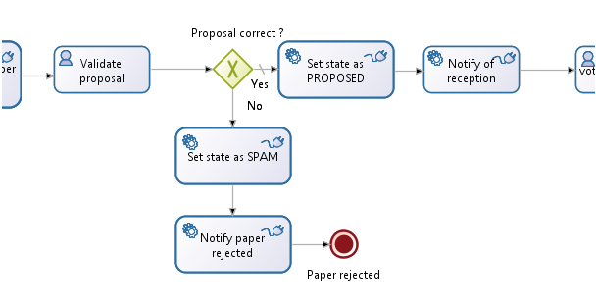
Feature request #2 Solution
Upgrade the process to ask for a validation
Create two paths (accepted / rejected)
Notify the user as before

Slide 17
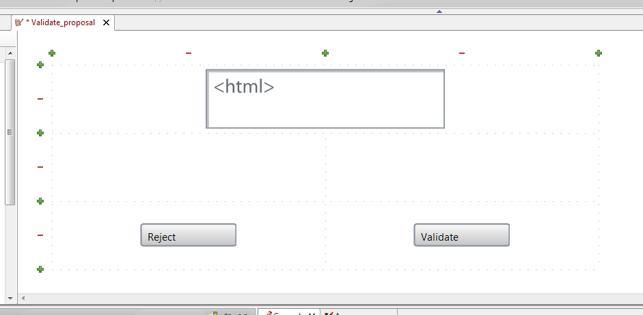
Feature request #2 Solution
Design web application
Retrive paper information using remote API

Slide 18
Feature request #3
Enable collaborative vote for papers

Slide 19
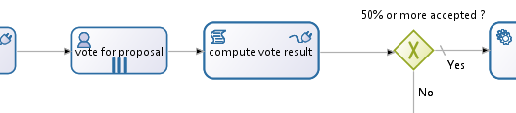
Feature request #3 Solution
Upgrade the process to ask for a vote
Multi instantiate the vote task
Store the data by sending the vote to the webapp
Compute the results
And of course… notify the submitter !

Slide 20
Feature request #4
Show validated papers on the web application

Slide 21
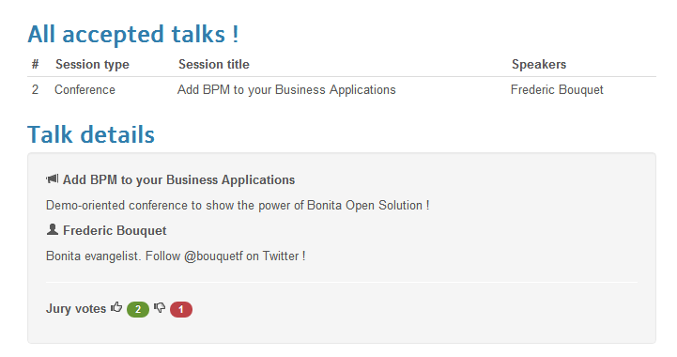
Feature request #4 Solution
Add a state for the paper business object
Only show papers with ACCEPTED state

Slide 22
Feature request #5
And how to
map the webapp with the process ?

Slide 23
Feature request #5 Solution
Use BEE REST API
Instantiate Process With Variables
/bonita-server-rest/API/runtimeAPI/instantiateProcessWithVariables
Call For Paper Application
Paper validation Process

Slide 24
What’s next ?
Handle errors
Embed the engine in the web application
Manage users
Authenticate users
Human tasks managed by business application
Rights management
Handle unauthenticated users
…

Slide 25

Thanks for your attention !
Questions ?
Answers !

