Slide 1
Brokerage Database
Presentation
By Sean Bradley, Carlos Gomez

Slide 2

Project Goals
Simulate a database that a brokerage firm may use. Database is required to keep track of:
Past values of stocks traded on the NASDAQ and the New York Stock Exchange.
Customer stock transactions whether they are buying or selling stock.
The current stock value and type of customer accounts (Traditional, Educational, Cash, Roth).
Employee and other business side information for the brokerage firm.
Along with storing the information the database should provide useful stock statistics (stock highs, lows, averages over time) for our brokers.

Slide 3

Business Rules
All customers must have a broker assigned
Brokers can have many customers
All customers must have a Cash account
May have more than one account (eg Roth and Educational)
Accounts have different minimums
Traditional/Roth IRA: $3,000
Educational: $1,000
Cash: $0
Some accounts have maximum contributions
Roth IRA only allowed $5,500 contributions per year
Brokers earn commision per a transaction performed.

Slide 4
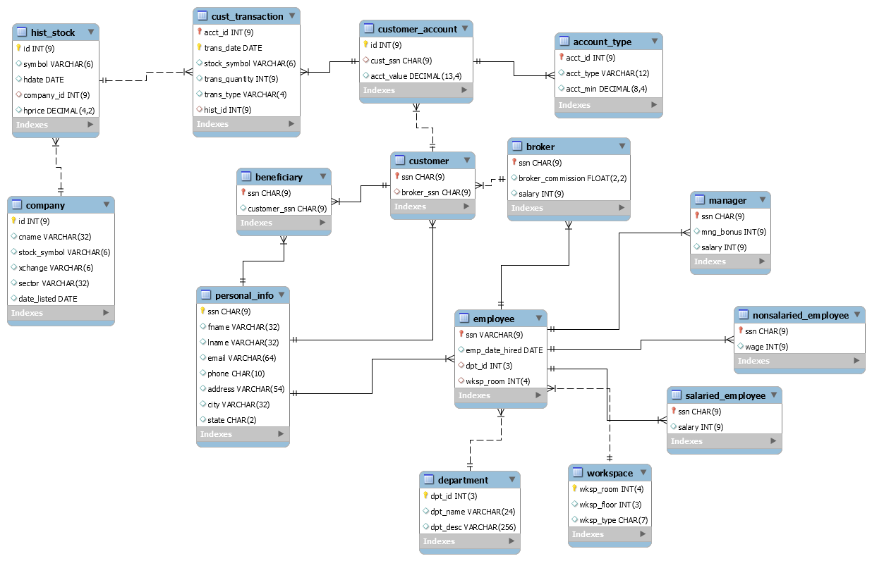

DB Design

Slide 5
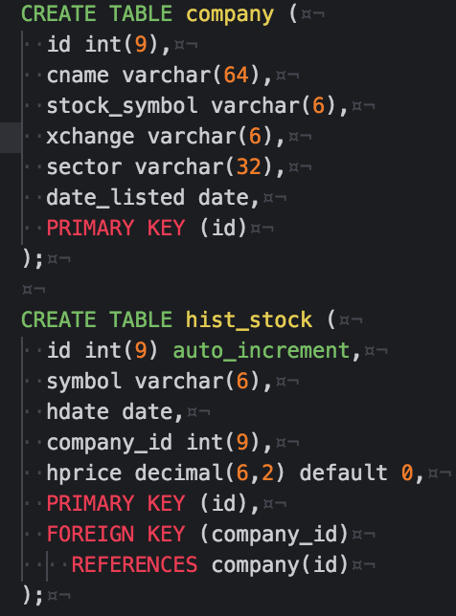
Storing Historical Stocks

Slide 6
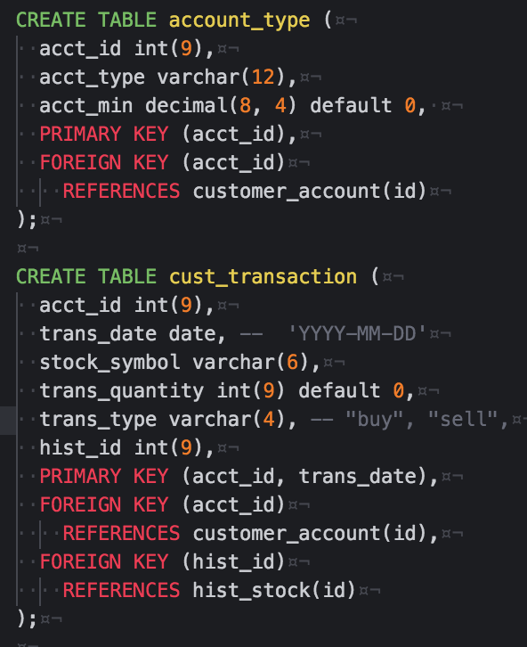
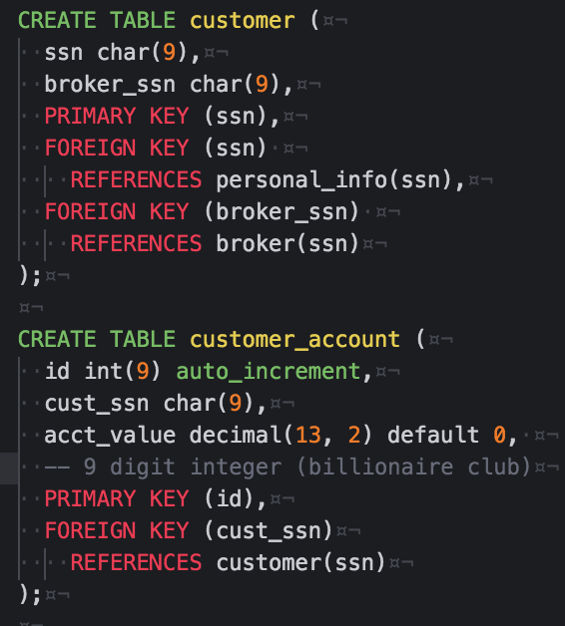
Customer Information

Slide 7
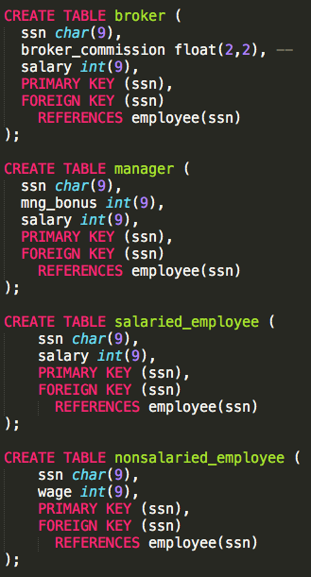
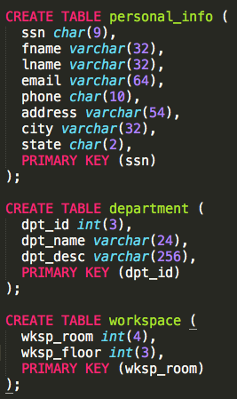
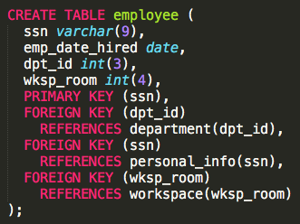
Business Tables

Slide 8
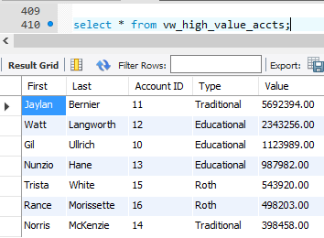
Implementation
Views
vw_high_value_accts
Returns account with values > 250,000.
vw_cash_accts
Returns cash accounts.
vw_total_cash_value_traded
Returns the total cash value the brokerage has traded.
vw_most_valuable_monthly_brokers
Returns the broker who has the most transactions within the last month.
vw_personal_info
Returns the personal information of all people in our system.

Slide 9
Implementation continued…
Triggers
Trg_create_cash_account
Whenever a customer is inserted into the table creates a cash account with a default value of zero for them.
Trg_account_transaction
On every insert or update to transaction table adjust account values.
Trg_stock_update
On every insert into historical stock table adjust account values for newly value of stock.

Slide 10
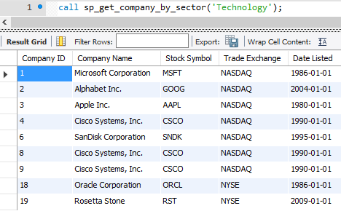
… Implementation final
sp_get_high
Returns the high value of a stock between two periods.
sp_find_mean_of_stock
Returns the mean stock value between two periods.
sp_stocks_by_account
Returns the stock bought but not sold by an account.
sp_get_company_by_sector
Returns the companies within an economic sector.

