Slide 2

Cloud4DCC
Susan Branchett / 2023-11-24

Slide 3
Agenda
Public Cloud 101
What does it look like?
How does it work?
Hands-on for Software Engineers
Concluding remarks

Slide 4
Agenda
Public Cloud 101
What does it look like?
How does it work?
Hands-on for Software Engineers
Concluding remarks

Slide 5
Public Cloud 101
“Someone else’s computer”
“Keys to a data centre” – Mark
“Cloud computing is the on-demand delivery of IT resources over the Internet with pay-as-you-go pricing” – AWS
“… delivery of computing services – including servers, storage, databases, networking, software, analytics, and intelligence – over the internet” – Azure

Slide 6
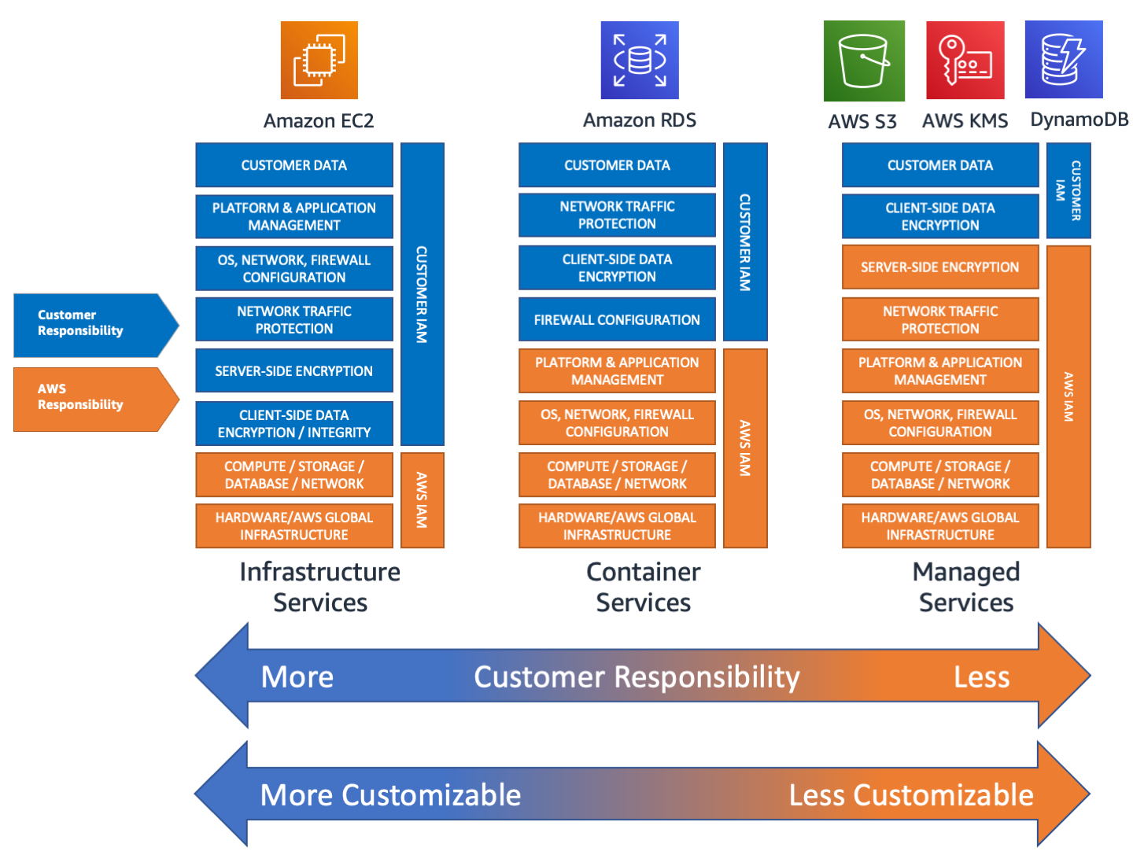
AWS Shared Respons-ibility Model by Service Types

Slide 7
Public Cloud 101
Fry their brains…
slides 31 to 153 in a couple of minutes
go back to serverless?

Slide 8
Agenda
Public Cloud 101
What does it look like?
How does it work?
Hands-on for Software Engineers
Concluding remarks

Slide 9
Agenda
Public Cloud 101
What does it look like?
How does it work?
Hands-on for Software Engineers
Concluding remarks

Slide 10
Accessing and managing AWS services
AWS Management Console
AWS Command Line Interface $ aws ec2 start-instances --instance-ids i-1348636c
Software Development Kits for: many languages, including Python (Boto3, IoT, Pandas) import boto3 client = boto3.client('ec2') response = client.run_instances(…)

Slide 11
Building and Managing Infrastructure
AWS Management Console
CloudFormation
Cloud Development Kit (CDK)

Slide 12



CloudFormation - Infrastructure as Code
…
Ec2Instance:
Type: AWS::EC2::Instance
Properties:
ImageId:
Fn::FindInMap:
- "RegionMap"
- Ref: "AWS::Region"
- "AMI"
KeyName:
Ref: "KeyName“
…
Template in JSON or YAML
Stack
AWS CloudFormation
Terraform!!

Slide 13
Cloud Development Kit – CDK
Available for many languages – including Python
Templates, SDK and CLI to:
facilitate creating Infrastructure as Code (IaC)
synthesize code (to CloudFormation template)
create, update, monitor, delete infrastructure stacks
…there is a VS Code plugin for AWS!
CDKTF!!

Slide 14
Agenda
Public Cloud 101
What does it look like?
How does it work?
Hands-on for Software Engineers
Concluding remarks

Slide 15
Agenda
Public Cloud 101
What does it look like?
How does it work?
Hands-on for Software Engineers
Concluding remarks

Slide 16
Useful resources
https://tu-delft-ict-innovation.github.io/Cloud4Research/
AWS
https://explore.skillbuilder.aws/learn
https://docs.aws.amazon.com/cdk/v2/guide/getting_started.html
https://github.com/aws-samples/aws-cdk-examples/tree/master/python
https://docs.aws.amazon.com/cdk/api/v2/python/
https://aws.amazon.com/marketplace/search

Slide 17
I wish I’d known…
I (nearly) always need more than one service
I need to learn more about networking
I need to learn more about security and setting permissions
The answer is (nearly) always “yes you can, but…”
it takes effort
it costs money

Slide 18
Take-home messages: Cloud Infrastructure as Code
There is a steep learning curve, but the possibilities are endless
Being a software engineer gives you an advantage
Susan would very much like to work together with you to support our researchers

Slide 19
Thank you for your attention
Susan Branchett

