Slide 1
Deep Learning Course
Foundation
Data

Slide 2
Data
The data is what is going to shape your neural network.
Numbers have meaning and data has to be represented correctly.
Bad data will influence the learning process.
Wrong information.
Imbalanced dataset.
Bad scaling.
Repetition and data similarity might be a problem.
New data can be artificially generated (Dataset Augmentation).
Must be done carefully to not generate bad data.

Slide 3
Data
Take a look at your dataset.
What is your data for?
What do you want your machine to learn from your data?
Keep only relevant information?
What is relevant information?
Causality.
Find inconsistencies.
Correct them.
Remove them.
Numerical representation changes how the network behaves.
Bad representation can be an impeditive in the learning process, or just make it harder.

Slide 4
Bad Data
Bad data can come in different forms. We either remove the bad data or fix them.
Incoherent information.
Understand your data. Look at your data. Is there any values that don’t make sense?
Different scales.
Numbers can have metrics. Is the data using the same metrics through the entire dataset?
Incomplete data.
Does any example have any parameter missing? Can it be filled by hand?
Repetitions.
Does any example repeats across the dataset? Is any of the with the same inputs but different outputs?

Slide 5
Removing Data
Remove samples with missing information.
Remove irrelevant information.
Name | Age | Years in Company | Years of Experience | Salary
Lara | 32 | 3 | 12 | $43000
Barry | 31 | 5 | 8 | $42000
Sandra | 40 | 10 | ??? | $48000
Eric | 33 | 7 | 11 | $50000

Slide 6
Removing Data
Remove samples with missing information.
Remove irrelevant information.
Name | Age | Years in Company | Years of Experience | Salary
Lara | 32 | 3 | 12 | $43000
Barry | 31 | 5 | 8 | $42000
Sandra | 40 | 10 | ??? | $48000
Eric | 33 | 7 | 11 | $50000

Slide 7
Dataset Normalization
Large numbers can cause problems while training.
Dead neurons.
Slow training.
Conflict with normalization of weights and bias.
May be harder for human comprehension, but it helps with the machine learning process.
Represent your entire dataset within the range of 0~1 or -1~1, or with standard deviation of 1.
Remember how your data is represented and use it later to understand the outputs of your network.

Slide 8
Dataset Normalization
Data Normalization.
Creates a linear representation of the dataset with new minimum and maximum values (between 0~1 or -1~1).
https://scikit-learn.org/stable/modules/generated/sklearn.preprocessing.MinMaxScaler.html
Data Standardization.
Creates a linear representation of the dataset with new minimum and maximum values in a way that the standard deviation of the data is 1.
https://scikit-learn.org/stable/modules/generated/sklearn.preprocessing.StandardScaler.html

Slide 9
Data Representation
Data Normalization.
Creates a linear representation of the dataset with new minimum and maximum values (between 0~1 or -1~1).
https://scikit-learn.org/stable/modules/generated/sklearn.preprocessing.MinMaxScaler.html
Data Standardization.
Creates a linear representation of the dataset with new minimum and maximum values in a way that the standard deviation of the data is 1.
https://scikit-learn.org/stable/modules/generated/sklearn.preprocessing.StandardScaler.html

Slide 10
Data Representation
Ordinal Encoding
Converts a set of values into a sequence of integers.
[Red, Green, Blue] → [0, 1, 2]
[Bad, Average, Good, Great] → [0, 1, 2, 3]
https://scikit-learn.org/stable/modules/generated/sklearn.preprocessing.OrdinalEncoder.html
One Hot Encoder
Converts a set of values into one-hot representations.
[Red, Green, Blue] → [001, 010, 100]
[Bad, Average, Good, Great] → [0001, 0010, 0100, 1000]
https://scikit-learn.org/stable/modules/generated/sklearn.preprocessing.OneHotEncoder.html

Slide 11
Imbalanced dataset
Networks trained with unbalanced data tend to have bad performance.
The bad performance usually is masked with good accuracy.
On each epoch, the deep learning algorithm tries to reduce the average loss.
If we have worse results with a few elements, but the majority has still improved, the average loss will still decrease.
This is normal in the learning process, but it fixes itself on every iteration.
But unbalanced data tend to make the bad cases worse every iteration.
Notes:
each epoch, the deep learning algorithm tries to reduce the average loss. If we have worse results with a few elements, but the majority has still improved, the average loss will still decrease.

Slide 12
Imbalanced dataset
Example:
We have a classification model that classifies into 5 classes:
Type A to Type E.
Type D and Type E are the most important types to be classified correctly.
It’s easy to find data for Type D, since it is a common case.
Type E is rare. Not so much data.
The overall accuracy was 95.55%.
When using the network, this behaviour was identified:
92.80% of the cases involving Type E were classified correctly. They either were classified as some other type instead of Type E, for some other type was classified as Type E.
39.21% of the cases involving Type D were classified correctly. With a similar behaviour of the misclassification happening with Type E.
Where did this bad performance came from?

Slide 13
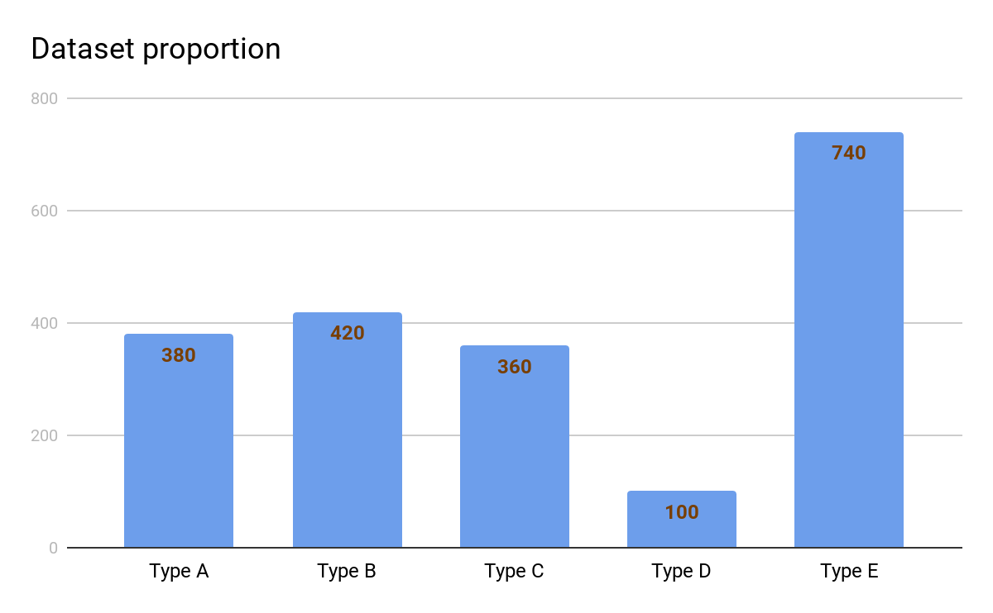
Imbalanced dataset

Slide 14
Imbalanced dataset
Confusion Matrix
 |  | Predicted
 |  | A | B | C | D | E
Real | A | 372 | 2 | 1 | 0 | 5
 | B | 2 | 410 | 3 | 1 | 4
 | C | 1 | 1 | 354 | 1 | 3
 | D | 5 | 10 | 5 | 40 | 40
 | E | 1 | 3 | 1 | 0 | 735

Slide 15
Imbalanced dataset
Add more data for the lacking types.
Remove data from the abundant types.
Change the influence of some data in the learning process.
Multiplies the learning rate when training with data from that class.
https://keras.io/models/model/#fit
Class Weights: { 0.26, 0.24, 0.28, 1.00, 0.14 }
Notes:
Defining the weights:
-2 ways:
1: normalized of 1 - proportion of that element
2: normalized of 1/proportion of that element

