Slide 1
Deep Learning Course
Foundation
Network Normalization

Slide 2
Underfitting and Overfitting
Problem of generalization.
Results in poor performance on the validation set or the real application.
Remember: the network learns with part of the dataset only.
It might look fine while training but it doesn’t work in the real application.
Every network underfits or overfits a little. We need it to happen as little as possible.

Slide 3
Underfitting and Overfitting
Underfitting
When the network learns enough from the training dataset but underperforms with new data. Sometimes it even stops learning (local minima).
The network is over generalized.
How to identify underfitting?
Loss is not reducing (or reducing very slowly) on the validation dataset.
Usually high number of false positives with new data.
How to fix it?
Increase the complexity of the network (more layers and/or more neurons).
Increase learning rate when it starts to underfit.
Shuffle the dataset on every training epoch.

Slide 4
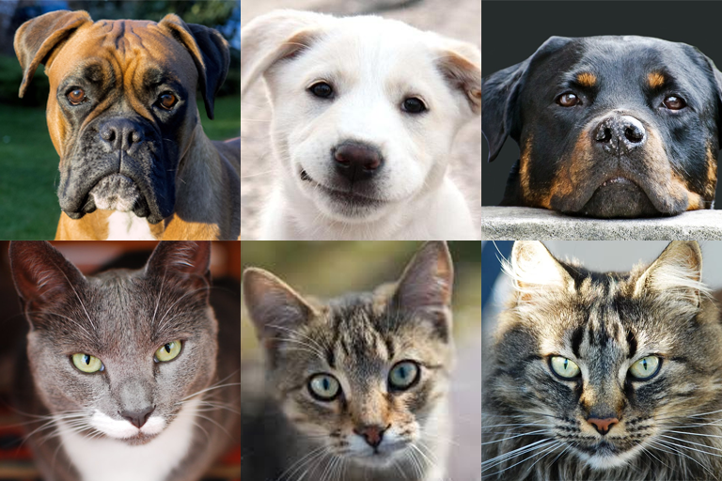
Underfitting and Overfitting
Underfitting:
Example: Network to identify dogs.

Slide 5
Underfitting and Overfitting
Underfitting:
Example: Network to identify dogs.
DOG
DOG
DOG
DOG
DOG
NOT DOG

Slide 6
Underfitting and Overfitting
Overfitting
When the network learns too much from the training dataset but underperforms with new data.
The network is under generalized.
How to identify overfitting?
Loss is reducing on the training but increasing on the validation dataset.
Usually high number of false negatives with new data.
How to fix it?
Decrease the complexity of the network (less layers and/or less neurons).
Stop shuffling the dataset on every training epoch.

Slide 7
Underfitting and Overfitting
Overfitting:
Example: Network to identify dogs.

Slide 8
Underfitting and Overfitting
Overfitting:
Example: Network to identify dogs.
DOG
NOT DOG
NOT DOG
NOT DOG
NOT DOG
NOT DOG

Slide 9
Dropout
Neutralizes neurons inside a network randomly on every epoch.
Increases generalization.
Forces the network to perform well with less neurons.
Forces some neurons to identify the same features as others.
Decreases specification of a network.

Slide 10
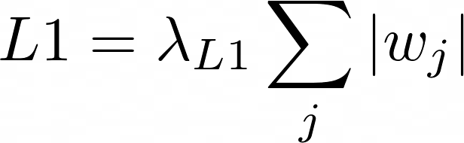
L1 Regularization
Increases loss on networks with high values.

Slide 11
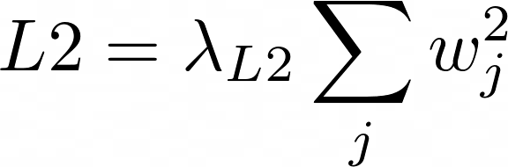
L2 Regularization
Increases loss on networks with high values.

Slide 12
Batch Normalization
Batch Normalization is another layer used to normalize the output of the previous layer.
Finds the normalization parameters during training only.
These parameters are fixed afterwards.
The neuron weights no longer have to over adjust to avoid these problems themselves.
Reduces the importance of one feature over another.
Use it only when feature importance if not as important as feature presence.

Slide 13
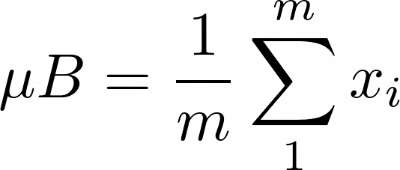
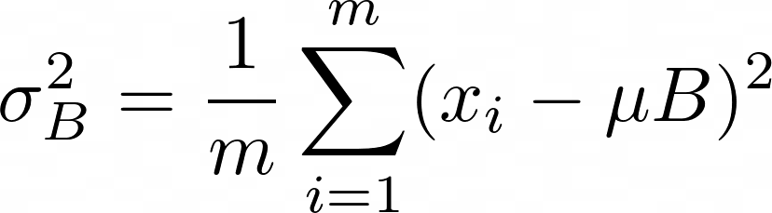
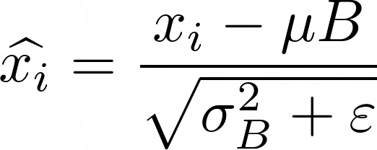
Batch Normalization
(Input Mean)
(Input Variance)
(Input Normalization)
Parameter (usually 1E-6)

Slide 14
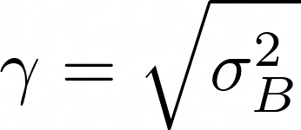

Batch Normalization

