Slide 1
Deep Learning Course
Foundation
Introduction to Deep Learning

Slide 2
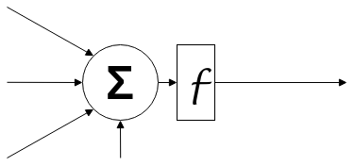
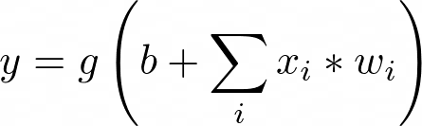
Activation Functions
What is it for?
Which function to use?
x1
w1
x2
w2
y
wn
xn
b
Notes:
Activation Functions
There is no function that can be used for all cases.
Understand the activation functions and when to use each.

Slide 3
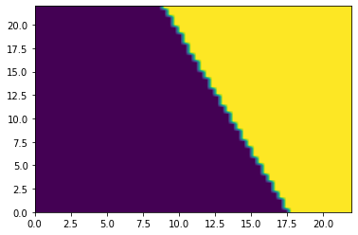
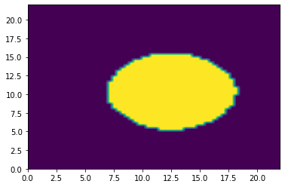
Activation Functions
Remove linearity from neural networks.
Allows to solve move complex problems.
Notes:
Activation functions are really important for a Artificial Neural Network to learn and make sense of something really complicated and Non-linear complex functional mappings between the inputs and response variable.They introduce non-linear properties to our Network.Their main purpose is to convert a input signal of a node in a A-NN to an output signal. That output signal now is used as a input in the next layer in the stack.

Slide 4
Activation Functions
Step Function is not used because of its derivative.
Notes:
Activation function

Slide 5

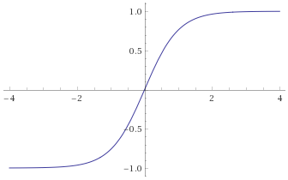
Activation Functions
Hyperbolic Tangent
Notes:
Activation function

Slide 6
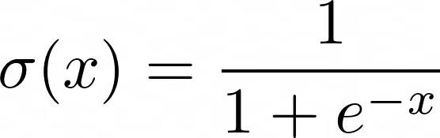
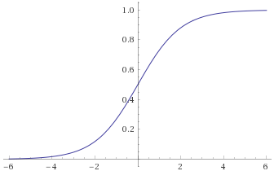
Activation Functions
Sigmoid
Notes:
Activation function

Slide 7

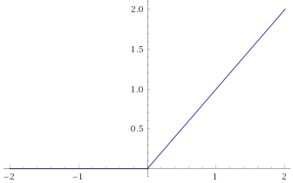
Activation Functions
ReLU (Rectified Linear Unit)
Notes:
Activation function

Slide 8

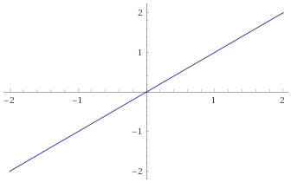
Activation Functions
Identity or Linear
Notes:
Activation function

Slide 9
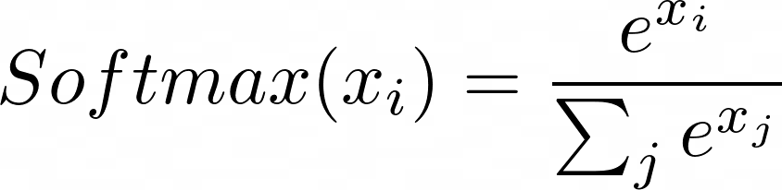
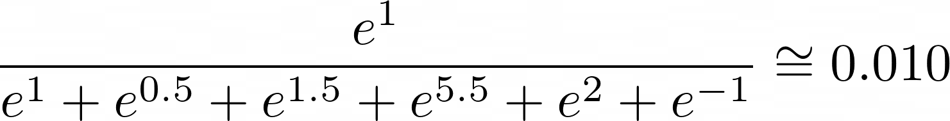
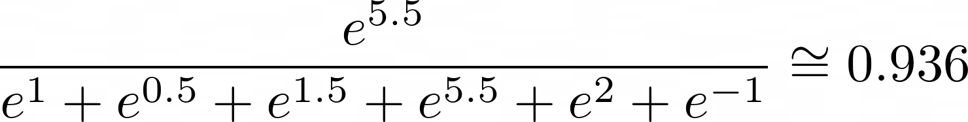
Activation Functions
Softmax: Normalizes a group of numbers into a probability distribution.
[1, 0.5, 1.5, 5.5, 2 , -1]
Notes:
Activation function
Show more on https://keras.io/activations/

Slide 10

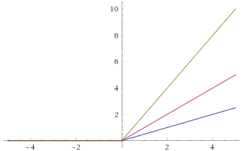
Activation Functions
How the weights and bias on the inputs influences the activation function output.
0
w = 2
w = 1
w = 0.5
Notes:
Loss Function
Weight

Slide 11
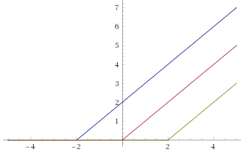
Activation Functions
How the weights and bias on the inputs influences the activation function output.
1
b = 2
b = 0
b = -2
Notes:
Loss Function
Weight

Slide 12
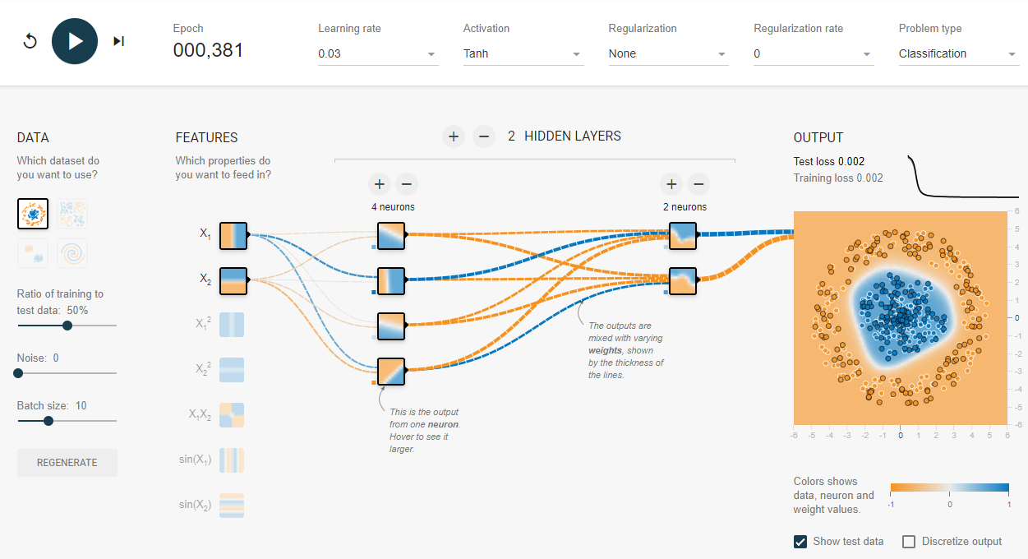
Activation Functions
Let’s experiment with some activation functions in Tensorflow Playground.
https://playground.tensorflow.org/
Notes:
Explore using https://playground.tensorflow.org/

Slide 13
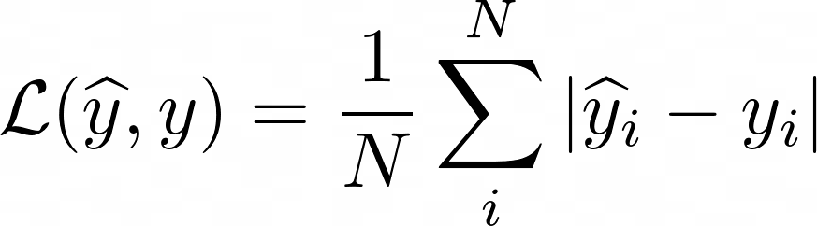
Loss Function
Mean Absolute Error (MAE)
Notes:
Loss Functions
There is no function that can be used for all cases.
Individual and total loss
Mean Absolute Error

Slide 14
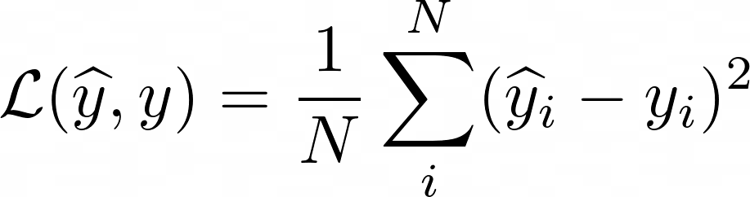
Loss Function
Mean Square Error (MSE)
Notes:
Mean Square Error

Slide 15
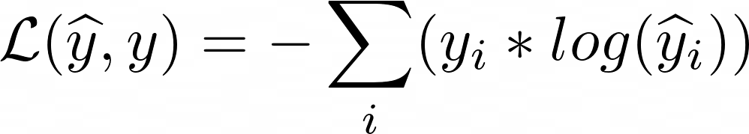
Loss Function
(Binary or Categorical) Cross Entropy
Notes:
Cross Entropy
Binary -> Only one output. There is no sum of values. Usually followed by a sigmoid activation function.
Categorical -> Several outputs. Usually a classification problem. Usually followed by a softmax activation function.
Show more on https://keras.io/losses/

Slide 16
Building a neural network is more about defining an architecture than coding.
It involves exploration, trial and error.
Number of layers
Number of neurons inside each layer
Activation function
Loss function
Know the data
What architecture to use
Number of inputs and outputs
Notes:
Organizing neurons
Start with 2 types of architectures:
Regression
Classification

Slide 17
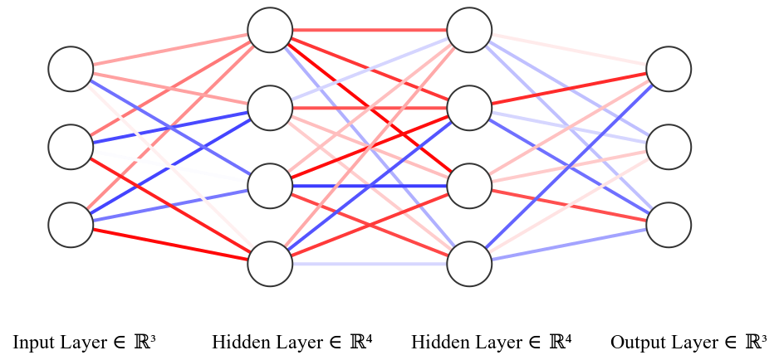
Two basic architectures:
Regression
Classification
Notes:
Organizing neurons
Start with 2 types of architectures:
Regression
Classification

Slide 18
Regression
A model capable to a set of values to another value (or set of values).
Resale value of an used car based on its year, model, and fuel consumption.
Number of sales of clothes based on the day of the year, average price, and type of clothing.
Expected temperature of motor based on other sensors readings.
Notes:
Explain about Regression (architecture)
Regression models are typically used to predict one value (or a set of values) based on input data. Let's say for example: Predict the price of a car based on the year, fuel consumption, type (sports, compact, SUV), motor power. Or predict the number of sales of a specific product based on month of the year, product price, local economy situation.
This is a supervised learning statistical model that correlates the influence of independent variables on dependent variables through fitting a mathematical function according to the behavior of the training data.

Slide 19
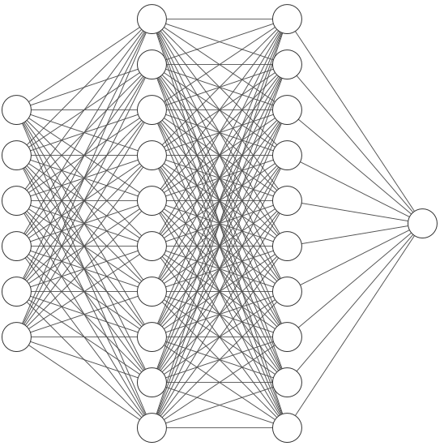
Regression
Resale value of an used car based on its year, model, and fuel consumption.
10
Year
7 Km/L
Fuel Consumption
0
1
0
0
Model A
Model B
Resale value
10 (in $1000)
Model C
Model D
Notes:
Explain about Regression (architecture)

Slide 20
Regression
Resale value of an used car based on its year, model, and fuel consumption.
2010
Year
7 Km/L
Fuel Consumption
0
1
0
0
Model A
Model B
Resale value
10 (in $1000)
Model C
Model D
Notes:
Explain about Regression (architecture)

Slide 21
Regression
Resale value of an used car based on its year, model, and fuel consumption.
2015
Year
6 Km/L
Fuel Consumption
0
0
1
0
Model A
Model B
Resale value
17 (in $1000)
Model C
Model D
Notes:
Explain about Regression (architecture)

Slide 22
Classification
A model capable to divide or categorize into groups or types.
Distinguish between dogs, cats, horses, and zebras.
Distinguish between motorcycles, cars, and busses.
Which kind of internet advertisement fits a person’s profile.
Notes:
Explain about Regression (architecture)

Slide 23
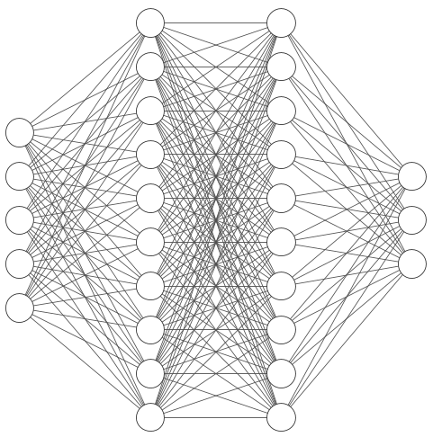
Classification
Resale value of an used car based on its year, model, and fuel consumption.
1
0
0
0
1
Hair
Feathers
Predator
2 Legs
4 Legs
Flamingo
Hawk
Giraffe
0
0
1
Notes:
Explain about Classification (architecture)

Slide 24
Classification
Resale value of an used car based on its year, model, and fuel consumption.
0
1
0
1
0
Hair
Feathers
Predator
2 Legs
4 Legs
Flamingo
Hawk
Giraffe
1
0
0
Notes:
Explain about Classification (architecture)

Slide 25
Classification
Resale value of an used car based on its year, model, and fuel consumption.
0
1
1
1
0
Hair
Feathers
Predator
2 Legs
4 Legs
Flamingo
Hawk
Giraffe
0
1
0
Notes:
Explain about Classification (architecture)

Slide 26
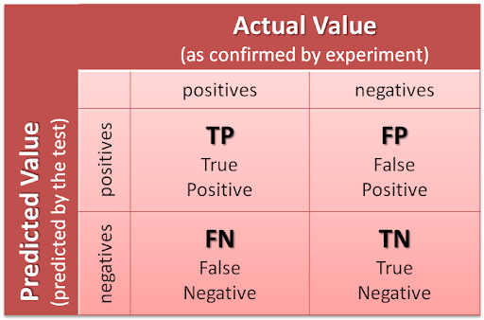
TP/TN/FP/FN

Slide 27
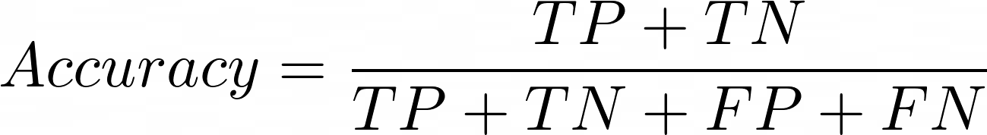
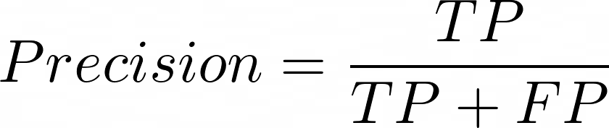
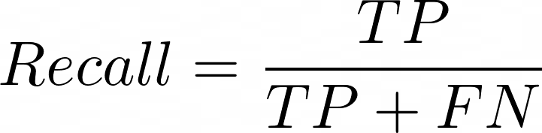
TP/TN/FP/FN

Slide 28
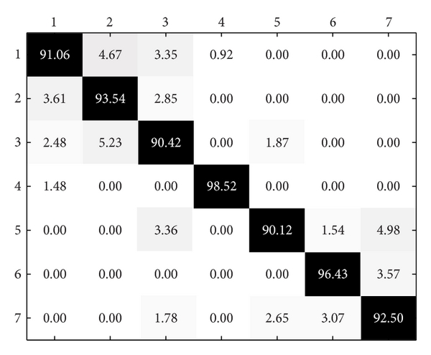
Confusion Table

Slide 29
Project Orientations
Find a dataset.
Build a neural network (Regression or Classification).
Integrate the model with another system (optional).
Submission by April 1st.
Project presentation:
10 minutes.
Explain the technical aspect of your project.
The dataset used.
The architecture used.
The hyperparameters.
Explain the purpose of your project.
What problem does your network help to solve?

Slide 30
Project Orientations
Free available datasets:
FiveThirtyEight
https://data.fivethirtyeight.com/
https://github.com/fivethirtyeight/data
BuzzFeed
https://github.com/BuzzFeedNews/everything
Data.gov
https://www.data.gov/
Kaggle
https://www.kaggle.com/datasets
UCI
https://archive.ics.uci.edu/ml/datasets.php

