Slide 1
emometamemory
Preliminary anaysis

Slide 2
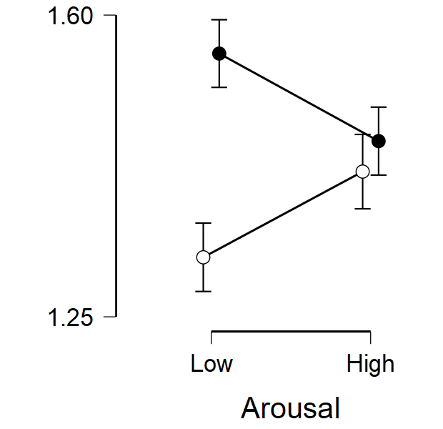
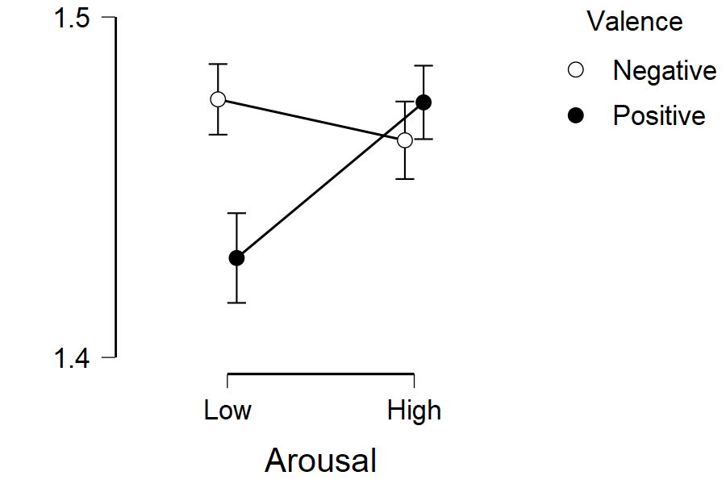
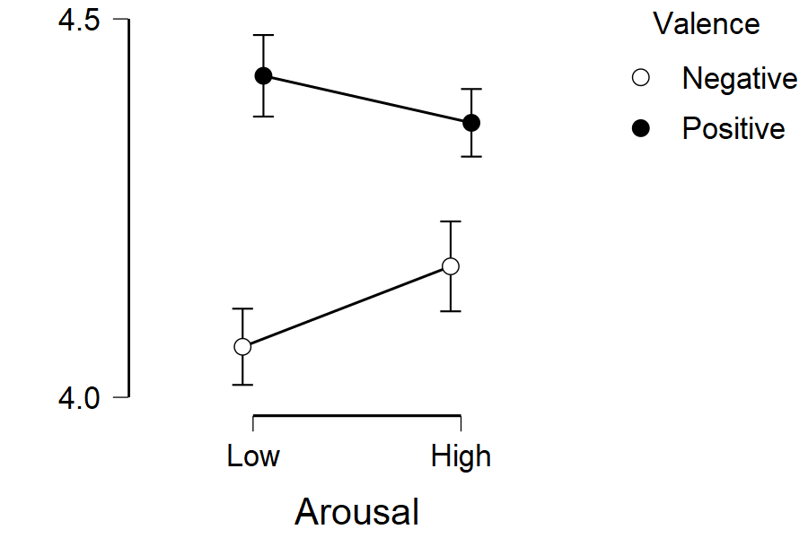
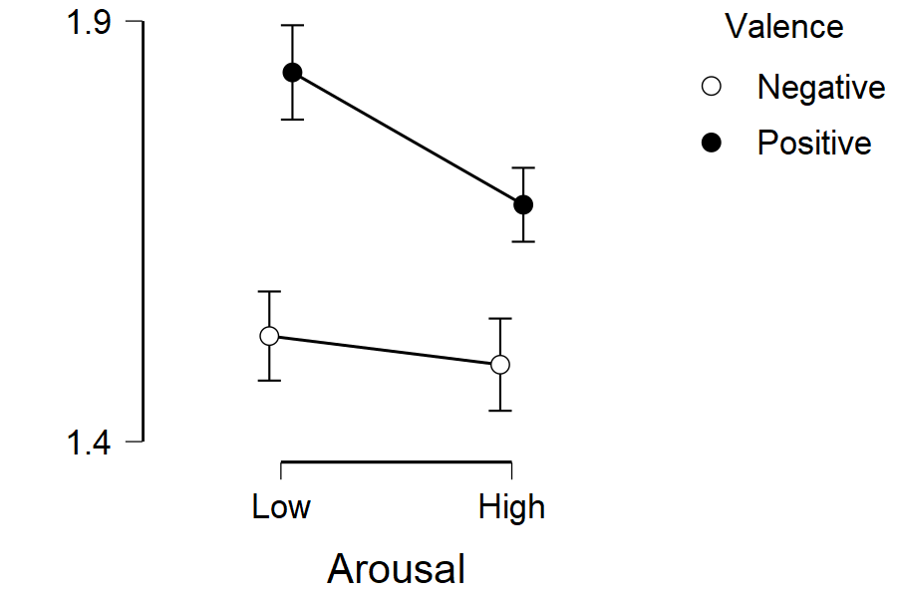
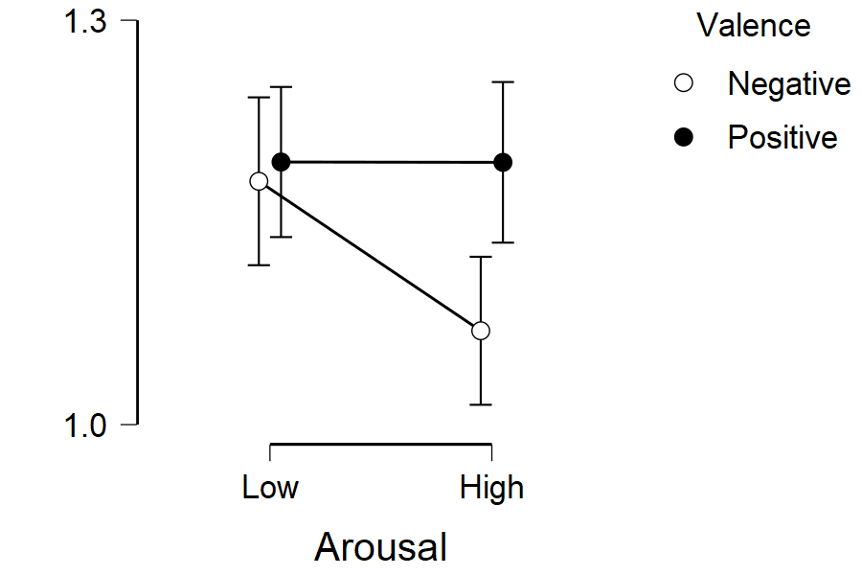
Reaction Time
Dprime
Type-I Recognition
Raw Confidence
Calibration (mprime)
Efficiency (mratio)
Type-II Recognition

