Slide 1


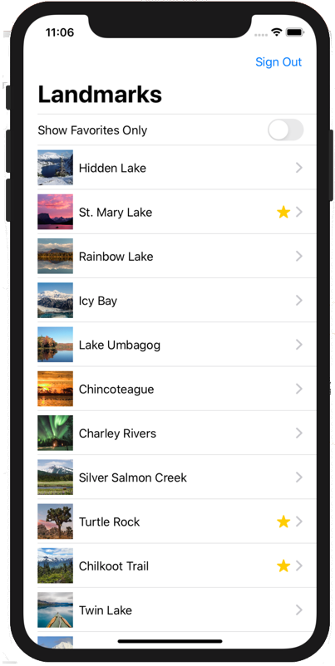



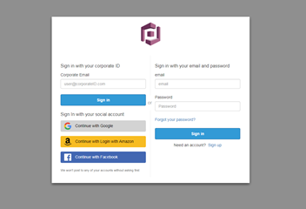

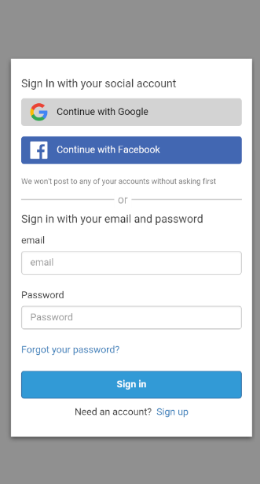


AWS Cloud
Amazon Cognito
Cognito token
AWS AppSync
Amazon DynamoDB
Access serverless backend
Temporary access key and secret key
Amazon S3

