Slide 1



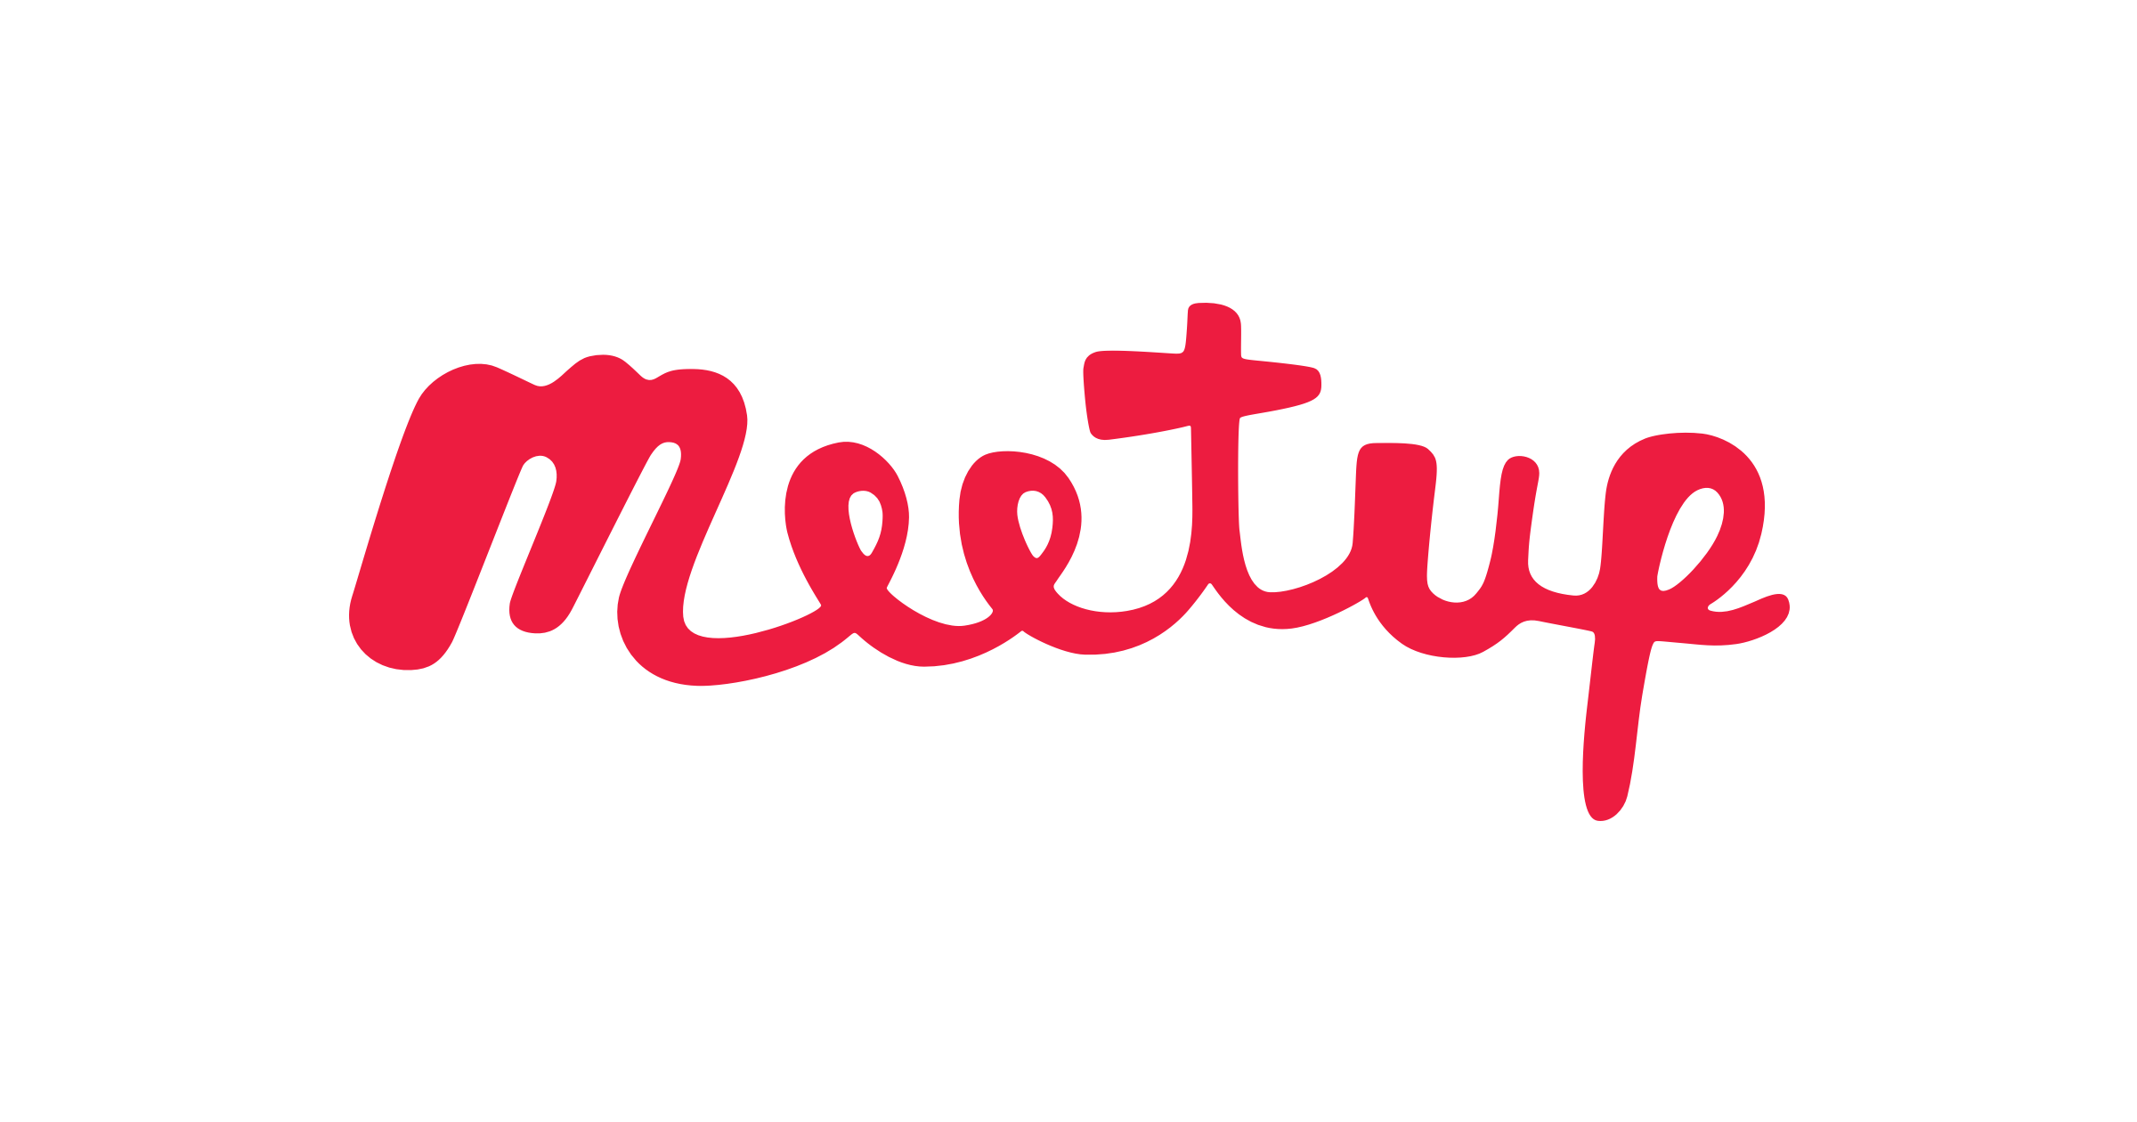


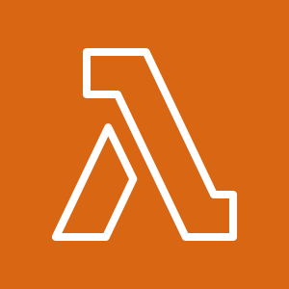

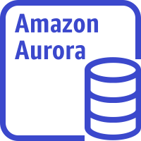
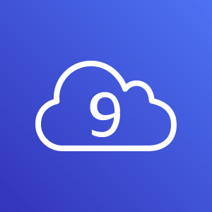



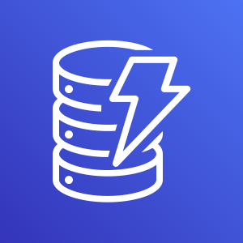
VPC
Public subnet
Private subnet
Isolated subnet
Meetup.com API
AWS Lambda
Aurora Cluster
NAT Gateway
Meetup Crawler
AWS Cloud9 (dev environment)
Writer
AWS Cloud
Simple Queue Service
CloudWatch Event (1 hour)
Meetup Scheduler
DynamoDB Control Table
Reader
NAT Gateway

