Slide 1
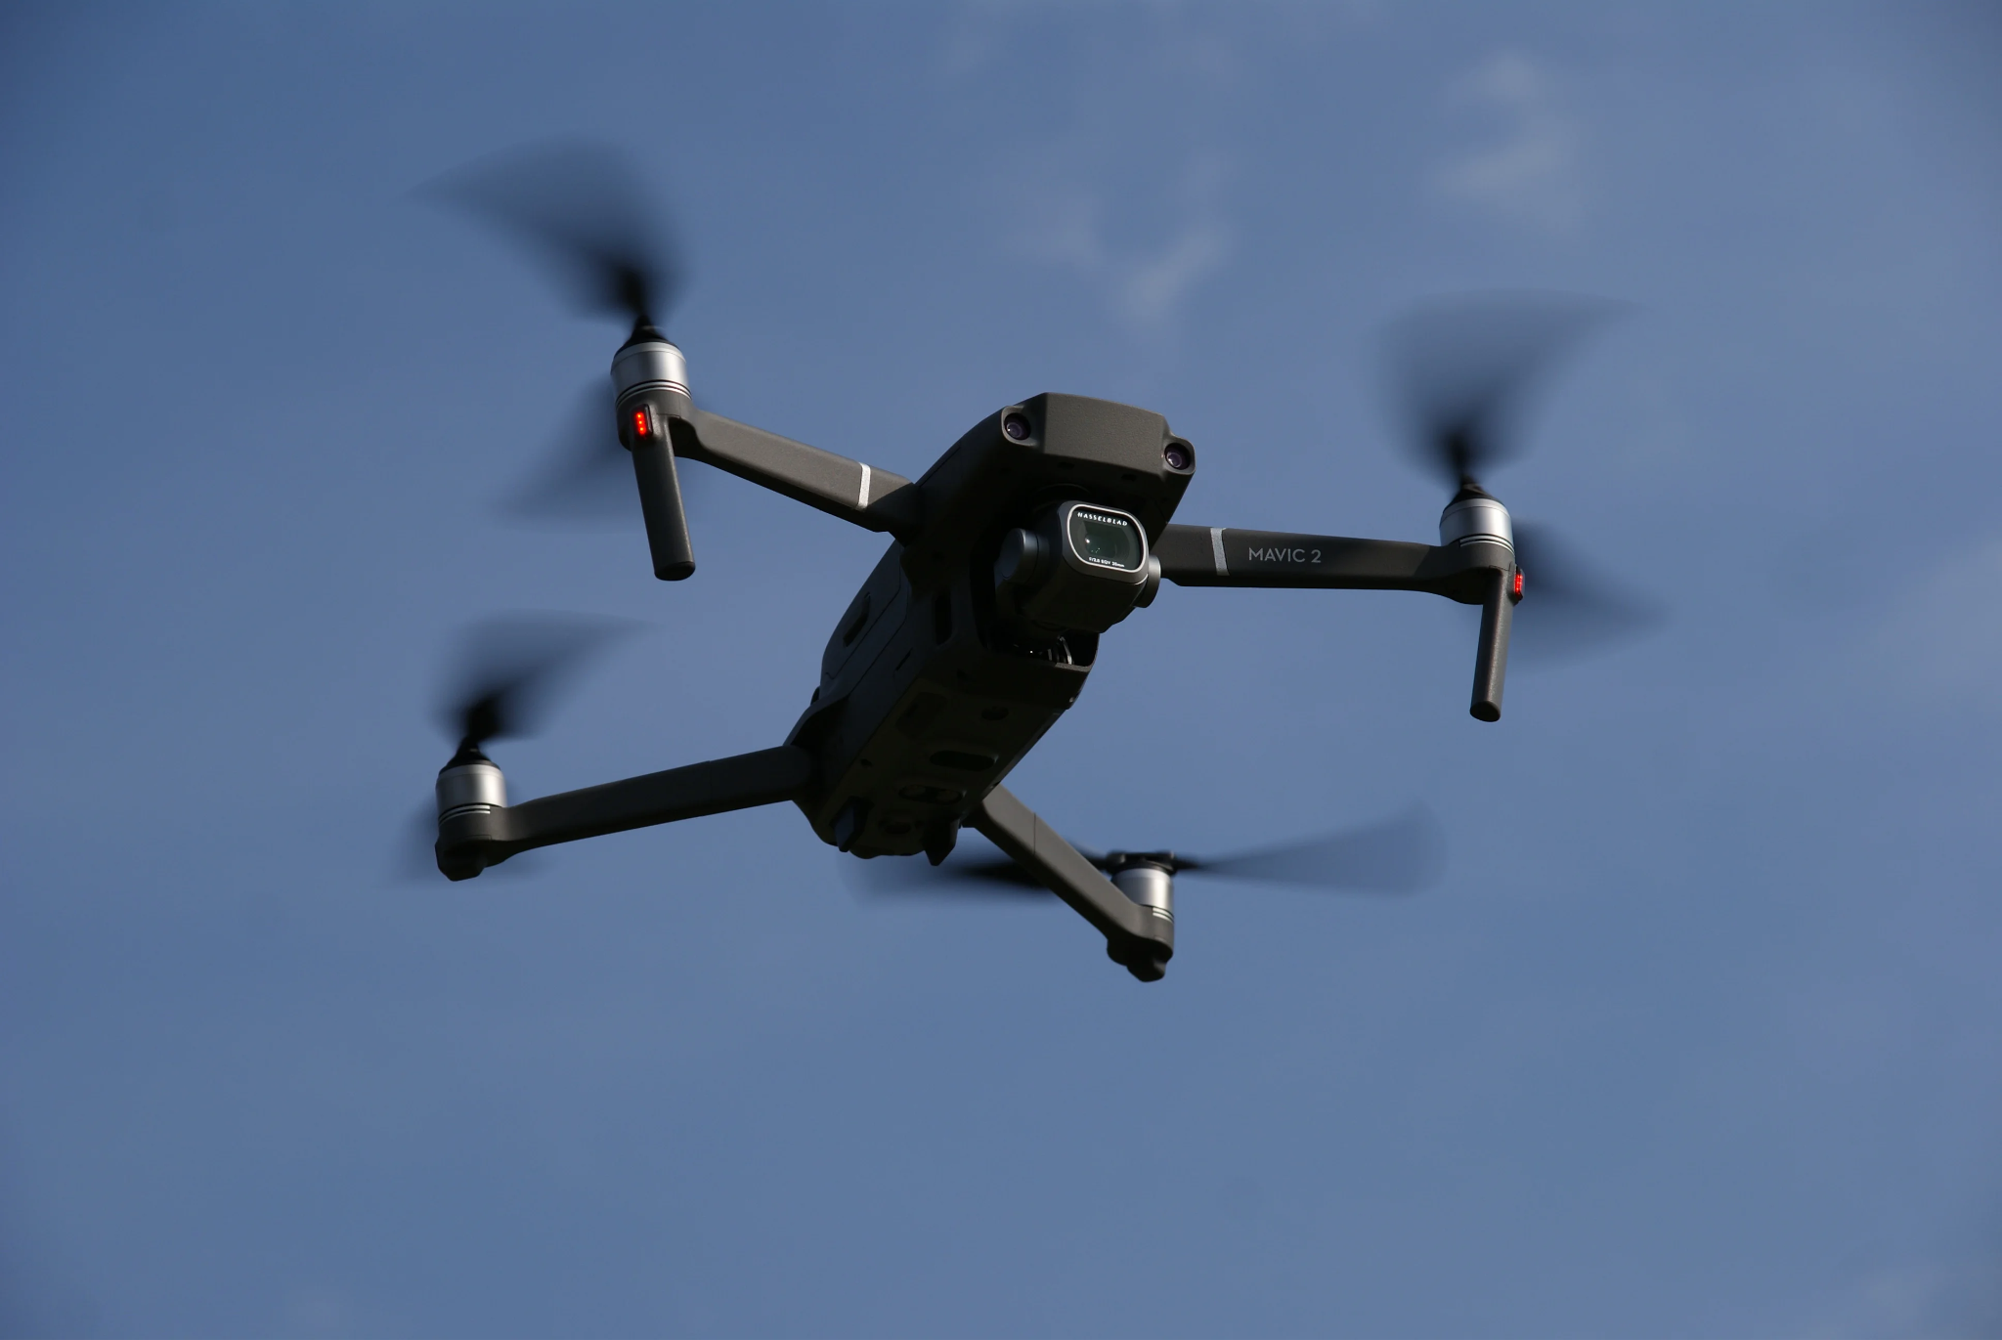
EMG Controlled Drone Simulation
Presented by: Conor Gagliardi, John Pesarchick, and Aharon Sebton

Slide 2
Motivation
Electromyography (EMG) sensing currently sees a variety of applications in:
-Prosthetics and rehabilitation
-Collaborative robotics
Currently, limited research has been conducted on EMG-based control for unmanned autonomous vehicles (UAVs)
Additionally, few methods employ the use of EMG and Inertial Measurement Unit (IMU) data together in decision making. Such a combination is hypothesized to increase classification accuracy through data fusion

Slide 3
Related Works
Control of a drone using EMG and gyroscopic data [1]
Uses SVM and KNN for EMG / IMU signal reading. 92% Accuracy
Uses Wavelet Transform.
Does not use simulation.
EMG based control of a quadcopter [2]
Does not use fusion.
Uses multi-movement gestures (double tap)
Less accurate than source [1] (at 86% average accuracy)
Uses simulation

Slide 4
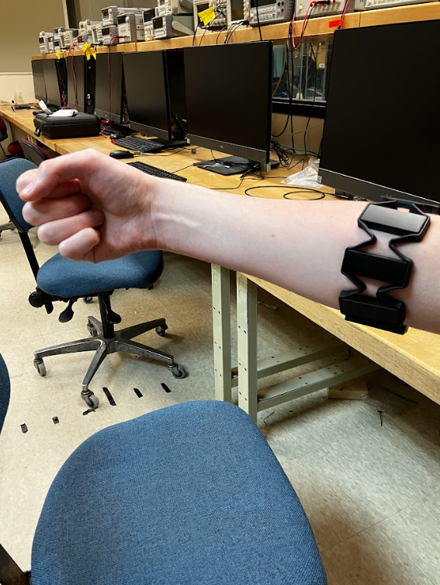
Methodology
-Used a Myo Armband for both EMG and IMU data collection
-Has 8 EMG channels, a gyroscope sensor, and an accelerometer. Sampled at 200 Hz.
-15 Gestures are used to control the drone. Samples were recorded from three subjects, each gesture was repeated at least five times by each subject. Total 300 samples.

Slide 5
Methodology (cont’d)
MYO
-EMG data is preprocessed using notch and bandpass filters along with rectification
-Feature extraction is performed on groups of datapoints at a time. Extracted features include:
-Max value, avg. value, and max power for each EMG channel
-Range of motion and variance for orientation data
-Maximum acceleration in X, Y, and Z
-48 EMG Feats+18 IMU Feats=66 Feats
EMG
IMU
Notch filter + rectification + bandpass filter
Feature set

Slide 6
Methodology (cont’d)
EMG Feats
IMU Feats
-Examined three methods of classification: SVM, LSTM, NN
-SVM uses a linear kernel and PCA with EMG and IMU features evaluated simultaneously
-LSTM uses two separate models for EMG and IMU with ReLu activation, and Adam Optimizer. A dense layer is also tested for a fusion of both models with an Adam Optimizer.
-Original NN uses three dense layers sandwiching two dropout layers on all features simultaneously. New NN performs data fusion by combining outputs from each branch classifier and learns relationships between them.
EMG branch Classifier
IMU branch Classifier
Fusion Classifier
Prediction

Slide 7
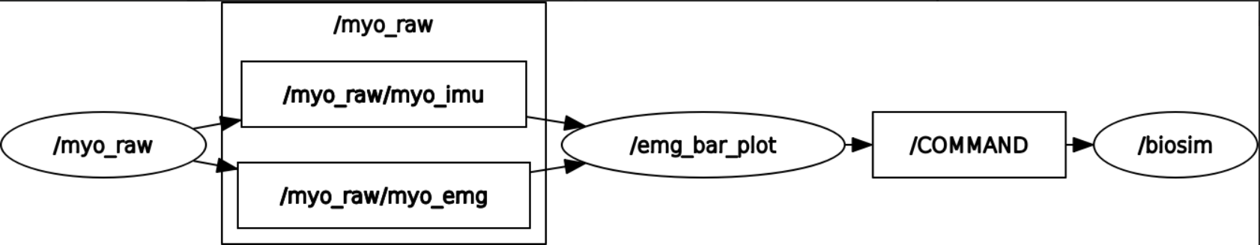
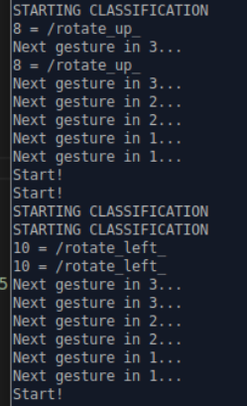
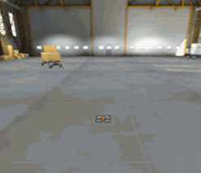
Methodology (cont’d)
-ROS (Robot Operating System) allows for communication between the Myo and Flightmare
-Uses the ros_myo package for data collection
-A subscriber program takes this data and determines commands
-Commands are published to Flightmare as strings (e.g. “down”)
-Movement pipeline is designed for continuous previous input motion until next command received

Slide 8
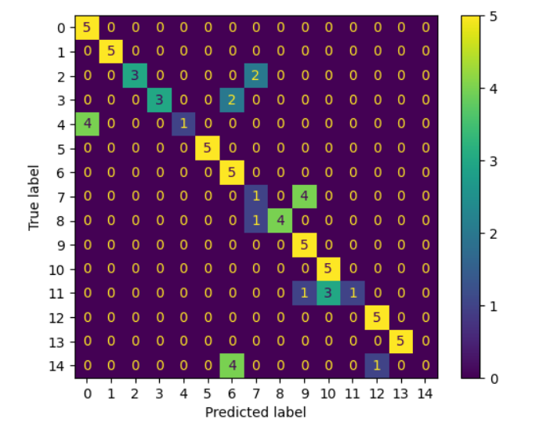
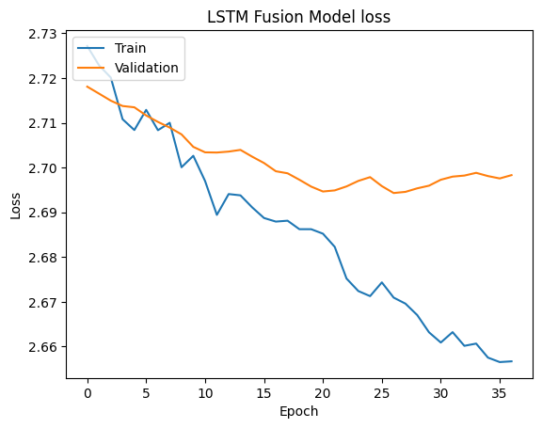
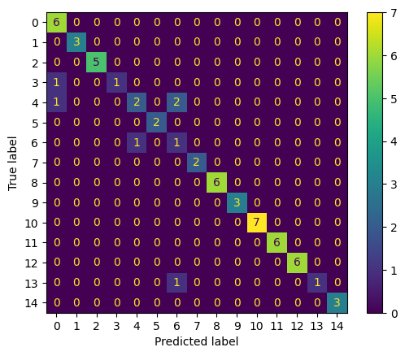
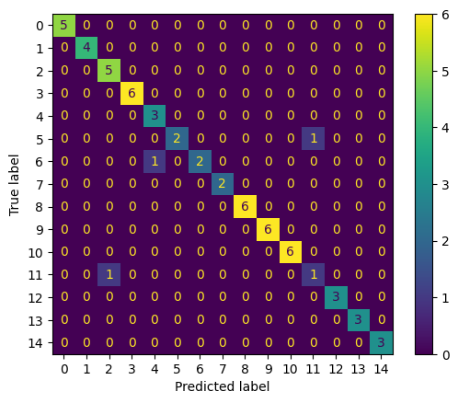
Results
-The SVM achieved a classification accuracy of 75% when using EMG and IMU features together
-This is an improvement over the same SVMs using either EMG or IMU features exclusively.
-Extracting features by file was not conducive to temporal learning, so the LSTM would not converge on many tests. A sliding window feature extractor for each file may allow for a better LSTM implementation.
-The fused NN performed better than its simpler counterpart (95% vs. 90% accuracy) with 3x as many epochs
SVM Confusion Matrix (75% Accuracy)
LSTM Loss vs. Time (Failure to Converge)
Original NN Confusion Matrix (90% Accuracy)
Data Fusion NN Confusion Matrix (95% Accuracy)

Slide 9
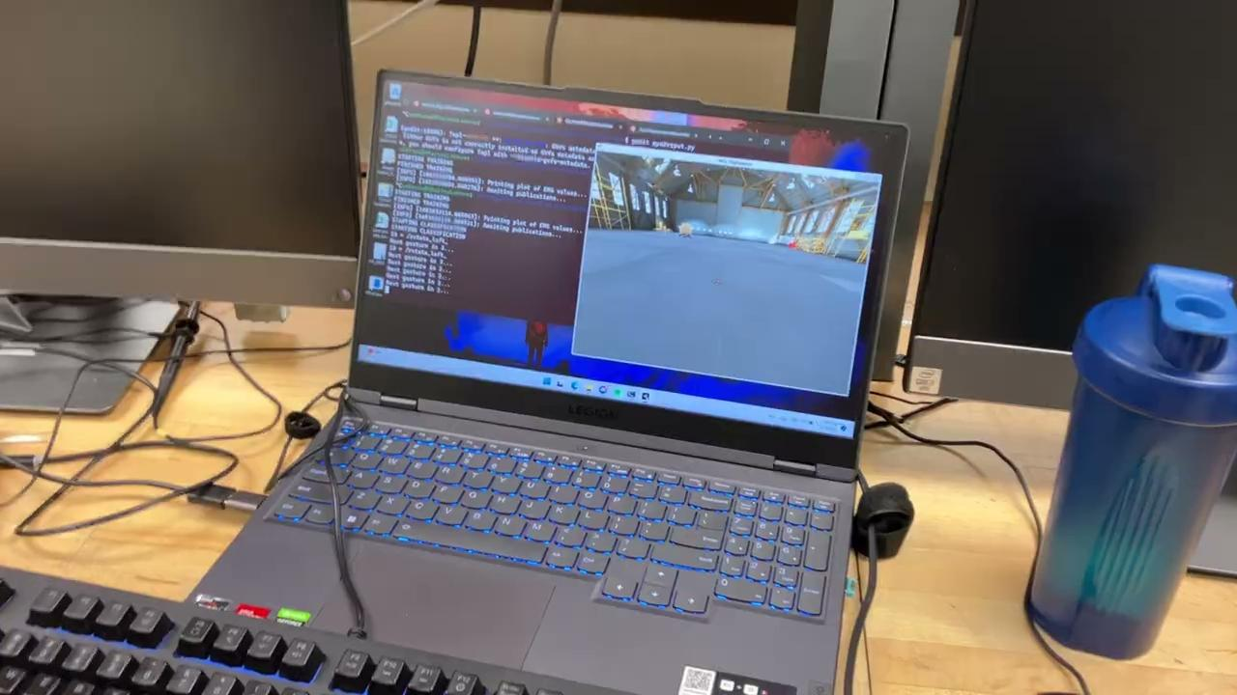
Results

Slide 10
Summary
-Expanded research into control of UAVs through the combination of EMG and IMU signals procured through a Myo armband
-Tested a novel drone control scheme through simulation in ROS driven by ML
-Data fusion yields mixed results overall.
-A sliding window feature extractor for each file may allow for a better LSTM implementation.
-Our classifiers performed poorly in real-time classification. This warrants further investigation, as there may be other factors in the limited performance of our system.

Slide 11
Questions?

Slide 12
References
[1] . Doshi and D. Nath, ”Designing a Drone Controller using Electromyography Signals,” 2021 International Conference on Communication information and Computing Technology (ICCICT), Mumbai, India, 2021, pp. 1-6, doi: 10.1109/ICCICT50803.2021.9510045.
[2]. M. Ali, A. Riaz, W. U. Usmani and N. Naseer, ”EMG Based Control of a Quadcopter,” 2020 3rd International Conference on Mechanical, Electronics, Computer, and Industrial Technology (MECnIT), Medan, Indonesia, 2020, pp. 250-254, doi: 10.1109/MECnIT48290.2020.916660

