Slide 1
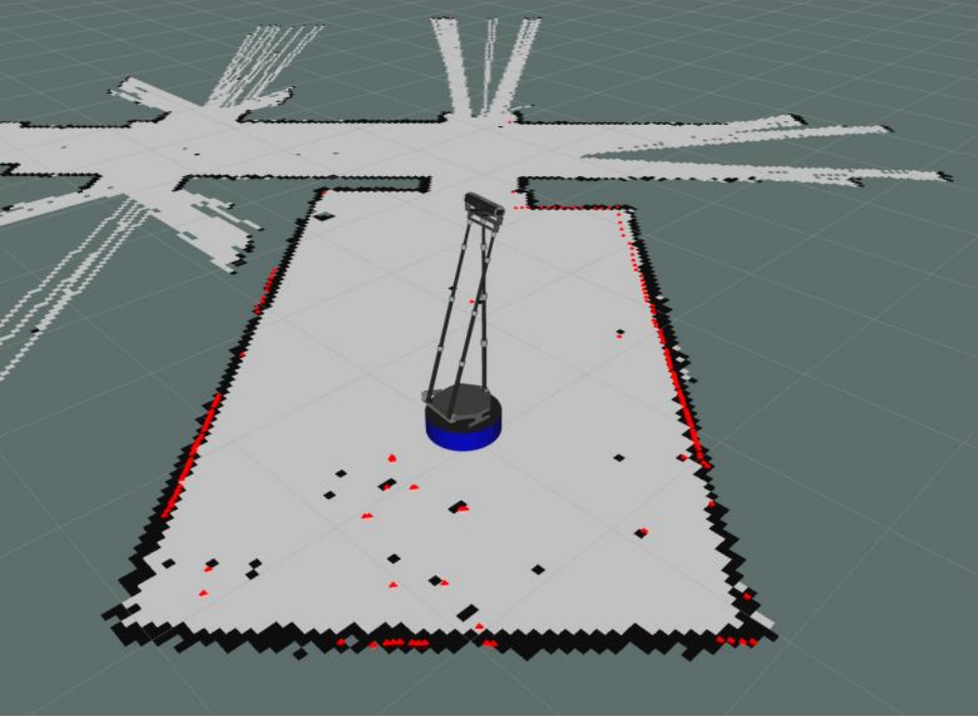
餐厅服务机器人
w
a
d
catch
on/off
on/off
s
s
Walk
set S
set T
catch
on/off
S/T
up
down
catch
put
start
fold
Arm
shut down
reboot
suspend

