Slide 1


Introduction to LangChain for AI-based applications
Sebastián Villanueva February 16th, 2024

Slide 2
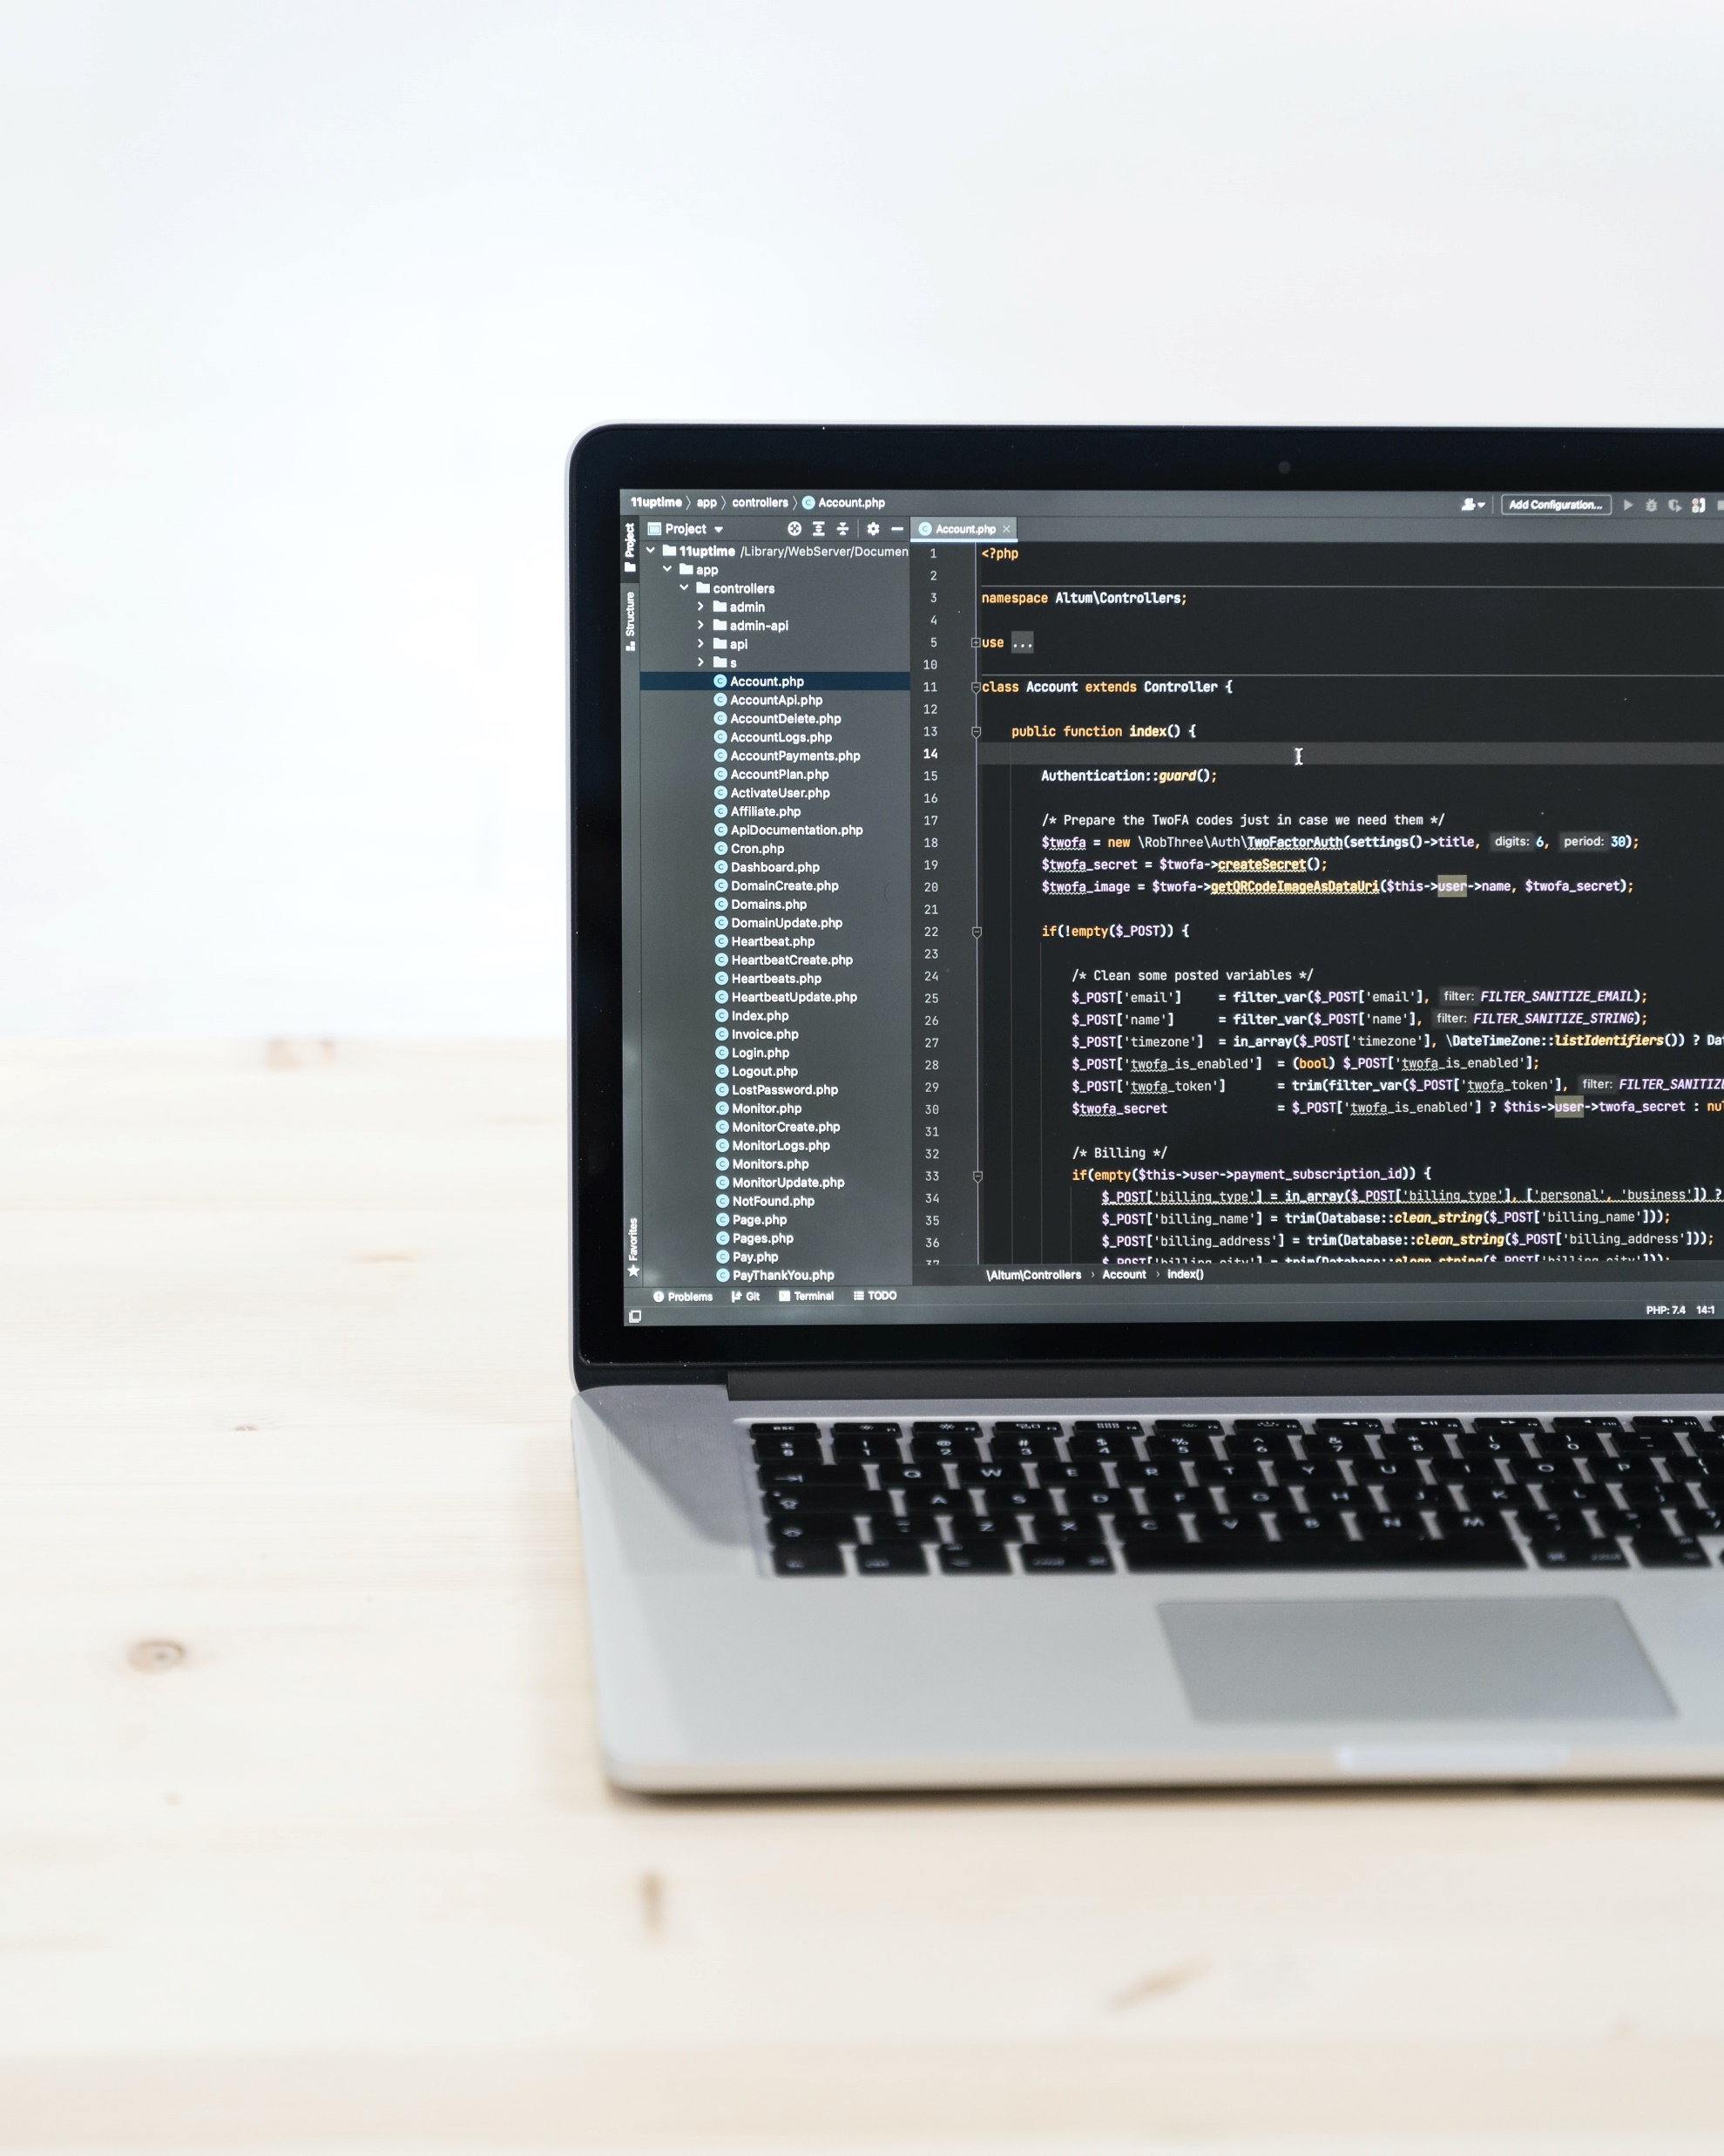
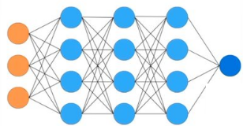
Understanding LLMs
Neural Network with billions of parameters.
I
slept
night
all

Slide 3
Understanding LLMs
Model Inference
e.g. I slept all night and still tired.
LLMs “dreams” internet documents.
Code snippets.
Blogs.
Products descriptions.

Slide 4
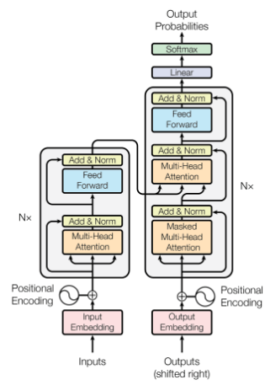
Understanding LLMs - Architecture
Transformer Neural Networks

Slide 5

Overview of LangChain
Framework for developing applications powered by large language models.
Context-aware applications.
Applications able to reason.

Slide 6
Logistics
Python packages
langchain
openai
tiktoken
python-dotenv
OpenAI API key
Cost of OpenAI usage
Environment

Slide 7
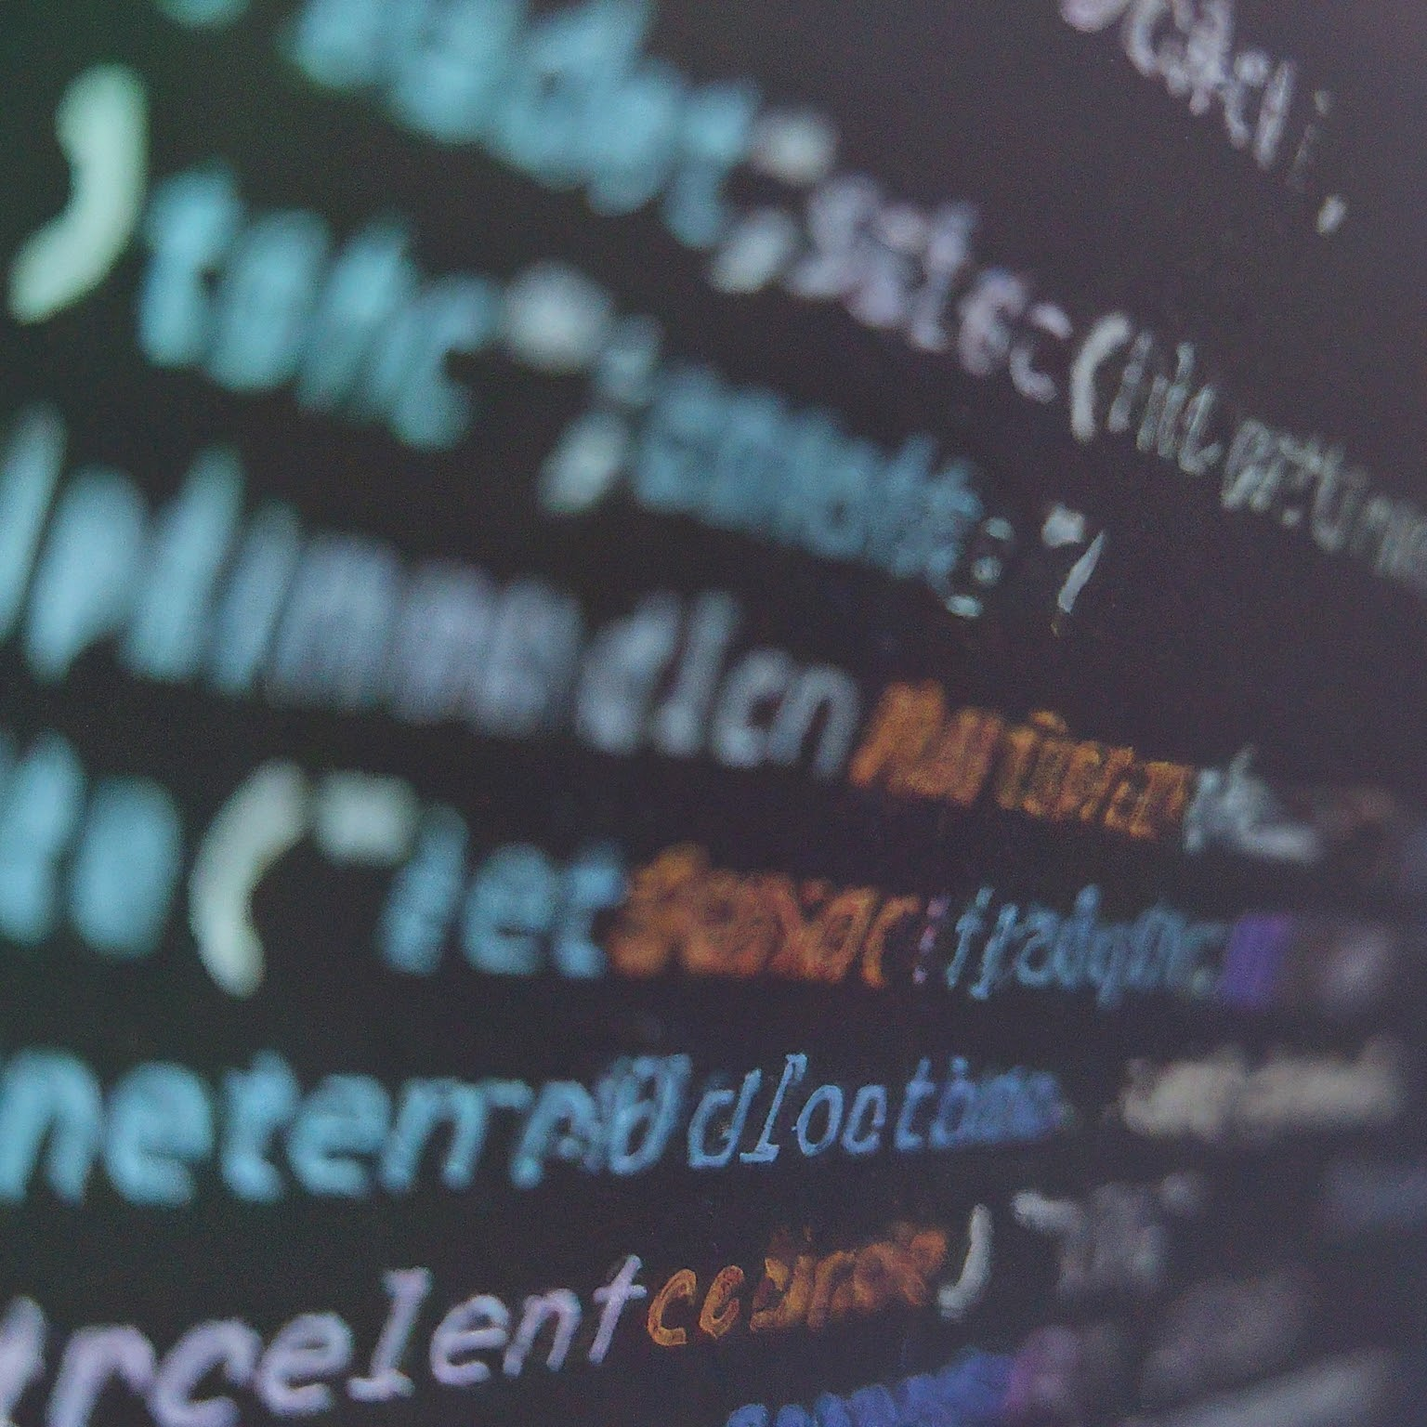
Code Demo

Slide 8
THANKS

