Slide 1
Pi Estimation using MPI and OMP
Miucin Sebastian

Slide 2
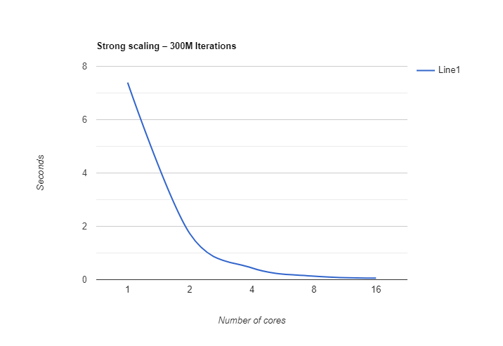
OpenMP
Strong scaling – 300M Iterations
Execution time. (seconds)
No. Cores | Run 1 | Run 2 | Run 3 | Run 4 | Avg.
1 | 6.871101 | 6.884723 | 6.882552 | 8.92639 | 7.391191
2 | 1.716127 | 1.750541 | 1.733366 | 1.718842 | 1.729719
4 | 0.443208 | 0.431311 | 0.451809 | 0.432318 | 0.439661
8 | 0.13138 | 0.128536 | 0.132362 | 0.129460 | 0.130434
16 | 0.054906 | 0.064013 | 0.051165 | 0.060655 | 0.057684

Slide 3
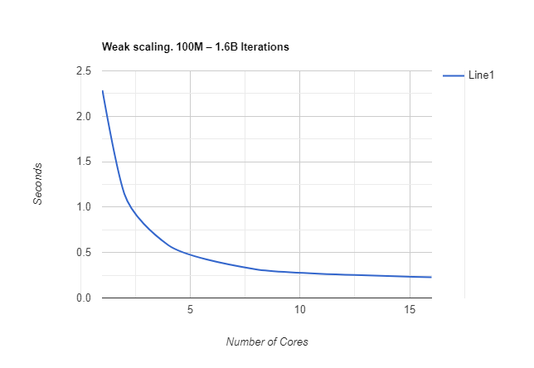
OpenMP
Weak scaling. 100M – 1.6B Iterations
Execution time.
It. | No. Cores | Run 1 | Run 2 | Run 3 | Run 4 | Avg.
100M | 1 | 2.303173 | 2.284516 | 2.275096 | 2.281039 | 2.285956
200M | 2 | 1.136306 | 1.147392 | 1.146071 | 1.157620 | 1.146847
400 M | 4 | 0.575323 | 0.584449 | 0.579647 | 0.589379 | 0.582199
800M | 8 | 0.312671 | 0.320563 | 0.322325 | 0.307009 | 0.315642
1.6 B | 16 | 0.226865 | 0.224823 | 0.230878 | 0.230136 | 0.228175

Slide 4
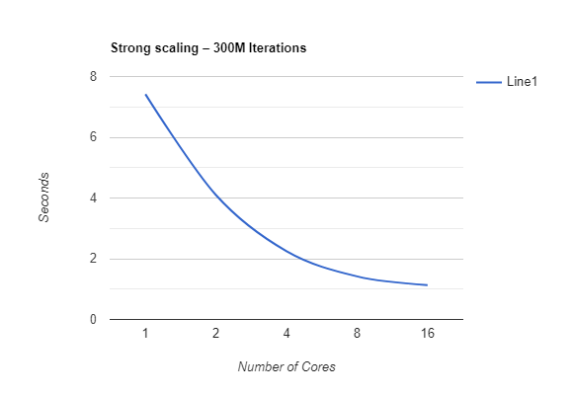
MPI
Strong scaling – 300M Iterations
Execution time.
No. Cores | Run 1 | Run 2 | Run 3 | Run 4 | Avg.
1 | 7.635339 | 7.511885 | 7.167273 | 7.357702 | 7.418049
2 | 4.393763 | 4.240884 | 3.591342 | 4.158816 | 4.096201
4 | 1.984181 | 1.912505 | 2.595539 | 2.501353 | 2.248394
8 | 1.373011 | 1.578638 | 1.219966 | 1.504218 | 1.418958
16 | 1.363439 | 1.307185 | 0.927906 | 0.937363 | 1.133973

Slide 5
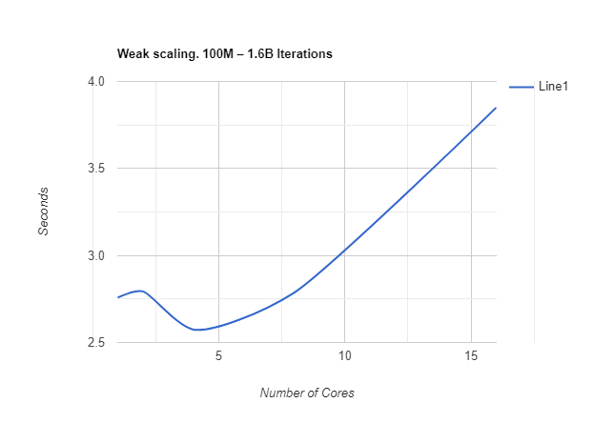
MPI
Weak scaling. 100M – 1.6B Iterations
Execution time.
It. | No. Cores | Run 1 | Run 2 | Run 3 | Run 4 | Avg.
100M | 1 | 2.563144 | 2.688488 | 2.722298 | 3.056297 | 2.757556
200M | 2 | 2.549593 | 2.820149 | 2.835671 | 2.968299 | 2.793428
400M | 4 | 2.921150 | 2.554148 | 2.487732 | 2.334365 | 2.574348
800 M | 8 | 3.281390 | 2.478797 | 2.763634 | 2.624309 | 2.787032
1.6 B | 16 | 3.602955 | 3.822519 | 3.708423 | 4.264745 | 3.849660

Slide 6
Merge Sort using MPI

Slide 7
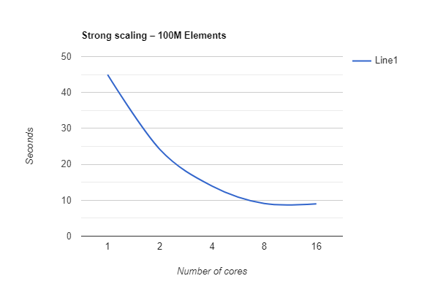
MPI
Strong scaling – 100M Elements
Execution time.
No. Cores | Run 1 | Run 2 | Run 3 | Run 4 | Avg.
1 | 45.011456 | 44.926811 | 44.896311 | 44.976334 | 44.952728
2 | 24.084008 | 24.166060 | 24.208774 | 24.240735 | 24.174894
4 | 13.981352 | 13.979200 | 13.910949 | 13.991204 | 13.965676
8 | 9.089155 | 9.085419 | 9.084286 | 9.064499 | 9.080839
16 | 8.958868 | 9.026884 | 8.677200 | 9.290476 | 8.988357

Slide 8
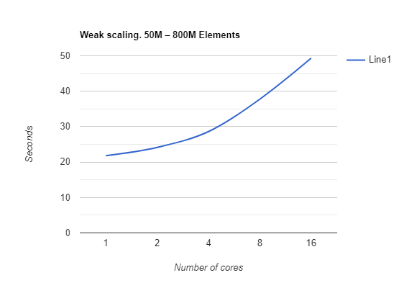
MPI
Weak scaling. 50M – 800M Elements
Execution time.
It. | No. Cores | Run 1 | Run 2 | Run 3 | Run 4 | Avg.
50M | 1 | 21.87529 | 21.80516 | 21.77101 | 21.75745 | 21.80222
100M | 2 | 24.16861 | 24.15547 | 24.18098 | 24.10410 | 24.15229
200M | 4 | 28.46522 | 28.66622 | 28.68542 | 28.63512 | 28.61299
400 M | 8 | 37.78197 | 37.69471 | 37.96220 | 37.62650 | 37.76634
800M | 16 | 50.15228 | 48.36542 | 49.15668 | 49.64452 | 49.32972

