Slide 1


Q4 2026 Business Review
BOARD OF DIRECTORS · NOVEMBER 2026
Margin recovered ahead of plan. We ask the board to approve the Nordic hub.
Maya Lindqvist, CFO · Board confidential

Slide 2
Agenda
Results · revenue, margin, cash
01
02
Operations · network and service levels
03
Customers · mix and retention
04
2027 plan · initiatives and roadmap
05
Decision · Nordic hub investment
Halden Logistics · Q4 Business Review · Board confidential
02
Notes:
Five sections, 25 minutes, decision at the end. Questions welcome throughout.

Slide 3
Margin is back to 14.2% and cash covers the Nordic hub without new debt
EXECUTIVE SUMMARY
1
Revenue $412M, up 9% and 2% ahead of plan
Contract logistics now 53% of revenue (slide 5)
2
Operating margin recovered to 14.2%
Pricing, route consolidation, labour planning (slides 6–7)
3
The Nordic network is at 94% utilization
Best margin and service, but turning work away above 90% (slide 8)
4
Approve $74M for the Nordic hub this quarter
19% IRR, 13.5% in the downside; site option expires Dec 15 (slide 17)
Halden Logistics · Q4 Business Review · Board confidential
03
Notes:
Lead with the decision. Each row maps to a section. If time is short, go straight to slide 17.

Slide 4
All four headline metrics beat plan in Q4
RESULTS
$412M
14.2%
$58M
96.4%
Revenue
Operating margin
Free cash flow
On-time delivery
+9% YoY
+2.6 pts YoY
+$21M YoY
+1.8 pts YoY
Plan $404M
Plan 13.0%
Plan $52M
Target 95%
Source: Halden finance, unaudited Q4 2026 management accounts
Halden Logistics · Q4 Business Review · Board confidential
04
Notes:
Each tile: actual, change versus last year, and the plan we committed to in February.

Slide 5
Revenue rose 9% year on year as contract logistics outpaced freight
RESULTS
WHAT IT MEANS
Contract logistics +17% YoY, now 53% of revenue
Freight flat in volume; price carried the gain
Q4 seasonality in line with the last three years
Source: Halden finance, revenue in $M
Halden Logistics · Q4 Business Review · Board confidential
05
Notes:
The mix shift matters more than the total: contract revenue is multi-year and carries a margin about 4 points higher.

Slide 6
Pricing and routes added $14M of operating profit; wages and energy took back $4M
RESULTS
+$6M
+$2M
−$3M
−$1M
$59M
+$8M
$44M
+$3M
Q4 2025
Volume
Pricing
Route consolidation
Labour planning
Wage inflation
Energy
Q4 2026
Source: Halden finance; operating profit, $M, Q4 2025 vs Q4 2026
Halden Logistics · Q4 Business Review · Board confidential
06
Notes:
Read left to right: $44M (11.6% margin) to $59M (14.2%). The three operational levers are $16M; cost inflation took back $4M.

Slide 7
Margin recovered in three steps: pricing, routes, then labour planning
RESULTS
WHAT MOVED IT
Q1: list-price reset
Q2–Q3: 41 routes merged
Q4: shift-planning tool live
Net +2.6 pts year on year; bridge on slide 6
Source: Halden finance
Halden Logistics · Q4 Business Review · Board confidential
07
Notes:
Plan line is the February budget. We crossed it in Q2 and the gap kept widening.

Slide 8
The Nordic region is the most profitable and the most capacity-constrained
OPERATIONS
REGION | REVENUE ($M) | YOY | MARGIN | ON-TIME | UTILIZATION
Nordics | 96 | +14% | 17.8% | 97.1% | 94%
DACH | 118 | +8% | 14.4% | 96.8% | 81%
Benelux | 84 | +6% | 12.9% | 95.9% | 78%
UK & Ireland | 71 | +7% | 11.8% | 95.2% | 74%
Iberia | 43 | +11% | 12.1% | 96.0% | 69%
Total | 412 | +9% | 14.2% | 96.4% | 81%
Source: Halden operations dashboard, Q4 2026; utilization = pallet positions used / available
Halden Logistics · Q4 Business Review · Board confidential
08
Notes:
Read across the Nordic row: best margin, best service, and 94% utilization. Above 90% we start turning work away.

Slide 9


Route consolidation cut empty kilometres by a quarter
OPERATIONS
Before — Q4 2025
After — Q4 2026
212 scheduled routes
31% empty running
Planning by depot, weekly
4.1 stops per route
171 routes (−41)
23% empty running
Network-wide planning, daily
5.6 stops per route
Halden Logistics · Q4 Business Review · Board confidential
09
Notes:
Same customers, same service level, 41 fewer routes. Fuel saving alone was $6.2M annualised.

Slide 10
Retail and health care are 58% of revenue; net retention is 108%
CUSTOMERS
WHAT IT MEANS
Largest customer 9% of revenue
Health care grew fastest, +22%
Gross retention 97%, net 108%
Two top-ten renewals due Jun 30, 2027
Source: Halden CRM, trailing twelve months
Halden Logistics · Q4 Business Review · Board confidential
10
Notes:
Concentration is healthy. The two Q2 renewals are both in talks; we expect multi-year terms.

Slide 11
“
Halden is the only partner that held 97% on-time through peak. We want to put more volume in the Nordics, and we need them to have room for it.
Head of Supply Chain
Top-five retail customer (name withheld)
Halden Logistics · Q4 Business Review · Board confidential
11
Notes:
Customer quote from the November QBR, used with permission, anonymized for this deck.

Slide 12



Three initiatives carry the 2027 plan; only the hub needs new capital
2027 PLAN
Nordic hub
Health care cold chain
Labour planning
120k pallet positions near Gothenburg. Frees 9 points of utilization across the region.
GDP-certified 2–8 °C capacity in three hubs. Follows our fastest-growing segment.
Roll the shift-planning tool to all 38 sites. Pilot sites saw 6% fewer overtime hours.
Halden Logistics · Q4 Business Review · Board confidential
12
Notes:
Each initiative has an owner and a business case in the appendix. Only the hub needs board approval.

Slide 13
The hub is the only high-value move we cannot make without the board
2027 PLAN
↑ Value
Nordic hub: highest value, needs capex approval
Labour planning and cold chain are funded in the operating plan
Electrification waits for 2028 truck pricing
Quick wins
Big bets
Labour planning
Nordic hub
Cold chain
Fleet electrification
Customer portal v2
Fill-ins
Avoid
Low ← Effort and capital → High
Halden Logistics · Q4 Business Review · Board confidential
13
Notes:
Bubble size = three-year profit impact. Only the top-right item needs a board vote.

Slide 14
Four workstreams run in parallel; the hub is on the critical path
2027 PLAN
Q4 26
Q1 27
Q2 27
Q3 27
Q4 27
Q1 28
Nordic hub
Live
Lease + tender
Fit-out
Ramp-up
Cold chain
Certification
3 hubs live
Labour planning
Pilot
Roll-out 38 sites
Customer renewals
Two top-ten renewals
Today
Halden Logistics · Q4 Business Review · Board confidential
14
Notes:
Amber bar: the two renewals due Jun 30. Both in talks; flagged so the board sees the dependency. Lease Dec 15, tender Jan 31, fit-out Q2–Q3, ramp-up Q4, live Q1 2028.

Slide 15
The hub opens in Q1 2028 if we sign the lease this quarter
2027 PLAN
NOV 2026
DEC 2026
JAN 2027
Q2 2027
Q1 2028
Board approval
Lease signed
Tender awarded
Fit-out starts
Full operation
$74M capex across 2027–2028
Site under exclusive option until Dec 15
Racking and automation, by Jan 31
Install through Q3 2027
120k positions, 180 roles; two retail pilots from Q4 2027
Halden Logistics · Q4 Business Review · Board confidential
15
Notes:
The December 15 option deadline is the reason we're asking today rather than in February.

Slide 16
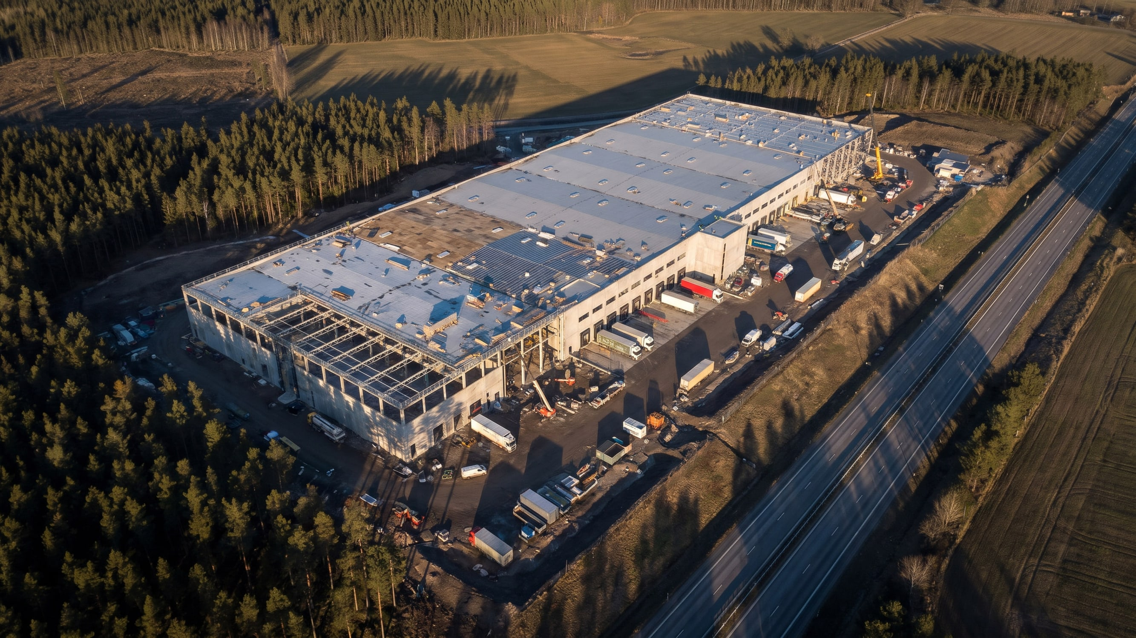
Gothenburg: 40 minutes from the port, on the E6 corridor
Illustrative comparable site · proposed plot 62,000 m², option until Dec 15 · drive time: Port of Gothenburg route planner
Notes:
Illustrative image, not the actual plot. The port connection (40 min, Port of Gothenburg route planner) is what makes the economics work.

Slide 17
We ask the board to approve $74M for the Nordic hub
DECISION
Funded from operating cash flow; leverage stays below 1.5× throughout.
$74M
19%
4.2 yrs
13.5%
Capex
Project IRR
Payback
Downside IRR
$52M 2027 · $22M 2028
Hurdle rate 12%
From full operation
Volumes −20%
Source: Business case v3, appendix A; base-case volumes
Halden Logistics · Q4 Business Review · Board confidential
17
Notes:
Even the downside case clears the 12% hurdle. Ask for a vote.

Slide 18
One decision today; four follow-up actions with owners and dates
DECISION
Vote: approve $74M capex for the Nordic hub.
ACTION | OWNER | DUE | STATUS
Decision: Approve Nordic hub capex ($74M, phased) | Board | Today | —
Sign Gothenburg lease before option expiry | M. Lindqvist | Dec 15 | ● On track
Award racking and automation tender | J. Berg | Jan 31 | ● On track
Close two top-ten renewals (multi-year) | S. Haddad | Jun 30 | ● At risk
Report hub progress at Q1 board | M. Lindqvist | Feb 2027 | ● On track
Halden Logistics · Q4 Business Review · Board confidential
18
Notes:
Ask for the vote explicitly, then confirm owners.

Slide 19
Sources
APPENDIX
1. Halden Q4 2026 management accounts (unaudited) — board portal, Q4-2026/finance
2. Nordic hub business case v3 — appendix A, base and downside cases
3. Port of Gothenburg — drive-time and volumes — slide 16
4. Halden operations dashboard, Q4 2026 — slide 8
5. Halden CRM, trailing twelve months — slide 10
6. Executive summary — back to slide 3
Halden Logistics · Q4 Business Review · Board confidential
19
Notes:
Everything on a slide traces to one of these. Internal documents are on the board portal.

Slide 20

Questions and discussion
Decision requested: approve the Nordic hub investment of $74M.
Maya Lindqvist, CFO
maya.lindqvist@halden.example
Appendix and business case: board portal, folder Q4-2026

