Slide 1
Self Driving Cars – Machine Learning
Sebastian Buza, MASTER IS Anul II

Slide 2
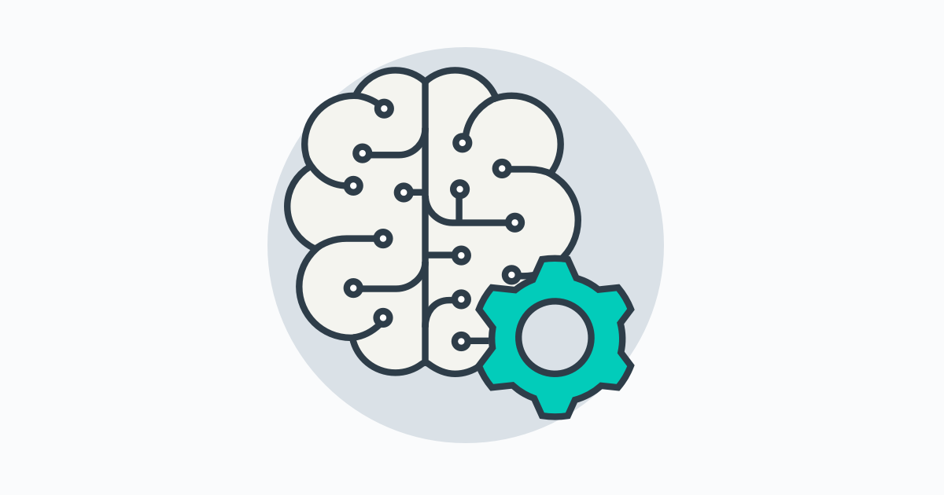
Machine Learning
Machine learning is a field of computer science that gives computers the ability to learn without being explicitly programmed.
Arthur Samuel, an American pioneer in the field of computer gaming and artificial intelligence, coined the term "Machine Learning" in 1959 while at IBM.
Evolved from the study of pattern recognition and computational learning theory in artificial intelligence, machine learning explores the study and construction of algorithms that can learn from and make predictions on data – such algorithms overcome following strictly static program instructions by making data-driven predictions or decisions through building a model from sample inputs. Machine learning is employed in a range of computing tasks where designing and programming explicit algorithms with good performance is difficult or infeasible; example applications include email filtering, detection of network intruders or malicious insiders working towards a data breach, optical character recognition (OCR), learning to rank, and computer vision.

Slide 3
Machine Learning
Machine learning is closely related to (and often overlaps with) computational statistics, which also focuses on prediction-making through the use of computers. It has strong ties to mathematical optimization, which delivers methods, theory and application domains to the field. Machine learning is sometimes conflated with data mining, where the latter subfield focuses more on exploratory data analysis and is known as unsupervised learning.:vii Machine learning can also be unsupervised and be used to learn and establish baseline behavioral profiles for various entities and then used to find meaningful anomalies.
Within the field of data analytics, machine learning is a method used to devise complex models and algorithms that lend themselves to prediction; in commercial use, this is known as predictive analytics. These analytical models allow researchers, data scientists, engineers, and analysts to "produce reliable, repeatable decisions and results" and uncover "hidden insights" through learning from historical relationships and trends in the data.

Slide 4
Machine Learning
According to the Gartner hype cycle of 2016, machine learning is at its peak of inflated expectations. Effective machine learning is difficult because finding patterns is hard and often not enough training data are available; as a result, machine-learning programs often fail to deliver.

Slide 5
Machine Learning
Machine learning tasks are typically classified into two broad categories, depending on whether there is a learning "signal" or "feedback" available to a learning system:
Supervised learning: The computer is presented with example inputs and their desired outputs, given by a "teacher", and the goal is to learn a general rule that maps inputs to outputs. As special cases, the input signal can be only partially available, or restricted to special feedback:
Semi-supervised learning: the computer is given only an incomplete training signal: a training set with some (often many) of the target outputs missing.
Active learning: the computer can only obtain training labels for a limited set of instances (based on a budget), and also has to optimize its choice of objects to acquire labels for. When used interactively, these can be presented to the user for labeling.
Reinforcement learning: training data (in form of rewards and punishments) is given only as feedback to the program's actions in a dynamic environment, such as driving a vehicle or playing a game against an opponent.
Unsupervised learning: No labels are given to the learning algorithm, leaving it on its own to find structure in its input. Unsupervised learning can be a goal in itself (discovering hidden patterns in data) or a means towards an end (feature learning).

Slide 6
Machine Learning
Tom M. Mitchell provided a widely quoted, more formal definition of the algorithms studied in the machine learning field: "A computer program is said to learn from experience E with respect to some class of tasks T and performance measure P if its performance at tasks in T, as measured by P, improves with experience E."This definition of the tasks in which machine learning is concerned offers a fundamentally operational definition rather than defining the field in cognitive terms. This follows Alan Turing's proposal in his paper "Computing Machinery and Intelligence", in which the question "Can machines think?" is replaced with the question "Can machines do what we (as thinking entities) can do?". In Turing's proposal the various characteristics that could be possessed by a thinking machine and the various implications in constructing one are exposed.

Slide 7
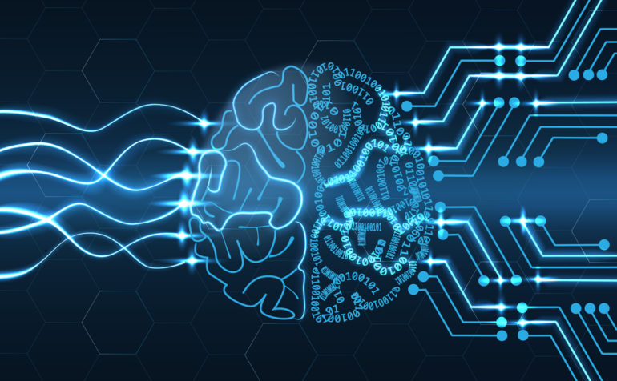
Machine Learning
Another categorization of machine learning tasks arises when one considers the desired output of a machine-learned system
In classification, inputs are divided into two or more classes, and the learner must produce a model that assigns unseen inputs to one or more (multi-label classification) of these classes. This is typically tackled in a supervised way. Spam filtering is an example of classification, where the inputs are email (or other) messages and the classes are "spam" and "not spam".
In regression, also a supervised problem, the outputs are continuous rather than discrete.
In clustering, a set of inputs is to be divided into groups. Unlike in classification, the groups are not known beforehand, making this typically an unsupervised task.
Density estimation finds the distribution of inputs in some space.
Dimensionality reduction simplifies inputs by mapping them into a lower-dimensional space. Topic modeling is a related problem, where a program is given a list of human language documents and is tasked to find out which documents cover similar topics.

Slide 8
Machine Learning
Machine learning, reorganized as a separate field, started to flourish in the 1990s. The field changed its goal from achieving artificial intelligence to tackling solvable problems of a practical nature. It shifted focus away from the symbolic approaches it had inherited from AI, and toward methods and models borrowed from statistics and probability theory.[20] It also benefited from the increasing availability of digitized information, and the possibility to distribute that via the Internet.
Machine learning and data mining often employ the same methods and overlap significantly, but while machine learning focuses on prediction, based on known properties learned from the training data, data mining focuses on the discovery of (previously) unknown properties in the data (this is the analysis step of knowledge discovery in databases). Data mining uses many machine learning methods, but with different goals; on the other hand, machine learning also employs data mining methods as "unsupervised learning" or as a preprocessing step to improve learner accuracy. Much of the confusion between these two research communities (which do often have separate conferences and separate journals, ECML PKDD being a major exception) comes from the basic assumptions they work with: in machine learning, performance is usually evaluated with respect to the ability to reproduce known knowledge, while in knowledge discovery and data mining (KDD) the key task is the discovery of previously unknown knowledge. Evaluated with respect to known knowledge, an uninformed (unsupervised) method will easily be outperformed by other supervised methods, while in a typical KDD task, supervised methods cannot be used due to the unavailability of training data.

Slide 9
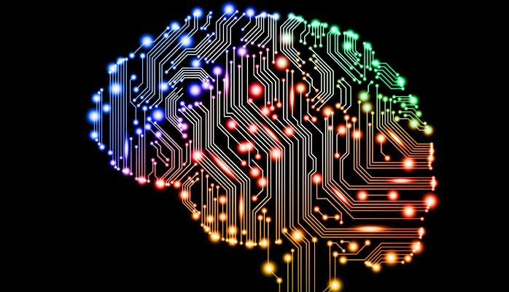
Machine Learning
Machine learning also has intimate ties to optimization: many learning problems are formulated as minimization of some loss function on a training set of examples.
Loss functions express the discrepancy between the predictions of the model being trained and the actual problem instances (for example, in classification, one wants to assign a label to instances, and models are trained to correctly predict the pre-assigned labels of a set of examples). The difference between the two fields arises from the goal of generalization: while optimization algorithms can minimize the loss on a training set, machine learning is concerned with minimizing the loss on unseen samples.

Slide 10
Machine Learning
However, an increasing emphasis on the logical, knowledge-based approach caused a rift between AI and machine learning. Probabilistic systems were plagued by theoretical and practical problems of data acquisition and representation.By 1980, expert systems had come to dominate AI, and statistics was out of favor.[20] Work on symbolic/knowledge-based learning did continue within AI, leading to inductive logic programming, but the more statistical line of research was now outside the field of AI proper, in pattern recognition and information retrieval.; 755 Neural networks research had been abandoned by AI and computer science around the same time. This line, too, was continued outside the AI/CS field, as "connectionism", by researchers from other disciplines including Hopfield, Rumelhart and Hinton. Their main success came in the mid-1980s with the reinvention of backpropagation.

