Slide 2

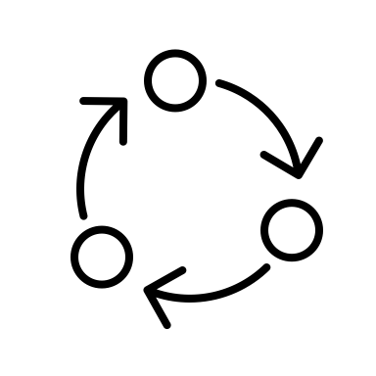
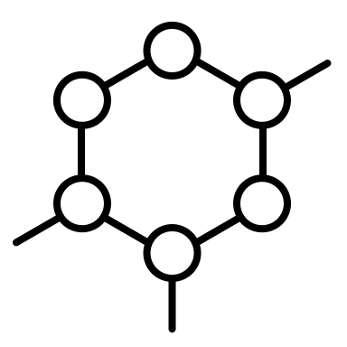

Complex Systems Modelling of Alcohol-related Health Inequalities
Agent Based Modelling
Fundamental Cause Theory
Person 1
Person 2
Drinks Infrequently
Drinks Frequently
Sebastiano Zuddas

Slide 3
Complex Systems Modelling of Alcohol-related Health Inequalities
Agent Based Modelling
Fundamental Cause Theory
Person 1
Person 2
Drinks Infrequently
Drinks Frequently
Low Education
High Education
Sebastiano Zuddas

Slide 4
Complex Systems Modelling of Alcohol-related Health Inequalities
Agent Based Modelling
Fundamental Cause Theory
Person 1
Person 2
Drinks Infrequently
Drinks Frequently
Low Education
High Education
£21,000/year
£50,000/year
Sebastiano Zuddas

Slide 5



Complex Systems Modelling of Alcohol-related Health Inequalities
Agent Based Modelling
Fundamental Cause Theory
Person 1
Person 2
Drinks Infrequently
Drinks Frequently
Low Education
High Education
£21,000/year
£50,000/year
More Alcohol Harm
Less Alcohol Harm
Sebastiano Zuddas

Slide 6
Complex Systems Modelling of Alcohol-related Health Inequalities
Agent Based Modelling
Agent Based Modelling
Fundamental Cause Theory
Fundamental Cause Theory
The Alcohol Harm Paradox
Exploring the Alcohol Harm Paradox in Scotland
Person 1
Person 2
Drinks: Frequently
Drink Location: Pub
Work: Blue collar
Left Education: 16
Healthcare: NHS
Sebastiano Zuddas
Drinks: Frequently
Drink Location: Conferences
Work: White collar
Left Education: 22
Healthcare: Private
Sebastiano Zuddas

Slide 7



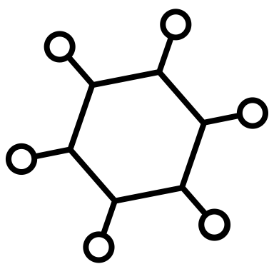






Education
Wealth
Fundamental Cause Theory
The Alcohol Harm Paradox
Person 1
Person 2
Occurs across scales
Multiple individual factors
Literature misses social factors
Fundamentally a complex issue
Drinks: Frequently
Drink Location: Pub
Work: Blue collar
Left Education: 16
Healthcare: NHS
Drinks: Frequently
Drink Location: Conferences
Work: White collar
Left Education: 22
Healthcare: Private
Wealth
Education
Healthcare Access
Social Power
Social Prestige
Social Power
Healthcare Access
Social Prestige

Slide 8

Education
Wealth
The Big Question:
Fundamental Cause Theory
Wealth
Education
Social Power
Healthcare Access
Social Prestige
Healthcare Access
Social Power
Social Prestige
Occurs across scales
Multiple factors
Literature misses social factors
Fundamentally a complex issue

Slide 9

Education
The Big Question:
Fundamental Cause Theory
Scottish Data
Wealth
Education
Social Power
Healthcare Access
Social Prestige
Healthcare Access
Social Prestige

Slide 10
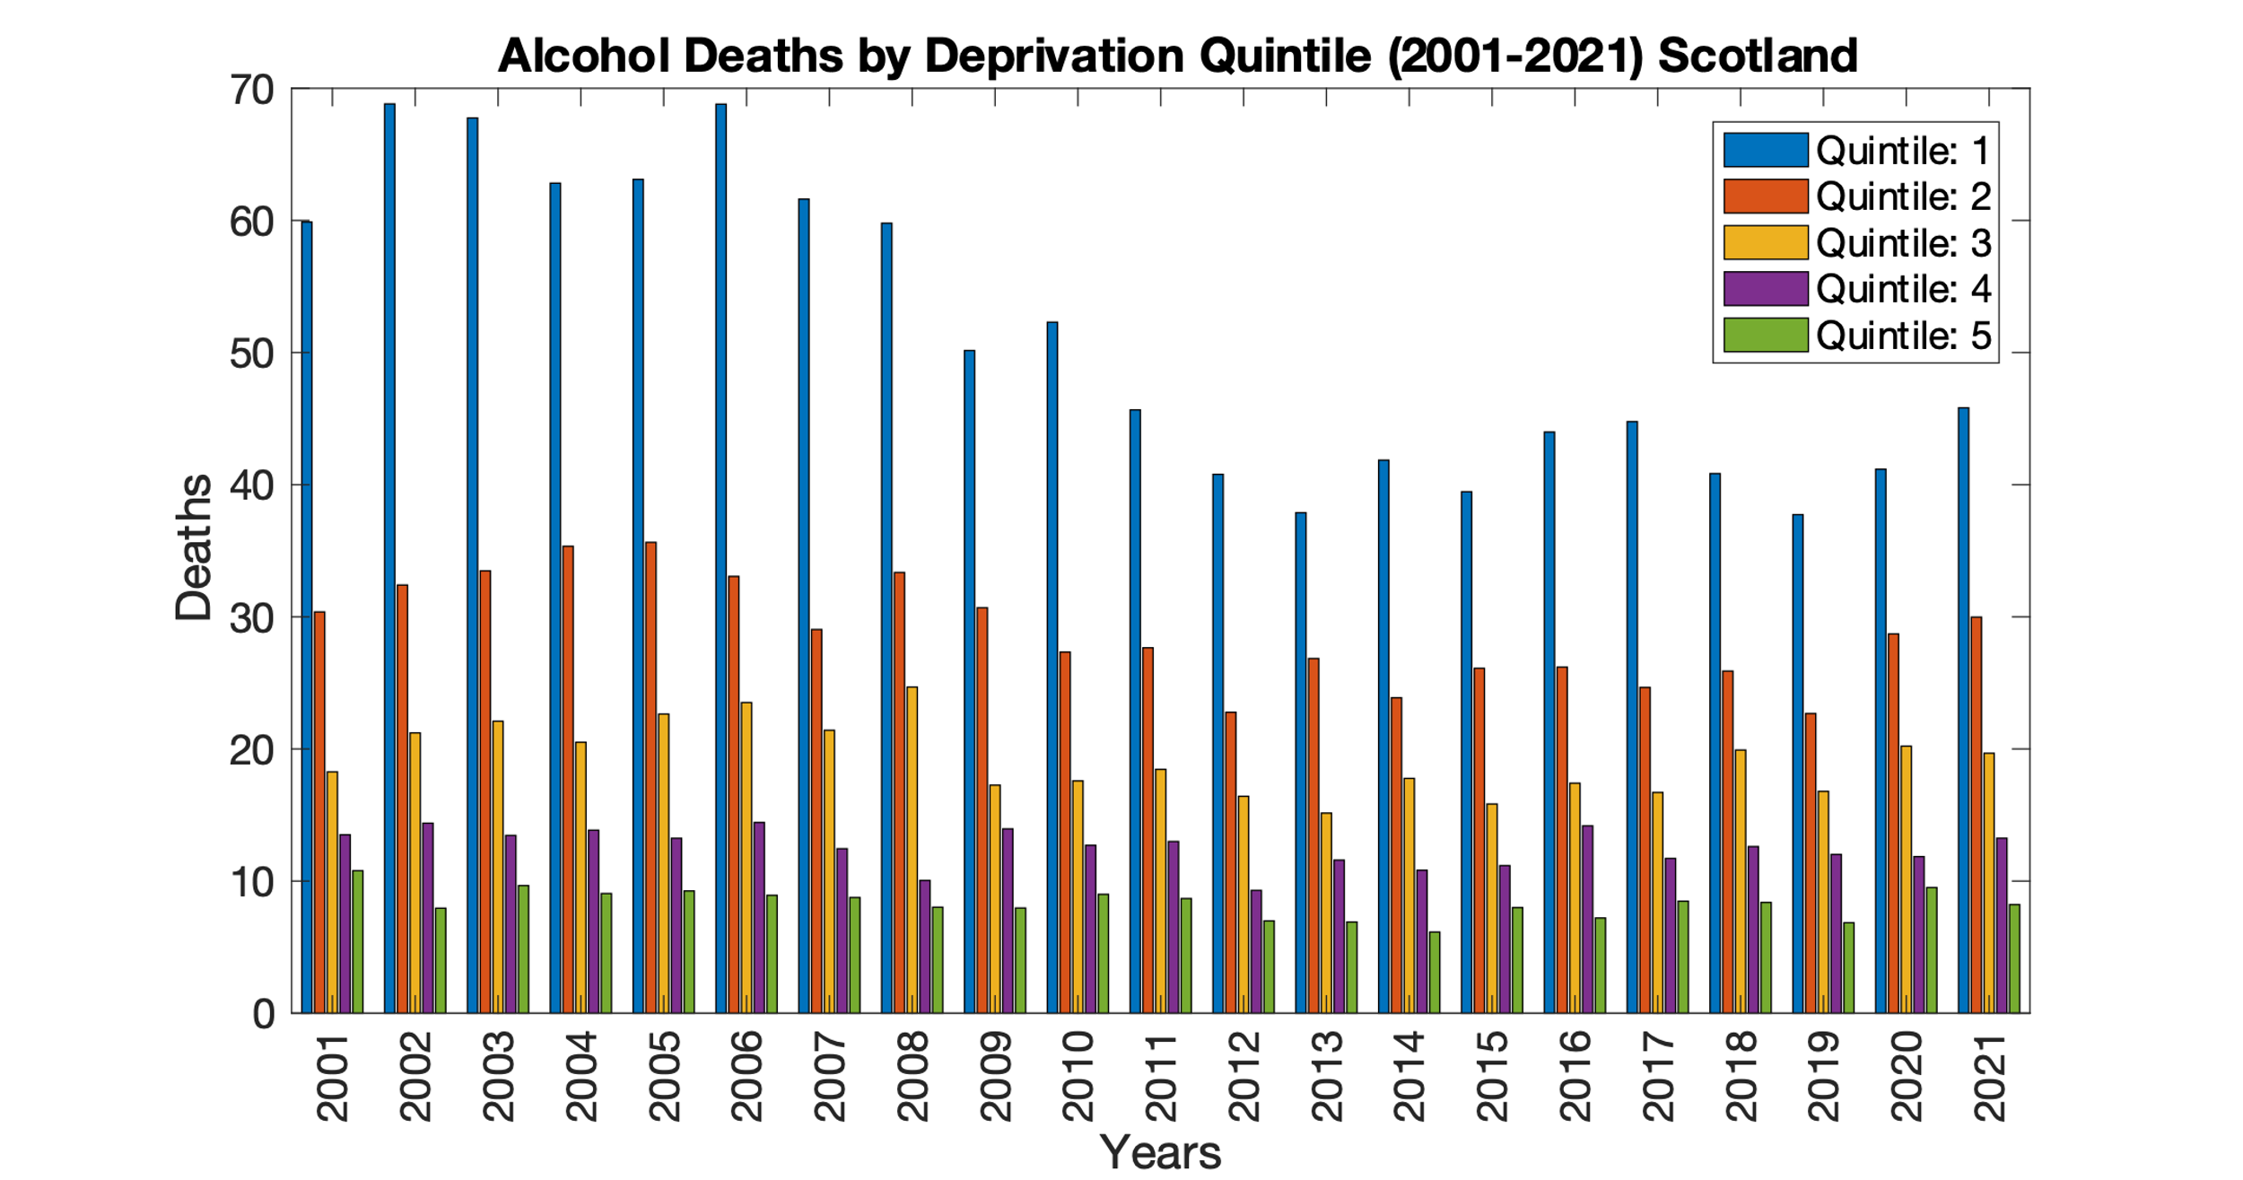
Education
The Big Question:
Scottish Data
Healthcare Access
Social Prestige
Notes:
Quintiles divide a group of people or things into five equal parts, each representing 20% of the total. They are used to compare how different factors or variables are distributed across a group and identify patterns or trends.

Slide 11
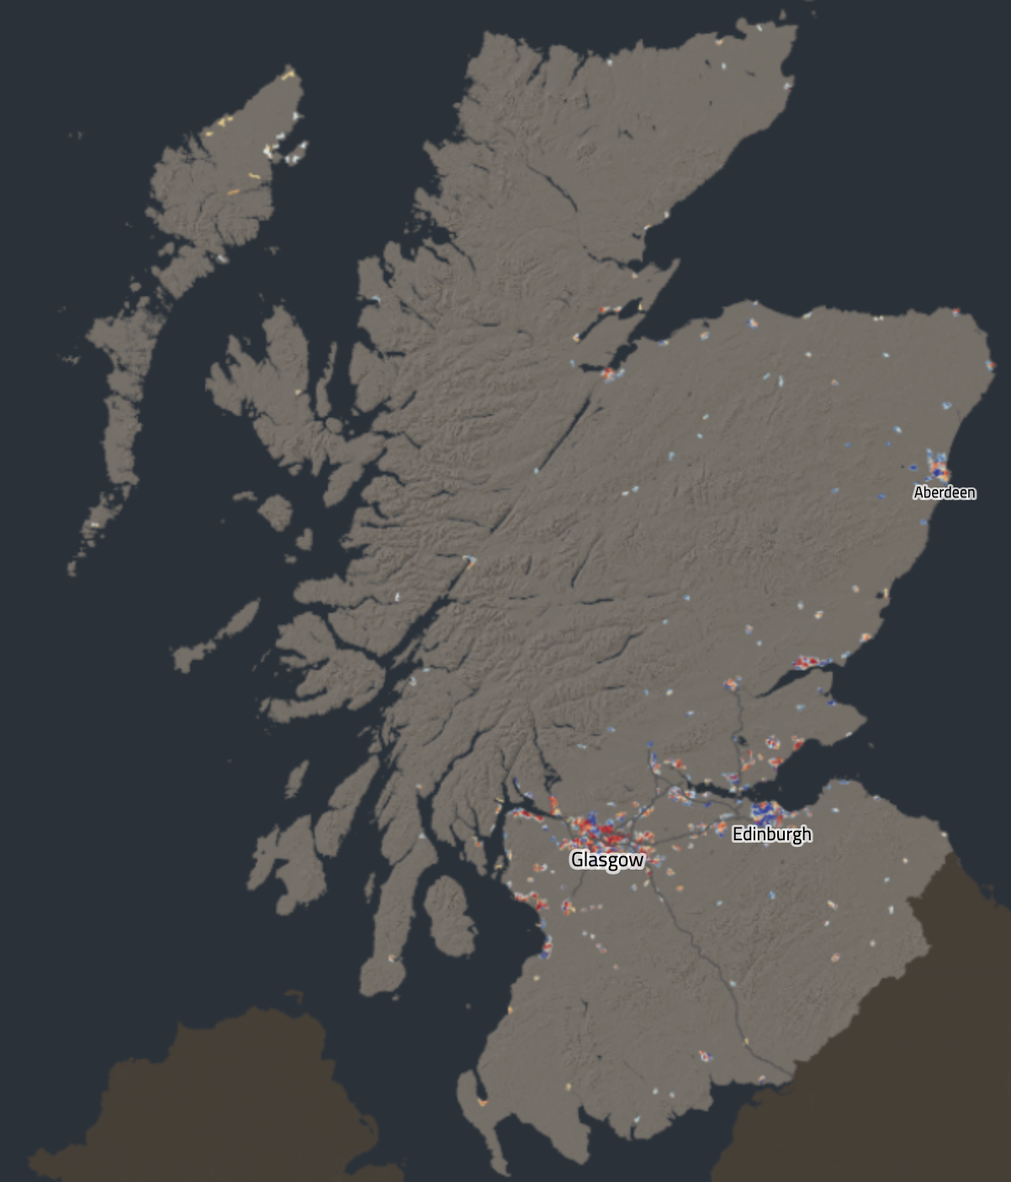
Education
The Big Question:
Scottish Data
https://simd.scot/
Healthcare Access
Social Prestige

Slide 12
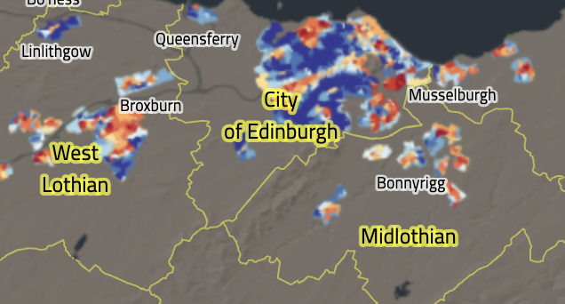
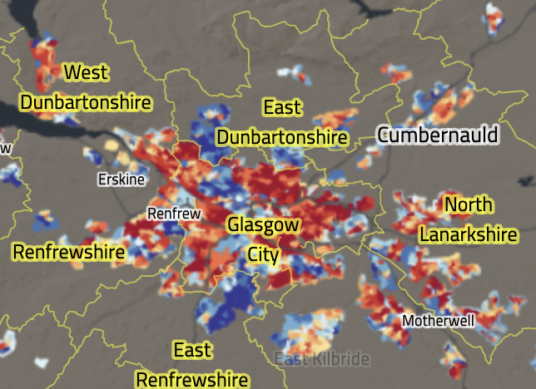
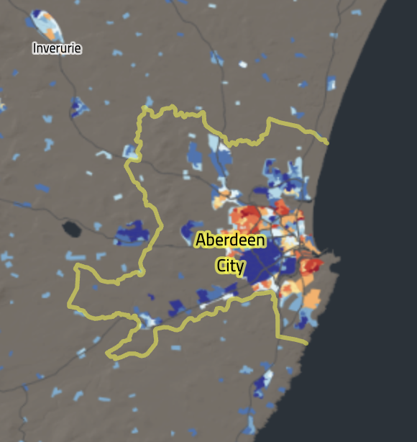
Education
The Big Question:
Scottish Data
https://simd.scot/
Healthcare Access
Social Prestige

Slide 13
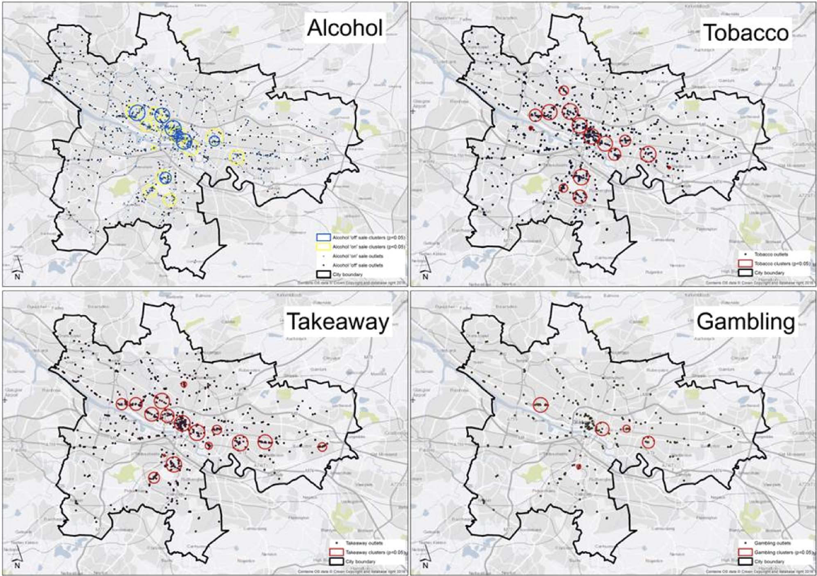
Education
The Big Question:
Scotland
Scottish Data
Macdonald, L. et al. (2018). https://doi.org/10.1016/J.HEALTHPLACE.2018.04.008
Healthcare Access
Social Prestige
Notes:
"environmental Bads"

Slide 14
Education
The Big Question:
Alcohol
Ned Culture
Data on a Scottish Level
Macdonald, L. et al. (2018). https://doi.org/10.1016/J.HEALTHPLACE.2018.04.008
Healthcare Access
Social Prestige
Notes:
Environmental Bads

Slide 15
Education
Wealth
Fundamental Cause Theory
The Big Question:
Why is the Alcohol Harm Paradox so Pronounced in Scotland?
Wealth
Education
Healthcare Access
Social Power
Social Power
Social Prestige
Healthcare Access
Social Prestige
Occurs across scales
Multiple factors
Literature misses social factors
Fundamentally a complex issue

Slide 16
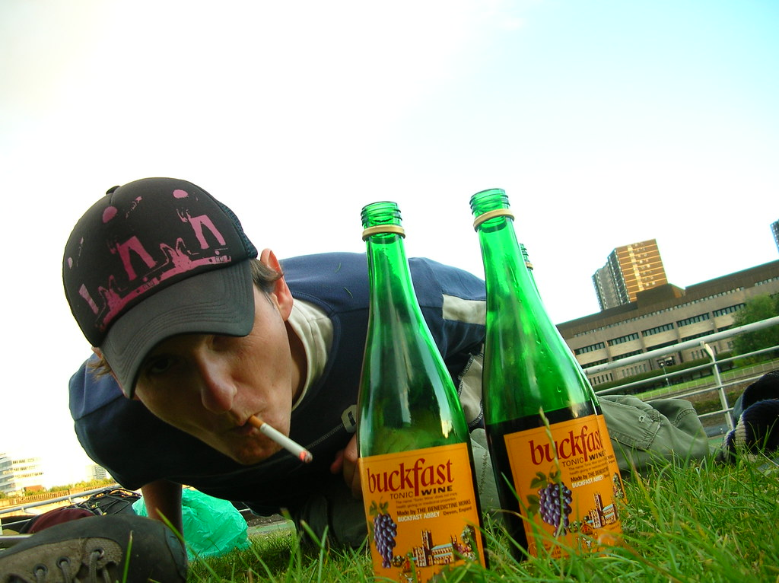





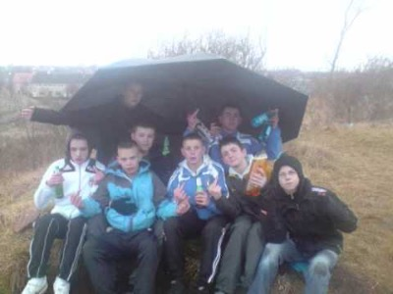
Thank You
Football Culture
Data on a Scottish Level
Alcohol
Software Implementation
Math to Functions
Ned Culture
UML
Characterised by:
Deprivation
Few opportunities
Territory
Substance abuse
MBSSM
FCT
AHP
Macro
Person 1
Person 2
Micro

Slide 17
Thank You
Football Culture
Data on a Scottish Level
Alcohol
Software Implementation
Math to Functions
Ned Culture
UML
Characterised by:
Deprivation
Few opportunities
Territory
Substance abuse
MBSSM
FCT
AHP
Macro
Person 1
Person 2
Micro

Slide 18
Thank You
Alcohol
Ned Culture
Football Culture
UML
Characterised by:
Deprivation
Few opportunities
Territory
Substance abuse
MBSSM
FCT
AHP
Macro
Micro

Slide 19
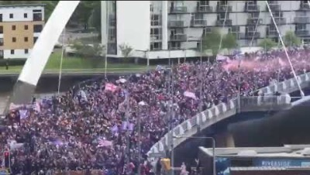
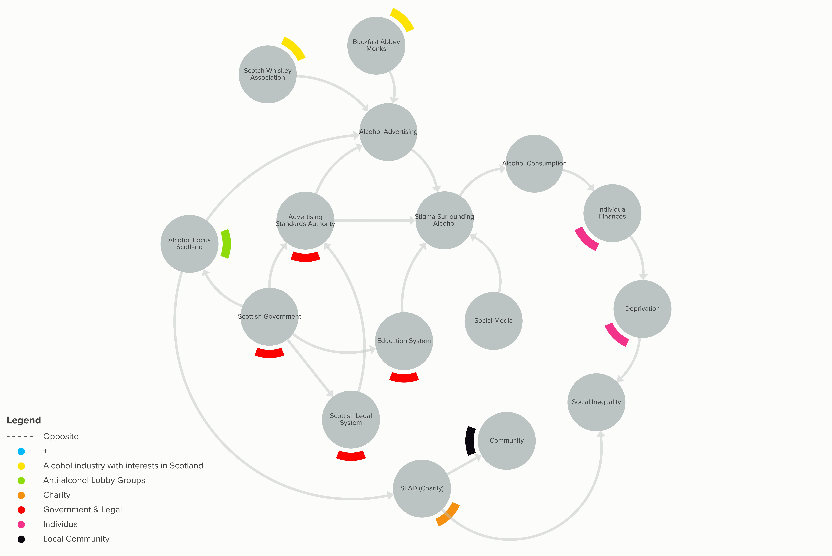
What are the origins?
Thank You
System Map
Alcohol
Ned Culture
Football Culture
UML
MBSSM
FCT
AHP
Macro
Micro

Slide 20
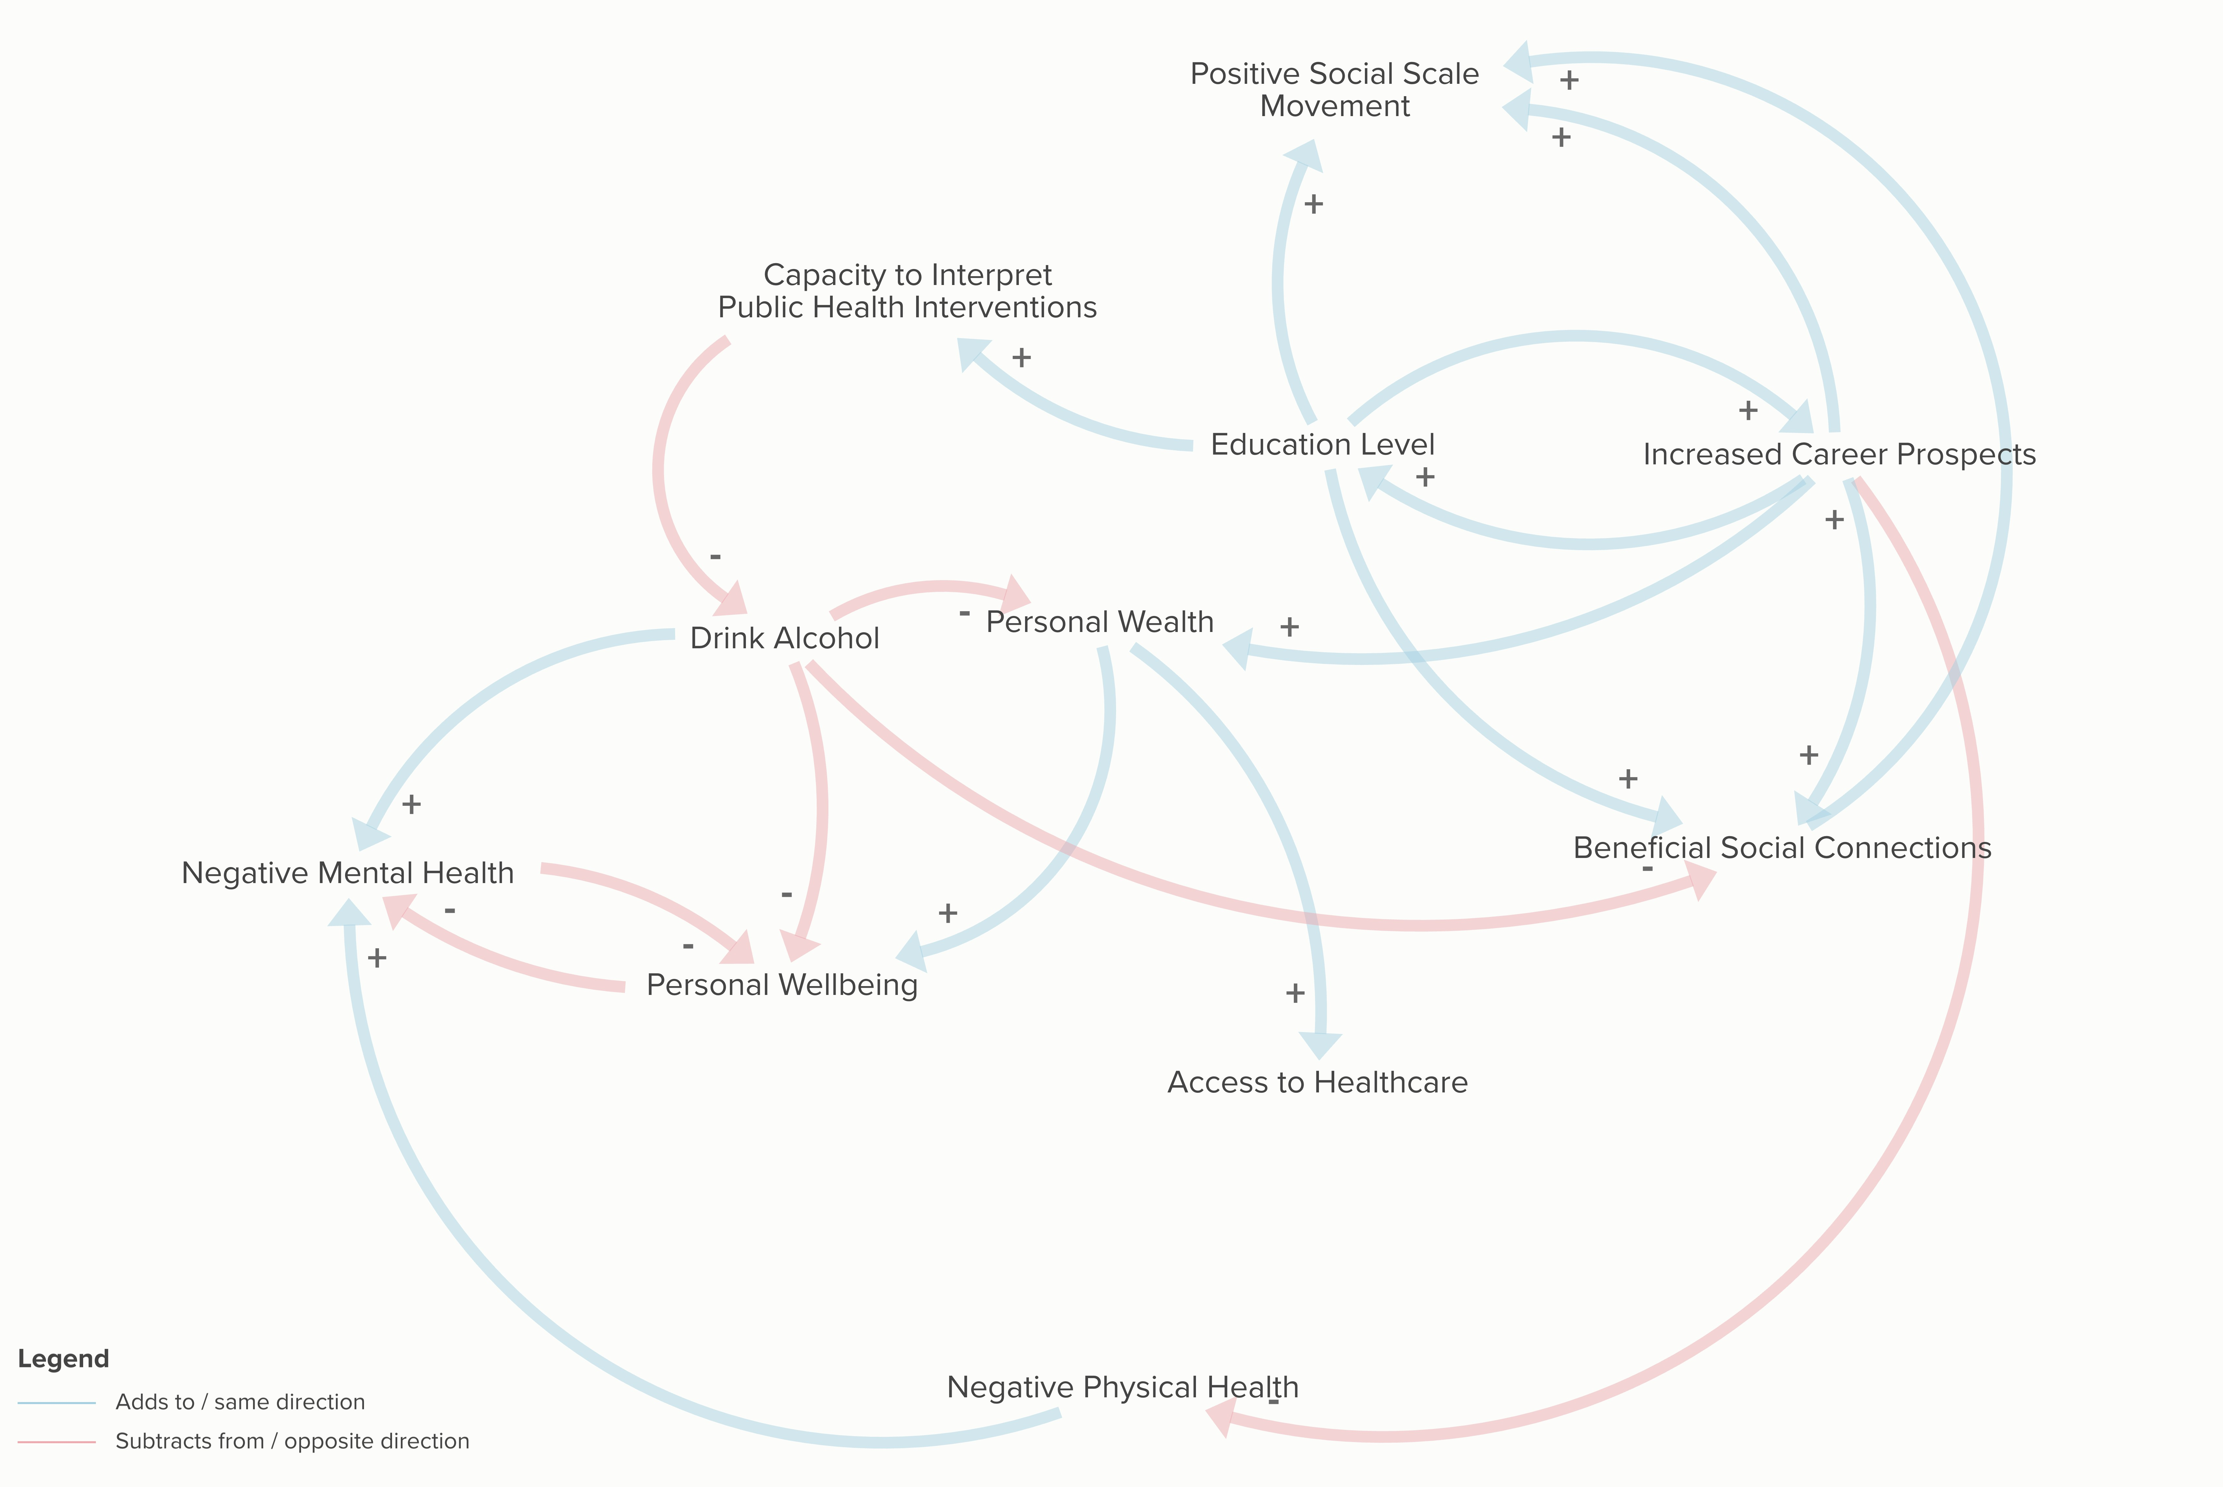
Thank You
Causal Loop Diagram
Alcohol
System Map
Football Culture
Ned Culture
UML
MBSSM
FCT
AHP
Macro
Micro

Slide 21
Thank You
Policy
Currently in Use
Alcohol
Causal Loop Diagram
System Map
Football Culture
Ned Culture
UML
MBSSM
FCT
AHP
Macro
Micro
Notes:
Education, wealth, access to healthcare, social standing through work.

Slide 22
Thank You
Proposed Solution
Causal Loop Diagram
Results
Policy
Software Implementation
Full Results
Finding the AHP
Math to Functions
Agent Network
Currently in Use
UML
MBSSM
FCT
AHP
Minimum Unit Pricing
Increased Police Presence
Macro
Minimum possible price is 50p per unit of ethanol
Successful in reducing deaths (10%/year since implementation in May 2018)
Some argue the hardest hit are those who are most deprived
Increased police presence in high-risk areas
Educating high-risk individuals at school
Somewhat successful in addressing violence
Doesn’t address other alcohol-related harms
Doesn’t address deprivation
Person 1
Person 2
Micro
Notes:
Some argue hardest hit are poorest
Others argue that long term reduction in consumption is the goal.

Slide 23
Thank You
Causal Loop Diagram
Results
Policy
Software Implementation
Full Results
Finding the AHP
Agent Network
Proposed Solution
Currently in Use
Math to Functions
UML
MBSSM
FCT
AHP
Minimum Unit Pricing
Increased Police Presence
Macro
Person 1
Person 2
Micro
Notes:
Environmental bads

Slide 24
Thank You
Causal Loop Diagram
Results
Policy
Software Implementation
Full Results
Finding the AHP
Agent Network
Proposed Solution
Currently in Use
Math to Functions
UML
MBSSM
FCT
AHP
Change tax incentives for ‘environmental bads’
Use cash generated to incentivize community projects and local businesses
Scale tax incentives with area deprivation
Minimum Unit Pricing
Increased Police Presence
Macro
Person 1
Person 2
Micro
Notes:
Provides opportunity

Slide 25
Thank You
Causal Loop Diagram
Results
Policy
Software Implementation
Full Results
Finding the AHP
Agent Network
Proposed Solution
Currently in Use
Math to Functions
UML
MBSSM
FCT
AHP
Change tax incentives for ‘environmental bads’
Use cash generated to incentivize community projects and local businesses
Scale tax incentives with area deprivation
Minimum Unit Pricing
Increased Police Presence
Macro
Person 1
Person 2
Micro

Slide 26
Causal Loop Diagram
Results
Policy
Software Implementation
Full Results
Finding the AHP
Proposed Solution
Agent Network
Currently in Use
Math to Functions
UML
MBSSM
FCT
AHP
Change tax incentives for ‘environmental bads’
Use cash generated to incentivize community projects and local businesses
Scale tax incentives with area deprivation
Minimum Unit Pricing
Increased Police Presence
Macro
Person 1
Person 2
Thank You!
Micro

