Slide 1
Sentiment is Not Stance: Target-Aware Opinion Classification for Political Text Analysis -
Bestvater & Monroe
Xiangming Zeng and Sam Cohen

Slide 2
Introduction

Slide 3
Introduction
Background and Research Question
Political scientists have been using NLP more and more often
While NLP is great for sentiment analysis, political scientists are often more interested in the political stance of a text rather than its sentiment
Is it reasonable to assume that the sentiment of a document reflects the stance of that document toward the primary topic of the document?
Methods
Sentiment Analysis (VADER)
Hypothesis Testing (logistic regression)
Supervised Machine Learning (SVM)
LLMs (BERT)
Notes:
This paper is very well suited for this class because it uses multiple tools we learned from the beginning until now. As you all know, the political science world uses NLP a lot. One of the most common uses of NLP is sentiment analysis, and there are of course many applications for this in political science.
However, more often than not, political scientists are more concerned with the stance of a text, not necessarily its sentiment.
Bestvater and Monroe explores the link between sentiment and stance by asking: Is it reasonable to assume that the sentiment of a document reflects the stance of that document toward the primary topic of the document?
They use a bunch of tools: VADER for sentiment analysis, but also uses LLMs and human coders to predict stance, supervised learning models, and hypothesis testing. And try to figure out this relationship.

Slide 4
Introduction
3 Sentiment and Stance Case Studies
Tweets About the 2017 Women’s March
Open-Ended Survey Responses About Donald Trump
Tweets About the Kavanaugh Confirmation
Findings
Case 1: Sentiment not a great predictor of stance for the Women’s March tweets, but strong correlation between ideology and approval of movement
Case 2: Respondents predicted as conservative had higher approval of Trump
Case 3: Probability of approving Kavanaugh’s confirmation increases as conservative views increase
“Simply put, sentiment is not the same thing as stance, and treating them as conceptually interchangeable can introduce significant measurement error.”
Notes:
They explore 3 case studies in his paper:
Tweets About the 2017 Women’s March
"Mood of the Nation” Open-Ended Survey Responses About Donald Trump
Tweets About the Kavanaugh Confirmation
In general, Besvater and Monroe find that while there is correlation between ideology and support for certain political outcomes, there is little evidence to suggest that sentiment and stance show the same relationship.

Slide 5
Methodology - Case 1

Slide 6
Case 1: Stance and Sentiment in Women’s March Tweets
Analyzed sentiment of 2.5 million tweets about the march using VADER
20,000 tweet sample was labeled by hand to determine:
Positive / Negative Sentiment
Approval / Disapproval of the movement
BERT model trained classify tweets as either pro- or anti-march based on hand-coding
Ideology for each user calculated (-2.5 to 2.5)
Relationship between sentiment and stance analyzed (logistic regression)
Supervised Machine Learning model trained to predict sentiment and stance based on text (SVM)
Extension: Naive-Bayes, LASSO, word embeddings, wordscore
Notes:
The first case study, authors measures sentiment and stance on tweets about the 2017 Women’s march.
Authors uses a corpus of 2.5 million tweets and measures sentiment of each using VADER.
These were broken down further by city.
They then took a sample 20k tweets, and labeled them by hand, determining: (1) whether or not the tweet was positive or negative in sentiment, and (2) whether the tweet was pro or anti march.
He then used a BERT model trained on these tweets and labels to classify the rest of the tweets as pro or anti march.
Next, the political position of each user was ranked on an ideological scale ranging from −2.5 (very liberal) to 2.5 (very conservative) according to the Bayesian ideal point estimation approach suggested and validated in Barberá.
-
To determine the effects of ideology on sentiment and stance, he used logistic regression to see the relationship between ideology score and (1) VADER Sentiment, (2) BERT Stance, and (3) Human-coded stance
He also trained a SVM model to predict stance and sentiment based on the text
But for our extension, we trained a Naive Bayes classifier to predict stance based on text

Slide 7
Results - Case 1

Slide 8
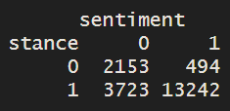
Crosstabs of Positive vs. Negative Stance and Sentiment
Original
Replication
 | Sentiment (-) | Sentiment (+)
Stance (-) | 2,153 | 494
Stance (+) | 3,723 | 13,242
Notes:
Our crosstabs replication of positive and negative sentiment and stance showed exactly the same results

Slide 9
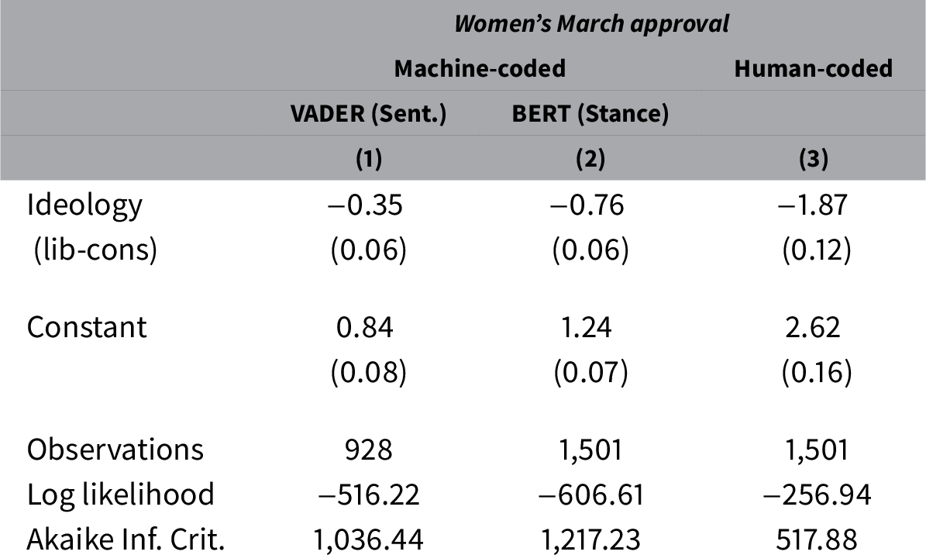
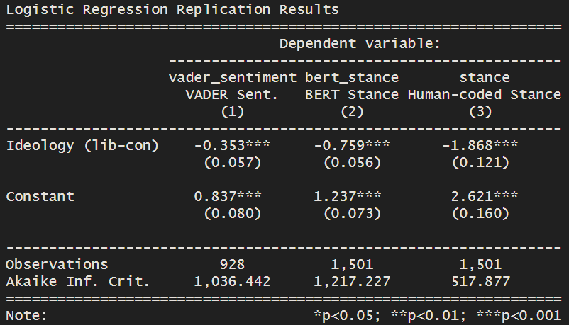
Logistic Regression(s)
Original
Replication
Notes:
This logistic regression shows the impact of ideology on (1) Vader Sentiment, (2) BERT stance, and (3) Human-coded stance
In general, the more liberal the user, the more pro-march they were, and the more positive the sentiment. However, sentiment and stance did not share this relationship.
Our logistic regression also showed the same results and coefficients.

Slide 10
Differences

Slide 11
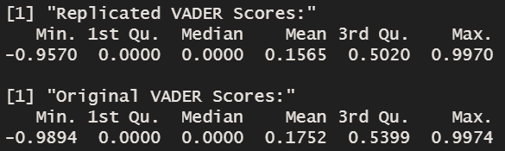
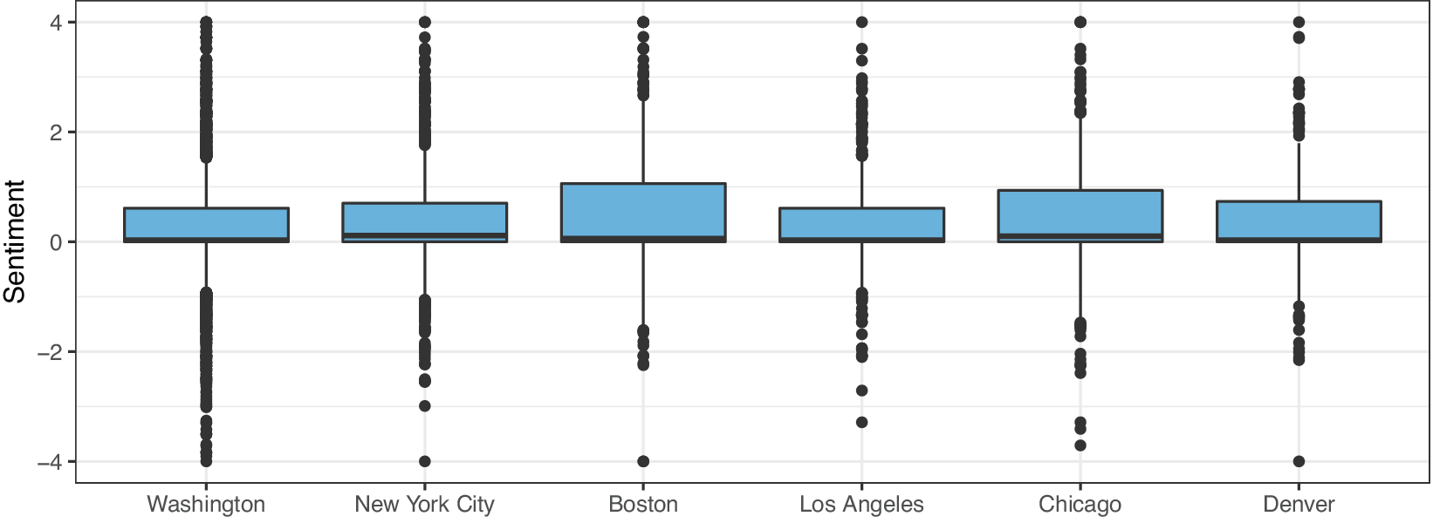
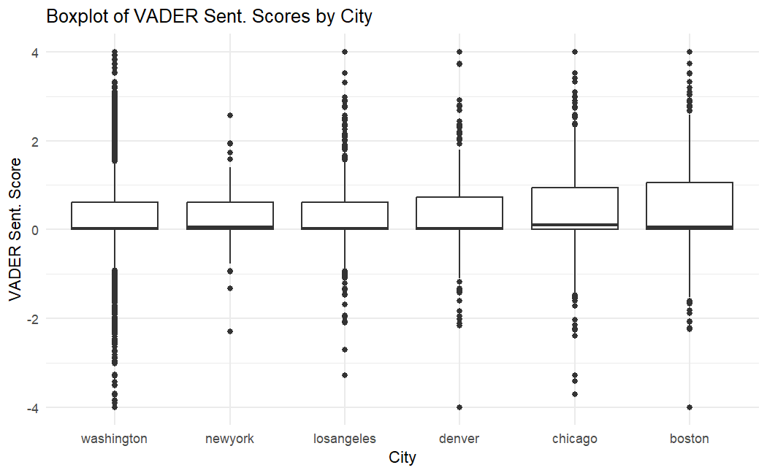
Differences
Slight differences in original vs. replicated VADER scores
No ML code in R to reproduce SVM
Different results for VADER score breakdown by city
Notes:
Overall, the most pressing differences resulted from the difference in original vs. our own VADER scores. The distributes was slightly different, and the breakdown by city was also different, as illustrated by the boxplot.
In addition, there was no R code to reproduce the SVM (it was done in python). Doing it in R is computationally expensive, so we omitted this.

Slide 12
Extensions
The paper
Sentiment
Stance
Our extentions
Notes:
The main argument of the paper: sentiment is not a perfect predictor for political stance.
Our extention: we used stance labels to examine how sentiment varies across different stance groups.

Slide 13
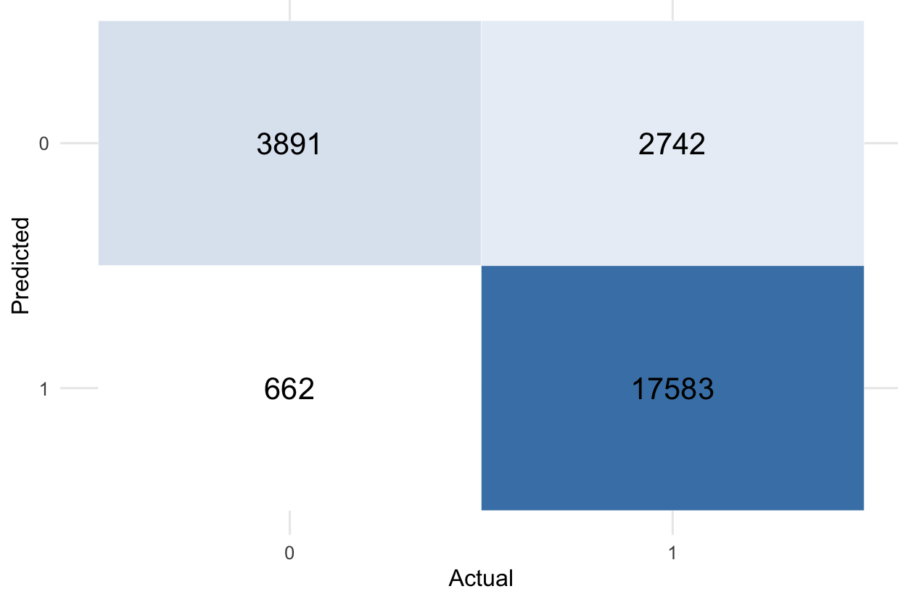
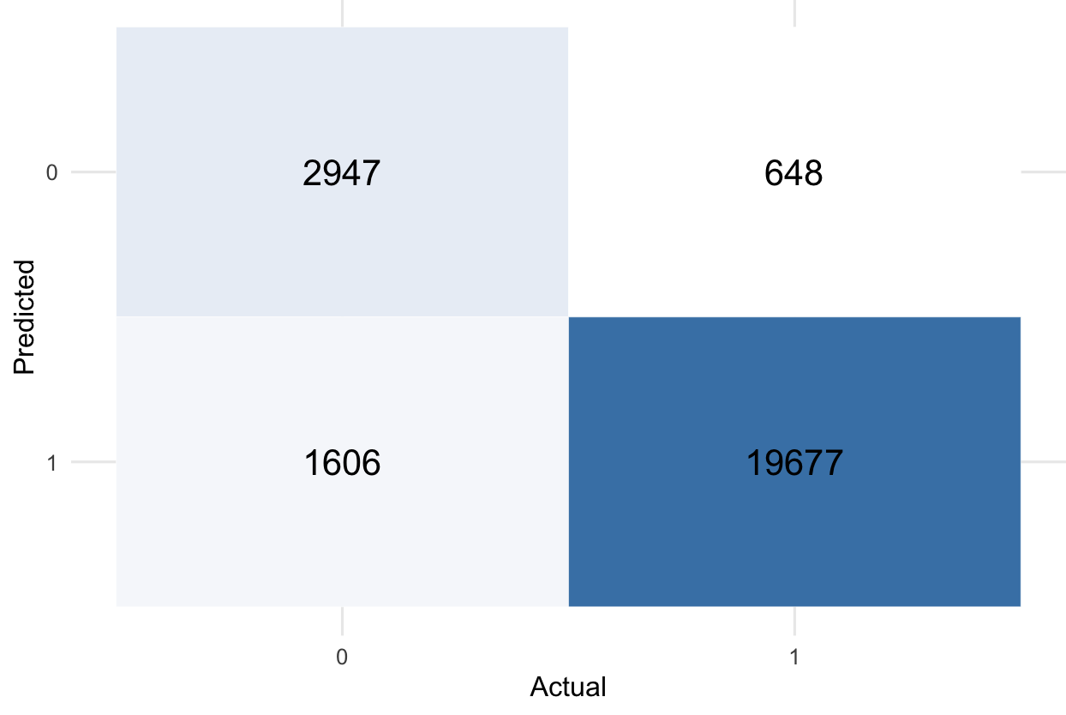
Extension for Case 1: Two Classifiers
Features matrix: Tweet DFM
Target: BERT Stance (1=pro-march, 0=anti-march)
Training size: 99,512
Test size: 24,878 (80-20% split)
min_termfreq = 20, min_docfreq = 10
Naive Bayes (accuracy = 0.8632)
Lasso (accuracy = 0.9094)
Notes:
For our extension we trained a Naive Bayes classifier to predict the stance given by BERT based on the text.
We utilized a 80-20 split, and played around a bit with the alpha, settling at 1.
Our results showed high accuracy, recall, and precision.
An accuracy score of 88.2 percent was observed, with a recall of 96.2 percent and a precision score of 89.0 percent.
The F1 score was 92.5 percent.
Our model also even performed better than Bestvater and Monroe’s SVM stance model, which exhibited a F1 score of 81.7.

Slide 14
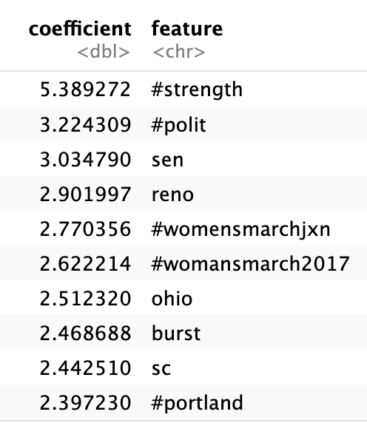
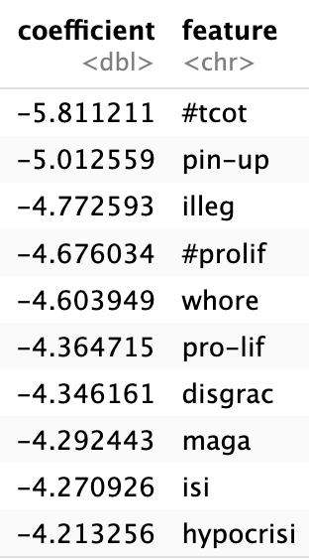
Insights from Lasso coefficients
conservative
terms
hashtags
dirty words
locations
negative expressions
Pro-march features
Anti-march features
Notes:
After training the lasso model, we can identify the most predictive features for each stance by filterting those with the largest positive and negative coefficients.

Slide 15
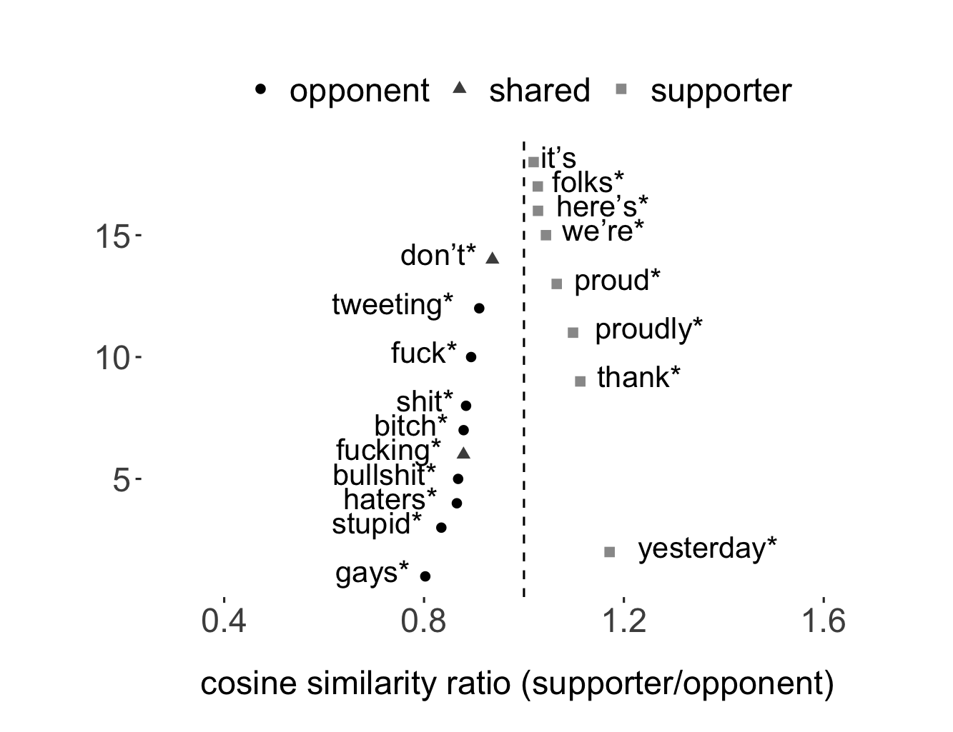
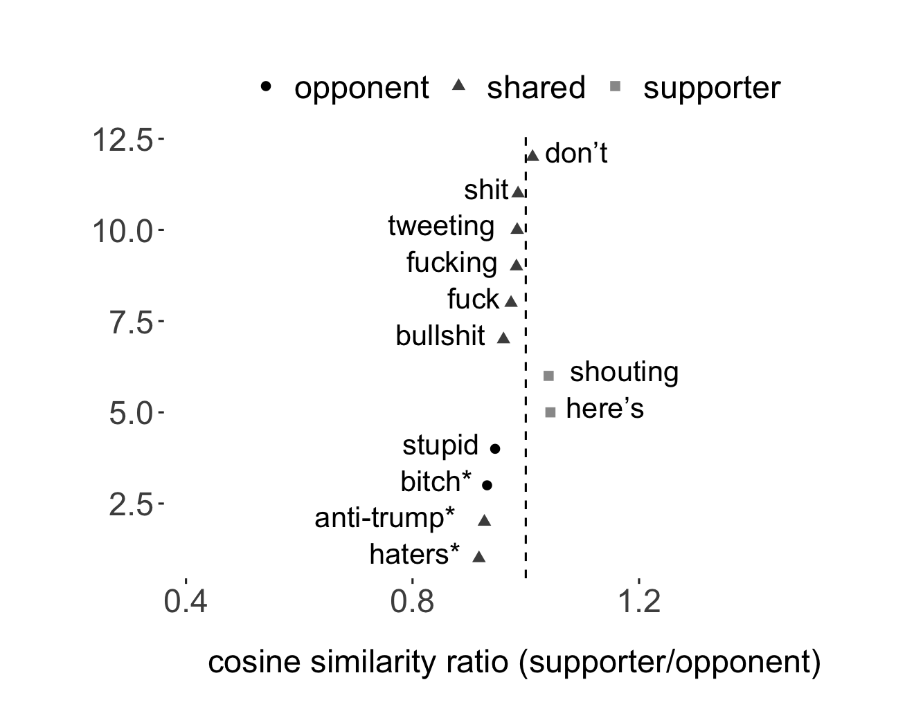
Extension for Case 1: ALC Embeddings
20,000 tweets sample labeled by hand
Pattern: *march*
Pattern: *trump*
Notes:
We used the pre-trained transformation matrix (A matrix) and embeddings.
It works well in identifying the nearest neighbers of two word patterns (march-related terms & trump-related terms) by stance.
This protest was triggered by Trump’s policy positions.
The sentiment of march-related terms differs significantly across stance groups. However, sentiments toward Trump-related terms are relatively consistent.
Pro-march individuals can also be negative if they are talking about Trump.
However, if we only have tweets talking about the march, sentiment may be a better predictor for political stance.

Slide 16
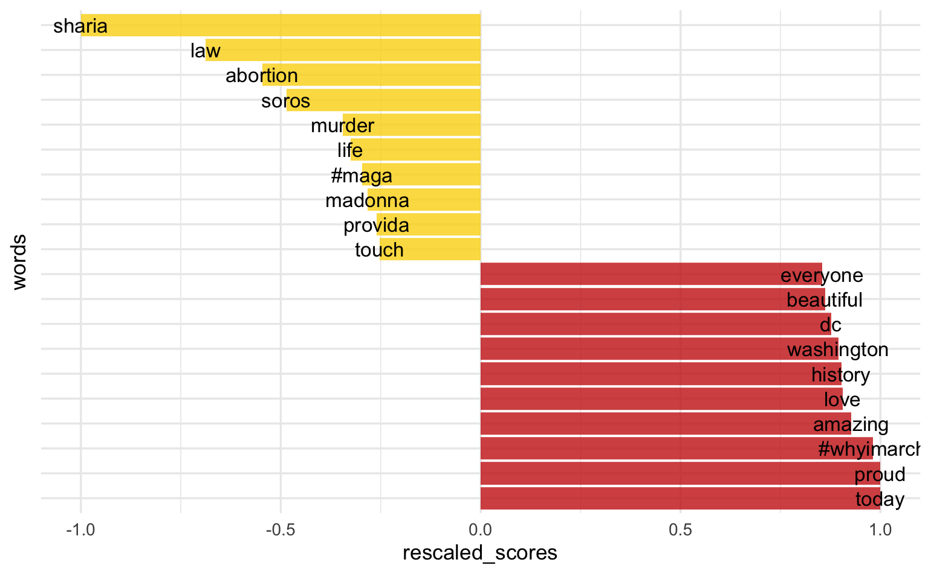
Extension for Case 1: Wordscore
20,000 tweets sample labeled by hand
Use stance labels as document scores
Pro-march = 1
Anti-march = 0
smooth = 0.01

Slide 17
Autopsy

Slide 18
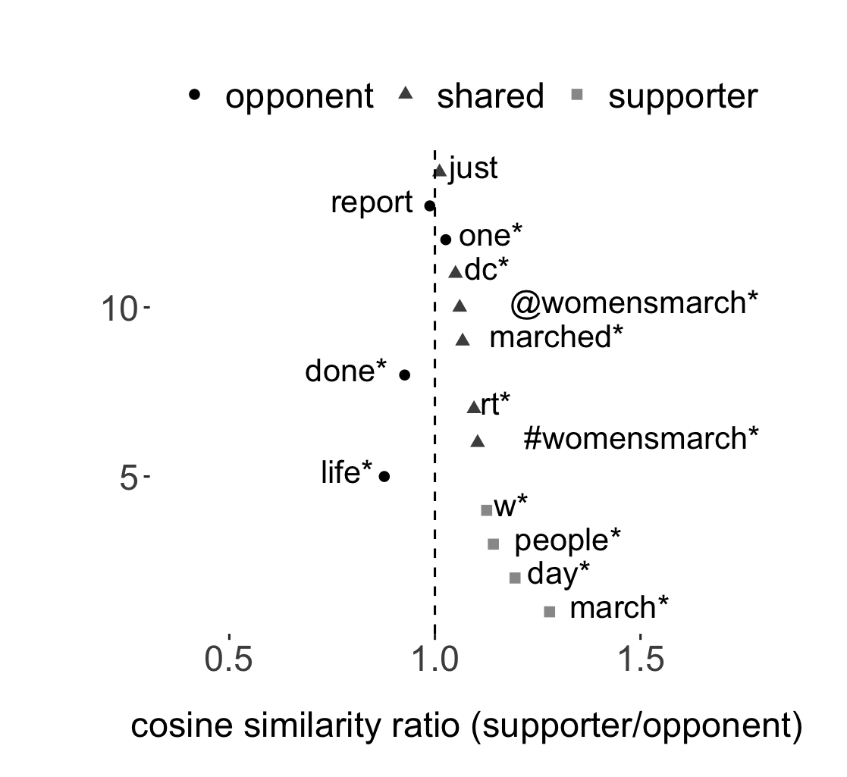
Autopsy
Difference in VADER scores likely due: (1) version and package differences, and (2) R vs. Python
ALC Embeddings: local A + local embeddings
“The researcher is out of sample if their corpus does not particularly resemble Wikipedia.”
“If their corpus is too small to fit local models, we recommend using our estimated A matrix, and carefully checking its validity.”
(Wirsching et al., 2025)
Pattern: *march*

Slide 19
Reference
Wirsching, E. M., Rodriguez, P. L., Spirling, A., & Stewart, B. M. (2025). Multilanguage Word Embeddings for Social Scientists: Estimation, Inference, and Validation Resources for 157 Languages. Political Analysis, 33(2), 156–163. https://doi.org/10.1017/pan.2024.17
Bestvater, S. E., & Monroe, B. L. (2023). Sentiment is Not Stance: Target-Aware Opinion Classification for Political Text Analysis. Political Analysis, 31(2), 235–256. https://doi.org/10.1017/pan.2022.10

Slide 20
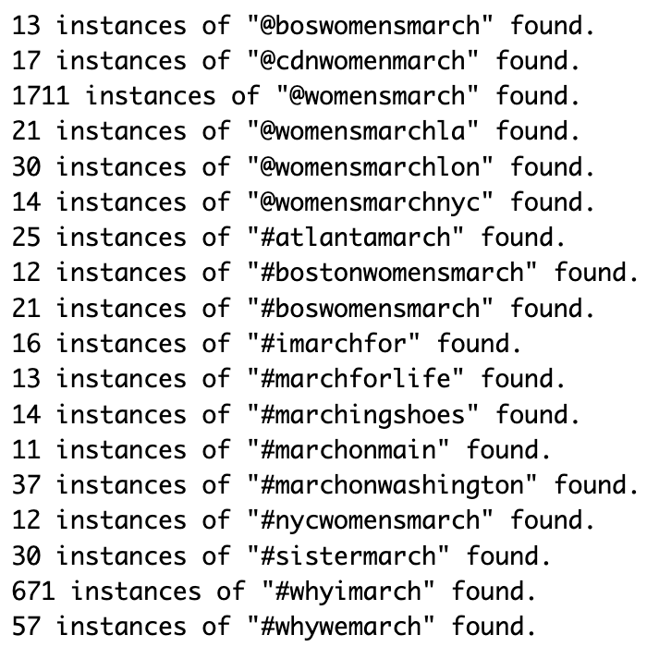
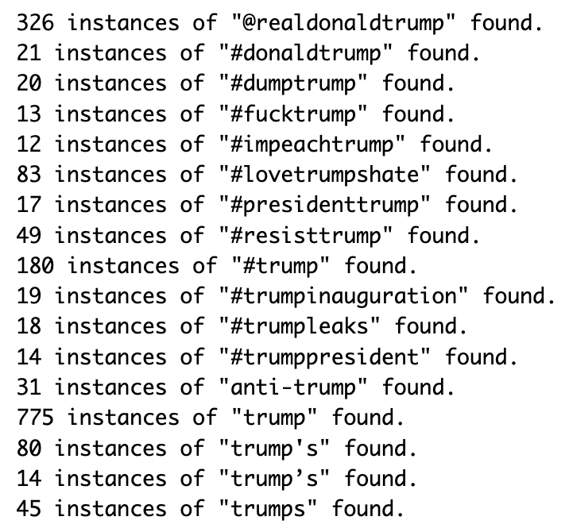
Appendix: why use patterns in ALC embeddings?
Pattern: *march*
Pattern: *trump*
There is no stemming in the preprocessing of ALC embeddings.
Therefore, using word patterns can capture more relevant concepts than relying on a single word

