Slide 1

Ezen Mall
By
천세은

Slide 2
상품매장
mallModal.jsp
로그인
주문
장바구니
loginForm.jsp
cartview.jsp
USER VIEW
확정
회원가입
주문이력
showHistory.jsp
Register….jsp
상세주문내역
detailorder.jsp

Slide 3
고객목록조회
customerListl.jsp
고객별주문이력
showHistoryBy….jsp
Admin VIEW
일단위고객별
일단위상품별
dailySales.jsp
inventory.jsp
주문이력
dailyByProduct
wholeSales.jsp
판매된 상품
inventory.jsp
inventory

Slide 4

Class Diagram
Customer
Customer
Customer DTO
String cId; String cName; String cPassword; String cEmail; String cTel;
public CustomerDTO() {} public CustomerDTO(String cId, String cName, String cPassword, String cEmail, String cTel) {} Get()/set()/toString()
Customer DAO
public static final int ID_PASSWORD_MATCH = 1; public static final int ID_DOES_NOT_EXIST = 2; public static final int PASSWORD_IS_WRONG = 3; public static final int DATABASE_ERROR = -1; Connection conn; PreparedStatement pstmt; ResultSet rs;
public int verifyIdPassword(int id, String password){} public String getLastId() {} public void addCustomer(CustomerDTO cDto) {} public CustomerDTO getOneCustomer(String cId) {} public ArrayList<CustomerDTO> getAllCustomers() {}

Slide 5
Class Diagram
Shopping
Shopping-product
Product DTO
String pId; String pName; String pUnitPrice; String pImgName; String pDescription;
Get()/Set()/toString()
SoldProduct
SoldProductDTO
String sOrderId; String sProductId; String sQuantity; String sProductName; String sUnitPrice;
Get()/Set()/toString() public int compareTo(SoldProductDTO spDto) {}
Product DAO
public static final int ARDUINO = 30001; public static final int SENSOR = 30011; public static final int ACTUATOR = 30021; public static final int PARTS = 30031; public static final int OSHW = 30041; Connection conn; PreparedStatement pstmt; ResultSet rs;
public ProductDTO getOneProduct(int pId) {} public ArrayList<ProductDTO> getProducts(int category) {} public ArrayList<ProductDTO> getAllProducts() {}

Slide 6
Class Diagram
Shopping
Order
OrderDTO
String oId; String oCustomerId; String oDate; String oPrice;
Get()/Set()/toString()
OrderDAO
Connection conn; PreparedStatement pstmt; ResultSet rs;
public boolean insertDetailOrders(TreeSet<SoldProductDTO> orderSet, String customerId) {} public void insertSoldProduct(int orderId, int productId, int quantity) {} public void insertOrder(int customerId, int price) {} public int sumDetailOrders(int orderId) {} public void updateOrders(int orderId, int price) {} public ArrayList<SoldProductDTO> getSoldProducts(String orderId) {} public ArrayList<DetailOrderDTO> getDetailOrders(String orderId) {} public OrderDTO getOneOrder(String orderId) {} public int getOrderIdByCustomerId(String customerId) {} public ArrayList<OrderDTO> getOrdersByCustomer(String customerId) {} public ArrayList<OrderDTO> getOrdersByDate(String date) {} public ArrayList<OrderDTO> getAllOrders() {}
DetailOrder
DetailOrderDTO
String dNumber; String dProductName; String dQuantity; String dUnitPrice; String dPrice;
Get()/Set()/toString()

Slide 7
Class Diagram
Admin
AdminDAO
Connection conn; PreparedStatement pstmt; ResultSet rs; ArrayList<InventoryDTO> iList = null;
public String prepareDownload() {} public String getTotalPrice(ArrayList<InventoryDTO> piList) {} public ArrayList<InventoryDTO> getInventoryByDate(String date) {} public ArrayList<InventoryDTO> getInventory() {} private void initInventory() {} private void updateInventory(String productId, int quantity) {} public int getTotalPage() {} public ArrayList<DailySalesDTO> getAllDailySales(int page) {} public String getDailyTotalPrice(ArrayList<DailySalesDTO> dsList) {} public ArrayList<DailySalesDTO> getDailySales(String date) {}
DailySalesDTO
String dDate; String dCustomerId; String dCustomerName; String dOrderId; String dPrice;
Get()/set()/toString()
InventoryDTO
String productId; String productName; String unitPrice; String quantity; String price;
Get()/set()/toString()
FileController
private static final long serialVersionUID = 1L;
public FileController() {} protected void doGet ...{} protected void doPost ...{}

Slide 8
Admin
항목 | 고객목록조회 | 고객별 주문이력 | 일단위(고객별) | 일단위(상품별) | 주문 이력 | 판매된 상품
Viewer | Index(top).jsp | customerList.jsp | Index(top).jsp | Index(top).jsp | Index(top).jsp | Index(top).jsp
Controller | adminControl.jsp
get | action | action id | action | action dateInventory | action page | action
Action | listCustomer | dailyByCustomer | dailySales | dailyByProduct | wholeSales | inventory
처리 후 화면 | customerList.jsp | showHistoryByCustomer.jsp | dailySales.jsp | inventory.jsp | wholeSales.jsp | inventory.jsp
Attribute |  | →showHistoryByCustomer.jsp “Order”, DTO

Slide 9
User
항목 | 로그인 | 로그아웃 | 회원가입
Viewer | loginForm.jsp | loginForm.jsp | registerCustomerForm.jsp
Controller | customerControl.jsp
get | action | action | action
Action | login | logout | register
post | Id password |  | cId cName cPassword cEmail cTel
처리 후 화면 | Index.jsp | Index.jsp | ＠→loginForm.jsp
session | cId, cName | cId, cName, OrderSet
＠: alertMsg.jsp, Attribute로 message, url

Slide 10
User
＠: alertMsg.jsp, Attribute로 message, url
항목 | 상품매장 | 주문버튼 | 장바구니 | 확정버튼 | 주문이력 | 상세주문내역
Viewer | Index(top).jsp | mallModal.jsp | Index(top).jsp | cartView.jsp | Index(top).jsp | showHistory.jsp
Controller | shoppingControl.jsp
get | action, category |  | action |  | action, | action, orderId
Action | view | buy | cartView | final | history | detail
post | pId pName quantity pUnitPrice
처리 후 화면 | mallModal.jsp | mallModal.jsp | cartView.jsp | @ → mallModal.jsp | showHistory.jsp | detailOrders.jsp
Attribute |  |  |  |  | → showHistory.jsp “Order”, DTO
session | cId | cId OrderSet | cId OrderSet | cId OrderSet | cId | cId

Slide 11
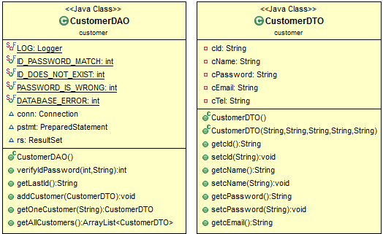
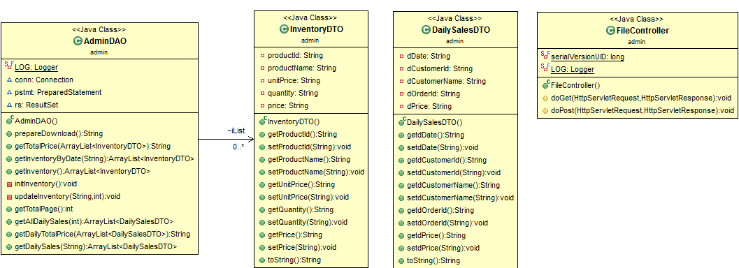

Slide 12
