Slide 1
Systematicity and Productivity. Language and Thought: Thought.
Systematicity. 3+4= 7. 4+3=7
Noam Chomsky ( 1957 to present day) famously argued that this kind of systematicity could not be learnt by association of input strings. The rules of composition need to be inferred and applied.
Productivity. (3+4)+(3+4)…. = 7x7… Rules allow construction of complex representational structures from simpler/basic. Assemble representational molecules from atoms.
The job of the mind is not to map string to string but to infer the rules/principles that Generate Strings
Classical computation is implementing this idea in a rules and symbols architecture.

Slide 2
Systematicity and Productivity. Language and Thought: Language
Language learning is inferring the fundamental rules for constructing sentences in a natural language
Since all children so this early and automatically those rules must be innately represented.
Trial and error, reinforcement learning, hypothetical induction cannot work
The evidence (linguistic input) underdetermines the data
Language acquisition is an innate specialized system that represents the basic rules for generating sentences

Slide 3
Representation in Neural Networks. incl. LLMs Abstract similarity space
Patterns of activation represent not symbolically but by similarity. Weight structure of a network produces similar patterns of activation for similar features, including abstract features. E.g. “noun” or “Auxiliary verb”. These properties are abstract, not represented in the stimulus string
Representation is distance in similarity space
Is holistic because the structure of similarity space represents to structure of target domain.
No discrete symbolic representations and rules.

Slide 4
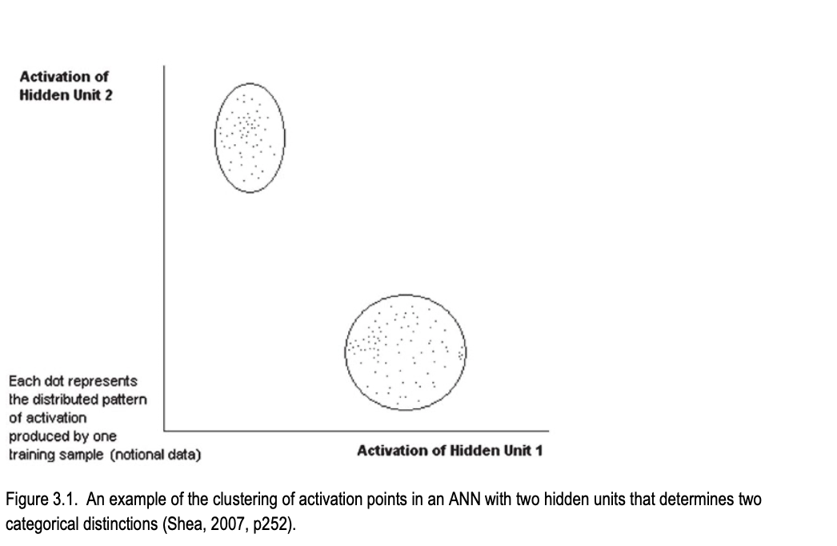
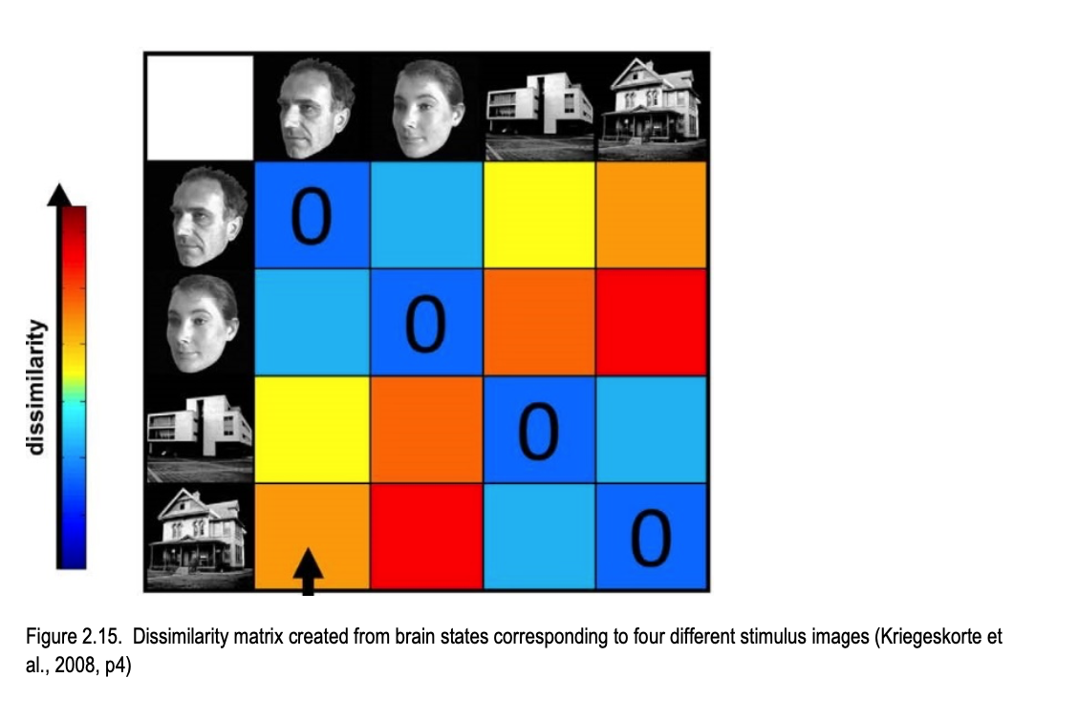
Similarity Space

Slide 5
Key themes in LLMs and language Strings or Trees. Is Chomsky wrong?
Generative rules of syntax must be innately specified. Poverty of Stimulus
(this makes some languages unlearnable for humans. Note such artificial languages are of course possible and can be learnt, but not by linguistic principles. Arbitrary rules could be learnt by domain general reasoning)
Syntax and semantics are distinct
Human language learning is is a modular capacity
Language processing cannot consist of processing word strings
According to probabilistic principles (trial and error induction)
Must use generative rules that manipulate symbols (arbitrary and discrete informational structures)
Language processing requires hierarchical tree structures

Slide 6
LLMs
Trained on massive data sets of sentences represented as strings
By gradient descent (approximating a loss function)
To predict the probable continuation or completion of a word string
Group lexical elements by similarity (probability of co-occurrence in a sentential context)
Construct feature maps or hierarchical similarity spaces
Don’t manipulate symbols according to rules
Syntax and semantics are not distinguished
World knowledge and linguistic knowledge are not distinguished.

Slide 7
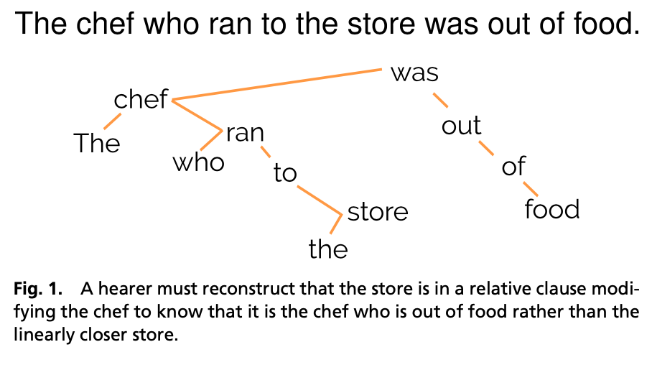
Tree structure

Slide 8
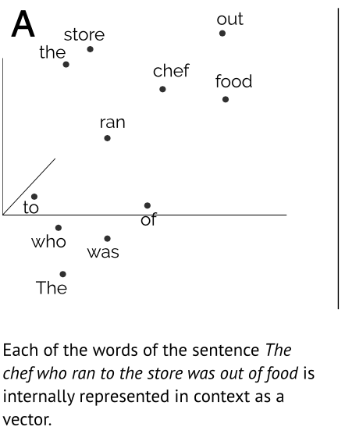
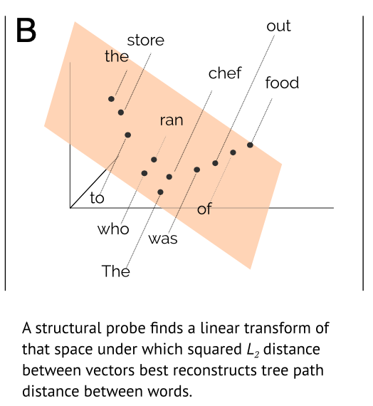
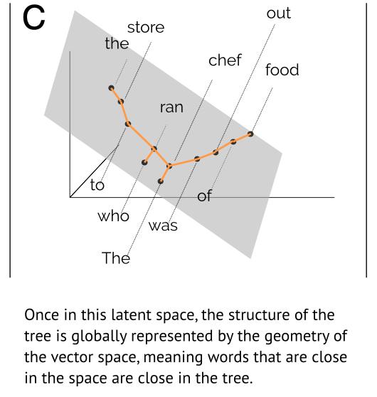
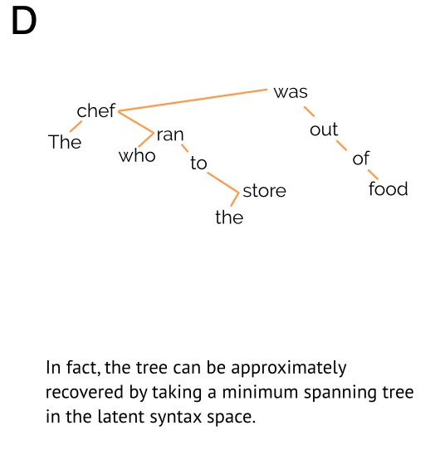
in LLMS feature space recapitulates syntactic structure

Slide 9
Emergence
None of these patterns of syntactic dependency are explicitly represented
They are emergent properties of the system after training
Statistical regularities that have to be uncovered by analytical techniques
In the same way as relationships between e.g. interest rates and house prices “emerge” in the economy
They can be modelled by economic theory to make predictions
But people don’t use those models and equations to set the price of their house. They just allocate their resources according to “local” incentives that in effect constitute the parameters of the economic system.

Slide 10
Against Chomsky. Piantadosi
LLMs integrate syntax and semantics Syntax in this approach is not supposed to be reducible to general statistics between words12—exactly the thing that large language models now provide"
Integrate world and linguistic knowledge
Probability a space of possible rules is implicitly encoded into the parameters of the model
Non symbolic and continuous cognitive processes are seen as graded, probabilistic, interactive, context-sensitive and domain-general… discreteness is a special case of continuous modeling, meaning that theories which work with continuous representations get the best of both worlds, fitting discrete patterns when appropriate and gradient ones otherwise.
Non Modular LLMS function somewhat like automated scientists or automated linguists, who also work over relatively unrestricted spaces, searching to find theories which do the best job of parsimoniously predicting observed data. It’s worth thinking about the standard lines of questioning generative syntax has pursued—things like, why don’t kids ever say “The dog is believed’s owners to be hungry” or “The dog is believed is hungry” (see Lasnik & Lidz 2016). The answer provided by large language models is that these are not permitted under the best theory the model finds to explain what it does see. Innate constraints are not needed.

Slide 11
Against Chomsky. Piantadosi
Language and Thought dissociate the models know so much syntax, and aspects of semantics, but it is not hard to trip them up with appropriate logical reasoning tasks. Thus, large language models provide a proof of principle that syntax can exist and likely be acquired separately from other more robust forms of thinking and reasoning. ….Models therefore show a logically possible dissociation between language and thinking. But a considerable amount of neuropsychological evidence supports the idea that language and thought are actually separate in people as well.
Poverty of Stimulus/Abundance of Data For language specifically, what needs to be built in innately to explain the typology will interact in rich and complex ways with what can be learned, and what other pressures (e.g. communicative, social) shape the form of language. If we see a pattern and assume it is innate from the start, we may never discover these other forces because we will, mis-takenly, think innateness explained everything.
It is not true that large hypothesis spaces always require huge amounts of data, in part because data points can be very informative: each single bit of information in the data can cut the space of likely hypotheses in half. In other words one important correction can ramify through the system resetting all the relevant weights
AI companies use as much data as they can find because it seems to help models on the rich kinds of tasks that they want to solve, often involving reasoning and complex discourse or conversation. But if we were only concerned with capturing syntax, it may be that much less data is required.

Slide 12
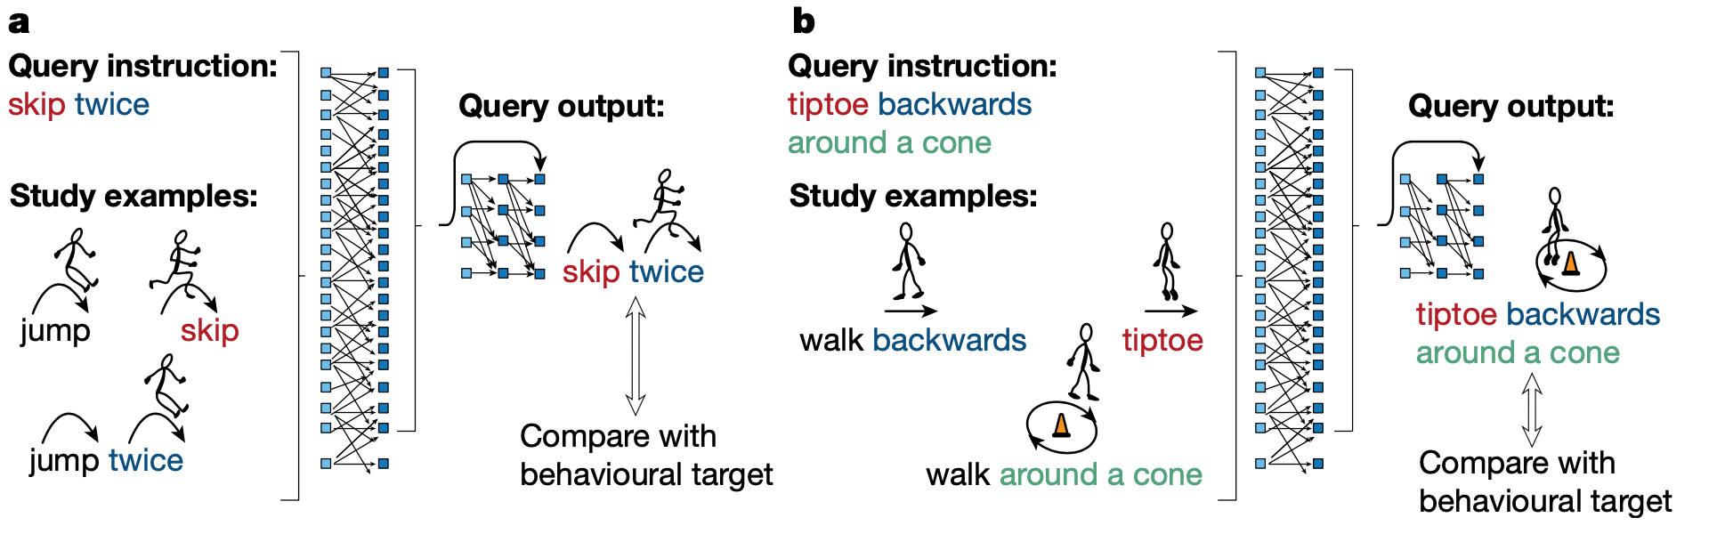
Compositionality (i)
https://doi.org/10.1038/s41586-023-06668-3

Slide 13
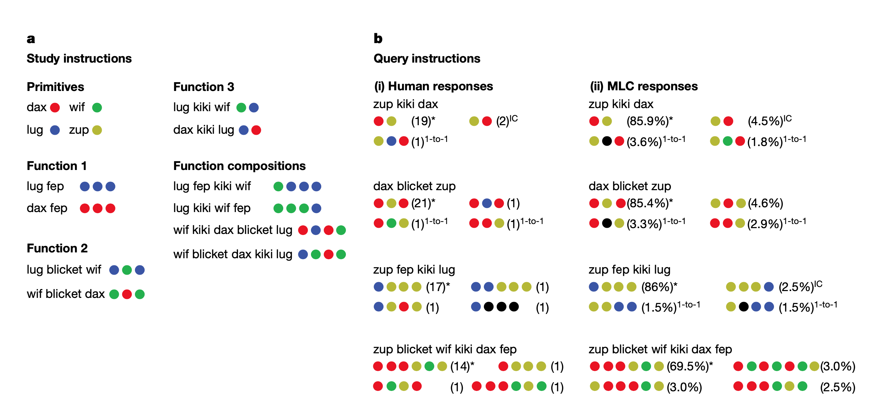
Compositionality (ii)
https://doi.org/10.1038/s41586-023-06668-3

Slide 14
Compositionality (ii)
Answers are
Algebraic
1-1
Iconic Concatenaction
https://doi.org/10.1038/s41586-023-06668-3

Slide 15
Last Frontier: Centre embedding
the mouse that the cat that the dog painted taught sang. As an exercise make a tree structure that makes this intelligible!

