Slide 1
Smart Obstacle
Narrator
Webcam-based assistive vision prototype
B.Tech Computer Science project
Implementation and evaluation status
Notes:
Experimental prototype. It does not replace mobility aids. Team names and college details can be added before submission.

Slide 2
The problem
A camera can detect many objects in one scene.
Speaking every detection creates repetition and delay.
Useful warnings need relevance, timing and honest uncertainty.
Notes:
This project evaluates concise obstacle narration. It does not claim safe autonomous navigation.

Slide 3
V1 scope
Eight target classes with deterministic warning templates
Camera-relative left, ahead and right
Conditional distance with a known-height reference
Offline speech and a local desktop interface
Notes:
No LLM, SLAM, pose estimation or depth network is required.

Slide 4
System architecture
Capture keeps the latest frame available.
YOLO supplies classes and original-frame bounding boxes.
Geometry and temporal state rank eligible warnings.
A separate speech worker speaks fresh events.
Notes:
See docs/ARCHITECTURE.md for the module interfaces. Capturing and speech do not block the main processing loop.

Slide 5
Detection modes
Synthetic demo exercises the software with generated boxes.
The bundled COCO baseline supports four project classes.
Custom training adds stairs, poles, barriers and doors.
Notes:
The pretrained baseline maps person, chair, bicycle and car/motorcycle/bus/truck. Source: https://docs.ultralytics.com/models/yolo11/ and https://docs.ultralytics.com/datasets/detect/coco/

Slide 6
Dataset plan
Target 2,500–4,000 distinct images, including negatives.
Collect local scenes across devices, lighting and viewpoints.
Split complete scene groups before augmentation.
Review labels and near-duplicate candidates.
Notes:
These are collection targets, not guaranteed data sufficiency. Dataset tooling checks normalized labels, hashes, group leakage and split coverage. No real custom dataset was supplied.

Slide 7
Training and model releases
Notebook 01 validates data and trains YOLO11n.
Checkpoints and run outputs persist in Google Drive.
Each release records classes, hashes and environment versions.
Notebook 02 loads that release in a fresh runtime.
Notes:
The checkpoint interruption/resume/export path passed a CPU synthetic execution test. A real Colab T4 run is pending. Source: https://docs.ultralytics.com/modes/train/

Slide 8
Distance and direction
Approximate depth follows Z = H × fy / h.
Unknown dimensions or calibration produce unknown distance.
Direction uses an unmirrored forward camera and box center.
Hysteresis reduces unstable boundary changes.
Notes:
Known-height geometry depends on object pose, visibility, true dimensions, camera identity and resolution. Source: https://docs.opencv.org/4.x/dc/dbb/tutorial_py_calibration.html

Slide 9
Warning policy
Confirm an observation before speaking.
Rank class importance, proximity and central overlap.
Suppress identical reminders with an eight-second cooldown.
Reannounce a stable direction change or closer distance band.
Notes:
Thresholds are configurable starting values and require evaluation. The score is a heuristic, not a collision probability.

Slide 10
Offline speech
One worker owns the speech engine.
One pending event prevents an accumulating backlog.
Freshness checks drop obsolete warnings before speech.
Driver callbacks record software speech-start timing.
Notes:
Windows audio has not been verified in the build environment. Driver-start latency is not acoustic-onset latency. Source: https://github.com/nateshmbhat/pyttsx3

Slide 11
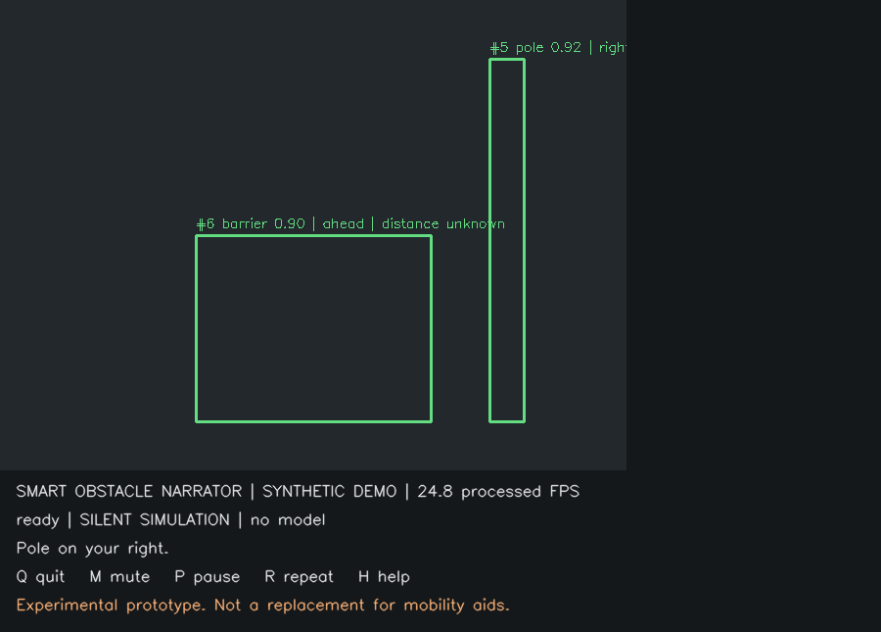
Application preview
Synthetic demonstration with generated boxes
Notes:
Screenshot of the executed synthetic demo. Boxes are generated fixtures, not detector predictions.

Slide 12
Verified software checks
50 automated tests passed.
The bundled YOLO detector completed a video smoke test.
A saved training checkpoint resumed and exported a release.
Both notebooks passed schema and Python-cell checks.
Notes:
See results/software_tests.xml and docs/VERIFICATION.md. Model training recovery used a tiny synthetic dataset solely for execution testing. These checks do not establish field accuracy.

Slide 13
Measurements still required
Train and evaluate the custom eight-class dataset.
Measure Windows webcam and audible warning latency.
Calibrate selected objects and report error plus coverage.
Run supervised field scenarios and a 15-minute soak test.
Notes:
Do not fill these results with software test counts or synthetic model metrics. The project report keeps these results pending.

Slide 14
Limitations and next steps
Missed detections and uncertain depth remain possible.
The system never declares a route safe.
The four-person team owns data collection and device evaluation.
The package includes source, notebooks, tests and documentation.
Notes:
Experimental assistive prototype. It does not replace a white cane, guide dog, human assistance or professional mobility aids.

