Slide 1

Super-X Case Study Sales
HWR Berlin
Data Warehousing
Ayreen Japutri, Gesara Halili, Dustin Schwarz, Elias Brummund

Slide 2
Content
Business Requirements & ME/R Diagram
Data Quality Analysis & ETL Process
Business Recommendations
Project Reflection

Slide 3
Business Requirements & ME/R Diagram
Building an environment to gather data for performance indicators.

Slide 4






Business Requirements & ME/R Diagram
Revenue & Sales
Products
Employees
Orders
Customers

Slide 5
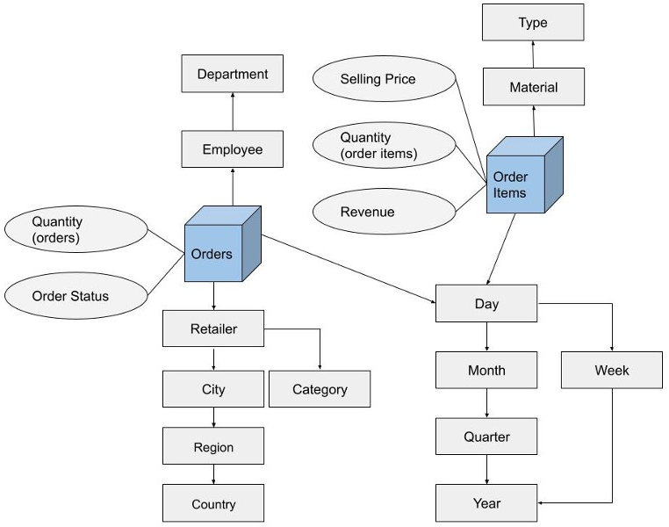
Business Requirements & ME/R Diagram
Slowly changing
dimension type 1
Slowly changing
dimension type 2
Slowly changing
dimension type 2

Slide 6
Data Quality Analysis & ETL Process
Analyzing quality of raw data and transforming it into the new data mart.

Slide 7




Data Quality Analysis & ETL Process
retailers
Overall structural
analysis
employees
Cross table
redundancy analysis
order items
Functional Dependency Analysis
orders
Matching Analysis
extra orders
event logs
Column Analysis

Slide 8

Data Quality Analysis & ETL Process
Name
Address
Category
Email Format
Retailers
Material name
Order name
No order id
Timestamp
Extra Orders
Order Items
Currency

Slide 9




Data Quality Analysis & ETL Process
Dimension tables transformation
superx_development
Extra orders transformation
Fact tables transformation
Jobs to load data
extra order files

Slide 10

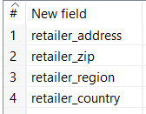
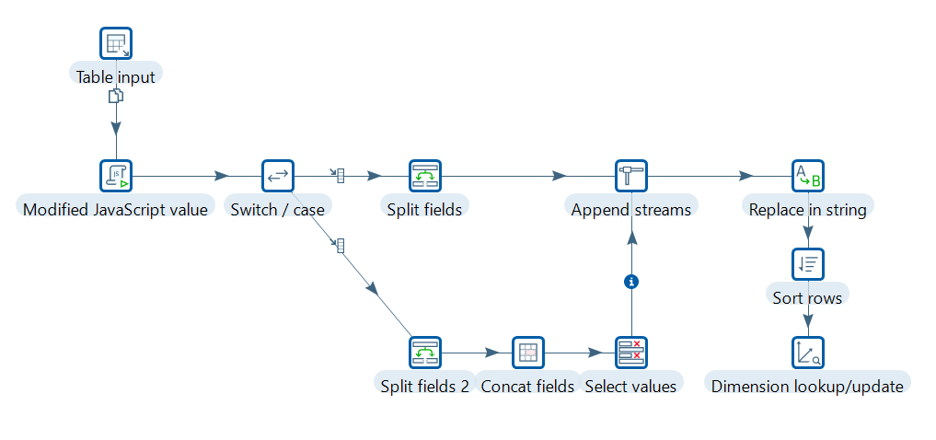
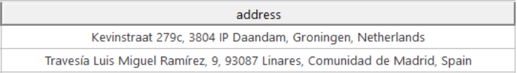
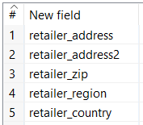
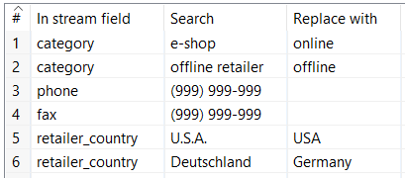
ETL Process – Retailer dimension
Retailer address
Retailer category

Slide 11
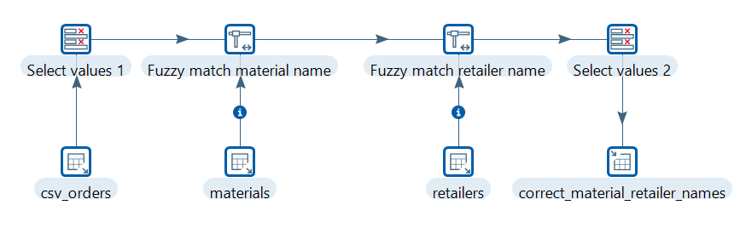
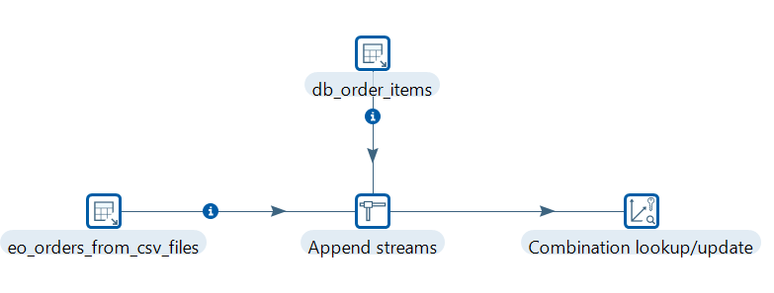
ETL Process – Extra Order
Retailer name
Material name
Order id

Slide 12
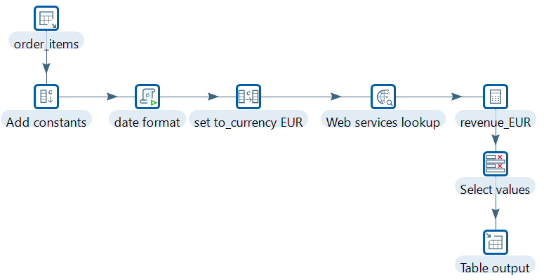
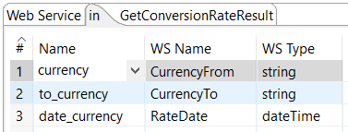
ETL Process – Fact Order Items
Revenue calculation
Current currency rate

Slide 13
Findings and Recommendations
Identifying business recommendations based on process mining and KPIs.

Slide 14
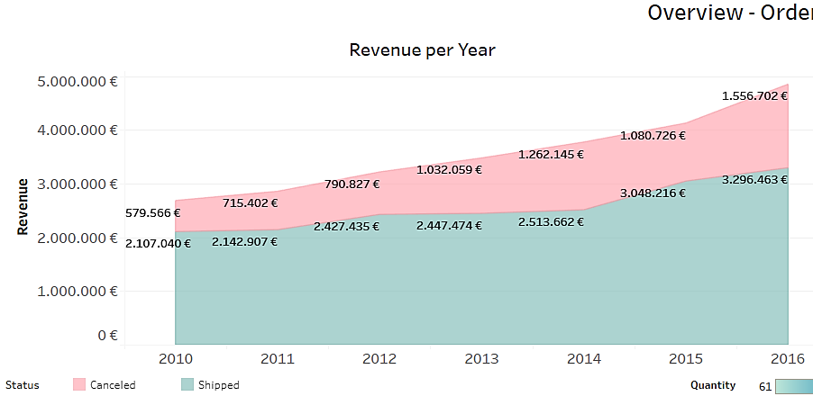
Findings and Recommendations
8% annual growth rate
More revenue generated by their own products than OEM products
Increase in cancellation rate

Slide 15
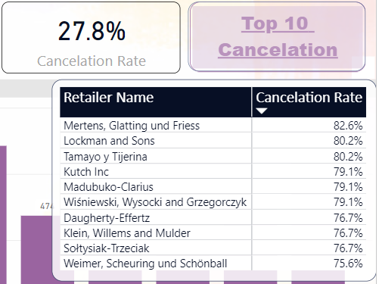
Findings and Recommendations
27.8% overall cancellation rate
High cancellation rate per retailer
Eliminate cancellation rate reasons

Slide 16
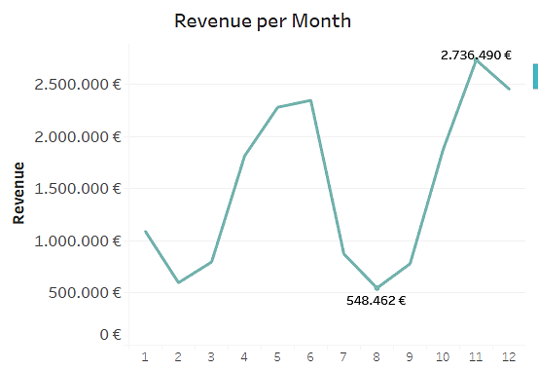
Findings and Recommendations
The existence of low and high seasons
The most revenue made in November
The least revenue made in February and August
Hire contract workers for high seasons

Slide 17
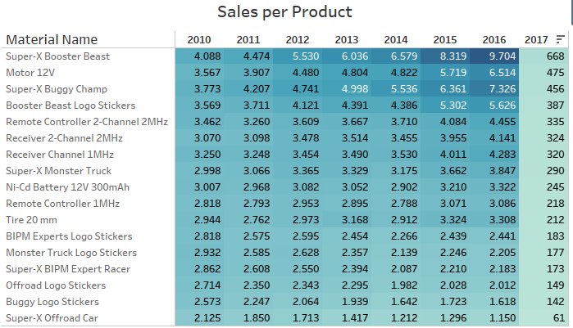
Findings and Recommendations
More quantity sold out from OEM products than their own products
Two main products whose sales are constantly dropping
Reconsider the products whose sales are decreasing

Slide 18






Findings and Recommendations
Takes 22.5 days
Is done 8,108 times
Orders vs. forecast
Automation
Takes 12.3 days
Is done 86 times
Financial Calculations
Database
Takes 6.2 days
Is done 1,761 times
Reminder Calls
Mass Mail

Slide 19

Findings and Recommendations
In 100% of the cases production could not meet the demands!

Slide 20
Project Reflection
Our thoughts about the project.

Slide 21

Project Reflection
Granularity of fact tables
Data quality of extra csv files
Calculating revenue with different exchange rates
Teamwork made the dream work
Tableau vs. Power BI
Finding a case ID for process mining
1
2
3
4
5
6

