Slide 1
ACADEMIC PRESENTATION
SYN CARDIO AKI SHADOW VALIDATION
复杂合成医学科研材料的可追溯影子验证；不代表真实临床研究或真实世界验证。
research_report · 18 min
Notes:
State scope and that all reported content is source-bound. [Slide-ID] SLD-8EF87E789A485E3F8EB6 [Slide-Revision] 1 [Content-Hash] f41e91ab22f4e8c144a0f19393c05f6f78f11c468c7e64faea20df9e9f633816 [Claims] - NONE [Wording-Boundary] Preserve source wording and uncertainty. [Sources] - SRC-01-patient-level-synthet-44fed4fb8cd3 - SRC-02-cohort-summary-1dbb58326345 - SRC-03-model-results-60094a3fa178 - SRC-04-sensitivity-results-5ccfe8975248 - SRC-05-subgroup-results-2615cf06f550 - SRC-06-missingness-52d547971cf7 - SRC-07-data-dictionary-651b51eed07b - SRC-08-frozen-analysis-workb-7c9d8fa9a6d0 - SRC-01-main-manuscript-synth-95e4fa25aff0 - SRC-02-protocol-synopsis-syn-00480991443d - SRC-03-supplementary-methods-91c0cedcb895 - SRC-figure-1-cohort-flow-768a1278488a - SRC-figure-2-primary-forest-64b705494c45 - SRC-figure-3-creatinine-traj-a6ac74f7bbf8 - SRC-figure-4-missingness-f10f6562518f - SRC-figure-5-sensitivity-1ccb24ef4f17 - SRC-figure-5-sensitivity-7703f707fec0 - SRC-reference-status-ca4e36a12f8d - SRC-selected-references-9ba20483f340

Slide 2
输入材料界定本次汇报的证据边界
已登记 19 个科研来源文件并保留 SHA-256 溯源。
01
01_patient_level_synthetic.csv
CSV · SRC-01-patient-level-synthet-44fed4fb8cd3
02
02_cohort_summary.csv
CSV · SRC-02-cohort-summary-1dbb58326345
03
03_model_results.csv
CSV · SRC-03-model-results-60094a3fa178
04
04_sensitivity_results.csv
CSV · SRC-04-sensitivity-results-5ccfe8975248
05
05_subgroup_results.csv
CSV · SRC-05-subgroup-results-2615cf06f550
Sources: SRC-01-patient-level-synthet-44fed4fb8cd3, SRC-02-cohort-summary-1dbb58326345, SRC-03-model-results-60094a3fa178, SRC-04-sensitivity-results-5ccfe8975248, SRC-05-subgroup-results-2615cf06f550, SRC-06-missingness-52d547971cf7, SRC-07-data-dictionary-651b51eed07b, SRC-08-frozen-analysis-workb-7c9d8fa9a6d0, SRC-01-main-manuscript-synth-95e4fa25aff0, SRC-02-protocol-synopsis-syn-00480991443d, SRC-03-supplementary-methods-91c0cedcb895, SRC-figure-1-cohort-flow-768a1278488a, SRC-figure-2-primary-forest-64b705494c45, SRC-figure-3-creatinine-traj-a6ac74f7bbf8, SRC-figure-4-missingness-f10f6562518f, SRC-figure-5-sensitivity-1ccb24ef4f17, SRC-figure-5-sensitivity-7703f707fec0, SRC-reference-status-ca4e36a12f8d, SRC-selected-references-9ba20483f340
06
06_missingness.csv
CSV · SRC-06-missingness-52d547971cf7
2
Notes:
Explain that unprovided information is not inferred. [Slide-ID] SLD-A9E00233DA0B5C5BBEB4 [Slide-Revision] 1 [Content-Hash] cc53f634b695baa22c5348944b70becdc8809595513c368944ebcf474918d0bd [Claims] - NONE [Wording-Boundary] Preserve source wording and uncertainty. [Sources] - SRC-01-patient-level-synthet-44fed4fb8cd3 - SRC-02-cohort-summary-1dbb58326345 - SRC-03-model-results-60094a3fa178 - SRC-04-sensitivity-results-5ccfe8975248 - SRC-05-subgroup-results-2615cf06f550 - SRC-06-missingness-52d547971cf7 - SRC-07-data-dictionary-651b51eed07b - SRC-08-frozen-analysis-workb-7c9d8fa9a6d0 - SRC-01-main-manuscript-synth-95e4fa25aff0 - SRC-02-protocol-synopsis-syn-00480991443d - SRC-03-supplementary-methods-91c0cedcb895 - SRC-figure-1-cohort-flow-768a1278488a - SRC-figure-2-primary-forest-64b705494c45 - SRC-figure-3-creatinine-traj-a6ac74f7bbf8 - SRC-figure-4-missingness-f10f6562518f - SRC-figure-5-sensitivity-1ccb24ef4f17 - SRC-figure-5-sensitivity-7703f707fec0 - SRC-reference-status-ca4e36a12f8d - SRC-selected-references-9ba20483f340

Slide 3
本次分析聚焦心室表型与随后 AKI 进展的关联
该完全合成观察性队列用于评估入组后 24 小时心室功能表型与随后 72 小时 AKI 进展的关联，不代表真实临床证据。
Editable chart · unit: percent · sample size: not provided
Sources: SRC-01-main-manuscript-synth-95e4fa25aff0
3
Notes:
Source: extracted line 5. Avoid: 仅可表述为合成观察性关联；不得表述为真实患者研究或因果效应。 [Slide-ID] SLD-4ABCCA3C794D54E8A2D7 [Slide-Revision] 1 [Content-Hash] b8f1ec5563015c8b43a8f6ce37d72714c76bd37bb55a9d25c8f65711416ab20c [Claims] - SHD-001 [Wording-Boundary] 仅可表述为合成观察性关联；不得表述为真实患者研究或因果效应。 [Sources] - SRC-01-main-manuscript-synth-95e4fa25aff0

Slide 4
Landmark 设计将暴露定义置于结局观察之前
研究采用 landmark 框架：在入组后 24 小时定义暴露，并观察其后 72 小时 AKI 进展。
Sources: SRC-02-protocol-synopsis-syn-00480991443d
4
Notes:
Source: extracted line 4. Avoid: 不得补充输入未提供的真实数据库、伦理审批或外部验证信息。 [Slide-ID] SLD-5C85C33891BD51B6B8A0 [Slide-Revision] 1 [Content-Hash] 0f54e0fdf472b8a729150132bb528abc7f9f5cd01a2a2f781c40abd93bde950a [Claims] - SHD-002 [Wording-Boundary] 不得补充输入未提供的真实数据库、伦理审批或外部验证信息。 [Sources] - SRC-02-protocol-synopsis-syn-00480991443d

Slide 5
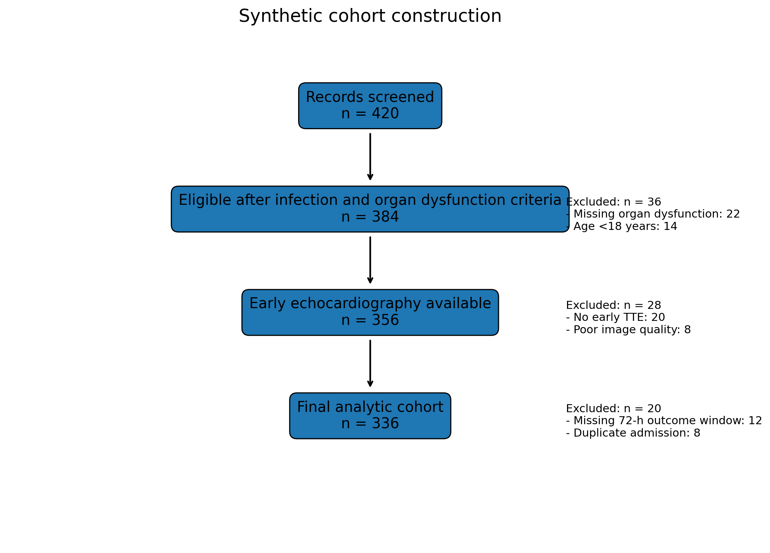
队列流程明确区分纳入、排除与最终分析人群
队列流程图展示完全合成样本的纳入、排除与最终分析人群。
Sources: SRC-figure-1-cohort-flow-768a1278488a
5
Notes:
Source: figures/figure_1_cohort_flow.png. Avoid: 流程图仅用于合成技术验证；不得解释为真实患者招募。 [Slide-ID] SLD-8018D568EBF75F53BBD9 [Slide-Revision] 1 [Content-Hash] add2161ce9c08b0b48c66b5f0312fcaa7b4f113d461fd9febd043d5eced3d600 [Claims] - SHD-003 [Wording-Boundary] 流程图仅用于合成技术验证；不得解释为真实患者招募。 [Sources] - SRC-figure-1-cohort-flow-768a1278488a

Slide 6
四类互斥心室表型构成主要暴露框架
24 小时时点的心室功能按无功能障碍、单纯 LV、单纯 RV 和双心室功能障碍四类互斥表型登记。
Sources: SRC-01-main-manuscript-synth-95e4fa25aff0
6
Notes:
Source: extracted line 56. Avoid: 不得把分类梯度解释为因果剂量反应。 [Slide-ID] SLD-5FA02A0DB7905F6592A6 [Slide-Revision] 1 [Content-Hash] b39c10443bd288de7147d46e2f0d7b246041dacf779922850d651010f242d6dc [Claims] - SHD-004 [Wording-Boundary] 不得把分类梯度解释为因果剂量反应。 [Sources] - SRC-01-main-manuscript-synth-95e4fa25aff0

Slide 7
双心室组的合成 AKI 进展发生率最高
AKI 进展发生率依次为 38/148（25.7%）、27/76（35.5%）、24/54（44.4%）和 34/58（58.6%）。
Sources: SRC-02-cohort-summary-1dbb58326345
7
Notes:
Source: data/02_cohort_summary.csv: all phenotype rows. Avoid: 只报告描述性发生率；不得表述为因果梯度。 [Slide-ID] SLD-56566EBFE1825B90B959 [Slide-Revision] 1 [Content-Hash] 24d80433946ea2f5790ec8f4463e1e1d23c502eb30605b97a8c290c15e98a1a7 [Claims] - SHD-005 [Wording-Boundary] 只报告描述性发生率；不得表述为因果梯度。 [Sources] - SRC-02-cohort-summary-1dbb58326345

Slide 8
单纯 LV 的估计方向为正，但不确定性仍跨越无效值
与无心室功能障碍相比，单纯 LV 的调整 OR 为 1.42（95% CI 0.78–2.59，P=0.247）；区间跨越 1。
Sources: SRC-03-model-results-60094a3fa178
8
Notes:
Source: data/03_model_results.csv: claim_id=CLM-001. Avoid: 不得称为统计学显著、明确阳性或独立因果效应。 [Slide-ID] SLD-C189C2D15E9D5599B044 [Slide-Revision] 1 [Content-Hash] ce56b31d3e4c5286c0ffeb583cfe0b484bb8e700d13bce4a6bd9131b703db515 [Claims] - SHD-006 [Wording-Boundary] 不得称为统计学显著、明确阳性或独立因果效应。 [Sources] - SRC-03-model-results-60094a3fa178

Slide 9
单纯 RV 与更高 AKI 进展 odds 存在统计关联
与无心室功能障碍相比，单纯 RV 与更高 AKI 进展 odds 相关：调整 OR 2.06（95% CI 1.05–4.03，P=0.036）。
Sources: SRC-03-model-results-60094a3fa178
9
Notes:
Source: data/03_model_results.csv: claim_id=CLM-002. Avoid: 不得表述为 RV 功能障碍导致 AKI。 [Slide-ID] SLD-D5B59FFA31B4585E943B [Slide-Revision] 1 [Content-Hash] fde9a9d322da95a40b63d448c551ecf36ef931b2348faeabbf709e860b07fcac [Claims] - SHD-007 [Wording-Boundary] 不得表述为 RV 功能障碍导致 AKI。 [Sources] - SRC-03-model-results-60094a3fa178

Slide 10
双心室功能障碍显示四组中最强的合成统计关联
双心室功能障碍在四组中显示最强关联：调整 OR 3.61（95% CI 1.91–6.84，P=0.0001）。
Sources: SRC-03-model-results-60094a3fa178
10
Notes:
Source: data/03_model_results.csv: claim_id=CLM-003. Avoid: 不得表述为剂量反应因果关系、机制证明或临床验证。 [Slide-ID] SLD-16F80628E010516E80BC [Slide-Revision] 1 [Content-Hash] 7075475402f948c412d33a263555ca8f85504b58edc628bd3b740bc7734af02c [Claims] - SHD-008 [Wording-Boundary] 不得表述为剂量反应因果关系、机制证明或临床验证。 [Sources] - SRC-03-model-results-60094a3fa178

Slide 11
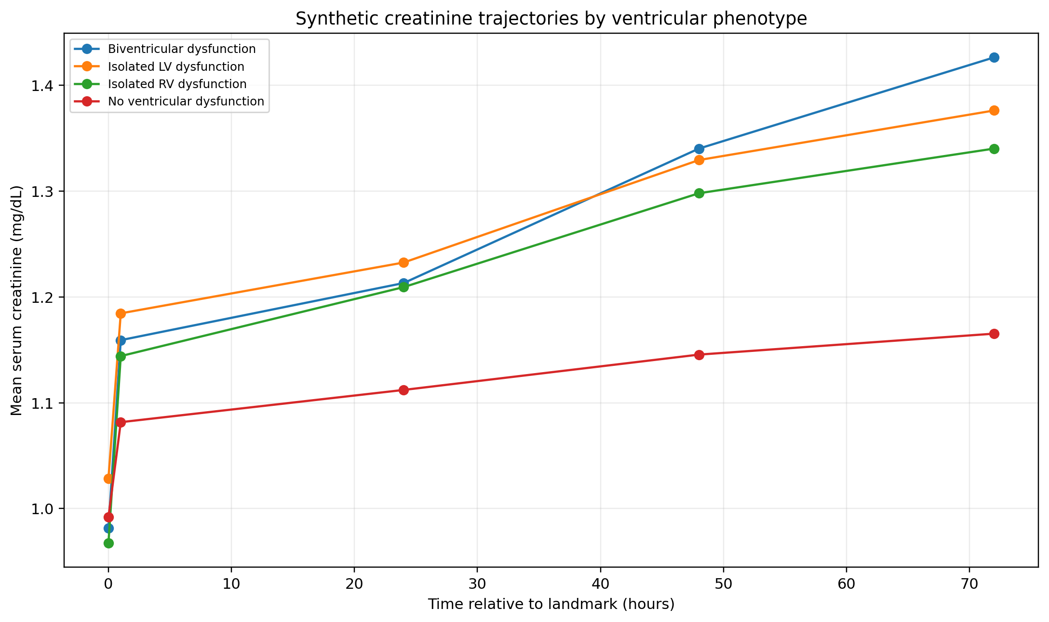
肌酐轨迹提供描述性时间变化信息
肌酐轨迹仅描述各合成表型组随时间的变化，不用于推断治疗效果。
Sources: SRC-figure-3-creatinine-traj-a6ac74f7bbf8
11
Notes:
Source: figures/figure_3_creatinine_trajectory.png. Avoid: 不得解释为治疗导致的改善或恶化。 [Slide-ID] SLD-EDBE6B706AA0576EB52B [Slide-Revision] 1 [Content-Hash] 890cd7a868482c401f5cc26fd73147a678a65bbd1e86b8fa47feeb4cf2678743 [Claims] - SHD-009 [Wording-Boundary] 不得解释为治疗导致的改善或恶化。 [Sources] - SRC-figure-3-creatinine-traj-a6ac74f7bbf8

Slide 12
双心室表型与合成 28 天死亡 odds 较高相关
双心室功能障碍与 28 天死亡的更高 odds 相关：调整 OR 2.18（95% CI 1.12–4.25，P=0.022）。
Sources: SRC-03-model-results-60094a3fa178
12
Notes:
Source: data/03_model_results.csv: claim_id=CLM-004. Avoid: 不得表述为真实临床死亡风险、因果效应或临床工具。 [Slide-ID] SLD-EE6EC72C1491573D8907 [Slide-Revision] 1 [Content-Hash] 1930a6c240cb207f07e83ff39063c204f0fb4e5c9a8efd27d2daea526b59f60a [Claims] - SHD-010 [Wording-Boundary] 不得表述为真实临床死亡风险、因果效应或临床工具。 [Sources] - SRC-03-model-results-60094a3fa178

Slide 13
敏感性分析的关联方向与主分析一致
四项敏感性分析的双心室调整 OR 为 3.54, 3.61, 3.27, 3.42，方向与主分析一致。
Sources: SRC-04-sensitivity-results-5ccfe8975248
13
Notes:
Source: data/04_sensitivity_results.csv: all rows. Avoid: 一致性不等于消除偏倚、证明稳健因果效应或临床有效性。 [Slide-ID] SLD-3F0AD88B772E5C7FA7E0 [Slide-Revision] 1 [Content-Hash] 7b732dfa2a9e8f2db26b6aaba705dfbcb824458f00b5785aa354b422591088f3 [Claims] - SHD-011 [Wording-Boundary] 一致性不等于消除偏倚、证明稳健因果效应或临床有效性。 [Sources] - SRC-04-sensitivity-results-5ccfe8975248

Slide 14
预设亚组未见异质性证据
所有预设亚组的 interaction P 均不支持异质性（最小 interaction P=0.41）。
Sources: SRC-05-subgroup-results-2615cf06f550
14
Notes:
Source: data/05_subgroup_results.csv: all rows. Avoid: 不得依据单个亚组点估计声称 effect modification。 [Slide-ID] SLD-7824DF78880858128303 [Slide-Revision] 1 [Content-Hash] 454f791816e2383e0167e4d4f3527bee7884af4afcfd6ee0b3751f76bc221243 [Claims] - SHD-012 [Wording-Boundary] 不得依据单个亚组点估计声称 effect modification。 [Sources] - SRC-05-subgroup-results-2615cf06f550

Slide 15
BNP 缺失超过 20%，未进入主调整模型
BNP 缺失 81 例（24.1%），超过 20%，因此未进入冻结的主调整模型变量列表。
Sources: SRC-06-missingness-52d547971cf7
15
Notes:
Source: data/06_missingness.csv: variable=bnp_pg_mL. Avoid: 不得声称插补消除了缺失偏倚、缺失不影响结果或 BNP 可安全纳入主模型。 [Slide-ID] SLD-700E716D00235B2E82ED [Slide-Revision] 1 [Content-Hash] 71e428bbe1cb0355d743035292457a1f590337271eaece4c7cf492453994e51e [Claims] - SHD-013 [Wording-Boundary] 不得声称插补消除了缺失偏倚、缺失不影响结果或 BNP 可安全纳入主模型。 [Sources] - SRC-06-missingness-52d547971cf7

Slide 16
冲突已按 canonical source 解决，缺失信息仍保留待确认
跨文件审计检出 2 处数字冲突并按 canonical source 解决；[ETHICS_ID_REQUIRED]、[REF_PENDING_04] 仍为 INFORMATION_REQUIRED。
Sources: SRC-reference-status-ca4e36a12f8d
16
Notes:
Source: references/reference_status.md. Avoid: 不得虚构伦理编号、补造参考文献或静默删除 unresolved marker。 [Slide-ID] SLD-CAEFF30DBD495361B959 [Slide-Revision] 1 [Content-Hash] 1d2beac8e56207bf7a2d68589b2c8182620183d922b5e4fe1a9b787cb37aa424 [Claims] - SHD-014 [Wording-Boundary] 不得虚构伦理编号、补造参考文献或静默删除 unresolved marker。 [Sources] - SRC-reference-status-ca4e36a12f8d

Slide 17
所有解释均须保留原始证据强度
Allowed
Not allowed
Preserve the study design, uncertainty, and source wording.
Do not upgrade association or computational inference into causal, mechanistic, or clinical proof.
Sources: SRC-01-patient-level-synthet-44fed4fb8cd3, SRC-02-cohort-summary-1dbb58326345, SRC-03-model-results-60094a3fa178, SRC-04-sensitivity-results-5ccfe8975248, SRC-05-subgroup-results-2615cf06f550, SRC-06-missingness-52d547971cf7, SRC-07-data-dictionary-651b51eed07b, SRC-08-frozen-analysis-workb-7c9d8fa9a6d0, SRC-01-main-manuscript-synth-95e4fa25aff0, SRC-02-protocol-synopsis-syn-00480991443d, SRC-03-supplementary-methods-91c0cedcb895, SRC-figure-1-cohort-flow-768a1278488a, SRC-figure-2-primary-forest-64b705494c45, SRC-figure-3-creatinine-traj-a6ac74f7bbf8, SRC-figure-4-missingness-f10f6562518f, SRC-figure-5-sensitivity-1ccb24ef4f17, SRC-figure-5-sensitivity-7703f707fec0, SRC-reference-status-ca4e36a12f8d, SRC-selected-references-9ba20483f340
17
Notes:
Discuss limitations and uncertainty explicitly. [Slide-ID] SLD-C81119DA20855F38A3D6 [Slide-Revision] 1 [Content-Hash] 735c939338876f18512623f1976c3dcf3bf4625430e9d0294f58c38e0c658f43 [Claims] - NONE [Wording-Boundary] Preserve source wording and uncertainty. [Sources] - SRC-01-patient-level-synthet-44fed4fb8cd3 - SRC-02-cohort-summary-1dbb58326345 - SRC-03-model-results-60094a3fa178 - SRC-04-sensitivity-results-5ccfe8975248 - SRC-05-subgroup-results-2615cf06f550 - SRC-06-missingness-52d547971cf7 - SRC-07-data-dictionary-651b51eed07b - SRC-08-frozen-analysis-workb-7c9d8fa9a6d0 - SRC-01-main-manuscript-synth-95e4fa25aff0 - SRC-02-protocol-synopsis-syn-00480991443d - SRC-03-supplementary-methods-91c0cedcb895 - SRC-figure-1-cohort-flow-768a1278488a - SRC-figure-2-primary-forest-64b705494c45 - SRC-figure-3-creatinine-traj-a6ac74f7bbf8 - SRC-figure-4-missingness-f10f6562518f - SRC-figure-5-sensitivity-1ccb24ef4f17 - SRC-figure-5-sensitivity-7703f707fec0 - SRC-reference-status-ca4e36a12f8d - SRC-selected-references-9ba20483f340

Slide 18
人工科学审核是最终交付门槛
合成结果提示双心室表型与更高 AKI 进展 odds 的关联最强；全部结论仍需人工科学审核，且不能外推为真实临床证据。
Sources: SRC-01-main-manuscript-synth-95e4fa25aff0, SRC-02-protocol-synopsis-syn-00480991443d, SRC-figure-1-cohort-flow-768a1278488a, SRC-02-cohort-summary-1dbb58326345, SRC-03-model-results-60094a3fa178, SRC-figure-3-creatinine-traj-a6ac74f7bbf8, SRC-04-sensitivity-results-5ccfe8975248, SRC-05-subgroup-results-2615cf06f550, SRC-06-missingness-52d547971cf7, SRC-reference-status-ca4e36a12f8d
18
Notes:
Confirm every claim, number, citation, and omission before external use. [Slide-ID] SLD-3F9BB64F1ED7527A8F85 [Slide-Revision] 1 [Content-Hash] 735b1e75474e8023b90b2f2400a3ea1619838a2f4223a501a415a772113c1c5c [Claims] - NONE [Wording-Boundary] Preserve source wording and uncertainty. [Sources] - SRC-01-main-manuscript-synth-95e4fa25aff0 - SRC-02-protocol-synopsis-syn-00480991443d - SRC-figure-1-cohort-flow-768a1278488a - SRC-02-cohort-summary-1dbb58326345 - SRC-03-model-results-60094a3fa178 - SRC-figure-3-creatinine-traj-a6ac74f7bbf8 - SRC-04-sensitivity-results-5ccfe8975248 - SRC-05-subgroup-results-2615cf06f550 - SRC-06-missingness-52d547971cf7 - SRC-reference-status-ca4e36a12f8d

