Slide 1
Speeded Up Robust Features (SURF)
Herbert Bay, Andreas Ess, Tinne Tuytelaars, and Luc Vin Gool in 10 September 2008
Serhat Emre Cebeci
15667

Slide 2
Outlines
Introduction
What was proposed by CV feature extraction researchers?
What is the problem in feature extraction?
Paper Feature Extraction Proposal: SURF Method
Result
Conclusion and Future Work

Slide 3
Introduction
Finding image correspondence is important in CV application.
Interest points can be:
Corners,
Blobs
T-junctions
Authors stated that repeatability is the most important thing in interest point detector.
Repetability finding same interest points under different viewing conditions.

Slide 4
Introduction(Cont’d)
Next, neighborhood is represented in feature vector. Distinctive, Robust to noise, Robust to geometric and photometric deformations.
Interest Point Detection
Orientation Assignment
Descriptor Construction
Feature Matching

Slide 5
Interest Point Detection
Orientation Assignment
Descriptor Construction

Slide 6
Interest Point Detection
Calculation of Hessian Determinant
Non-max Suppression
Thresholding
Interpolation

Slide 7
Interest Point Detection
Calculation of Hessian Determinant
Non-max Suppression
Thresholding
Interpolation

Slide 8
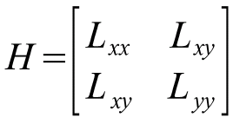
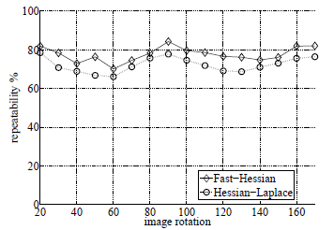
Hessian Determinant
Hessian-based is more stable and repeatable than Harris-based determinant.
SURF constructs Hessian determinant layers with different scales.
Lxx, Lxy, Lyy: LoG of image using second derivative of Gaussian

Slide 9
Construction of Hessian Det. Layers
Hessian determinant is taken with different octave and scale level.
4 octaves and 4 scale levels are used
Aim: To localize interest point.
Iterative solution is computationally exhaustive!!!
How can this method be faster and robust at the same time?

Slide 10
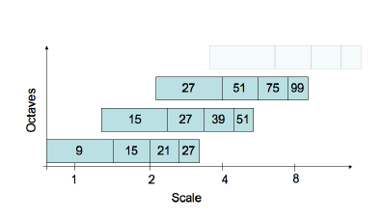
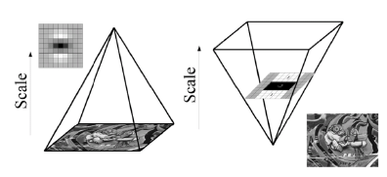
.
Lowe proposed DoG rather than LoG.
Authors approximate LoG by box filters,
computationally efficient
Hessian Approximation using box filters:
detH_app = DxxDyy – (0.9Dxy)^2 where Dxx,Dyy, Dxy is the box filter approximation of LoG
σ = 0.4L where L = 2^{oct} *s +1
Size of filter = 3L
Notes:
Oct = octave number
S = scale level in octave

Slide 11
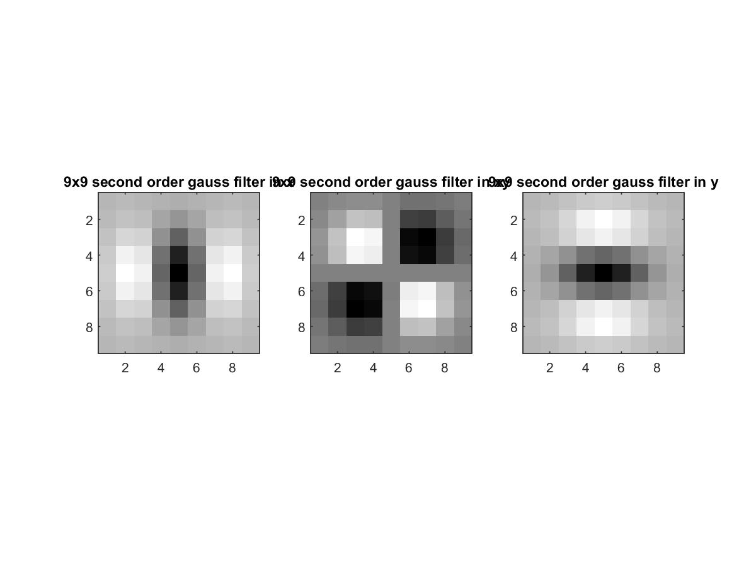

Slide 12
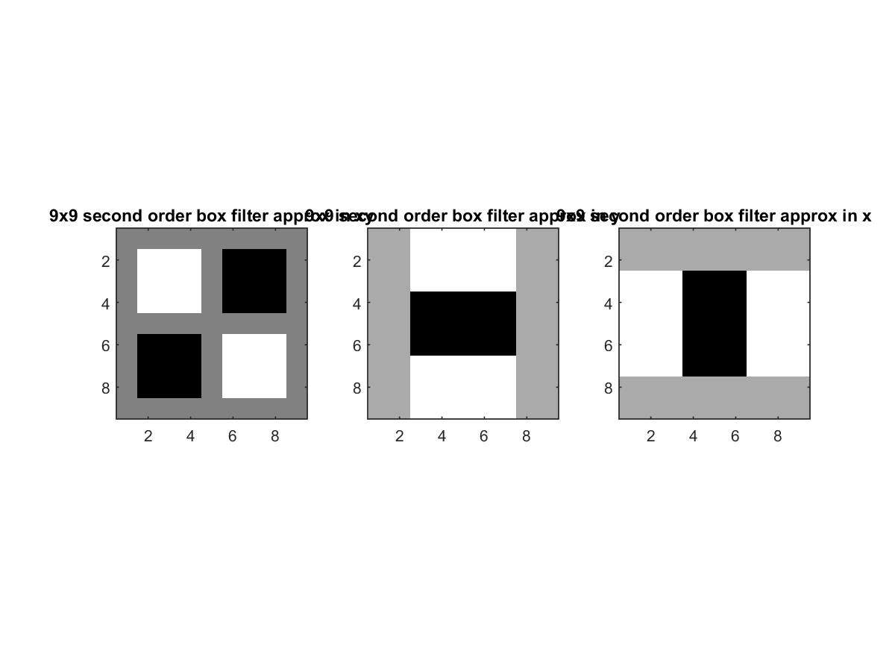

Slide 13

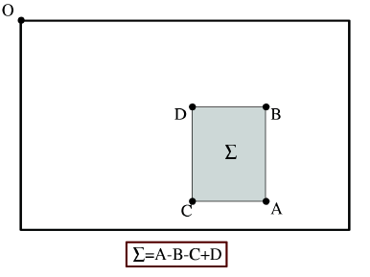
Integral Images and Box Filters
Summation of all intensity values within rectangular region from top-left point to specified point.
Why They chose integral image?
To decrease computation time, by getting rid of multiplication.
3 addition operation is needed.

Slide 14
Interest Point Detection
Calculation of Hessian Determinant
Non-max Suppression
Thresholding
Interpolation

Slide 15
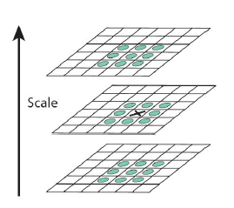
Interest Point Filtering
Thresholding:
Simple eliminating method by removing the values under threshold value.
I used 0.001, but, still it removes so many points.
Non-max suppression:
Non-max suppression in x-y-scale direction.

Slide 16
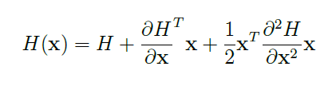

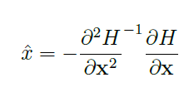
Interpolation
Point Interpolation:
It is for sub-pixel accuracy
Taylor expansion of Hessian determinant for detecting offset from pixel point.
Here, I took x is 0.
Derivatives are calculated by taking difference of Hessian.

Slide 17
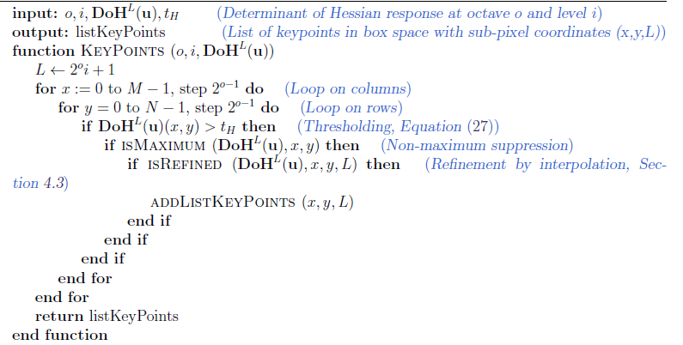

Slide 18
Feature Filtering
There are 3 step here.
Thresholding
3x3x3 non-max suppression
Interpolation of interest point. (this step was skipped in my implementation).
3x3x3 non-max suppression is checking its neighbors’ values in x – y direction and scale level direction.

Slide 19
Interest Point Detection
Orientation Assignment
Descriptor Construction

Slide 20
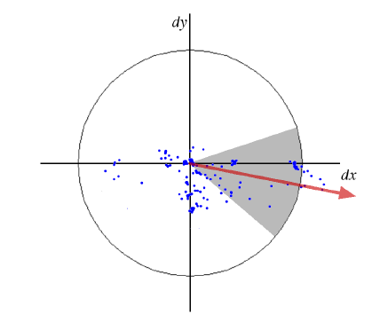
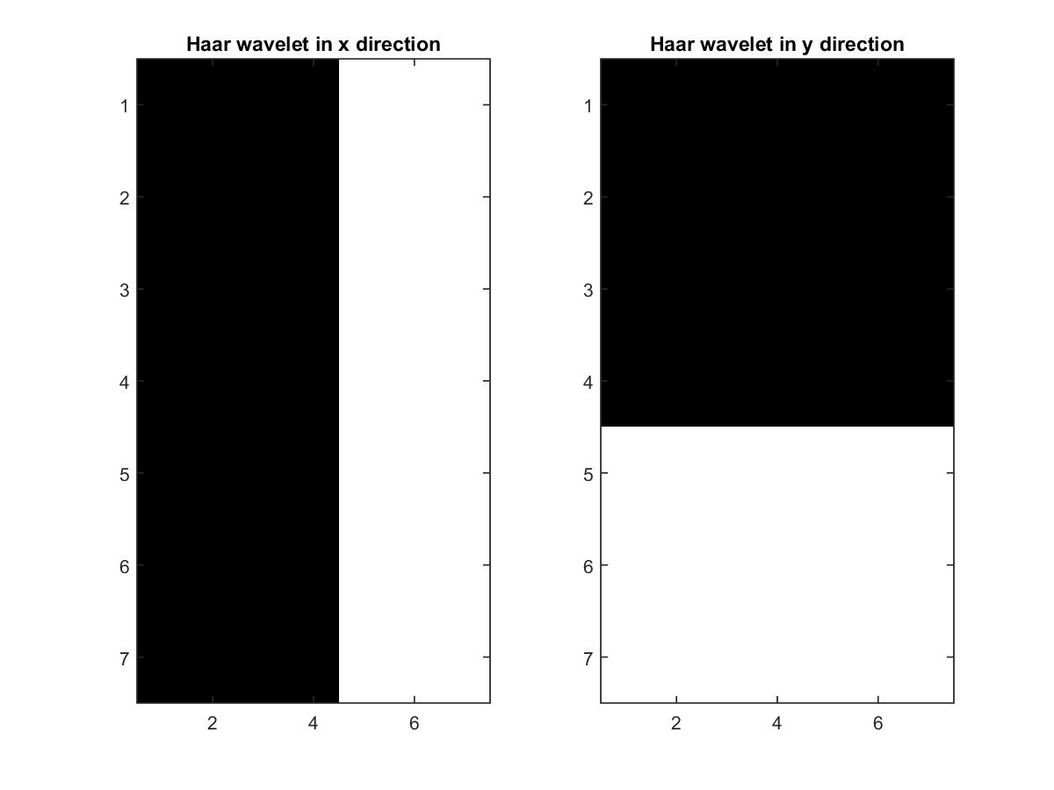
Orientation Assignment
Information retrieval from circular region with 6*s radius around interest point.
Dominant orientation is found by scanning circular region with sliding window (π/3 at each step).
Information is extracted using Haar wavelet .
Then, to decrease the effect of point that is far from interest point, Gaussian weights are used.
Each wavelet response within window are summed. Longest vector’s orientation is chosen to represent point’s orientation.
For U-SURF, this part is skipped.

Slide 21
Interest Point Detection
Orientation Assignment
Descriptor Construction

Slide 22
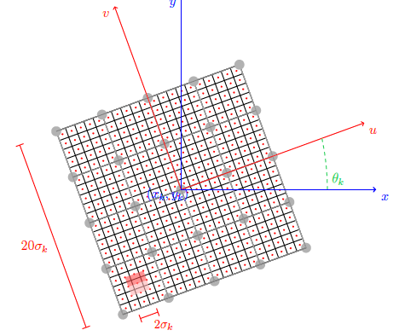
Descriptor
1. Construct square region with 20*s length.
2. Square is divided into 4x4 square subregions
3. Take Haar response of these sub-regions
4. Weight the response with Gaussian weights.

Slide 23
Descriptor
Within each sub-region:
Sum the responses in x direction d_{x,}
Sum the responses in y direction d_{y,}
Sum absolute of the responses in x direction |d_{x}|
Sum absolute of the responses in x direction |d_{y}|
Then, we have 4 dimensional array for each subregion.
64 dimensional array from 16 sub-regions

Slide 24
Feature Matching
Final step Matching the feature vectors between images.
Which distance metric? Mahalonobis Euclidean Dist.

Slide 25
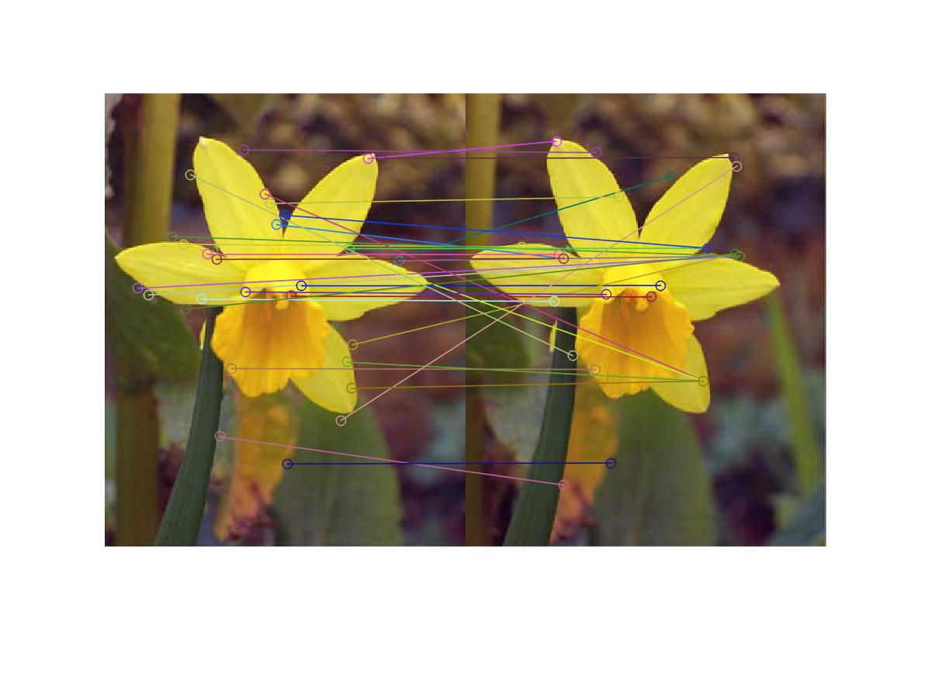
Results

Slide 26
Future Work
Image Classification or Object detection using SURF features.
Thinking about how to get rid of double for loops.

Slide 27
Conclusion
SURF is good at
rotation invariance
blurred images
SURF is not so good at
Illumination change
Viewpoint change

Slide 28
References
1. Bay H, Ess H., Tuytelaars T., Gool L.V., Speeded Up Robust Features(SURF) in 10 September 2008.
2.http://docs.opencv.org/2.4/doc/tutorials/features2d/feature_homography/feature_homography.html.
3.http://docs.opencv.org/master/df/dd2/tutorial_py_surf_intro.html
4. Oyallon, E., Rabin, J., “An Analysis of the SURF Method” Departmen Informatique, France

