Slide 1
WPA Based Packet Decrypt
POC 2015

Slide 2
Prologue
It is not a zero-day vulnerability at all. Let me tell you the principle of WPA protocol and how to decrypt WPA packet.
You'd better know not the specific web sites shown in a demo but also most web sites(those do not support full ssl) in the world have the same problem.

Slide 3
Your lan card may not support wireless packet capturing
This is why it is hard to get wireless packet information on googling.

Slide 4
Let's search a monitor mode supported lan card
Notebook or smart phone have its own wireless lan card, but most of them do not support “monitor mode”.
Only if the lan card is able to support monitor mode, you can capture wireless packets properly.

Slide 5
How to check monitor mode
Let me show you how to check if my lan card supports monitor mode.
Notes:
wlan0(monitor mode 지원하지 않는) 및 wlan1(monitor mode를 지원하는)을 monitor mode로 변환한 이후, 각각 제대로 작동하는지 구분해서 설명한다(monitor_mode.avi). // gilgil temp

Slide 6
Starting capturing wireless packets
Not encrypted
    OPEN
Encrypted
    WPA
    WPA2
Notes:
암호화되어 있지 않도록 AP를 설정하고 packet 잡기(no_decryption.avi).
암호화되어 있도록 AP를 설정하고 packet 잡기(decryption.avi).

Slide 7
How to decrypt wireless packet(open mode)
just capture the open AP’s packets
olleh wifi, T wifi zone, other open APs

Slide 8
How to decrypt wireless packet(wep mode)
24bit IV + 40bit or 104bit shared key
plain text
CRC
D
RC4 (xor)
IV
WEP Key
E
802.11 Header
IV(24bit)
encrypted data
Notes:
WEP 모드는 패킷마다 생성되는 IV값과 사전에 공유된 WEP Key값으로 RC4 스트림 암호화를 적용하여 데이터를 encrypt, decrypt한다.

Slide 9
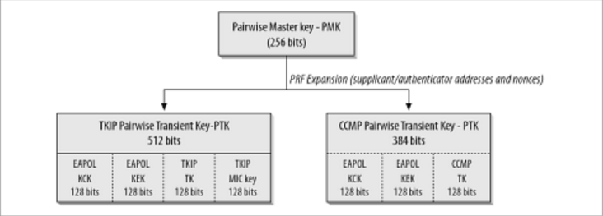
wpa/wpa2 key distribution
IEEE 802.11i
- Dynamic key distribution (EAPoL 4Way-HandShaking)
- We need “TK Key” for decryption
Notes:
802.11i로 규정된 WPA, WPA2는 초기 인증시 EAPoL 핸드 쉐이킹으로 동적 암호키를 분배하여 각 STA, AP 세션마다 서로 다른 암호키를 사용한다.
유니캐스트 패킷의 암/복호화에 사용되는 키는 PTK 중 128bit의 TK키이다.

Slide 10
wpa/wpa2 key distribution
PTK Generation
passphrase
passphrase
PBKDF2(HMAC−SHA1, passphrase, ssid, 4096, 256)
PMK
PMK
ANonce
PTK
SNonce
PTK, MIC Check
ANonce
MIC Check
Key Install
PTK = PRF-512(PMK, "Pair-wise Key Expansion", AP_MAC || STA_MAC || ANonce || SNonce)
Notes:
EAPoL 핸드 쉐이킹에서 ANonce, SNonce를 얻어야 PTK키를 구할 수 있다.

Slide 11
How to decrypt wireless packet(wpa mode)
WPA/TKIP
- TSC(TKIP Sequence Counter), TA(Transmitter address)
TK
TSC
TA
plain text
MIC
D
RC4 xor
TKIP
Mixing
128bit key
E
802.11 Header
TSC(48bit)
encrypted data

Slide 12
How to decrypt wireless packet(wpa2 mode)
WPA2/CCMP
- PN(Packet Number), CTR(Counter)
flag(1)
priority(0)
TA
PN
CTR
plain text
CBC-MAC
D
AES ECB
XOR
TK
E data
E
802.11 Header
PN(48bit)
encrypted data

Slide 13
Demo
It consists of 2 modules.
  Capture wireless packets and decrypt them to analyzable ethernet frames(DeSniffer).
  Figure out host and http cookie and tell the web browser them(cs).
Notes:
청중들에게 인터넷 사용 자제를 부탁한다.
준비가 완료된 이후 특정 몇명에게만 스마트폰으로 인터넷을 사용하라고 한다.
packet 떠서 cookie 세팅하는 데모(예 : 네이버)를 보여 준다.
안되면 시연 동영상(demo.avi)를 보여 준다. // gilgil temp

Slide 14
How to protect?
Do not use an wireless network.
  WTF? Does it make sense?
Use an web application that supports encrypted communication.
  Use an web site encrypted over full ssl(strict) .
State at a person who use the odd lan card in public area.
  If he launches wireshark in his notebook?

Slide 15
Where can I get source code?
open source. Feel free to use my codes. :)
https://github.com/wifihack

Slide 16
To do list
Integrate these modules in “snoopspy” project.
Support not only ubuntu but also android, raspberry pi and arduino.
No plan on windows os.

Slide 17
References
https://wiki.wireshark.org/HowToDecrypt802.11
https://codebutler.github.io/firesheep

Slide 18
Any Question?

Slide 19
Thank you
gilgil ( http://gilgil.net, http://snoopspy.com )
yeongsik moon ( http://bbolmin.tistory.com )

