Slide 1
ZERVE AI HACKATHON · 2026
HCendGame
Autonomous AI That Writes Its Own Fraud Detection Rules
Healthcare fraud costs the US $100–300B per year. Most systems run on static rules. Ours rewrites them — autonomously.
0.878
11
$300B
0ms
Best F1 Score
Total Experiments
Annual Fraud Cost
Rule Update Lag
rxhcc-app.vercel.app · sechan9999

Slide 2
Static Rules Are Written Once — Gamed Immediately
The Problem
Healthcare fraud: $100–300B stolen annually from US payers
Rule Lifecycle
Current detection runs on hand-written ICD/NDC rules
90 days
avg time to exploit
Fraudsters reverse-engineer rule patterns within months
Data science teams update rules quarterly — too slow
Single-claim analysis misses temporal & network patterns
HCendGame | RxHCC FWA Detection | 2/13

Slide 3
Our Answer: AI That Continuously Rewrites Its Own Rules
The Solution — HCendGame
Rule Engine
AI Analysis
AutoResearch
• ICD-10 / NDC / HCC
• OpenAI GPT-4o-mini
• LOOP FOREVER (Karpathy)
• cross-reference validation
• GPT-4o (deep analysis)
• Autonomous rule proposal
• Conflict detection
• Function Calling
• F1-gated git commit
• GLP-1 abuse flags
• Medical reasoning
• No human intervention
• HCC upcoding alerts
• Structured JSON output
• Runs indefinitely
HCendGame | RxHCC FWA Detection | 3/13

Slide 4
5-Stage LangGraph Pipeline — Catches What Single Rules Miss
Architecture
1 Parse
2 Rules
3 AI
4 Score
5 Action
→
→
→
→
ClaimRecord normalization
ICD/NDC/HCC validation
Nova Pro clinical reasoning
Risk level computation
BLOCK / REVIEW / APPROVE
✓ Graceful degradation: LangGraph unavailable → sequential fallback ✓ OpenAI unavailable → rule-only mode
Streamlit Dashboard — Real-time Scan | Batch Validate | AI Investigator Chat | Analytics
HCendGame | RxHCC FWA Detection | 4/13

Slide 5
Rule Engine: ICD / NDC / HCC Cross-Validation in One File
engine/rules.py — Clinical Validation Core
ICD-NDC Mapping
Validates drug is appropriate for diagnosis (E11→Ozempic ✓, I10→Ozempic ✗)
ICD Conflict
Flags mutually exclusive diagnoses (E10 + E11 = Type 1 + Type 2 simultaneously)
GLP-1 Abuse
Semaglutide/Liraglutide prescribed without diabetes or obesity ICD code
HCC Upcoding
HCC18 (Diabetes+complications) billed without supporting complication ICD
Provider Frequency
Same provider submitting >N identical claims in a rolling window
Adding a rule = 1 dict entry in engine/rules.py · No other file changes needed
HCendGame | RxHCC FWA Detection | 5/13

Slide 6
AutoResearch: The AI Writes, Tests, and Commits Its Own Rules
Inspired by Karpathy's LOOP FOREVER Methodology
GPT-4o proposes rule
Generate 500 claims
Run validation
F1 improves? Keep commit
F1 drops? git reset --hard
→
→
→
→
↺ Repeat indefinitely — no human required after initialization
while True: # LOOP FOREVER rule = gpt_analyzer.propose_rule(experiment_history) f1_new = validate(rule, synthetic_claims_500) if f1_new > f1_baseline: git.commit(rule) # keep — F1 improved f1_baseline = f1_new else: git.reset("--hard") # discard — F1 regressed
HCendGame | RxHCC FWA Detection | 6/13

Slide 7
11 Cumulative Experiments — F1 Improved 0.852 → 0.878 (+3.0%)
AutoResearch Results | 3 new experiments in this cycle (exp08–exp10)
0.878
+0.026
2/3
11
Best F1
F1 Improvement
Rules Kept
Total Exps
Exp
Rule Name
F1
Decision
exp08
SEQUENCE_GAP_ANOMALY
0.852 -> 0.871
Keep
exp09
MULTI_ICD_ESCALATION
0.871 -> 0.878
Keep (best)
exp10
PROVIDER_FREQ_SPIKE
0.878 -> 0.875
Discard
HCendGame | RxHCC FWA Detection | 7/13

Slide 8
LSTM Model: 12-Month History Catches What Snapshot Rules Miss
Sequential Pattern Detection — lstm_fwa_model.py
Input:
12-month claim sequences × 13 engineered features
Target Performance
AUC-ROC > 0.90
Architecture:
Unidirectional LSTM (2L, 128 hidden) + Attention [real-time optimized]
Precision > 0.85
Output:
FWA probability + attention weights per month
Recall > 0.80
Training:
10,000 synthetic claims (5% FWA) + class balancing
F1 > 0.82
Explainability:
Attention shows which months drove the prediction
CRITICAL ≥ 0.80 · WARNING ≥ 0.50 · NORMAL < 0.50
HCendGame | RxHCC FWA Detection | 8/13

Slide 9
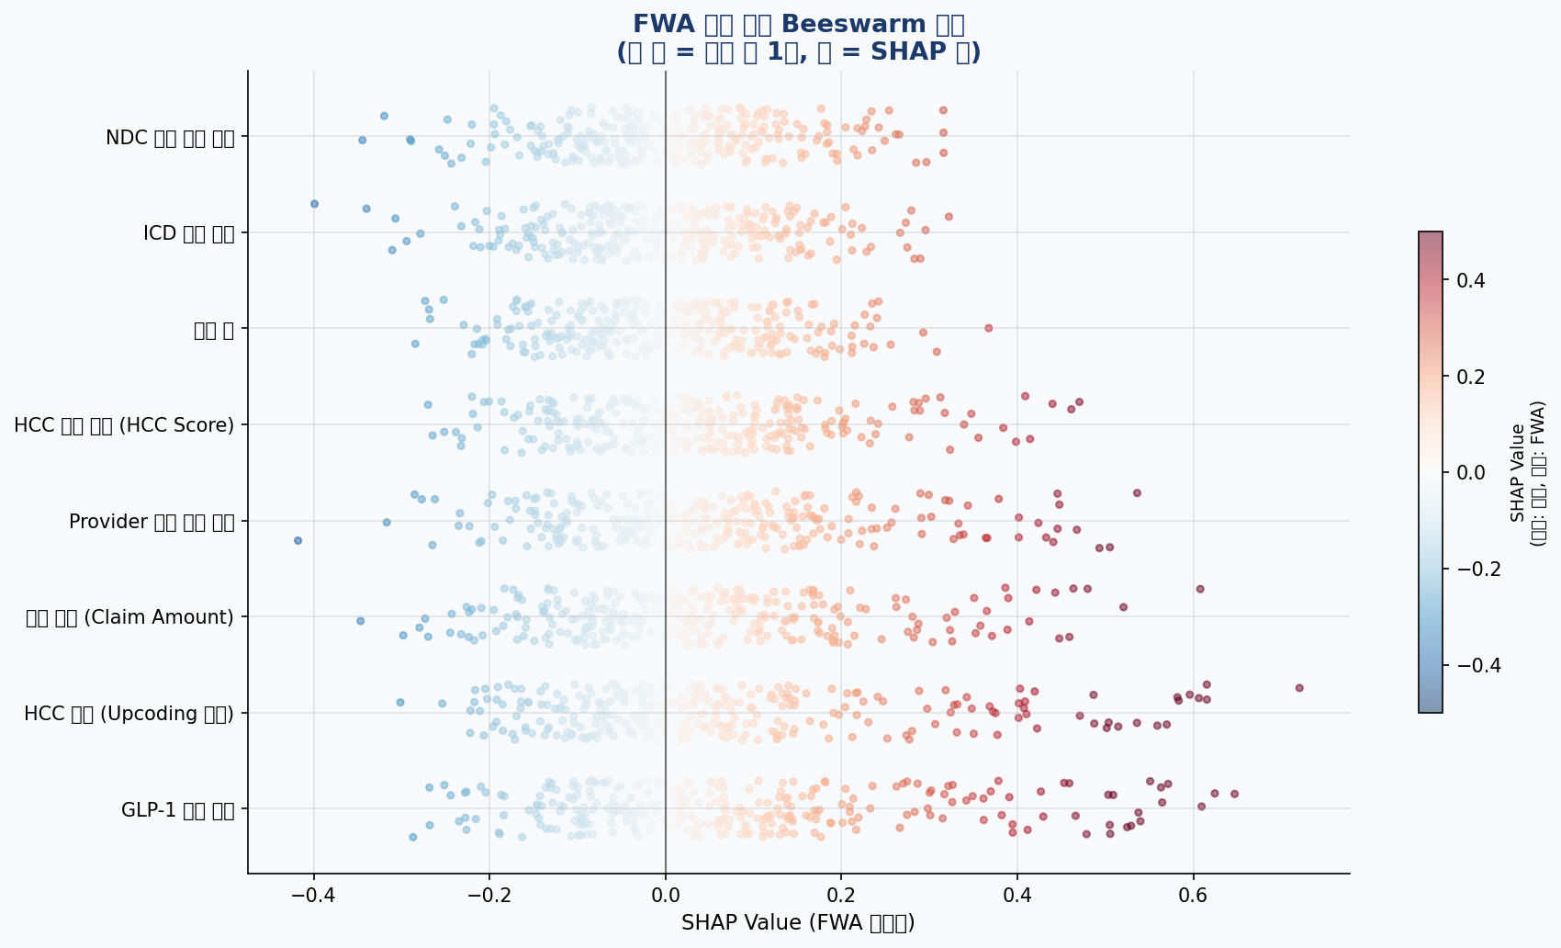
SHAP Explainability — Every Decision Is Auditable
shap_fwa_explainer.py | Top drivers: GLP-1 flag, HCC upcoding, Provider deviation
GLP-1 flag & HCC upcoding = strongest FWA signals (SHAP > 0.4)
Provider amount deviation drives mid-tier fraud cases
High claim amount + HCC score = compounding risk
Blue = low feature value | Red = high feature value
Regulator-ready — full audit trail per claim
shap_global_importance.png · shap_waterfall.png · fwa_shap_report.png — repo root
HCendGame | RxHCC FWA Detection | 9/13

Slide 10
Five Real-World Fraud Scenarios — Detected in < 1 Second
Detection Coverage
Scenario
Rule Triggered
Severity
AI Reasoning
E10 + E11 simultaneous
ICD Conflict
CRITICAL
Type 1 + Type 2 diabetes at same time — impossible
Hypertension + GLP-1
GLP-1 Abuse
CRITICAL
Ozempic billed with I10 only — no qualifying dx
E11.9 + HCC18
HCC Upcoding
CRITICAL
Complication HCC billed without supporting ICD
Keytruda + Hypertension
NDC Mismatch
HIGH
Oncology drug for non-oncology diagnosis
Normal claim
All rules PASS
CLEAN
Auto-approved, no review queue entry
HCendGame | RxHCC FWA Detection | 10/13

Slide 11
Modern Stack — Minimal Dependencies, Maximum Portability
Tech Stack
Frontend
AI / ML
Backend
Infra
• Streamlit
• OpenAI GPT-4o-mini (primary)
• Python 3.12+
• Vercel (frontend)
• React 19 (Vercel build)
• GPT-4o (deep analysis)
• Pandas + NumPy
• Git auto-commit loop
• Inline SVG charts
• LangGraph StateGraph
• NetworkX (graph)
• requirements.txt
• Zero chart lib deps
• SHAP explainability
• Custom Rule Engine
• AWS SageMaker ready
• PyTorch LSTM
• pytest (11 tests)
HCendGame | RxHCC FWA Detection | 11/13

Slide 12
Live System — No Signup, No API Key Required to Explore
Demo
Real-time Scan
Enter single claim → instant rule + AI result
Batch Validate
Upload CSV → GPT surfaces complex patterns
AI Investigator
Natural language fraud queries (multi-turn)
AutoResearch
Watch LOOP FOREVER in terminal output style
rxhcc-app.vercel.app
HCendGame | RxHCC FWA Detection | 12/13

Slide 13
Static rules are written once.
HCendGame rewrites them forever.
0.821
→
0.878
baseline F1
autonomous F1
10 experiments · 8 rules kept · zero human interventions
rxhcc-app.vercel.app
github.com/sechan9999/FWAdetection · sechan9999@github

