Slide 1
SPLUNK AGENTIC OPS HACKATHON 2026
LLMai
Closed-Loop Agentic Ops for Splunk
Observability that acts back.
TRACK · OBSERVABILITY
github.com/sechan9999/splunk_hec · splunkhec.streamlit.app

Slide 2
THE PROBLEM
AI agents are a blind spot
Cost
Failures
Data leaks
What did the agent spend this hour? Unknown — until the bill.
Which model is erroring or slow right now? No signal.
Did a prompt leak PII or secrets? Invisible.
And remediation is 100% manual. A human reads a dashboard, then changes config. Slow, reactive, after the damage.
LLMai · Closed-Loop Agentic Ops for Splunk
2 / 10

Slide 3
THE IDEA
Make it a closed loop
telemetry → HEC
MCP Agent
Splunk
Multi-LLM router
Semantic cache · DLP
index=mcp_agents
Anomaly detection · SOAR
anomaly → auto-remediation
Bidirectional. The platform doesn't just watch the agent — it reconfigures it, autonomously.
LLMai · Closed-Loop Agentic Ops for Splunk
3 / 10

Slide 4
ARCHITECTURE
How it fits together
MCPAgents
HEC
index=
mcp_agents
Splunk
Auto-
Remediation
agent + router
async batch
8 event types
anomaly · SOAR
router re-weight
closed loop: runtime router re-weight + auto-restore after cooldown
Tools splunk_query · supabase_query
Security X-MCP-Token (const-time) · DLP→SOAR
LLMai · Closed-Loop Agentic Ops for Splunk
4 / 10

Slide 5
EXECUTION
Built in 4 weeks
WEEK 1
WEEK 2
WEEK 3
WEEK 4
HEC Telemetry Emitter
Splunk MCP Tool
DLP → SOAR Bridge
Anomaly → Auto-Remediation
Async batched HEC, retry logic, 8 event types hooked into router & cache.
Natural language → SPL; MCP Server connector with REST fallback.
Foundation-sec PII scoring → 6 SOAR playbooks, zero-coupling patch.
CDTS alert webhook → runtime router re-weight + cooldown restore.
LLMai · Closed-Loop Agentic Ops for Splunk
5 / 10

Slide 6
LIVE DEMO
Streamlit Control Center
Mission Control
AI Agent Lab
Live Threat Feed
ROI Impact
SPL Query Lab
Demo Mode (default ON) → runs fully on Streamlit Cloud with realistic simulated data. Zero setup for judges.
▶ splunkhec.streamlit.app
One-click public demo · 5 tabs · Supabase + Splunk as MCP tools
LLMai · Closed-Loop Agentic Ops for Splunk
6 / 10

Slide 7
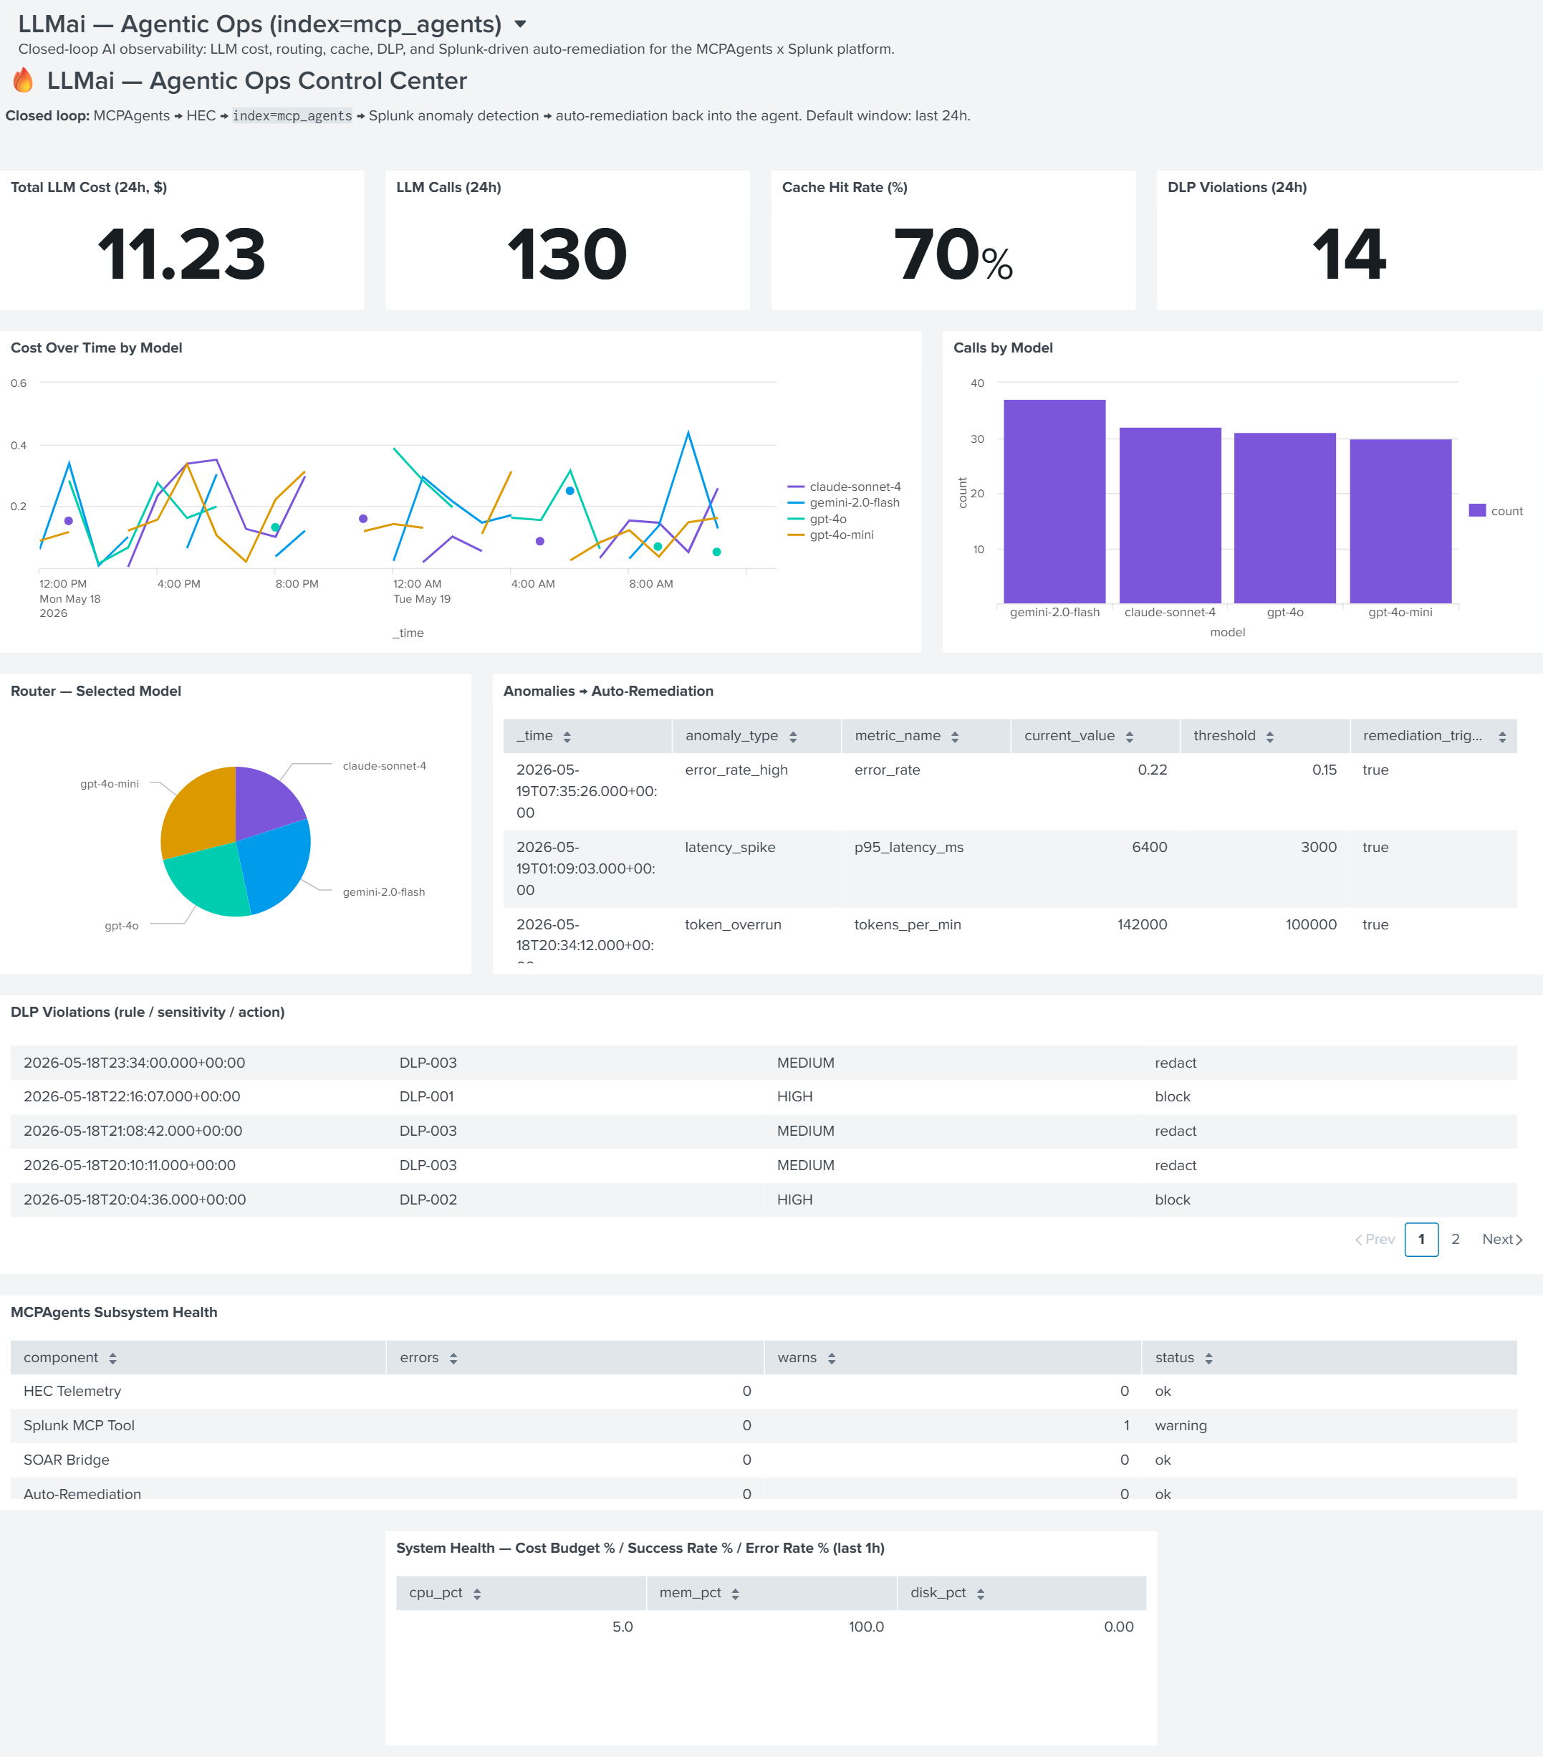
PROOF
Splunk Dashboard Studio
12 panels
over index=mcp_agents
KPIs
cost · calls · cache · DLP (24h)
Cost by model
line + router pie
remediation_triggered = true
← the closed loop, proven
LLMai · Closed-Loop Agentic Ops for Splunk
7 / 10

Slide 8
ENGINEERING RIGOR
Built to ship, not just demo
0
const-time
regression — graceful degradation: env-gated, monkey-patch, try/except
X-MCP-Token shared-secret auth on every sensitive endpoint
96–100%
Apache-2.0
PDCA design-match across features (Plan→Check→Report→Archive)
open source · README · architecture diagram · seeder
LLMai · Closed-Loop Agentic Ops for Splunk
8 / 10

Slide 9
WHY IT WINS
One-way logging vs. a control loop
Typical entry
LLMai
Ship logs to Splunk
Dashboards to look at
Human reads, then fixes
One-directional
Streams rich telemetry in
Splunk anomaly detection acts back
Agent re-tunes itself at runtime
Bidirectional & self-healing
Observability becomes a control loop.
LLMai · Closed-Loop Agentic Ops for Splunk
9 / 10

Slide 10
ROADMAP
What's next
Deploy the backend → cloud demo runs against real Splunk
Per-user identity & RBAC + rate limiting
GitHub Actions CI on the headless test suite
Package as a Splunkbase-style add-on
Thank you.
github.com/sechan9999/splunk_hec · splunkhec.streamlit.app
Track · Observability | Splunk Agentic Ops Hackathon 2026

