Slide 1

Automate Your Data Analysis Testing
Stephen Childs
November 12, 2016

Slide 2
Introduction
Economics
Educational Research
Institutional Research
The 80%
Notes:
The 80% of that data science 80/20 spilit – I was the 80%...

Slide 3
Test Driven Development
Saw TDD
How to apply to data preparation?
Unit tests – should be fast

Slide 4
Agenda
Introduction
Py.test
numpy.testing
Unit tests
Testing data
Comparing data frames

Slide 5
Py.test
Major Python test framework
Runs unittest and nose tests as well
Re-writes assert statements
Fixtures - @pytest.fixture decorator

Slide 6
Fixture example
@pytest.fixture(scope='module')
def output_data():
from project.db_engines import create_mssql_engine
engine = create_mssql_engine()
return pd.read_sql_table(
‘output_data', engine)

Slide 7
Using a fixture
def test_unique_student(output_data):
df = output_data
assert True not in df.duplicated(subset=['id’]).unique()

Slide 8
NumPy.testing
np.testing.assert_array_equal()
np.testing.assert_array_close()
Works with py.test
Takes numpy arrays, not pandas dataframes
Convert with DataFrame.values, Series.values

Slide 9
Unit Tests
These tools let you write unit tests
Break data preparation code into small functions
Think of a test for all cases
Supply fake data to cover all tests

Slide 10
Testing Data
Run statistics (describe method) – are they what you expect.
Are the observations unique
Columns of the expected type
Observations in the expected range

Slide 11
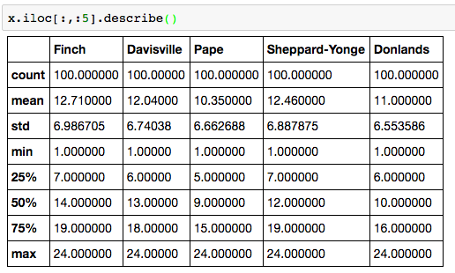
Descriptive Statistics

Slide 12
Comparing Data Frames
Compare output of your code to previous versions.
Store versions in database – datetime stamp and “reliability” flag.
Compare against the last solid version.
Useful for legacy (no unit tests) code.

Slide 13
Implementing Data Frame Comparison
Relies on knowing your data
Have unique row and column index
Put those unique identifiers in the index
set_index() and reset_index()

Slide 14
Use NumPy and Pandas functions
Numpy.setdiff1d(x,y)
x,y are array-like
Returns unique entries in y that aren’t in x
Find dropped and new rows/columns
Numpy.intersect1d(x,y)
X, y are array-like
Return unique entries that are in x & y
Create a comparable matrix
Pandas .loc indexing
Take the results of the above methods

Slide 15
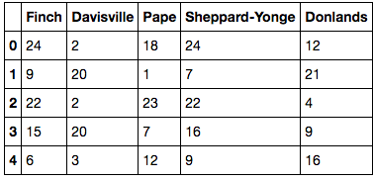
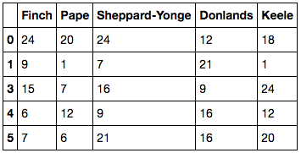
Example Old and New Data Frame

Slide 16
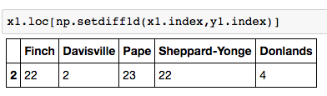
Rows Removed

Slide 17
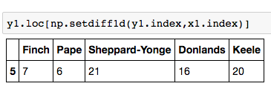
Rows Added

Slide 18
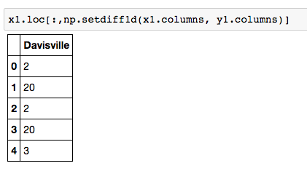
Removed Columns

Slide 19
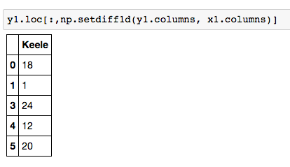
Added Columns

Slide 20
Compare the same rows
rows, cols =
np.intersect1d(x1.index, y1.index),
np.intersect1d(x1.columns, y1.columns)
same_x1 = x1.loc[rows, cols]
same_y1 = y1.loc[rows, cols]

Slide 21
Find rows/columns with differences
x.loc[~((x == y).all(axis=1)), ~((x == y).all(axis=0))]
[~(x==y)].applymap(str) +
‘ -> ‘
y.loc[~((x == y).all(axis=1)), ~((x ==y).all(axis=0))]
[~(x==y)].applymap(str)
Notes:
If you have data frames x & y with the same rows & columns – you can get the differences this way.
All columns with difference, 2) all rows with difference, 3) select cells with differences – then you filter out nan -> nan with replace

Slide 22
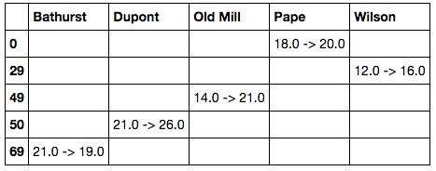
Changes

Slide 23
Automated Comparison
Number of rows/columns added/removed - compare % to threshold number
Number of differences within common rows/columns – more than expected?
Differences clustered in 1 row or column

Slide 24
Jupyter Notebook
Will post to my github: github.com/sechilds
Follow me on twitter: @sechilds
PyData Calgary – meetup.com
PyYYC

