Slide 1
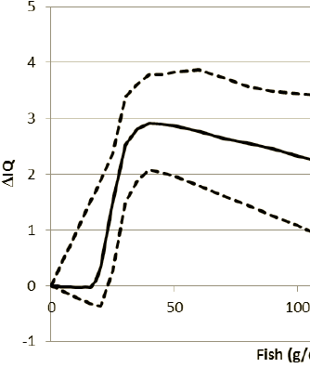
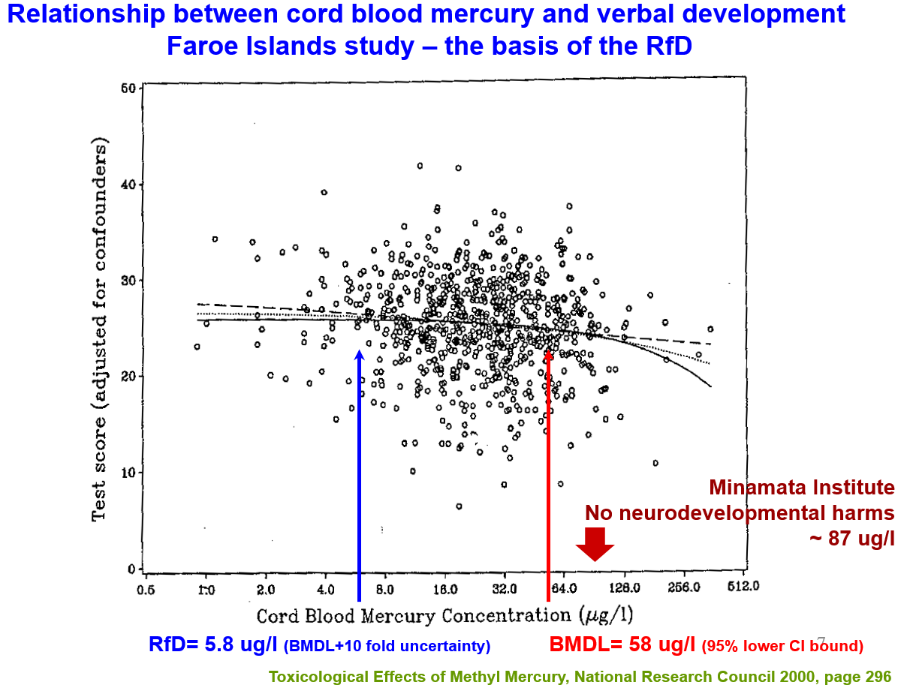
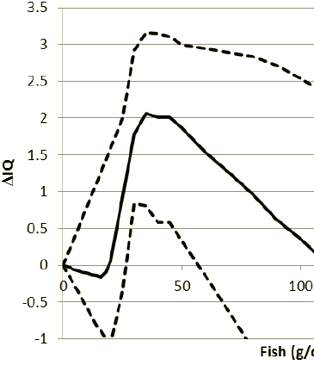
Net Effects on IQ
Salmon
Should albacore tuna be singled out as being limited to 6 oz per week when the recommendation is for 12 oz per week of a variety of fish?
Assumes consumption of all one fish (no variety)
Fig D-4, Salmon (mean and 95% CI); Max benefit +3.3 IQ points
Fig D-6, Albacore Tuna; Max benefit about +3 IQ points
Fig D-7, Shark; Max benefit +2 IQ points
Mean increase in 6-9 year old child IQ points from maternal intake during pregnancy.
Dotted vertical lines
12 oz per week = 2x 6 oz cans; ~50 g/d (48.6 g/d)
24 oz per week = 4x 6 oz cans; ~100 g/d
Albacore
Tuna
Shark
12 24 ounces per week
{Courtesy J Hibbeln}

