Slide 1


R BASICS
Prepared by SEÇKİN CANBAZ

Slide 2
In this presentation, we will learn about the advantages of using R to perform data analyses. We’ll install Rstudio. And we’ll learn the basic data types and commands of R.

Slide 3
Why we are using R ?
R is the leading programming language for statistics and data analysis. One of the main advantages of using R is that we can build up an analysis line by line in code. We can save all of our work in a file and go back to see what we investigated at a later date. Having R scripts allows you to easily share your work with others. And you can see what others are doing with data. R also has over 2000 user contributed packages that increase its functionality.

Slide 4
Installion of R and RStudio
I installed all of the computers in EGB-15 (this class) R and Rstudio.
But if you want to install by yourself click the links below. And than just click the ‘Next’ button, until you see the ‘Finish’ button.
This is for Windows OS
https://cran.r-project.org/bin/windows https://download1.rstudio.org/RStudio-1.1.423.exe
This is for MAC OS
https://cran.r-project.org/bin/macosx/ https://download1.rstudio.org/RStudio-1.1.423.dmg

Slide 5
First Use Of R And RStudio
Now Please open Rstudio. And go to the «File», than «New File», after that click «R Script». Now your screen looks like my screen. This opens an empty R Script which allows us to start programming in R.

Slide 6
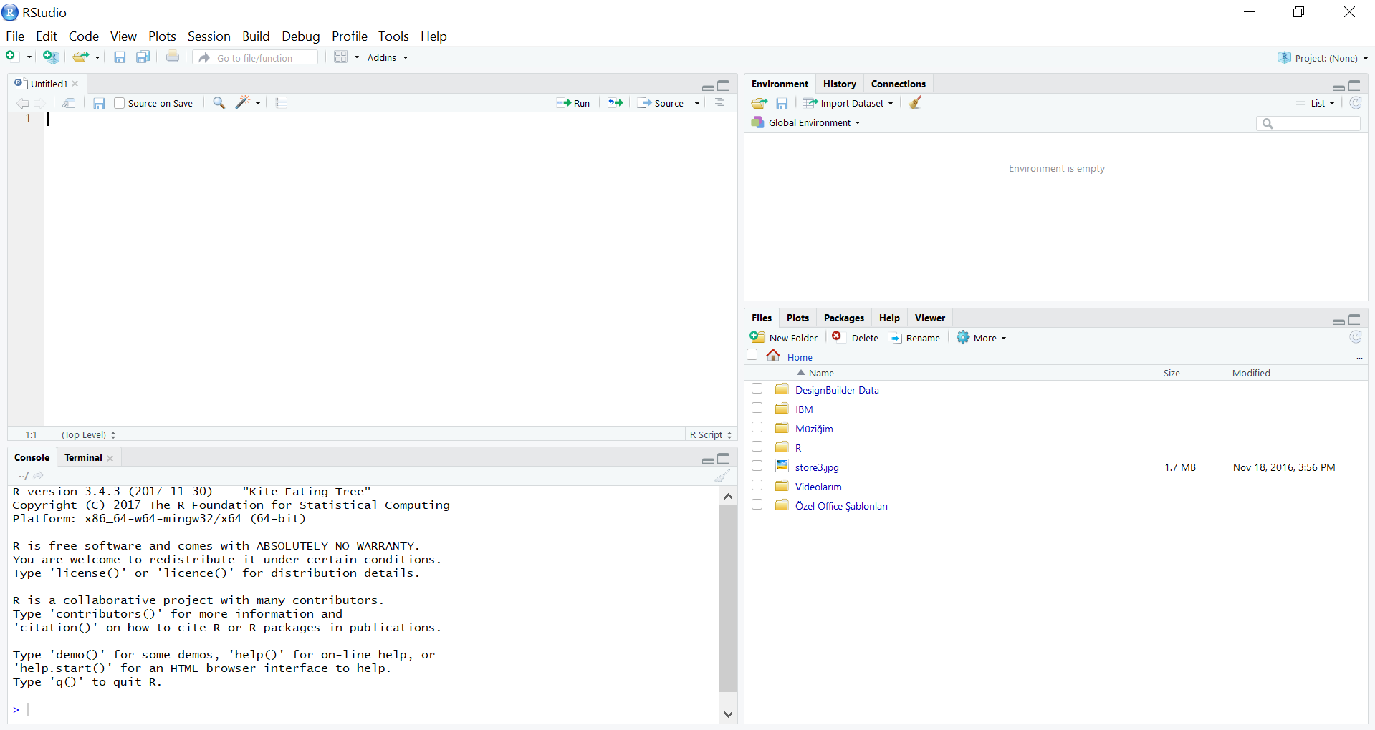
RStudio Interface

Slide 7
«(demystifying.R)» File Source
https://d17h27t6h515a5.cloudfront.net/topher/2016/November/581a4977_eda-course-materials/eda-course-materials.zip
We recommend anyone new to R and RStudio to try Swirl (statistics with interactive R learning). Swirl is a software package for the R statistical programming language. Its purpose is to teach statistics and R commands interactively.
Type the following commands in the Console, pressing Enter or Return after each line:
install.packages("swirl")
library(swirl)
swirl()
Let’s try swirl.

Slide 8
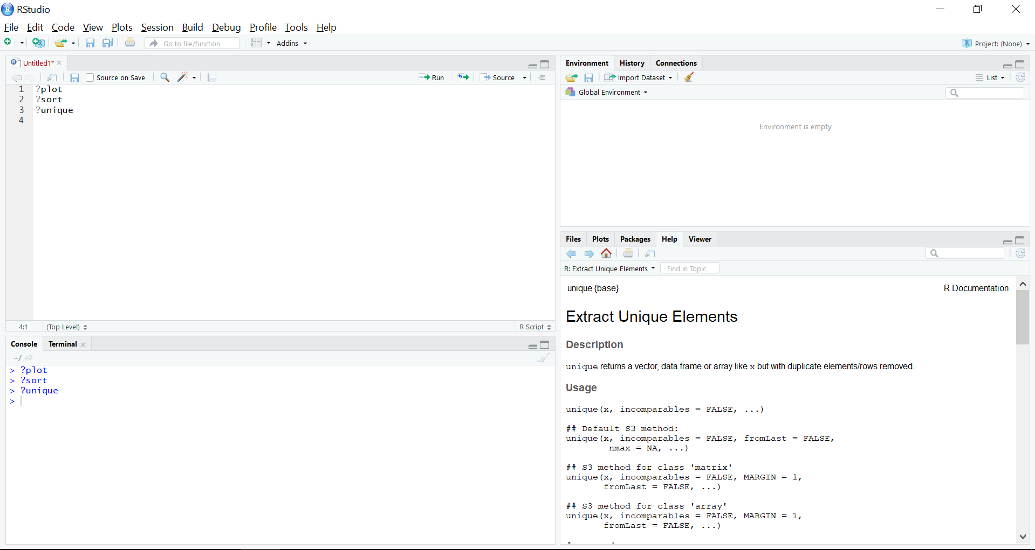
Getting Help ?

Slide 9
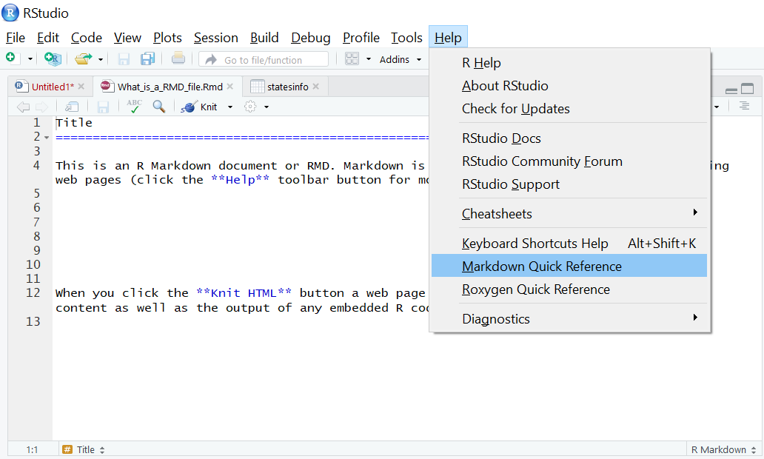
Markdown Quick Reference

Slide 10
THANKS FOR LISTENING

