Slide 1
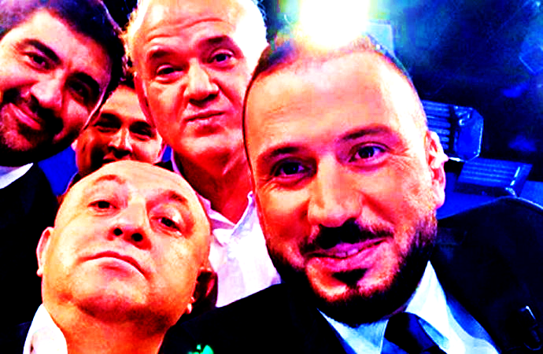
BLG 212E – TERM PROJECT
TEAM NAME: BEYAZ FUTBOL
CAN BOZACI - 040170099
SEÇKİN GEZER - 040170217
Instructor: Assistant Professor Tankut Akgül
Course Assistant : Research Assistant Yasin Fırat Kula

Slide 2
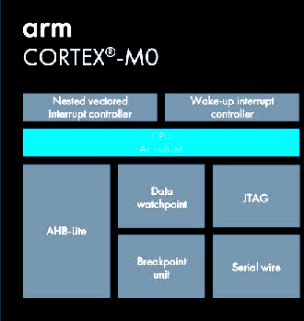
Project Goals
Creating a Pong Game algorithm played by two players
Using ARM Cortex M0 assembly language for algorithm
Using NESTED Vectored Interrupt Controller to move left and right goalkeeper positions
Using the LCD Peripheral to monitor code in LCD screen

Slide 3
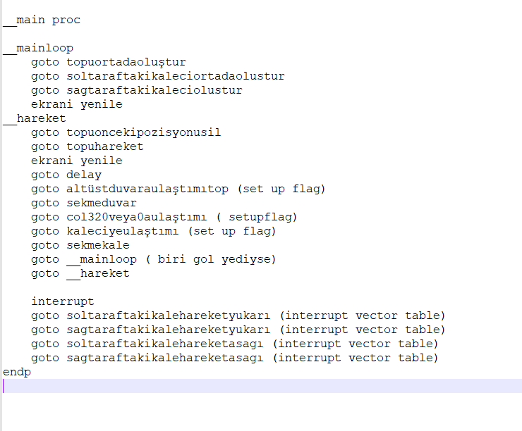
Creating the Main Algorithm
This is the algorithm prototype we have written before writing codes to uVision.

Slide 4
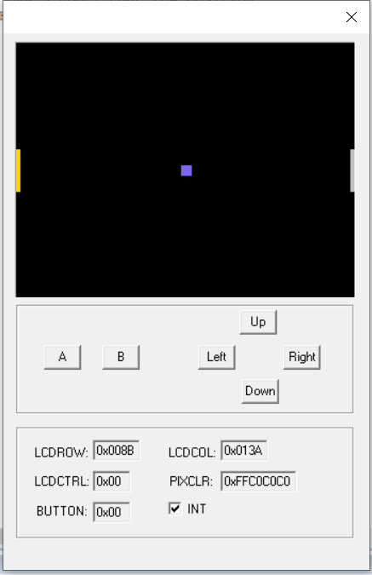
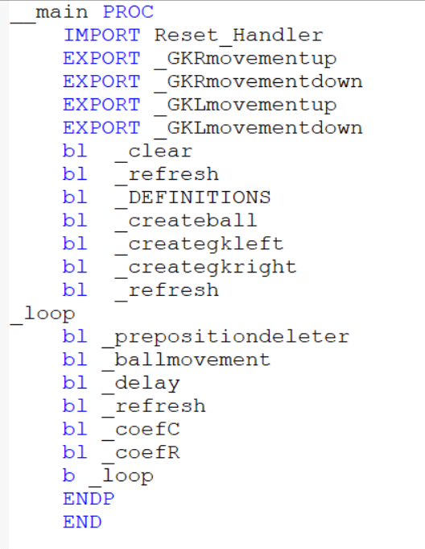
Creating the Elements of the Game
We have chosen the ball size 10x10 and goalkeeper size 20x4.
In order to create them in the middle of the LCD screen we have found row and column offsets for both ball and goalkeepers.
Made some global definitons on the main.

Slide 5
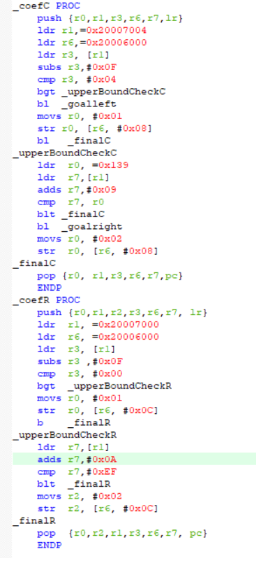
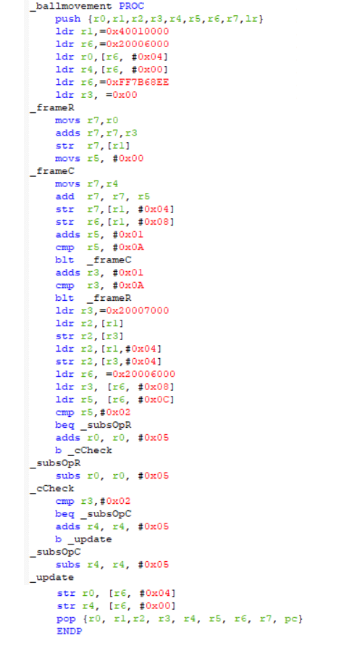
Moving the ball accross the LCD

Slide 6
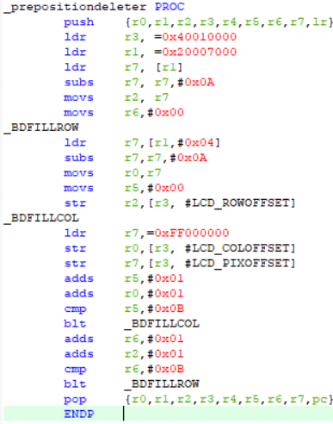
Deleting the preposition of ball

Slide 7
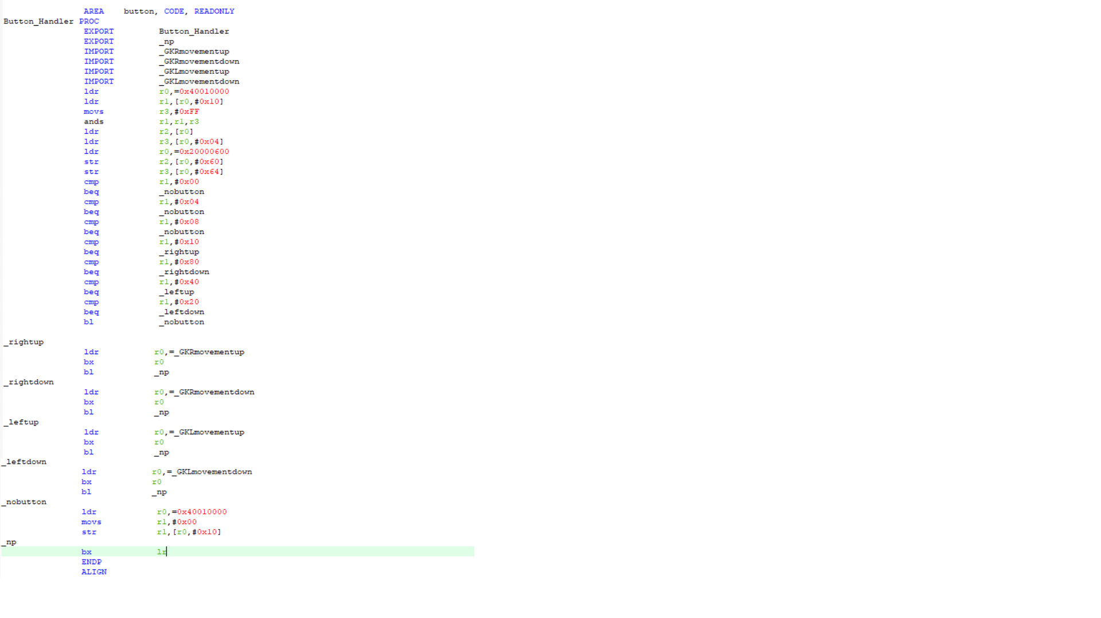
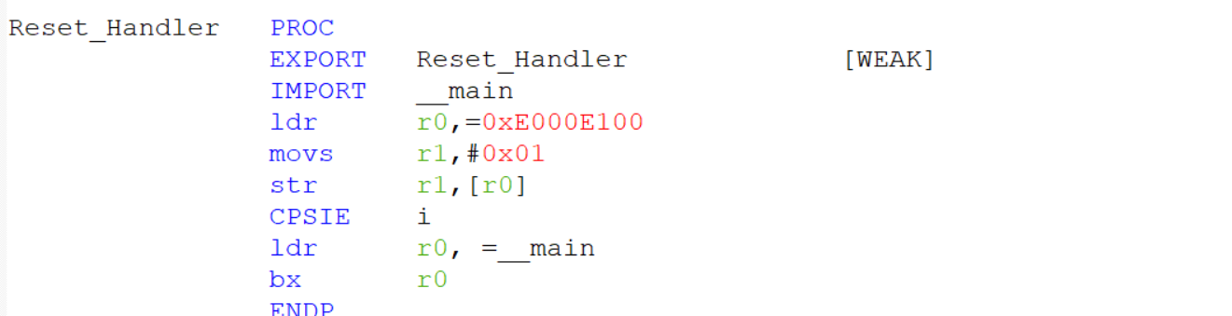
Interrupt

Slide 8
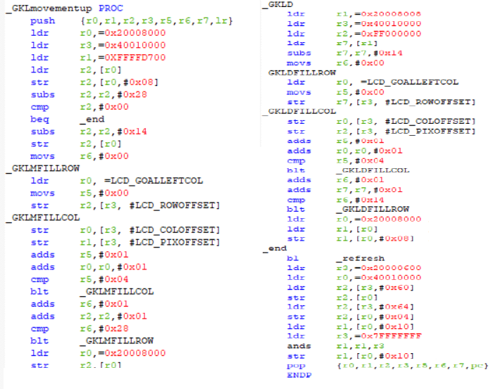
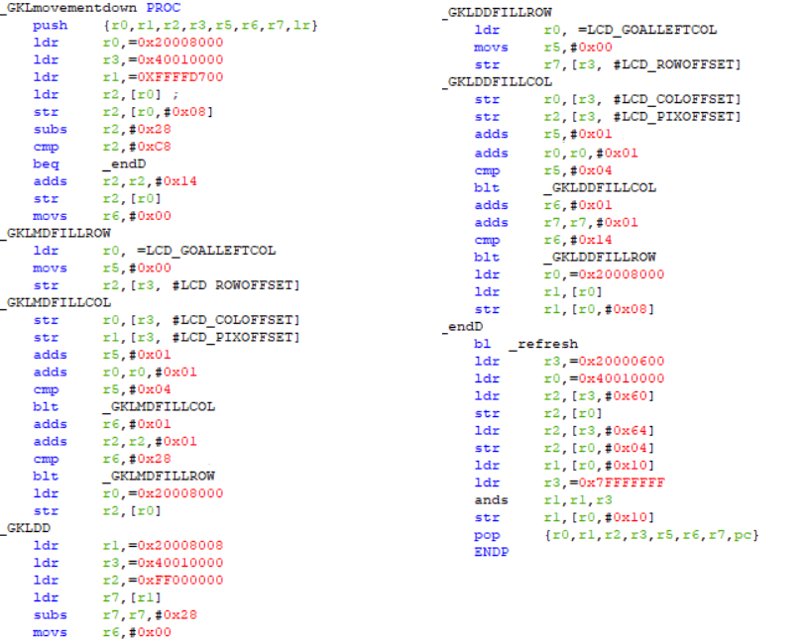
Goalkeeper Movements

Slide 9
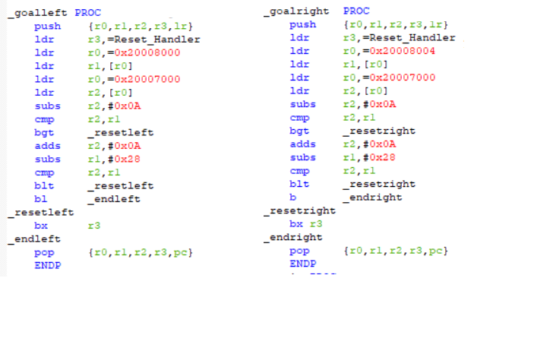
Checking if there is a goal

Slide 10
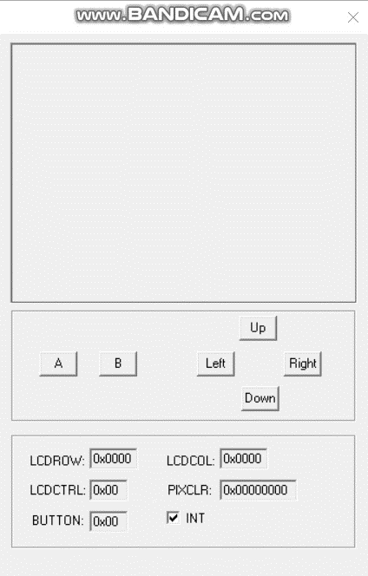
Video of Pong Game

Slide 11

What have we learned from this project?
We have improved our basic algorithm development skills.
We have learned how does the RAM work, how to store a value into RAM and load it back when there are insufficient numbers of registers.
We have learned how does the interrupt handler of ARM CORTEX M0 work, learned about Nested Vector Interrupt Controller (NVIC).
We have learned about using LCD peripheral with ease.

Slide 12

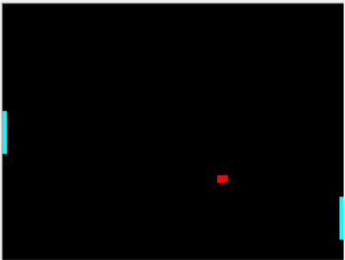
Challenges we have been through
When an interrupt kicks in while processors doing something other than delay operation, it may lead to some corruptions and data losses in LCD registers which usually resulted in random drawing or erasing pixels in the screen.
We had a hard time understanding the interrupt mechanism of processor.
Limit of commercial use of uVision Keil supports 4kB maximum.

Slide 13
Some features that could be added/upgraded
We could have added:
1- When the game starts ball could move randomly in any direction
2- A loading screen for the game and a button to start it
3- A button to stop the game in current position and another button to resume it
4- Ball's rebound from goalkeeper can be related to gk's movement rather than just a plain reflection.
*Since free version of Keil only supports 4kB it is really hard to add these features and make a game that doesnt break.

Slide 14
THANK YOU FOR LISTENING

