Slide 1

MACD and
Technical Analysis:
Basic Building Blocks of
Technical Analysis
Investors want to see into the future.
Technical analysis employs past patterns in stock prices to forecast the future.

Slide 2

Beliefs About the Future
The
Future
Forecasting rests on an implicit belief that past relationships will continue into the future.
Natura non facit saltum – Nature never moves in leaps.
If the world changes too quickly, no model will be useful.
The Present

Slide 3
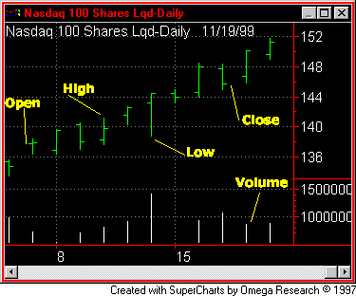
Reading Daily Stock Charts
Open-High-Low-Close appear in bar charts.
Charts show volatility and how the stock performed over the day in summary fashion.
Volume also shows activity on the bottom.
Plain Vanilla Charts

Slide 4
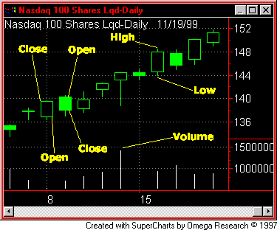
Candlestick Charts
The wick represents the high and the low
The bar (candle) shows the open and close
  An empty bar shows a rising price from open to close
  The filled bar shows a declining price
  Candles call attention to up and down moves
Closed and Open Candlesticks

Slide 5
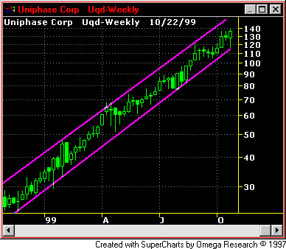
Trendlines and Channels
Market Wisdom Revealed
  The trend is your friend
  Don’t fight the ticker
  Don’t stand in front of a runaway train
  Go with the flow
  Don’t swim upstream
They demonstrate wisdom that the market sometimes has updrafts and downdrafts
The trend is definitely upward

Slide 6
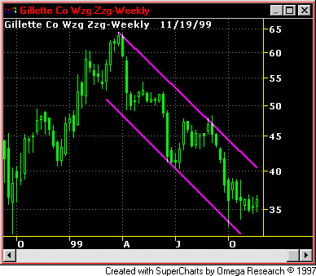
Downtrends Occur
The trick is to know when the trend is down and when it is up.
Selling at the top is hard to do.
But hanging on to a loser is unprofitable.
Downward Channel Lines

Slide 7
Ten Top Technical Tools
Trends, Channels, Bollinger Bands
Moving Averages
Relative Strength Indicators
Advance/Decline Ratio
Elliott Waves
Head and Shoulders Reversal Patterns (DOW)
Cumulative Volume Indices
Short Ratio
Number of New Highs or New Lows
Moving Average Convergence-Divergence Analysis (MACD)

Slide 8
Brief Technical Tool Methods
Use charts, std. dev. bands, regressions & go with the flow
Chart prices and multiple day moving averages & the trend is your friend
A stock relative to S&P500 or industry
Healthy markets have positive A/D ratios
3 impulse waves up, and 2 corrective waves down
3 trend phases, confirmation with other indices, and support levels
Add the difference between advancing and declining stocks to a running total.
Divide short interest by total daily volume & buy when there’s high short interest
Ratio of the lesser of new highs or new lows to total number of trades as the High Low Logic = buy when ratio is low
Moving Average Convergence-Divergence Analysis (MACD)

Slide 9
4 Traps of Technical Analysis
Most technical buy & sell indicators occur too late
  Often the first few days of a market move includes 2/3rd of the total upward or downward correction. If missed, there is much less to be had.
Many technical indicators switch on and off too often, leading to excessive trading costs
  Stop loss orders can leave you out of the stock, then buy it back, eating up profits.
Some technical indicators keep you out of the market for years
  Hard to explain to clients if you keep them out of stocks for long, long periods.
4. Communists view of the failure of the USSR – “The Soviets just didn’t do it correctly.” All test failures are blamed on inexact methods.

Slide 10
Moving Averages (MA) and Exponential Moving Averages (EMA)
MA(current) = { Price(past1) + Price(past2) + … Price(pastN) } / N
EMA(current) = ( (Price(current) - EMA(prev) ) x Multiplier) + EMA(prev) where the Multiplier = 2 / (N + 1) and N in the time period is the fixed period one
Percentage EMA uses a set percentage multiplier and the above equation.
In EVA (3), multiplier is 2/(3+1) or .5
Ex: EVA at period 3 is (29.22 – 22.94)(.5)+ 22.94 = 26.08 in oval using fixed period of 3 example.
CLOSE | MA (3 day) | EMA (3)
23.00 | 23.00 | 23.00
22.87 | 22.87 | 22.94
29.22 | 25.03 | 26.08
20.90 | 24.33 | 23.49
26.55 | 25.56 | 25.02
26.85 | 24.77 | 25.93
20.33 | 24.58 | 23.13
19.88 | 22.35 | 21.51
30.33 | 23.51 | 25.92
26.00 | 25.40 | 25.96

Slide 11
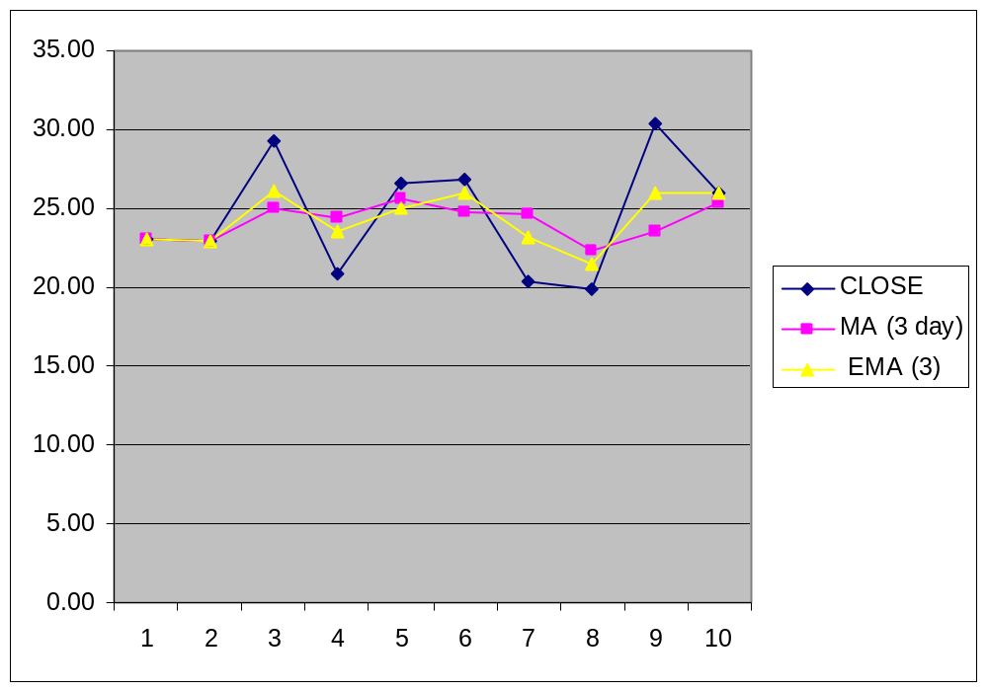
SMOOTHING BY MOVING AVERAGE &
EXPONENTIAL MOVING AVERAGE
EMA is subject to quicker turns than a simple MA is.

Slide 12
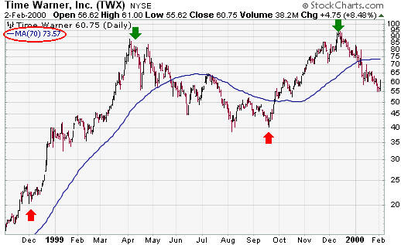
Simple Price Analysis
SELL BUY SELL
If buy when price is above 70 day EMA and sell when below, then sell in mid MAY, buy back again in mid October, and sell again in early 2000.

Slide 13
Two Moving Averages
(for momentum price oscillators)
Short run moving average emphasizes what is currently occurring
  Someone could be accumulating shares and bidding the price up
  Someone could be dumping shares to bring it down
A long run moving average is the base line against what is happening generally
When the short run crosses the long run, we see momentum in the price (BUY).

Slide 14
Momentum Price Oscillator
A Price oscillator is the difference between a short and long exponential moving average as a percent or as an amount
  For British pounds, I used 9-day and 25-day periods.
  The oscillator is positive when the 9-day is above the 25 day line
When line goes above zero, buy as the 9 day is above the 25 day
It is good in a trending market, but it whipsaws with too many trades in sideways markets

Slide 15
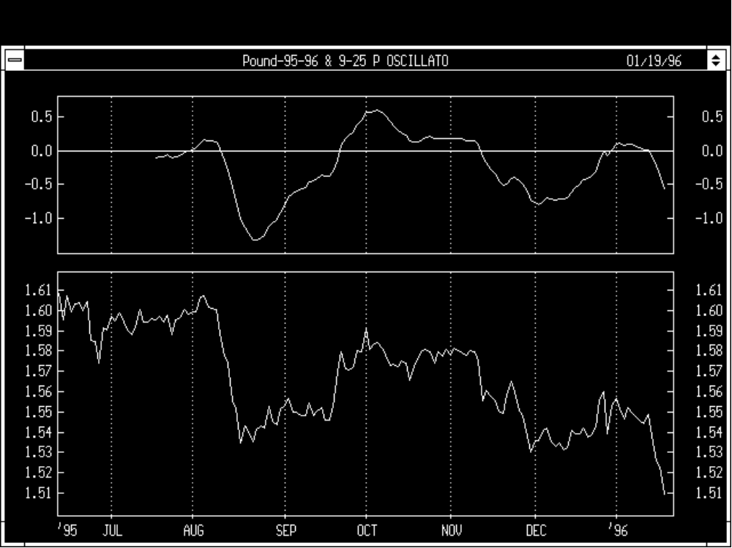
Price Oscillator Using 9 days (short) and 25 days (long)
SELL
SELL
BUY
Notes:
*

Slide 16
Moving Average Covergence-Divergence (MACD)
MACD is an updated price momentum indicator (Gerald Appel) which sometimes includes a signal or trigger line.
It is a smoothed oscillator based on the point spread difference between two exponential moving averages, constructed as a (Short – Long) oscillators.
  A 26 week EMA (long) & a 12 week EMA (short)
  The difference (short - long) is MACD line
  9 week EMA to form the SIGNAL or TRIGGER line
    Buy when MACD crosses Trigger Line
  “You don’t have to understand the concept behind a technical indicator to use it; you just need to know what to ask the computer to do with it” -- Cyber-Investing, Brown & Bentley, 1995, p. 62

Slide 17
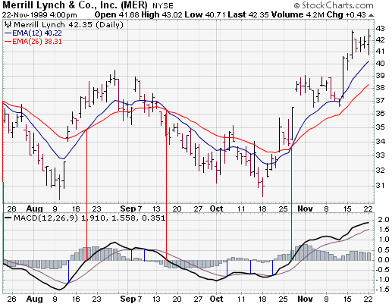
26 Day
12 DAY
Divergence
of MACD
& Trigger
MACD crosses Trigger Line is an early buy indicator

Slide 18
Moving Average Convergent Divergent (MACD) is a trend deviation oscillator that measures the difference between two exponential moving averages of different lengths.
MACD line = subtract a 26 period exponential moving average from a 12 period (a price oscillator)
The SIGNAL line - dotted line is a 9 period exponential moving average of the MACD line as an early trigger.
  Buy when MACD crosses above Trigger line.
  Sell when MACD crosses below he Trigger line
MACD tends to “beat” price oscillators in back testing
Research by Colby & Meyers “The Encyclopedia of Technical Market Indictors” suggest shorter EMA’s.
Brown & Bentley in Cyber Investing suggest 17 days (long) and 8 days (short), and signal line 9 days
But I used 26, 12, and 9 days as is suggested in MetaStock SE by Equis for the British pound.

Slide 19
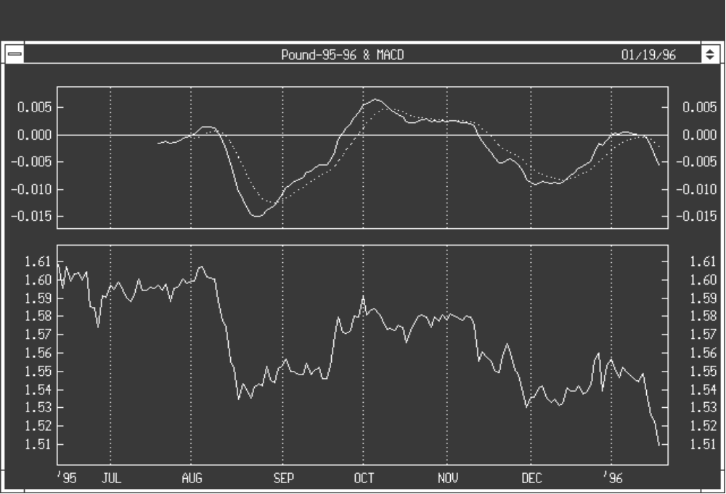
MACD is the solid line. Trigger is the dotted line
SELL
SELL
BUY
BUY

Slide 20
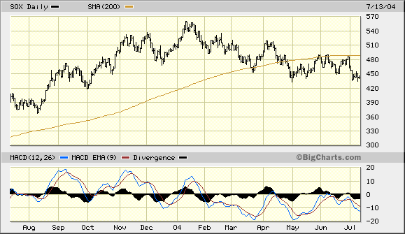
SOX is the semi-conductor index. Top box: shows 200-day simple MA
Bottom box: shows blue MACD line of 12 day EMA – 26 day EMA
Red line is 9 day EMA of MACD which is a signal or trigger line. Divergence is the difference between MACD and its 9-day EMA. The histogram is positive when MACD is above its 9-day EMA; negative when MACD is below its 9-day EMA.

