Slide 1

LineUp
Helping people be more productive with their time.
Presented by Vincent Buccini, Alex Paulius, and Lewis Hunter for Backers and Hackers
| February 28, 2019

Slide 3
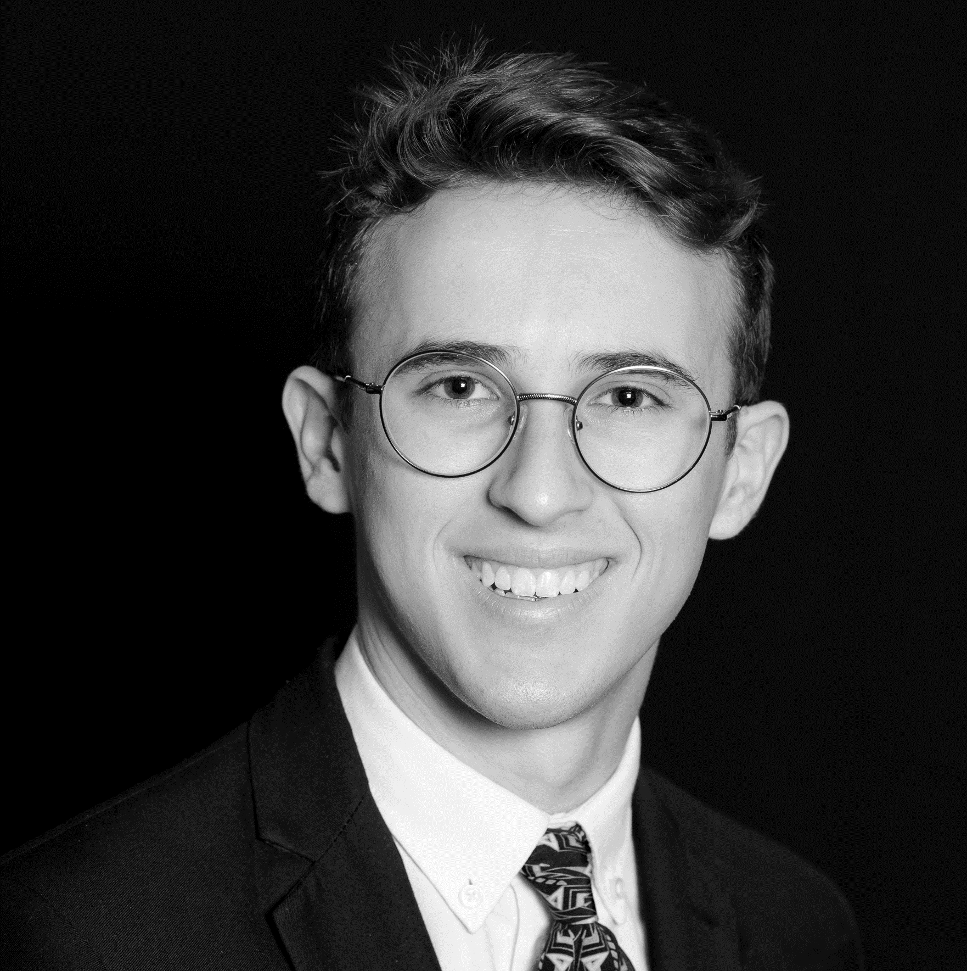

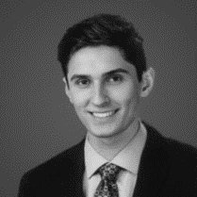
About the Company
Owned by LineSkip LLC Incorporated in December
“How can we figure out a better way to wait in line?”

Slide 4
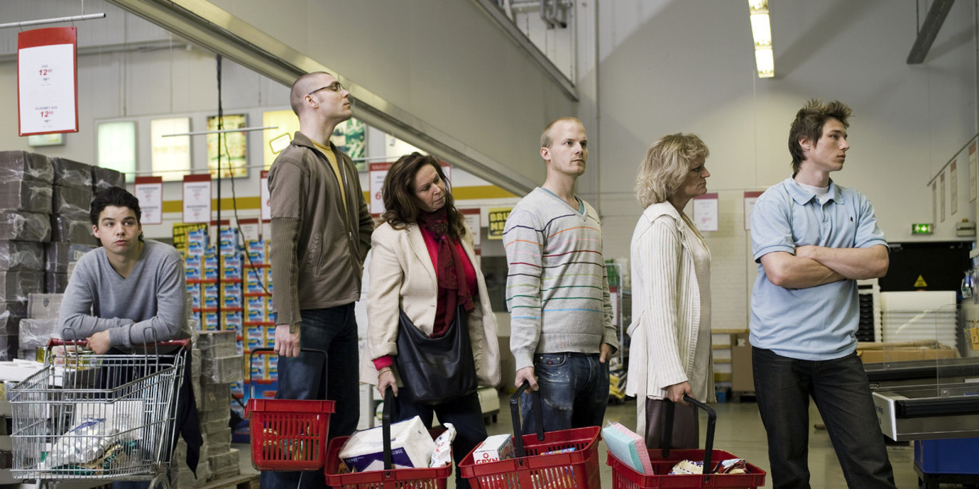
The dangers of Lines for a business
“Often the psychology of queuing is more important than the statistics of the wait itself” – Dr. Richard Larson, MIT
People overestimate how much they have waited by 36%
This issue can be seen in almost any facet of consumption based/service based business.
Americans spend roughly 37 billion hours each year waiting in line according to the New York Times.
Psychologically “empty time” i.e. time spend waiting in a line feels longer than occupied time.

Slide 5
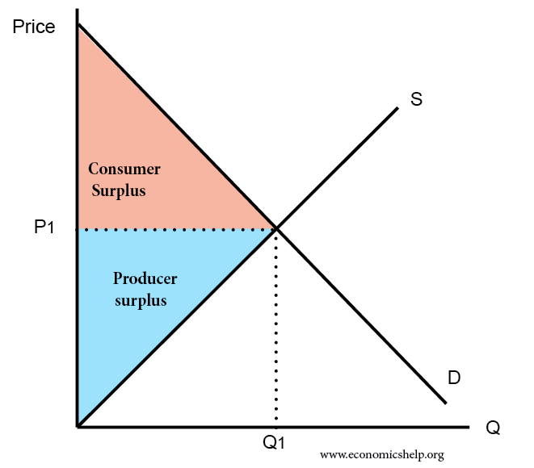
Application
We aim to provide consumers and venues choices pertaining to lines
Price discrimination
Risk mitigation, pre-purchasing tabs

Slide 6
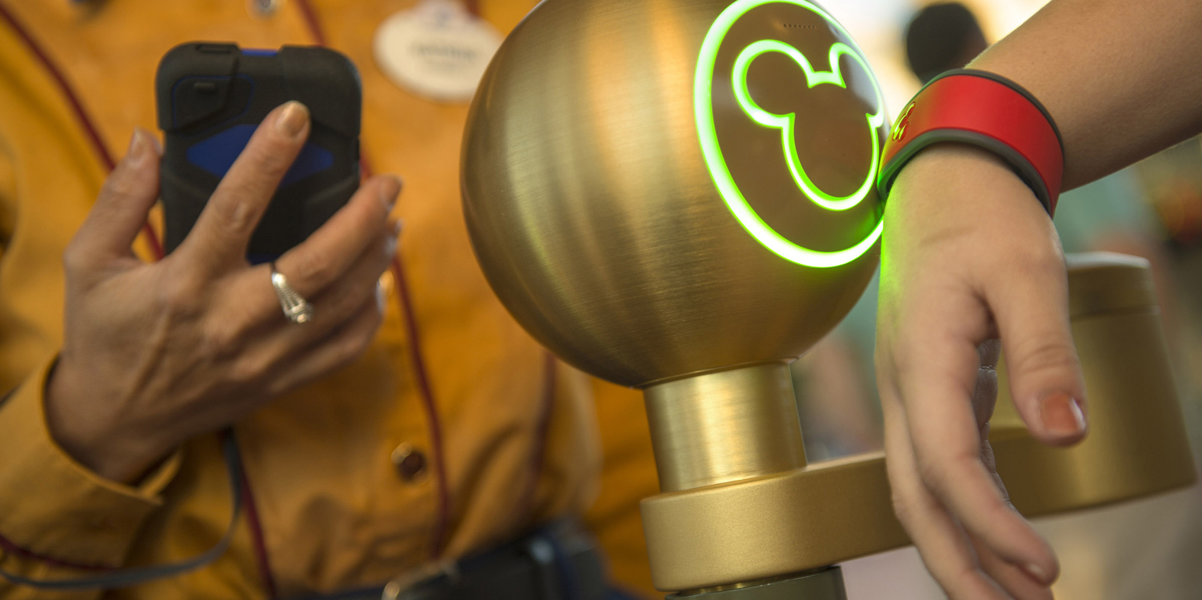
Market Examples
Six Flags
Disney
USC ticketing services

Slide 7
Thank you

