Slide 1
CONTRACT REQUIREMENTS
Agreement (offer and acceptance)
Consideration
Contractual Capacity
Legality of Purpose

Slide 2
DEFINITION OF A CONTRACT
Agreement that can be enforced in court: offer and acceptance and consideration
Formed by two or more parties (promisor and promisee).
Failure to perform results in breach and damages.
Objective Theory of Contracts. (Intent is interpreted by a reasonable person.) the existence of a contract is determined by the legal significance of the external acts of a party to a purported agreement, rather than by the actual intent of the parties.
(Common law governs contracts, unless statutory laws have been adopted such as UCC)

Slide 3
Contracts Clause

Slide 4
AGREEMENT
OFFER
ACCEPTANCE
CONSIDERATION

Slide 5
OFFER
Serious objective intention by offeror
Expression of opinion is not an offer
Statement of future intent… not an offer
Preliminary Negotiations are not offers.
Advertisements, Catalog, and Circulars are not offers.
Auctions are not offers.
Agreements to Agree are not offers
The terms must be reasonably certain so that the parties and the court can determine the terms
The offer must be communicated to offeree.
Is it an offer?

Slide 6
TERMINATION OF OFFER
Revocation of the Offer (by Offeree) is possible if communicated to Offeree before the offer is accepted.
Irrevocable Offers, based on detrimental reliance or promissory estoppel, cannot be revoked.
Option Contracts: requires consideration.

Slide 7
OFFER TERMINATES BY LAW
Lapse of Time. Offer automatically terminates by law based on terms specified in the offer itself.
Destruction of Subject Matter. Offer automatically terminates if subject matter destroyed before offer accepted.
Death or Incompetence of either party. Unless offer is irrevocable.
Supervening Illegality of Proposed Contract. Statute or court decision making the offer illegal automatically terminates it.

Slide 8
RESPONSE TO OFFERS
Rejection of the Offer by the Offeree. Effective only when actually received by the Offeror or its agent.
Counter Offer by the Offeree. Rejection of original offer and simultaneous making new offer with different, material terms. Original Offeror can accept.
Acceptance

Slide 9
ACCEPTANCE
Voluntary act by Offeree that shows assent to terms of original offer.
Mirror Image Rule. Mirror Image Rule
Offeree must unequivocally accept offer.
Additional terms may be considered a counteroffer.
Silence as Acceptance

Slide 10
COMMUNICATION ACCEPTANCE
Authorized Means of Communication is either express or implied by form of offer (e.g., U.S. mail, fax, email).
“Mailbox Rule”: Offeree accepts offer when the acceptance is dispatched to Offeror in the form it was received, unless offer requires a different method (e.g., Fed-Ex, or receipt by Offeror).
Exceptions:
Acceptance is not properly dispatched.
Offer stipulates not accepted until received.
Offeree rejects then accepts. First communication received determines whether contract is formed.

Slide 11
CONSIDERATION
Consideration is value given in return for a promise.
Something of legally sufficient value given in exchange for a promise (forbearance) and
That is bargained-for-exchange between the parties.
Adequacy of Consideration.
Courts generally do not look for “how much” consideration” is given…. But do not like to enforce contract where there is a disparity of consideration and often find other factors… undue influence… duress..

Slide 12
LACKING CONSIDERATION
Pre-Existing Duty.
A promise to do what one is already legally obligated to do is not consideration.
Unforeseen Difficulties.
Rescission and New Contract
Past Consideration. A promise made in return for actions or events that have already taken place are unenforceable.
Illusory Promises. If the terms of performance are so uncertain that the promisor has not legally promised anything, the promise is illusory. Option to Cancel clauses.

Slide 13
CONSIDERATION
Consideration....
CONSIDERATION ANIMATION

Slide 14
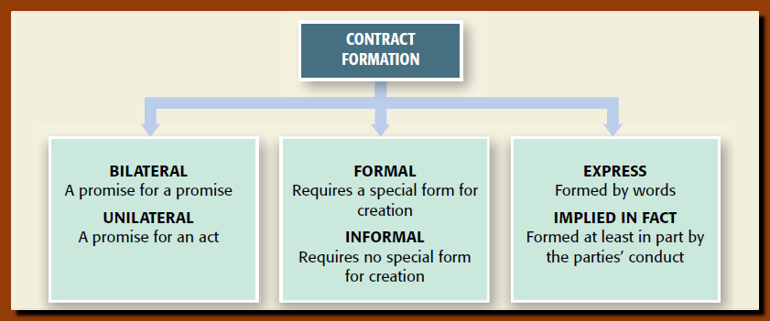

Slide 15
EXPRESS AND IMPLIED CONTRACTS
Express Contract A contract in which the terms of the agreement are stated in words, oral or written.
Implied in fact Contract A contract formed in whole or in part from the conduct of the parties.
Plaintiff furnished service or product.
Plaintiff expects to be compensated. AND
Defendant had a chance to reject and did not.

Slide 16
SETTLEMENT OF CLAIMS
Accord and Satisfaction. Debtor and Creditor agree on lesser amount.
Release. One of the parties forfeits the right to purse legal claim against the other.
Covenant Not to Sue. Parties substitute a contractual obligation for some other type of legal action.
ANY SETTLEMENT TODAY HAS ALL THREE

Slide 17
FORMATION Bilateral and Unilateral Contracts
Bilateral Contracts:
Offeror (PROMISOR) and Offeree (PROMISEE) exchange promises to each other.
A contract is formed when Offeree promises to perform. (I will buy your car for $1000 on Friday)
Unilateral Contracts:
Offeror wants performance in exchange for his promise.
Contract is formed when Offeree performs.(If you drive your car to Mesa College on Friday I will buy it for $1000)
Contests and lotteries are examples. Submit winning ticket by 4pm Sunday.

Slide 18
FORMAL --- INFORMAL
Formal contract. By law requires special form or method to be enforceable…. All negotiable instruments, checks, promissory notes, etc.
Informal contracts No special form required.

Slide 19
PERFORMANCE & ENFORCEABILITY
Contract Performance: Executed vs. Executory.
Executed: fully performed by both sides.
Executory: at least one of the parties has not performed.
Contract Enforceability
Valid Contract.
Four Elements: Agreement (Offer & Acceptance), Consideration, Legal Purposes, Parties have legal capacity.
Voidable Contract.
Valid contract that is legally defective and can be avoided (rescinded) by one of the parties.
Unenforceable Contract
Valid contract unenforceable because it violates a law
Void Contract.
No contract at all

Slide 20
PROMISSORY ESTOPPEL
Promissory Estoppel (“detrimental reliance”) doctrine applies when a person relies on the promise of another to her legal detriment. Promisor is “estopped” (precluded) from revoking the promise.
promissory estoppel
Elements:
Clear and definite promise
Promisor expected promisee would rely.
Promisee reasonably relies by acting.
Reliance with definite and substantial detriment.
Enforcement of promise is necessary to avoid injustice.

Slide 21
QUASI CONTRACTS
Fictional… not a contract
Imposed on the parties by Court for fairness and justice
Usually to avoid unjust enrichment
Pay physician for services rendered even though you were unconscious.
LIMITATION: conferring a benefit as a result of misconduct or negligence
Cannot be used to supplement an actual contract

Slide 22
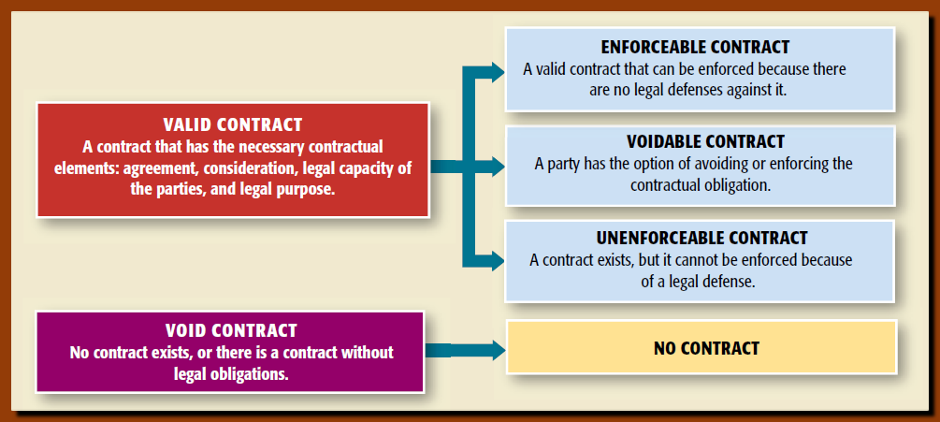
ENFORCEMENT OF CONTRACT

Slide 23
CONTRACTUAL CAPACITY The legal ability to enter into a contractual relationship
Minors (under 18)
Legally Intoxicated
Mentally Incompetent
Legality of Purpose

Slide 24
Minors (under 18) A minor can enter into any contract that an adult can…. But the contract is voidable at the option of that minor up through 18 plus a reasonable time. minors
Disaffirmance: Must be of the entire Contract and must return the goods or put parties back to status quo.
Minor Misrepresents Age Still can disaffirm
Contracts for Necessities Still can disaffirm (but responsible for value of goods)
Food, shelter, clothing… YES
Insurance, loans (except to buy necessaries) no.
Parents are not responsible for Minor’s Contracts

Slide 25
Legally Intoxicated
Does not have the contractual capacity
Historically Voidable Contract
Courts now looking at objective indicia and may determine it’s a valid contract
If voidable may be disaffirmed… just as Minor’s
May be ratified, expressly or impliedly.

Slide 26
Mentally Incompetent
Void. If Court has determined the person to be mentally incompetent and appointed guardian
Voidable If the person does not know he or she is entering into the contract or lacks the mental capacity to comprehend its nature, purpose, and consequences.
Valid
If person is able to understand the nature and effect of entering into a contract yet lacks capacity to engage in other activities.
Lucid Interval
mentally incompetent

Slide 27
ILLEGAL PURPOSE
A contract to do something prohibited by federal or state statutory law is illegal and therefore void (never existed).
EXAMPLES:
Murder for Hire
Usury
Gambling (in most states)

Slide 28
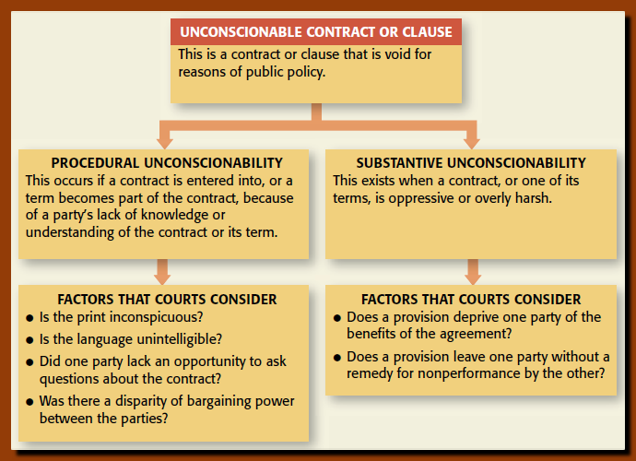
UNCONSCIONABLE CONTRACT Contract or clause void against public policy because one party, as a result of disproportionate bargaining power, is forced to accept terms that are unfairly burdensome and unfairly benefit the dominating party ADHESIONS AND EXCULPATORY CLAUSES

Slide 29
EXCEPTIONS TO VOID ILLEGAL CONTRACTS
Justifiable Ignorance of the Facts. (one innocent party… Courts will compensate)
Members of Protected Classes. (flight attendants can be compensated even if working more hours)
Withdrawal from an Illegal Agreement.
Severable or Divisible Contracts. (Illegal provision cannot impact essence of bargain.)
Contract Illegal through Fraud, Duress, or Undue Influence. (innocent party allowed to recover for performance or value)

Slide 30
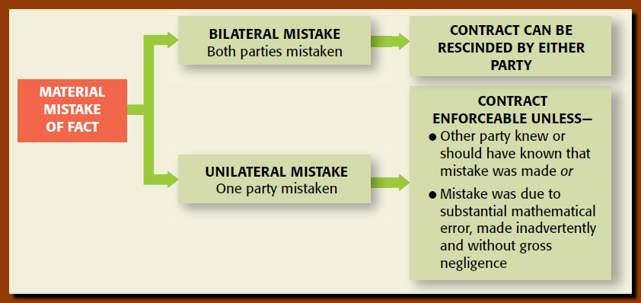
Voluntary Consent(acceptance must be voluntary act) MISTAKE of MATERIAL FACT NOT MISTAKE OF VALUE

Slide 31
FRAUD
Contract is voidable by innocent party. Injured party must show:
Misrepresentation of a material fact (not opinion) by conduct, of law, silence, or words. Opinion is not fact (unless it is an expert opinion).
Intent to deceive. Also known as “scienter.”
Innocent party must have justifiably relied on the misrepresentation.
Plaintiff must have suffered a legal injury

Slide 32
Undue Influence & Duress
Undue Influence.
Arises from a special relationship of trust.
A stronger party overcomes a weaker party’s free will by exerting psychological influence.
Duress.
Threat of physical force or extortion.
Can serve as basis for rescission of contract.
Economic need, by itself, is not duress.

Slide 33
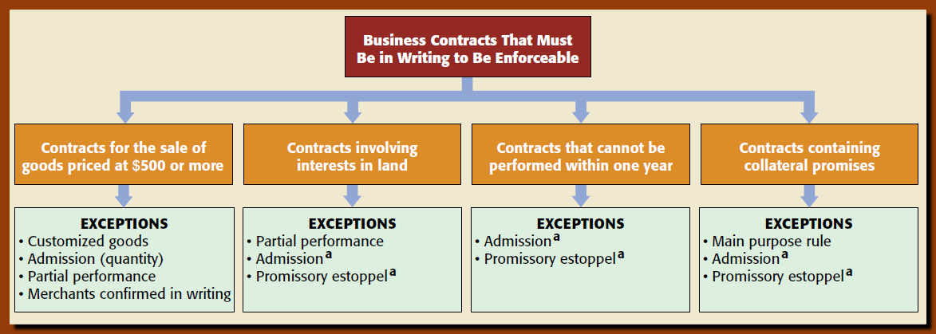
STATUTE OF FRAUDS

Slide 34
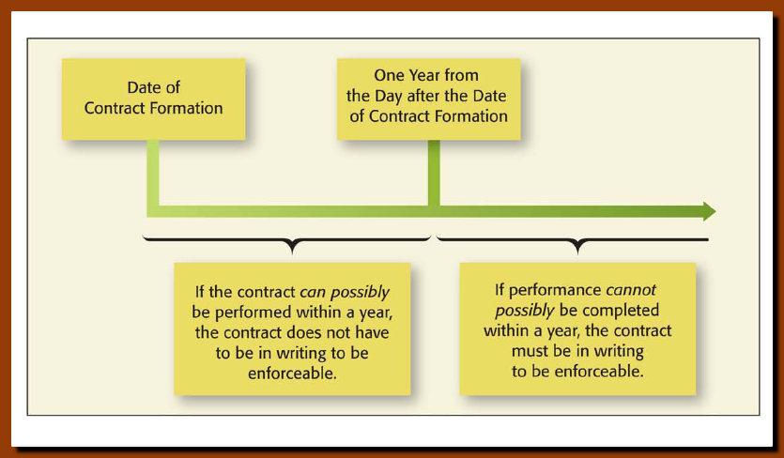
Statute of Frauds Performance within one year

Slide 35
Statute of Frauds Sufficiency of the Writing
What Constitutes a Writing?
Written contract(s) or memorandum(s) (paper or electronic) SIGNED by the party against whom enforcement is sought (typically the defendant in the case).
Documents can be “incorporated” into each other.
What Must be Contained in the Writing?
Essential terms only.
Must name parties.
Be signed by party against whom enforcement is sought (usually the Defendant). Proving an “e-signature” is a matter for trial.
Statute of Frauds

Slide 36
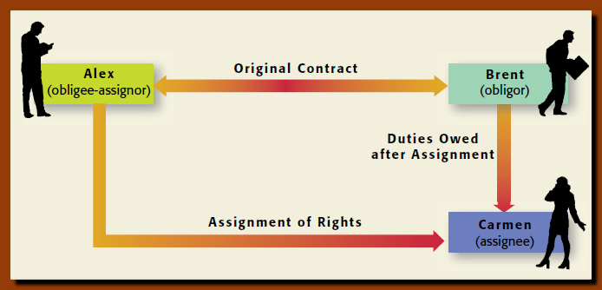
ASSIGNMENT OF RIGHTS Transfer of RIGHTS to a third party – assignee

Slide 37
ASSIGNMENT OF RIGHTS
Effect: Assignee has the right to demand performance from the original party (Obligor) to the contract.
Notice of Assignment.
Rights That Cannot Be Assigned:
Statute Expressly Prohibits Assignment.
Contract is for Personal Services.
Assignment will Materially Change Risks or Duties of Obligor.
When Contract Itself Prohibits Assignment.
assignment

Slide 38
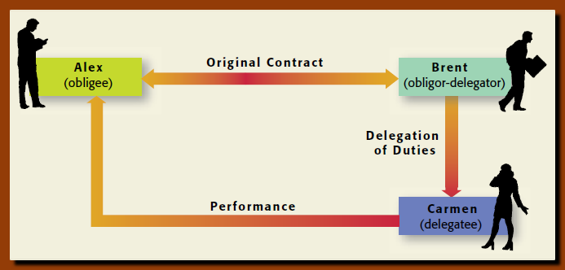
Delegations of Duties Transfer of duties to a 3rd party (Delegatee) by Delegator. Delegatee still owes duty to original party in contract, and is still liable for performance

Slide 39
DELEGATION OF DUTIES
Generally any duty can be delegated except:
When performance depends on personal skills or talents of original obligor.
When special trust has been placed in the obligor.
When 3rd party performance will materially vary.
When the contract expressly prohibits delegation.
https://study.com/academy/lesson/what-is-delegation-definition-parties-duties.html

Slide 40
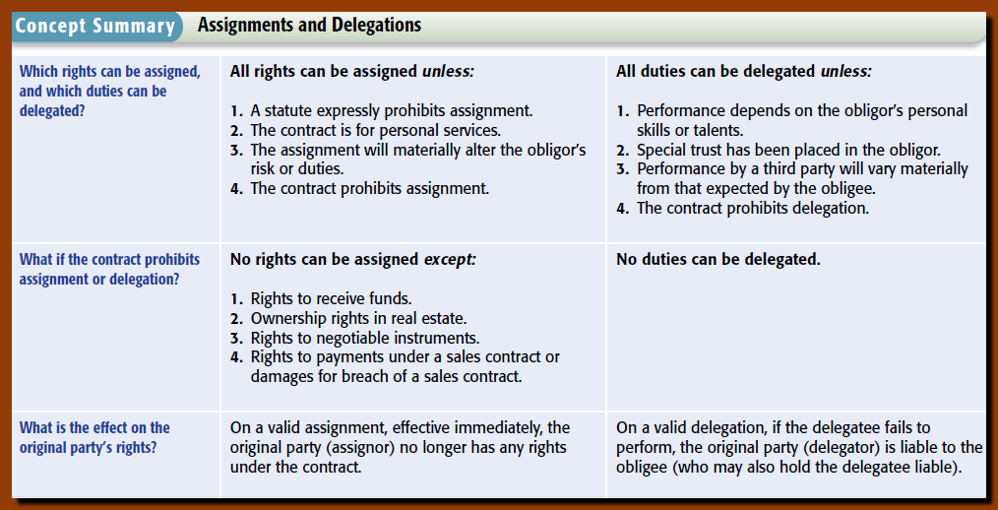
ASSIGNMENTS AND DELEGATIONS

Slide 41
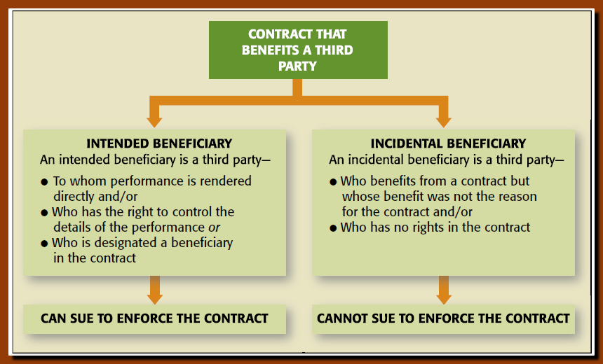
THIRD PARTY BENEFICIARY Person who obtains a benefit from a contract

Slide 42
THIRD PARTY BENEFICIARY
3P Intended Beneficiary
Original parties to K intend at the time of contracting that the contract performance directly benefit a 3rd party.
When rights vest:
Third party demonstrates express consent.
Third party materially alters her position.
When conditions are satisfied.
After rights vest, third party can sue for breach.
3P Incidental Beneficiary. Benefit is unintentional. 3P has no rights.
Third Party Beneficiary

Slide 43
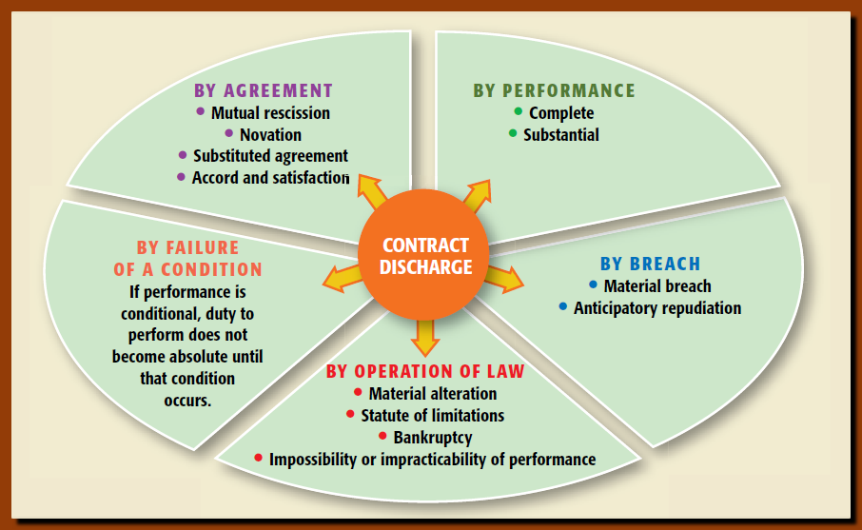
CONTRACTUAL DISCHARGE

Slide 44
DISCHARGE BY PERFORMANCE
Discharge is the Complete or Substantial performance of all contractual duties.
Discharge by Failure of a Conditions
Condition is a possible future event that may or may not happen.
Condition triggers or terminates performance.
Condition Precedent: prior to performance
Condition Subsequent: follows initial performance.
Concurrent Conditions: occur simultaneously
Discharge Conditioned on Satisfaction

Slide 45
DISCHARGE BY BREACH OF CONTRACT
Material Breach of Contract.
When performance is not substantial.
Innocent party is excused from performance and has the right to sue for damages.
A minor breach may be cured.
Anticipatory Repudiation of Contract.
One party gives notice of refusal to perform.
Innocent party treats AR as material breach.

Slide 46
DISCHARGE BY AGREEMENT
Discharge By Mutual Rescission: parties must make another agreement.
Discharge by Novation: new contract with substitution of a third party for one of the original parties.
Discharge by Accord and Satisfaction: settlement to discharge original contract

Slide 47
DISCHARGE BY OPERATION OF LAW
Contract Alteration.
Material alteration discharges innocent party.
Statutes of Limitations.
Automatically discharges.
Bankruptcy.
Impossibility
Objective Impossibility.
Party with required personal performance dies or becomes incapacitated prior to performance.
Specific subject matter is destroyed.
Change in law renders performance illegal.
Temporary Impossibility.
Performance is suspended until impossibility ceases.
.

Slide 48
Impracticability and Frustration of Purpose
Commercial Impracticability.
Parties may be excused when performance becomes extremely more expensive than originally agreed and not known or foreseeable.
Frustration of Purpose: supervening circumstances make it impossible to attain the purpose both parties had in mind.

Slide 49
DAMAGES
Compensatory : covers direct losses and costs).
Consequential: indirect and foreseeable losses.
Punitive: punish and deter wrongdoing.
Nominal: recognize wrongdoing with no monetary loss.
https://study.com/academy/lesson/legal-remedies-in-contracts-definition-acts.html

Slide 50
COMPENSATORY DAMAGES
Compensates injured party (Plaintiff) who must prove actual damages caused by breach. Amount is calculated:
Generally: difference between Defendant’s promised performance and actual.
Sale of Goods: difference between the contract price and market.
Sale of Land: Usually specific performance (or difference between contract price and FMV of land.
Construction Contracts: Depends on the stage of construction

Slide 51
OTHER DAMAGES
Consequential (Special) Damages
Foreseeable damages that result from breach of contract.
Caused by other than breach of contract.
Punitive (Exemplary) Damages. NOT IN CONTRACTS
Deter wrongdoer; set example.
Nominal Damages.
Technical injury, no actual damages.
Liquidated: fixed, certain dollar amount agreed to by parties, paid in the event of breach. Clauses for liquidated damages are enforceable.
Penalties: designed to penalize a party. Generally not enforceable.

Slide 52
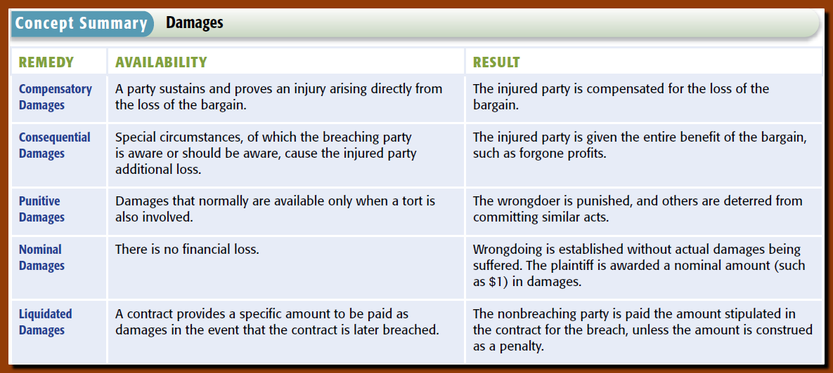

Slide 53
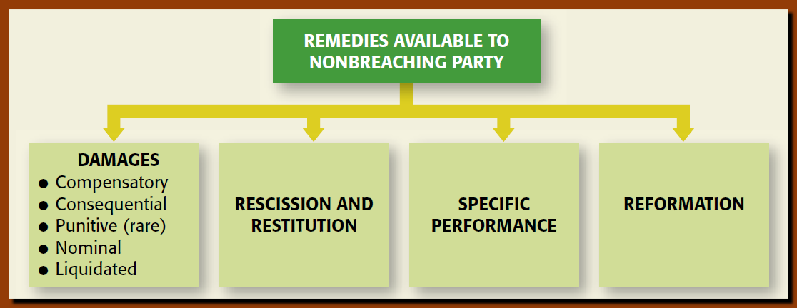
ONLY ON CERTAIN UNUSUAL ITEMS OR REAL PROPERTY

Slide 54
EQUITABLE REMEDIES
Specific Performance. Non-monetary relief only granted in cases where the legal remedy is inadequate and the subject matter is unique (e.g., sale of land, or original art). EXCEPTION: Contracts for Personal Services. Courts generally refuse to grant specific performance due to notions of ‘involuntary servitude.’
Rescission: cancel or undo a contract.
Available for fraud mistake, duress and failure of consideration.
Restitution: recapture the benefit conferred on the defendant that has unjustly enriched her.
Parties must return goods, property or money
Reformation.
Used when parties have imperfectly expressed their agreement in writing.
Court can rewrite the contract to reflect the parties’ true intentions.

Slide 55
Quasi Contract Remedy
Recovery based on Quasi-Contract. Plaintiff must show:
Benefit was conferred on the other party.
Party conferring benefit expected to be paid.
Party seeking recovery did not volunteer.
Retaining benefit without payment would be unjust enrichment.

Slide 56
ELECTION OF REMEDIES
Generally, a non-breaching party has several remedies available.
The common law of contracts requires the party to choose which remedy to pursue. This is called election of remedies.
The purpose of the doctrine of election of remedies is to prevent double recovery.

