Slide 1
Internet and crimes

Slide 2
SPAM
UNSOLICITED JUNK MAIL
state laws that regulate spam require the senders of e-mail ads to instruct the recipients on how they can “opt out” of further e-mail
The Federal CAN-SPAM Act: Prohibited activities include the use of a false return address and the use of false, misleading, or deceptive information when sending e-mail. The statute also prohibits the use of “dictionary attacks”—sending messages to randomly generated e-mail addresses—and the “harvesting” of e-mail addresses from Web sites through the use of specialized software.

Slide 3
Domain Names
Internet Corporation for Assigned Names and Numbers (ICANN), a nonprofit corporation, oversees the distribution of domain names and operates an online arbitration system… top level and second level domain problems
In 2012, ICANN started selling new generic top-level domain names (gTLDs) for an initial price of $185,000 plus an annual fee of $25,000. Whereas TLDs were limited to only a few terms (including com, net, and org), gTLDs can take any form

Slide 4
Cybersquatting also discussed in crimes
occurs when a party registers a domain name that is the same as, or confusingly similar to, the trademark of another and then offers to sell the domain name back to the trademark owner.

Slide 5
Anticybersquatting Legislation
Congress enacted the Anticybersquatting Consumer Protection Act (ACPA) in 1999. The act amended the Lanham Act—the federal law protecting trademarks. The ACPA makes cybersquatting illegal when both of the following are true:
1.The domain name is identical or confusingly similar to the trademark of another.
2.The one registering, trafficking in, or using the domain name has a “bad faith intent” to profit from that trademark.

Slide 6
Typosquatting
A form of cybersquatting that relies on mistakes, such as typographical errors, made by Internet users when inputting information into a Web browser.

Slide 7
Meta Tags
Playboy vs. Terri Welles
A judge refused to grant an injunction against Terri Welles, Playboy’s 1981 Playmate of the Year, to prevent her from using terms such as “Playmate” and “Playboy” on her web pages and within her meta tags.
The judge felt Welles had a legitimate reason to use them in order to describe herself, and importantly, to catalog her web site properly with search engines. She further noted that Welles was not using the terms in an attempt to mislead into believing they were at a Playboy site.

Slide 8
Online trademark dilution
Claim of dilution does not require proof that consumers are likely to be confused by a connection between the unauthorized use and the mark. For this reason, the products involved need not be similar, as the following
Candyland.com as an internet porn site diluted the Hasbro Game trademark for Candyland. Hasbro, Inc. v. Internet Entertainment Group, Ltd.

Slide 9
The Digital Millennium Copyright Act
civil and criminal penalties for anyone who circumvents (bypasses) encryption software or other technological antipiracy protection.
Prohibits manufacture, import, sale, and distribution of devices or services for circumvention
limited the liability of Internet service providers (ISPs). Under the act, an ISP is not liable for any copyright infringement by its customer unless the ISP is aware of the subscriber’s violation

Slide 10
E-Mail Hacking… disclosures
Sony…. Embarrassed
Merrill Lynch….emails are forever

Slide 11
Social Media Posts will follow you forever
Employers… check policies
Government/Police/Investigators
Colleges
Job Interview
How Else can this come back at you?

Slide 12
The Electronic Communications Privacy Act ECPA
prohibits the intentional interception of any wire, oral, or electronic communication
prohibits the intentional disclosure or use of the information obtained by the interception

Slide 13
ECPA Exceptions
business-extension exception… if your boss gave you the computer, phone, etc. to use in ordinary course of
Stored Communications Act (SCA). prohibits intentional and unauthorized access to stored electronic communications and says AT&T cannot give YOUR information to someone else
Case about restaurant employees… myspace…

Slide 14
Protection of Social Media Passwords
Can your boss demand your social media passwords?
About 25 states have laws that protect you from having to disclose passwords…. BUT THAT MEANS 25 DO NOT.
California does have these ANTI-SNOOPING laws

Slide 15
Company-wide Social Media Networks
Some Companies creating their own social media platforms…. Perhaps easier to control trade secrets
Real time solutions for glitches

Slide 16
Online Defamation… who is the speaker
YELP…. Is it opinion?
Bed and breakfast
Manage online reputation

Slide 17
Liability of Internet Service Providers
The Communications Decency Act (CDA) states that “[n]o provider or user of an interactive computer service shall be treated as the publisher or speaker of any information provided by another information content provider. (unlike newspapers, magazines, etc that are liable)
But see: Roommate.com, LLC, operates an online roommate-matching Web site and created discriminatory questionairre asking sex, family status, and sexual orientation—which is not permitted under the federal Fair Housing Act.

Slide 18
Privacy… & Right to be Forgotten
The new “right to be forgotten” in the European Union allows individuals to petition Google to remove search result links that are personal in nature and that have become “outdated” or “irrelevant
Commission says will not work in US because of right to free speech??? What do you think?.

Slide 19
Data Collection and Cookies
Facebook, Inc., recently settled a lawsuit over its use of a targeted advertising technique called “Sponsored Stories.” An ad would display a Facebook friend’s name and profile picture, along with a statement that the friend “likes” the company sponsoring the advertisement. A group of plaintiffs filed suit, claiming that Facebook had used their pictures for advertising without their permission. When a federal court refused to dismiss the case, Facebook agreed to settle.

Slide 20
Internet Companies’ Privacy Policies
The Federal Trade Commission (FTC) investigates consumer complaints of privacy violations. The FTC has forced many companies, including Google, Facebook, Twitter, and MySpace, to enter an agreement consenting to give the FTC broad power to review their privacy and data practices. It can then sue companies that violate the terms of the decree.

Slide 21
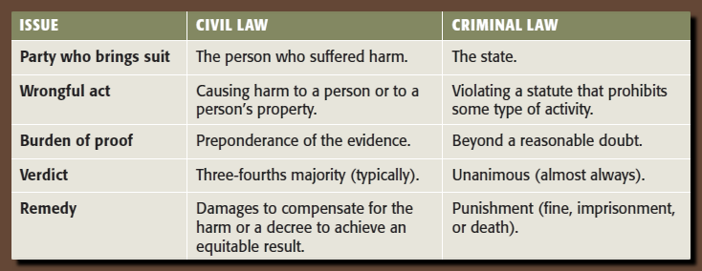
KEY DIFFERENCES IN CIVIL AND CRIMINAL LAW

Slide 22
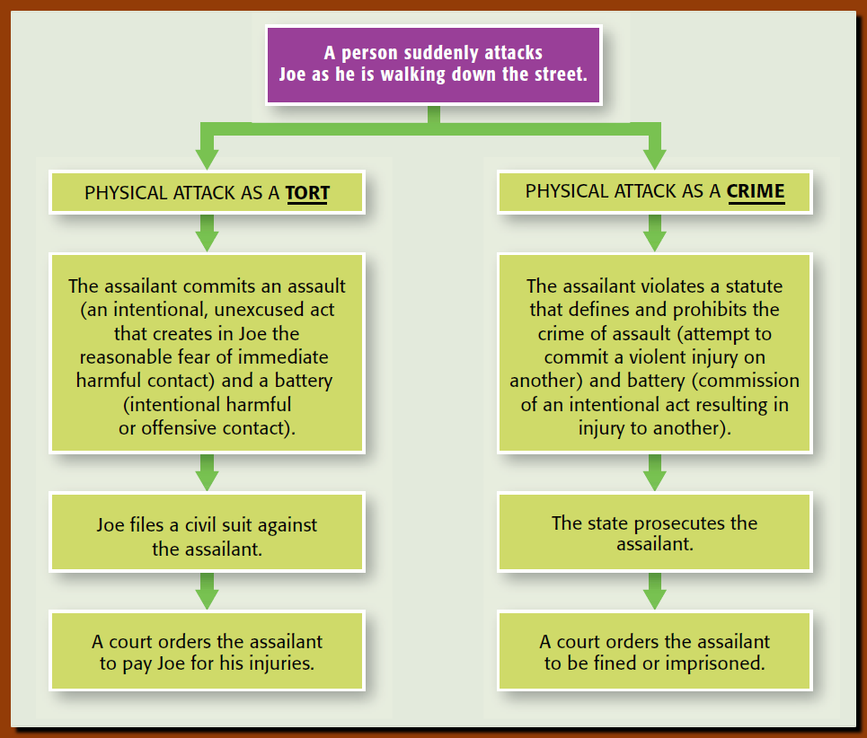
ONE ACT CAN BE A CRIMINAL AND CIVIL VIOLATION

Slide 23
Overview SOME CRIMES

Slide 24
What two elements must exist before a person can be convicted of a crime? Actus reus and mens rea
Can a corporation commit crimes? yes
What are five broad categories of crimes? Violent, property, public order, white collar, organized crime
What defenses might be raised by criminal defendants to avoid liability for criminal acts? Justifiable force, duress, necessity, insanity, entrapment, statute of limitations, mistake immunity.
What constitutional safeguards exist to protect persons accused of a crime? Fourth, Fifth, Sixth and Eighth Amendments and Miranda

Slide 25
CRIMES CLASSIFICATIONS
Felonies: serious crimes punishable by death or by imprisonment over one (1) year.
Misdemeanors: less serious crimes punishable by fine or by confinement up to one (1) year.

Slide 26
actus reus and mens rea
State must show beyond a reasonable doubt that the defendant:
Performed an criminal act (actus reus) AND
While performing the act, had the required intent or specific state of mind (mens rea).
Without the required intent there can be no criminal conviction
Ethan drives off in Floyd’s car mistakenly believing that it is his. Is this theft? Why or why not?
Daisy takes her roommate’s credit card, intending to charge expenses that she incurs on a vacation. Her first stop is a gas station, where she uses the card to pay for gas. With respect to the gas station, has she committed a crime? If so, what is it?

Slide 27
TYPES OF CRIMES
Violent Crime.
Crimes against persons (murder, rape).
Robbery is a violent crime.
Property Crime: most common, involves money or property:
Burglary.
Larceny.
Obtaining Goods by False Pretenses.
Receiving Stolen Goods.
Arson.
Forgery.
Public Order Crime.
White Collar Crime: non-violent crimes involving a business transaction.
Embezzlement.
Mail and Wire Fraud.
Bribery.
Theft of Trade Secrets.
Insider Trading
Organized Crime.
Money laundering.
Racketeer Influenced and Corrupt Organizations Act (RICO).
Criminal Provisions (includes 26 different types of felonies with fines up to $25,000 and 20 years in prison for each offense).
Civil Penalties include forfeiture, and treble damages.

Slide 28
Justifiable Use of Force …. You can Protect yourself Duress threat of immediate danger “Get me the $$$ or I will kill you child.” Not a defense to murder Necessity … to prevent greater harm Insanity. Did not understand nature of the act or that it was wrong at the time Entrapment… government suggests crime… undercover agents Statute of limitations prosecute within certain # of years Mistake (of Facts…. Not of Law) Immunity…. Government promise
DEFENSES TO CRIMES

Slide 29
FOURTH AMENDMENT PROTECTIONS
Search Warrants:
Officer must have Probable Cause.
Exceptions to Warrant (food and liquor)
Search and Seizure in Businesses (consent)
No warrant required for contaminated food or highly regulated liquor or gun businesses.
State officials can seize business records without a warrant if owner agrees to search.
Fruits of the Poisonous Tree

Slide 30
DUI CHECKPOINTS
DUI checkpoints pose an interesting application of the Fourth Amendment’s rules. Stopping the driver of a car is considered a seizure since the person has to pull over and can’t leave again until the officer allows it. Since the law enforcement officers at a DUI checkpoint stop every single driver without any individualized suspicion, IS A DUI CHECKPOINT AN UNREASONABLE SEARCH AND SEIZURE?

Slide 31
Michigan Dept. of State Police v. Sitz, 496 U.S. 444 (1990), a majority of the Supreme Court Justices determined that the needs of the state to prevent drunk-driving accidents outweighed the minimal intrusion on sober drivers who just happen to get caught up in the DUI dragnet. Thus, the Justices argued, DUI checkpoints did not constitute an unreasonable search and seizure.

Slide 32
FIFTH AMENDMENT PROTECTIONS
Due Process of Law.
Opportunity to Object.
Hearing before a neutral Magistrate.
Double Jeopardy.
Person cannot be retried for the same offense in the same court.
Civil action, however, is permitted.
Self-Incrimination.
“Right to Remain Silent” or not testify against yourself

Slide 33
SIXTH & EIGHTH AMENDMENT PROTECTIONS
Right to Speedy Trial.
Right to Jury Trial.
Right to Public Trial.
Right to Confront Witnesses.
Right to Counsel.
Prohibition on cruel and unusual punishment.

Slide 34
MIRANDA AND EXCLUSIONARY RULES
Evidence obtained in violation of constitutional procedures must be excluded.
Evidence derived from illegal evidence is “fruit of the poisonous tree.”
Deters police from misconduct.
Herring v. United States (2009). Evidence obtained during a search incident to a ‘mistaken’ arrest is admissible.
Miranda v. Arizona (1966).
Inform suspect of his rights.
Exceptions:
Public Safety
Coercion.
Illegally obtained evidence.

Slide 35
CORPORATE CRIMINAL LIABILITY
Liability of the Corporate Entity.
Crimes must occur within scope of employment.
Corporations can be held criminally liable when they FAIL to fulfill certain statutory duties.
Criminal liability of corporate officers and directors under the “Responsible Officer” doctrine:
Employees under their control and supervision.
Do not have to participate in, or direct, or know about criminal violation.

Slide 36
CYBER CRIMES A CRIME THAT OCCURS ONLINE IN THE VIRTUAL WORLD
What distinguishes cyber crime from “traditional” crime?
How has the internet expanded opportunities for identity theft?
What are three reasons that cyberstalking may be more commonplace than physical stalking?
What are three major reasons the internet is conducive to juvenile cyber crime?
How do encryption programs protect digital data from unauthorized access?

Slide 37
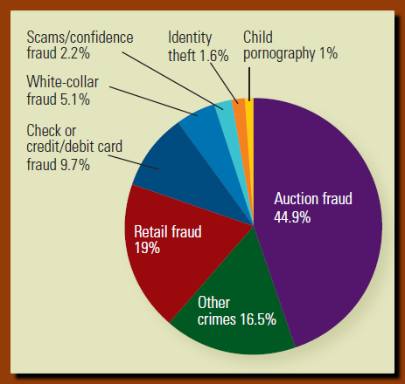
Cyber Crimes Against Persons and Property https://www.youtube.com/watch?v=PIELVMQhvXc

Slide 38
CYBER THEFT
Cyber Theft.
Identity Theft using novel methods.
Low cost of black-market data.
“Phishing.” (False request from a creditor/relationship leading to Trojan Horse)
Vishing. (Phishing with voice communications… call creditor)
Employment Fraud.

Slide 39
Cyberstalking
Stalking through use of the internet through email or other electronic communication
Harassing and putting person in fear (or fear for family)
Cyber bullying… fictitious person on facebook.
Prosecutable in any state where the communication is received or sent from.

Slide 40
Cyber Crimes in the Business World
Credit Card Crime on the Web.
Risk is with bank
Hacker (using one computer to break into another)
Botnets, malware, viruses, and worms.. Up to $5 million a day while cleaning up.
JUVENILE CYBER CRIME: (growing threat)
offenses disproportionate to their age and anonymity.

Slide 41
Hacking and Cyberterrorism
Cyberterrorists are stealth hackers trying to exploit computers for maximum impact… infrastructure of business and government vulnerable.
Logic bombs may “explode” and shut down computers and online networks.
2009 – Chinese and Russians hacked into our electrical power grid, leaving behind ‘botnet’ software that could hijack facilities.

Slide 42
SPAM
Spam: unsolicited “junk” emails with ads, solicitations, and other messages (pornography).
State Regulation of Spam. Tell people how to unsubscribe
Federal CAN-SPAM Act. Prohibits use of false information (including return addresses)
U.S. Safe Web Act. Allows FTC to share information with foreign agencies investigating and prosecuting cyber crimes. Provides ISP’s with immunity from liability for supplying subscriber information to FTC.

Slide 43
ONLINE GAMBLING
Gambling is illegal… EXCEPT
Native American Lands
Nevada, New Jersey…. Etc.
Horseback racing
Lotteries
Bingo (for charity)
Foreign Countries
2005 12 million Americans wagered $6 billion online.
Civil Forfeiture
2006 Unlawful Internet Gambling Enforcement Act….Cannot create accounts with electronic payments

Slide 44
Prosecuting Cyber Crimes.
Threshold questions of jurisdiction and venue.
Identification of wrongdoers is difficult because they do not leave fingerprints or DNA.
Computer Fraud and Abuse Act…. FEDERAL OFFENSE to use a computer to obtain or attempt to obtain protected data (financial, credit card, military, medical, legal, national security, etc.) Infrastructure Protection Act 1996
Private Efforts to Combat Cyber Crime. Encryption is a good, inexpensive security device.

