Slide 1
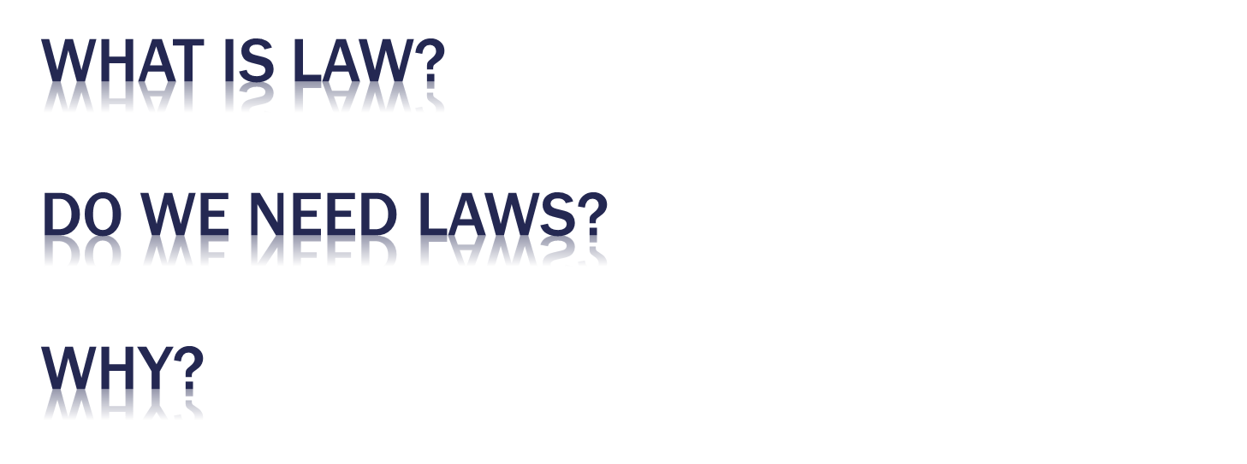

Slide 2

Law consists of enforceable rules governing relationships among individuals and between individuals and their society
Law establishes rights, duties, and privileges that are consistent with the values and beliefs of a society or its ruling group

Slide 3

Of course we need laws… but…
Do we need an uncountable number of laws?
Do we need 20,000 laws governing the ownership of guns? Have they worked?
Do we need a tax code that is over 3,400,000 words or 7500 pages?

Slide 4

Would we know not to steal from someone without laws? How would we know not to stop at a red light?
Would we all be running around killing and stabbing each other without laws?
1927 First codified laws… they were a single volume (1776-1927)… Now 50 Volumes (JUST FEDERAL).

Slide 5

The U.S. Constitution… and its Amendments are the Supreme Law of the land.
Federal & State Statutes and Local Ordinances (passed by legislative bodies).. UNIFORM CODES
Administrative Rules And Regulations promulgated by federal, state, and local regulatory agencies; and
Common law…. Judicial review

Slide 6

5 U.S. 137 (1803),
"It is emphatically the province and duty of the judicial department to say what the law is. Those who apply the rule to particular cases, must of necessity expound and interpret that rule.“
JUDICAL REVIEW which results in COMMON LAW

Slide 7

COMMON LAW: Judicial decisions interpreting and enforcing constitutional, statutory, or administrative law and governing those relationships and transactions that constitutional, statutory, and administrative law do not govern.
Judges Need to Be Independent

Slide 8

Supremacy Clause, (Art. VI § 2) Federal constitutional and statutory law and treaties supersede state law. Federal Preemption.
The Commerce Clause (Art. 1 § 8) The national government had the exclusive power to regulate interstate commerce or business that substantially impacts interstate commerce.
  Wickard v. Filburn (1942). Purely local production, sale and consumption of wheat was subject to federal regulation.
  Heart of Atlanta Motel v. U.S. (1964). Motels that provided public accommodations were subject to federal civil rights legislation.

Slide 9

The 1st Amendment guarantees freedom of religion, speech, the press, assembly, and petition.
  Can a Christian baker refuse to bake a cake for a gay wedding?... Free Exercise Clause … Freedom of Religion.
  Corporations have protected political speech to financially support candidates. Citizens United v. FEC (2010).
  Bad Frog Brewery, Inc. v. NYSLA (1998)… can a beer company put a frog “giving the finger” on labels? (defamation, threats, incite) Freedom of Speech
  Can 200 teenagers quietly sit in the street of Ferguson to protest their friends death? Freedom of Assembly
.

Slide 10

Restrictions must:
  (1) Seek to implement substantial government interest,
  (2) Directly advance that interest, and
  (3) Must go no further than necessary to accomplish.

Slide 11

The Fifth Amendment
Due Process… No person will be deprived of life, liberty or the pursuit of happiness without a fair hearing. NOTICE and FAIR HEARING
No Person’s property will be taken without just compensation Eminent Domain

Slide 12

The Fourteenth Amendment
The State cannot deny anyone within its jurisdiction equal protection of the law.
What does within its jurisdiction mean… geography… or people under its control. Why does it matter how its defined?

Slide 13

Griswold v. Connecticut (1965) implied right to privacy under the constitution….
But its not explicitly anywhere in the Constitution.
Led to Roe v. Wade Decision.
Body scanners? Terrorism justify?

Slide 14

The doctrine obliging judges to follow established precedent within a particular jurisdiction.
Precedent: The authority afforded to a prior judicial decision by judges deciding subsequent disputes involving the same or similar facts and the same jurisdiction’s substantive law.

Slide 15

BINDING AUTHORITY: Any primary source of law a court must follow when deciding a dispute. This includes all constitutional provisions, statutes, treaties, regulations, or ordinances that govern the issue being decided, as well as prior court decisions that constitute controlling precedent in the court’s jurisdiction.
Persuasive Authority: Any primary or secondary source of law which a court may, but is not bound to.

Slide 16

Substantive law creates, defines, describes, regulates, restricts, suspends, and sometimes abolishes legal rights and obligations.
Procedural law establishes and regulates the METHOD of enforcing or vindicating substantive legal rights.
Civil law defines and enforces the duties or obligations BETWEEN and AMONG Individuals and Businesses.

Slide 17

Criminal law, by contrast, defines and enforces the obligations of persons to society as a whole.
Cyberlaw: A growing body of law dealing specifically with issues raised by cyberspace actions and transactions.
National Law: Written and unwritten laws governing rights and obligations within a particular country.

Slide 18

International Law: Written and unwritten laws governing the relations between and among nations and between nations and the citizens of one or more other sovereign nations (e.g., the Geneva Convention on the Treatment of Prisoners of War, the Warsaw Convention on International Air Travel, the General Agreement on Tariffs and Trade).

Slide 19

Criminal Actions are prosecuted by Government on behalf of the PEOPLE:
Federal Government --- United States Attorneys and FBI.
State Government… District Attorneys and Police/Sheriffs
Civil Cases are pursued by INDIVIDUALS

Slide 20

The body of rules, orders, and decisions issued by administrative agencies, such as the federal Securities and Exchange Commission, The Internal Revenue Service, The Environmental Protection Agency or a state’s public utilities commission.

Slide 21

Agencies formed to assist the President or, at the state level, the Governor, in carrying out executive functions (e.g., the Federal Bureau of Investigation).

Slide 22

When an AGENCY decides to create a new rule they must first publish the proposed rule in the Federal Register and allow time for comment.
The agency must respond to comments and modify the rule when appropriate.

Slide 23
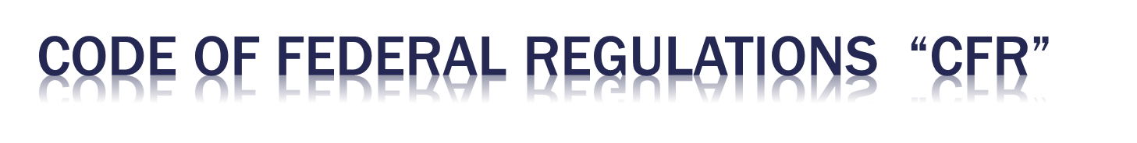
When the Agency finalizes the rule it becomes published in the Code of Federal Regulations: C.F.R.

Slide 24
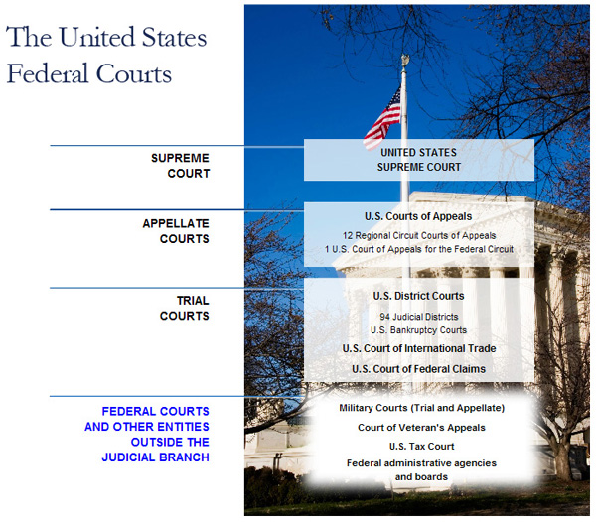

Slide 25
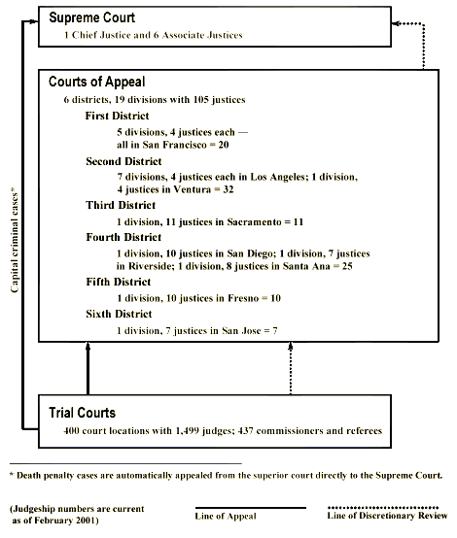

Slide 26
STATE FEDERAL
Superior Court
TRIAL COURT
District Court
4th District Court of Appeals
9th Circuit Court of Appeals
APPEALS COURT
California Supreme Court
SUPREME COURT
SCOTUS
SCOTUS
PETITION FOR FURTHER REVIEW
COURT STRUCTURE IN
SAN DIEGO COUNTY

Slide 27

Mostly addressed in Federal Court
Diversity plus $75,000 in dispute
Federal Question
Also an issue in small claims court. In CA claims are limited to disputes up to $5,000. However, natural persons (individuals) can claim up to $10,000.

Slide 28

Minimum Contacts
  Purposefully avails … some transaction
  The claim must be related to the transaction
  Reasonable to exercise jurisdiction
Would the operator of a passive website out of the region have minimum contacts.

Slide 29

Venue… when there is jurisdiction… where should the suit be litigated.
Standing… must have a stake in a justiciable controversy.

Slide 30
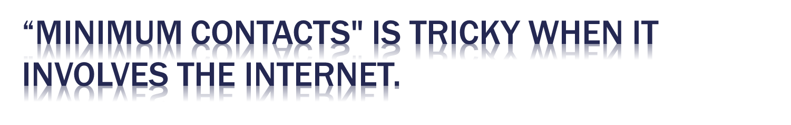
Pennsylvania court had personal jurisdiction over a California Internet service provider that had 3,000 Pennsylvania subscribers. Zippo Mfg. Co. v. Zippo Dot Com, Inc., 952 F. Supp. 1119 (W.D. Pa 1997).
A Texas court gained personal jurisdiction over an out-of-state online gambling enterprise because the gambling operation entered into contracts with Texas residents, sent emails to the Texas residents, and sent winnings to Texas residents. Thompson v. Handa-Lopez, Inc., 998 F. Supp. 738 (W.D. Tex. 1998).
sites over which credit card sales or other active business is conducted, called "interactive sites," are more likely to satisfy the minimum contacts requirement.

Slide 31

Pleadings (ELECTRONIC FILINGS)
  Plaintiff files a Complaint
  Plaintiff serves Complaint and Summons on Defendants
  Defendants file Answers (or challenges)

Slide 32

  Interrogatories
  Request for Documents
  Requests for Admission
  Depositions
  Duty to Preserve Electronic Evidence

Slide 33

PreTrial Motions
  Motion for Judgment on the Pleadings (No Evidence)
  Motions for Summary Judgment (Evidence)

Slide 34

Pre-Trial Conferences (court call)
  Expert Witnesses
  Motions in Limine
  Voir Dire Questions / Prescreeninig panels

Slide 35

Pick a Jury (voir dire)
Opening Statements (Cannot be Argumentative)
Plaintiff’s Case in Chief (cross examination)
Plaintiff rests (motion for directed verdict)
Defendants’ Case in Chief (cross examination)
Plaintiff’s rebuttal
Closing Arguments (Argue Away)
Jury Instructions
Jury Deliberations
Jury Delivers Verdict Forms

Slide 36

JNOV (Judgment Notwithstanding Verdict)
Motion for New Trial
The Appeal
  De novo Review
  Reversible Error (accepts all factual findings)

Slide 37

Negotiation (non-binding)
Mediation (non-binding)
Arbitration (binding)
Online Dispute Resolution (infancy)
ADR Originally a good plan… not working
  Judges leaving bench because they can make $900 an hour in ADR …judges probably about $100.
  Not true that this is less expensive… OFTEN MUCH MORE expensive.
  Not good for a consumer… too costly no jury

Slide 38

Arbitration Clauses are EVERYWHERE. Make sure you read documents.
They are generally enforceable… law favors arbitration because Courts are too crowded.
No standards… unpredictable results
Binding
Award converted to a judgment

