Slide 1
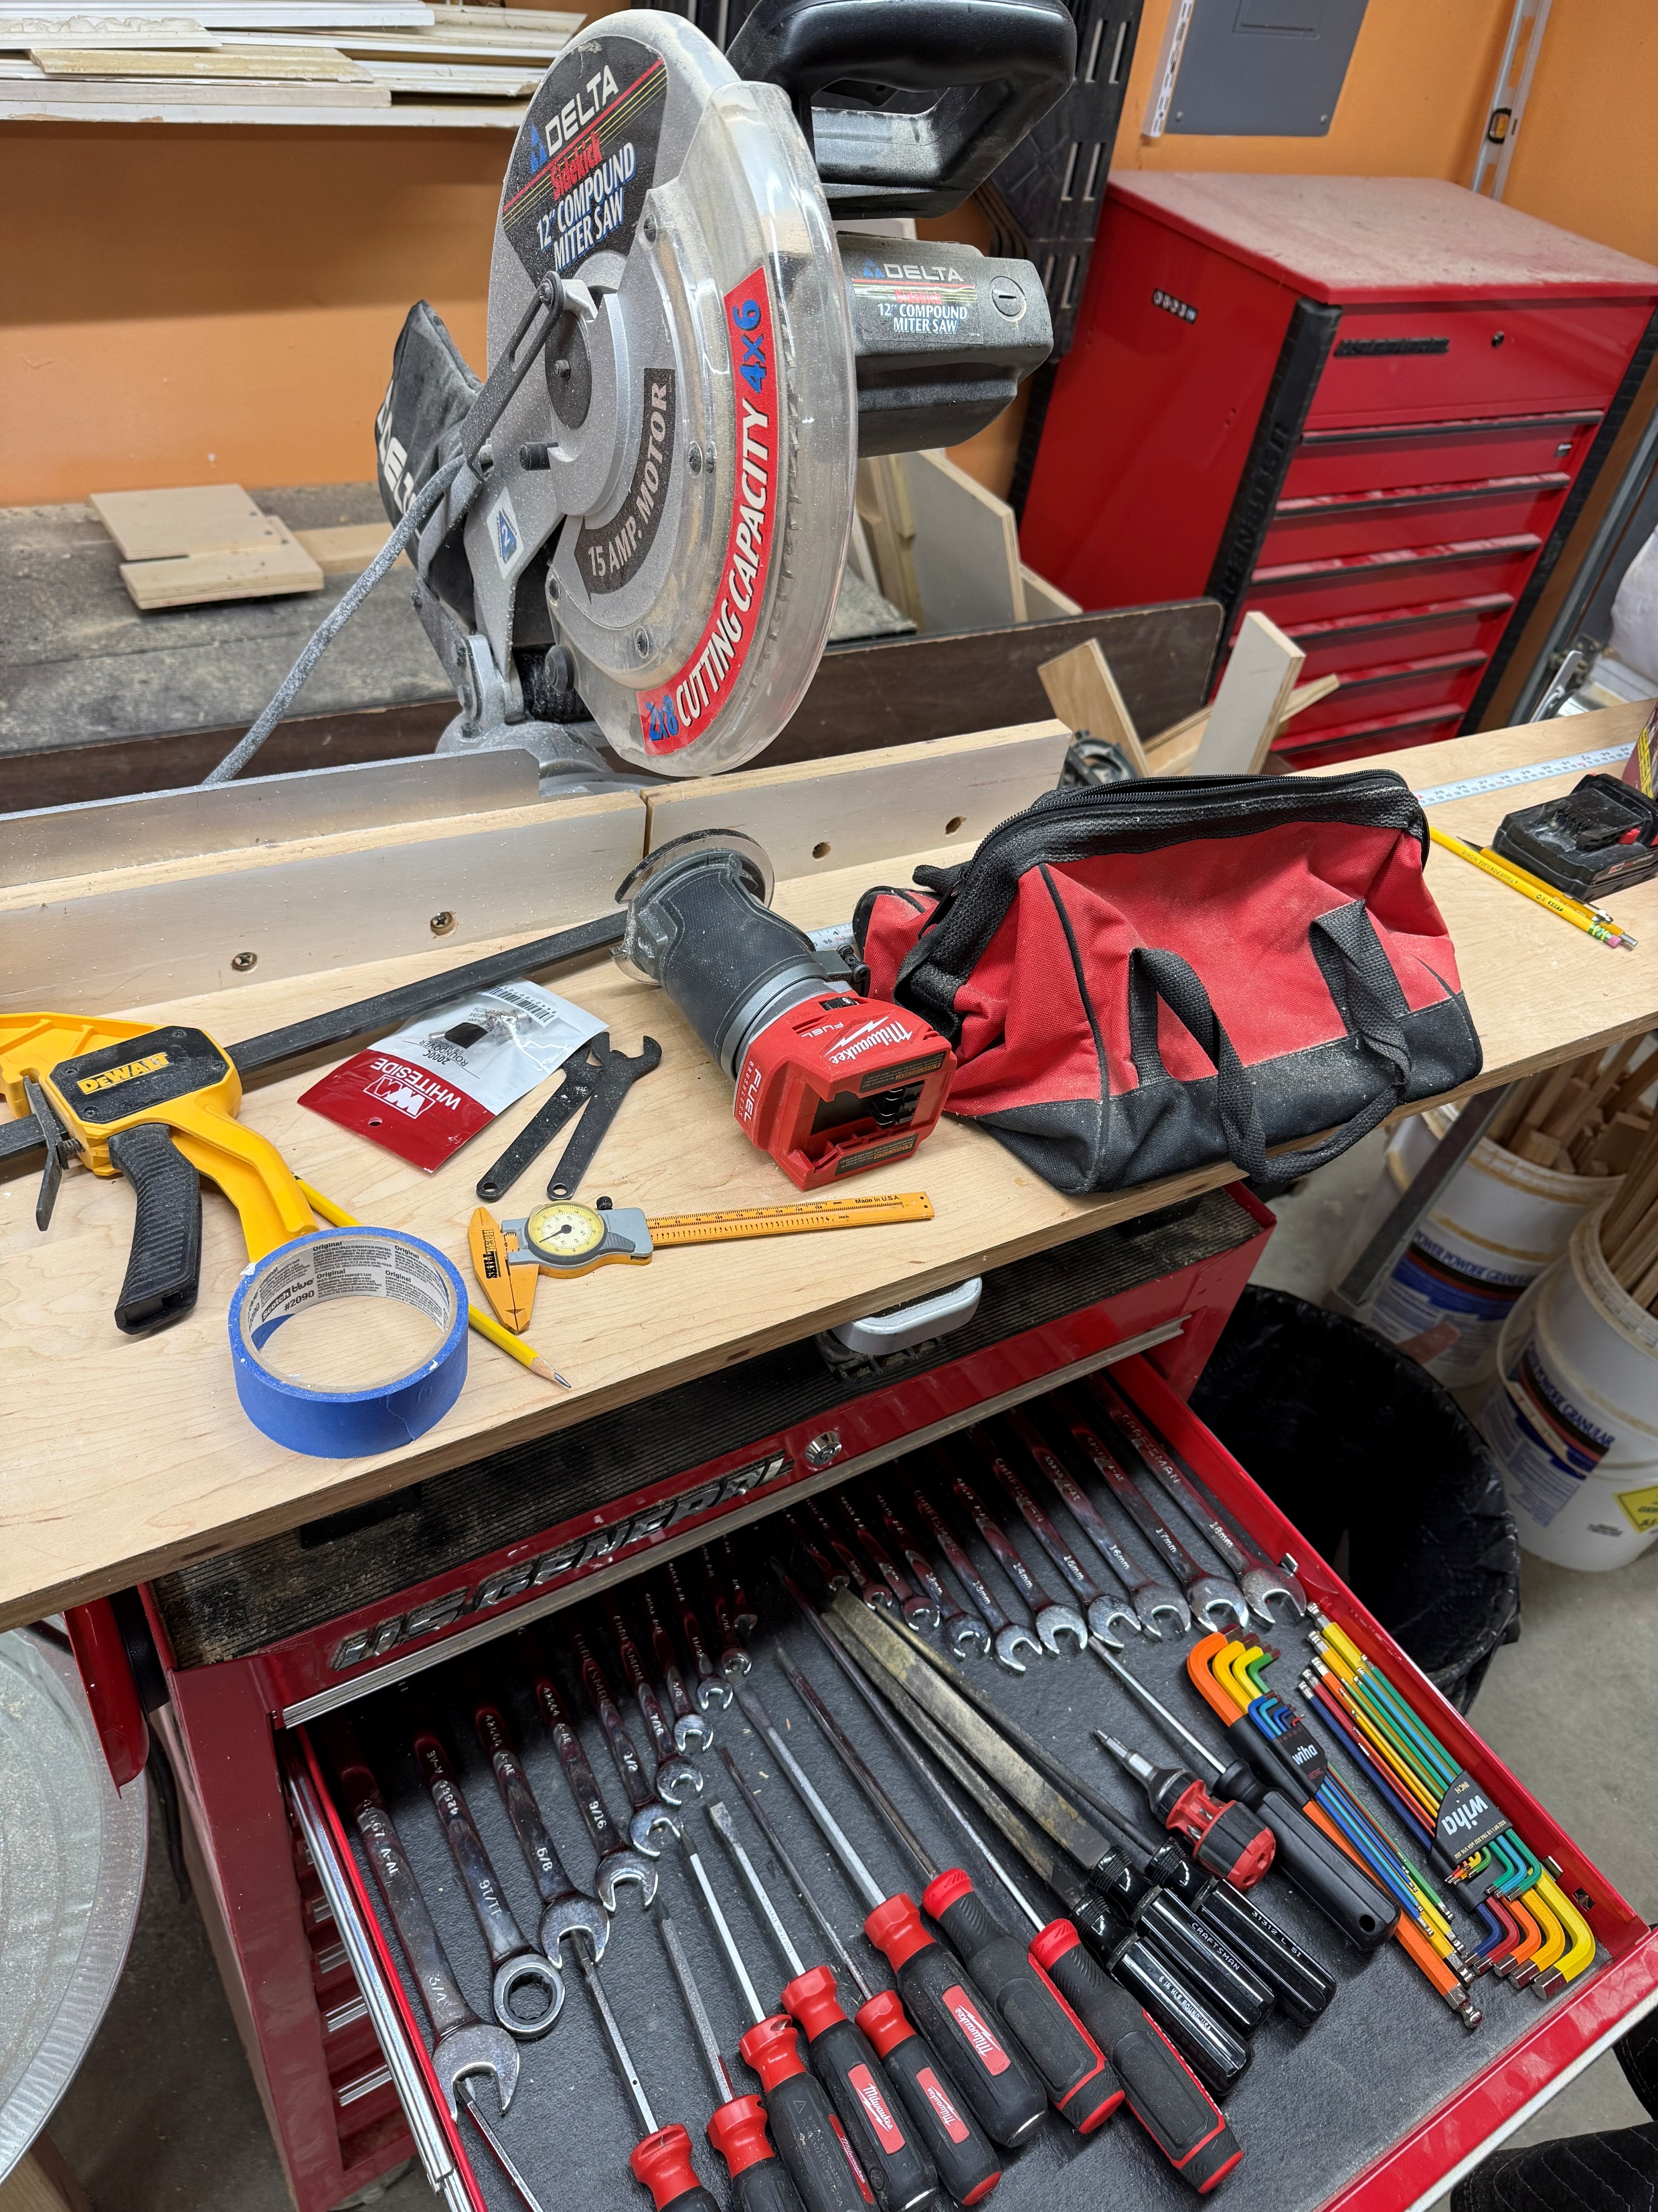
More Than a Toolbox of Technical Skills
How Leadership, Business, Interpersonal, and Technical (LBIT) Assessment Relates to Your Job Hunt
William Docter
2026-Oct-26
License: © 2026 William Docter. This work is licensed under a Creative Commons Attribution 4.0 International License (CC BY 4.0). You may copy, redistribute, remix, and build upon this material, including for commercial purposes, provided you give appropriate credit to William Docter and indicate if changes were made. The Second-Hand Tigers logo is not covered by this license. All rights in it are reserved.

Slide 2
Overview
  The four LBIT performance dimensions
    Leadership, Business, Interpersonal, Technical
    What happens without the first three: Nedry from "Jurassic Park"
  How LBIT runs through your career
    Job hunt, development planning, and annual performance assessment
  LBIT in the specifics of your job hunt
    Resume
    LinkedIn Profile
    Interview
  Mock interview: practice LBIT assessment live

Slide 3
Dimensions of Development and Mentoring Focus
Leadership
  Commitment to Excellence
  Owning your work
  Initiating action
  It’s NOT just named officer positions in an organization. It’s a behavior, not a title.
Business
  How to get work done & why the work is important
  Industry and Company Standards
  Work Processes & Stewardship
  Big Picture Understanding & Economics
Interpersonal
  Working in Teams
  Communicating to Stakeholders
  Networking
Technical
  Important, but undergrads tend to focus here and underestimate the other three
Setting and Accomplishing Development Goals · second-hand-tigers/badocter-career-learnings Wiki

Slide 4
Don’t Be the Technical “A” Who Gets an “F” on the Other Three
Jurassic Park's Nedry is a classic example of a failed expert who doesn't realize he's a failed expert
Technical capability exceptional, despite Hammond’s complaints about system bugs (scope of work described would easily justify a team of 10)
Acting ethically — Fail (Leadership — an ethics failure will get immediate disciplinary action: likely termination and possible criminal prosecution)
Owning and addressing his own mistakes — Fail (Leadership)
Caring about and mentoring the team — Fail (Interpersonal & Leadership)
Communicating priorities, challenges, and wins effectively — Fail (Interpersonal)
Business financials — Fail (Business)
 | Leadership | Business | Interpersonal | Technical | Overall
Nedry thinks of himself | N/A | N/A | N/A | A+ | A+
Hammond thinks of Nedry | F | F | F | C- | F
An Objective Supervisor | F | F | F | A+ | F
The Failed Expert · second-hand-tigers/badocter-career-learnings Wiki

Slide 5
Your LBIT Assessment Has Already Started
Job Hunt (Resume/LinkedIn/Interview)
  You are being assessed vs other applicants (peers) on each dimension
    Will you contribute to the team’s objectives and success?
    Will you be competitive in the LBIT performance assessment a year from now?
  You are not just a toolbox of technical skills
Development Planning
  You will have assigned objectives in each LBIT dimension based on growth opportunities identified during assessment
Performance Assessment
  You will be graded vs your peers and progress on your development plan on each dimension → Did you grow what you agreed to grow?
  Targets escalate with career stages
    Non-technical share of the job: ~50% at Expert, 100% at Sponsor
    You will eventually have to mentor across all LBIT dimensions and “influence without authority” above your pay grade
Annual Cycle
Mentoring Integration with Stage Development · second-hand-tigers/badocter-career-learnings Wiki

Slide 6
LBIT Screenings in Your Job Hunt
Resume
LinkedIn
Interview
The hook that lands the interview.
One-way: applicant to interviewer. Every bullet is a lead-in for LBIT probing questions.
Your public, two-way presence.
Interviewers read your profile; you read theirs. Every entry and every post is fair game.
The room itself.
The interviewer probes until all four dimensions are covered, unless you cover them first.
Same rule at every step: show you are not just a toolbox of technical skills.
Leadership, Business, Interpersonal, and Technical capability all need to shine in the Resume, LinkedIn Profile, and Interview. The Interview is the only stage where the interviewer can actively dig it out of you.
 | Leadership | Business | Interpersonal | Technical | Overall
Resume | Up to You | Up to You | Up to You | A | (L+B+I+T)/4
LinkedIn | Up to You | Up to You | Up to You | A | (L+B+I+T)/4
Interview | Q&A | Q&A | Q&A | A | (L+B+I+T)/4
The Job Hunt · second-hand-tigers/badocter-career-learnings Wiki
Notes:
Bridge from development planning to the job hunt. The same LBIT lens the employer uses for assessment and development is what the screener and interviewer use on you.

Slide 7
You Probably Have Highlights Across LBIT for Your Job Hunt
  Leadership
    Mentoring/Tutoring
    Undergrad Research Projects
    Team lead in Extracurricular
    Volunteer in Education Outreach (e.g., Junior Achievement Finance Park, JA-in-a-Day)
  Business
    Internships/Co-op
    Active in a Professional Organization (e.g., AIChE, and not just paying dues!)
    Interviewing Workshops, Researching Employers
  Interpersonal
    Mentoring/Tutoring
    Group Projects
    Team/Group Extracurricular Activities
    Volunteer in Outreach
  Technical
    Mentoring/Tutoring
    Undergrad Research Projects
    Technical Electives
    Base Engineering Curriculum
Many activities develop more than one dimension at the same time. Those are the ones to feature on your resume.
Can frame full LBIT narrative for Resume/LinkedIn/Interview
Extracurriculars · second-hand-tigers/badocter-career-learnings Wiki

Slide 8
Resume: One Bullet, Four Dimensions
Before: Technical only
Built a program to automate a manual data analysis process.
After: all four
Automated daily data analysis process, freeing up ~5 hours/week per application, eliminating errors, and meeting end-user requirement for instant analysis availability. Partnered with a software developer and a system engineer to deploy the pilot; developed job handover playbook and led training for company-wide rollout.
Dimension | Ask yourself | In the example
Technical | What did you do? | Automated a daily data analysis process
Business | Why did it matter? | Freed up ~5 hours/week per application, eliminated errors, and met end-user requirement for instant availability of analysis
Interpersonal | Who did you work with? | Partnered with a software developer and a system engineer to deploy the pilot
Leadership | How did you own it? | Developed job handover playbook and led training for company-wide rollout
Use ownership verbs (automated, partnered, developed, led), not "helped with." Across the whole resume, don't leave an all-Technical picture.
Resumes · second-hand-tigers/badocter-career-learnings Wiki
Notes:
Don't force all four into every bullet. It gets exhausting to read. Balance across the resume as a whole. Hold on to this example: it comes back on the interview slides.

Slide 9
LinkedIn: Every Profile Entry Is a Potential Probe
Interviewers may print your profile and go through it like your resume, looking for LBIT items to ask about
Endorsements don't confirm competency: don't list a skill you can't back up in the room with an LBIT narrative
Principal Process Control Engineer | Jan 2023 – Aug 2025 | Beaumont, Texas
Before: a duty list
Beaumont Complex RTO/DMC fleet value capture and improvement lead
Optimization technology and work process innovation and implementation
Mentoring, people development, succession planning
Strategic and tactical asset support & resourcing
After: LBIT narrative
Led fleet-wide value capture across the Beaumont Complex's Real Time Optimization (RTO) and Dynamic Matrix Control (DMC) portfolio, with the team contributing to sustained value capture exceeding $100MM/yr (B, L, T)
Championed GitHub for RTO collaboration and knowledge retention, adopted as the company standard for the global RTO fleet the following year (L, B, I)
Established the succession pipeline for the next Beaumont RTO/DMC Principal Engineers; one took over this role directly (L, B, I)
Same role, same facts: the difference is whether the reader can tell what happened and why it mattered. (Tags for reference only.)
LinkedIn · second-hand-tigers/badocter-career-learnings Wiki
Notes:
RTO/DMC means nothing to a reader outside process control: spell out acronyms. Full rewrite is on My Resume - A Worked Example.

Slide 10
LinkedIn: Do Your Homework on the Interview Team
Connect with your interviewers
Follow, don't connect with, their team
As soon as you know who they are. Don't read anything into a pending request: some interviewers hold candidate requests until after a decision.
Browse their connections to learn the team's roles and career paths. A follow is safer than a connection request.
Prepare a question for each interviewer
Keep posts professional
Draw it from their actual background. Have two or three each: intros often answer one before you get to ask it.
LinkedIn isn't Facebook or X. Political posts can alienate roughly half the interviewers before you ever meet them.
Build your network before you need it: a network built the week you need it is a thin one.
LinkedIn · second-hand-tigers/badocter-career-learnings Wiki

Slide 11
The Interviewer Is Working From a Script
It isn't a sign of disinterest or lack of preparation. It's doing real work for both of you:
Nothing gets missed
Keeps it legal and fair
Tailored to the role
They're assessing you, taking notes for the hiring committee, and selling you on the team, all at the same time.
It's written alongside a list of what should and shouldn't be asked. Parts may be set by corporate policy and backed by interviewer training.
It follows a common framework, re-tailored each time with questions specific to that opening.
They're nervous too. The person across the table may be running one of their first solo interviews, and the script keeps them from going blank.
The structure exists to give you a fair, complete shot, not to trip you up.
Interview Prep · second-hand-tigers/badocter-career-learnings Wiki

Slide 12
One Resume Bullet, Four Probes
Interviewer asks | You answer | Dimension
What did you do in the role? | "I automated a daily analysis that was being run by hand." | Technical
What was the motivation for automating it? | "It was a complex, resource-intensive task done by hand daily, prone to mistakes, and did not meet the end-user timing requirement. Automating it freed up about five hours a week per application, eliminated the errors, and made the analysis instantly available to all." | Business
Who did you work with on this effort? | "I worked with a software developer and a system engineer to hook it into the site's automation system. I led training for the company-wide rollout and wrote the handover playbook." | Interpersonal
(never asked) | By now, how you initiated, owned, networked, and drove the effort has already come through. | Leadership (inferred)
Same example as the resume bullet. A skilled interviewer covers all four dimensions with a few probes about a single role.
Interview Prep · second-hand-tigers/badocter-career-learnings Wiki

Slide 13
Cover All Four Before You're Asked
When asked about a role, cover Leadership, Business, Interpersonal, and Technical yourself, instead of waiting to be walked through them one probe at a time
Every answer is about what you did. Credit the team, but keep coming back to "we" and expect: "What did you specifically do?"
You can't reliably do this cold. Practicing with classmates makes it feel natural instead of scripted when it counts
☑ Leadership
☑ Business
☑ Interpersonal
☑ Technical
There IS an "I" in "TEAM": recruiters are assessing how you function with a team and your own specific contributions. Show a balance of the two.
Resumes · second-hand-tigers/badocter-career-learnings Wiki

Slide 14
Mock Interview: The Game
Pair up: one Interviewer, one Interviewee. Odd number? Make a triad with an observer
The Interviewer holds the Interviewee's resume and the scorecard
Pick one resume entry and start asking questions to cover LBIT
Write down their responses, and continue probing until all four dimensions have been covered
Then take the next entry, or swap roles
Observers share what they noticed at the end of the round
Dimension | Covered? | What They Said
Leadership | ☐
Business | ☐
Interpersonal | ☐
Technical | ☐
Scorecard (paper copies provided)
Setup 2 min
Round 1 ~7 min
Swap: Round 2 ~7 min
Debrief 3 min
A real interviewer works through 5-6 of these per one-hour interview: about 7 minutes each, notes taken live.
Mock Interview Practice · second-hand-tigers/badocter-career-learnings Wiki
Notes:
Why 7 minutes? That’s real-interview pacing. When I interviewed candidates, I brought a page like your scorecard for each of 5-6 items I was testing. The extra page was a backup in case an item turned out to have too little scope. That’s about 35 minutes of a one-hour interview, with introductions and Q&A taking the rest. At that pace there’s no way to keep five or six narratives in your head. You take detailed notes in the moment, because at the end of the day you have to represent each candidate to the hiring committee from those notes.

Slide 15
Debrief
Interviewers: what was hard?
That's the actual skill
Now you've felt it
Take it further
Asking a good question, actually listening, and writing down what was said, all without an awkward pause. It gets easier with practice.
That's what the person across the table is doing in a real interview. They're nervous too.
A real mock interview event is this same game, with a working professional in the Interviewer's chair. Chase those when you can.
Practicing the Interviewer's chair is worth as much as practicing the Interviewee's.
Mock Interview Practice · second-hand-tigers/badocter-career-learnings Wiki
Notes:
Ask the interviewers first, then the interviewees. Draw out the ask/listen/write difficulty before revealing the first card.

Slide 16
More Than a Toolbox of Technical Skills
Activities
Pick ones that develop more than one dimension
Resume
Write bullets that hit more than one dimension
LinkedIn
Every entry is a potential probe; keep it current and professional
Interview
Cover all four dimensions before you're asked
Practice
Trade resumes with a classmate and play the mock interview game
More on the wiki: The Job Hunt hub links Resumes, LinkedIn, Interview Prep, and Mock Interview Practice.
The Job Hunt · second-hand-tigers/badocter-career-learnings Wiki

Slide 17

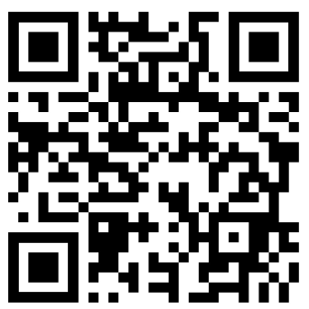
Full Career Development Wiki
https://second-hand-tigers.github.io/

Slide 18
BACKUP

Slide 19
Non-Technical Demand increases with Career Stages
 | Stage | Focus | Work Scope
1 | Apprentice 1-2 yrs | Learning the Business | Training – Tools, Skills, Work Processes, Job Specific Theory Tasks within project (under direction of Stage 2-3) Collaborating
2 | Colleague 5-10+ yrs | Implementing | Competent on standard Application and Troubleshooting in own discipline Leading and contributing to standard projects of predefined scope. Onboarding and training Stage 1 Managing Stakeholder Communication & Expectations
3 | Expert 10+ yrs | Leadership/Mentoring | Defining Projects and Initiatives (Scope, Benefit, Cost, Time) Advanced Application & Troubleshooting Leading New Technology Pilots & Commercialization Mentoring Stage 1-2 Coaching, 1-on-1s, Shadowing/Delegating Accountability on “Individual Development Plans”
4 | Sponsor | Strategic Vision Regional/Global Influence | Developing the Strategic Plan (1 & 5 year) Promoting the Strategic plan Driving Emerging Technologies to Commercialization Regional/Global Discipline Health
R&Rs with significant non-technical component
50%
100%
Technical Career Stages · second-hand-tigers/badocter-career-learnings Wiki

Slide 20
Crafting a Balanced Development Plan
Set at least one objective each planning cycle (~yearly) in each Dimension
  Leadership
  Business
  Interpersonal
  Technical
Focus on Quality over Quantity
  Setting too many goals can often result in none of them getting done well and feeling overwhelmed (3-4 items at most in each area)
Tie each objective to a tangible deliverable that requires the competency
  Training doesn’t stick or deliver value without practical reinforcement
  Tie development accomplishments with value delivery in performance discussions
Identify & leverage a mentor strong in the competency
  You can’t teach yourself if you don’t know what you don’t know
  Discuss your development plan with your Mentor & Supervisor regularly
Get a Mentor’s input on your plan → Flush out your blind spots!
Setting and Accomplishing Development Goals · second-hand-tigers/badocter-career-learnings Wiki

