Slide 1


Scorpio :
A Git Clinet for Monorepo Based on FUSE System.
基于Rust的Monorepo用户态文件系统开发探索
韩晓阳 北京科技大学 研二
@Ivanbeethoven
开源之夏 2024
Web3 Infrastructure Foundation

Slide 2
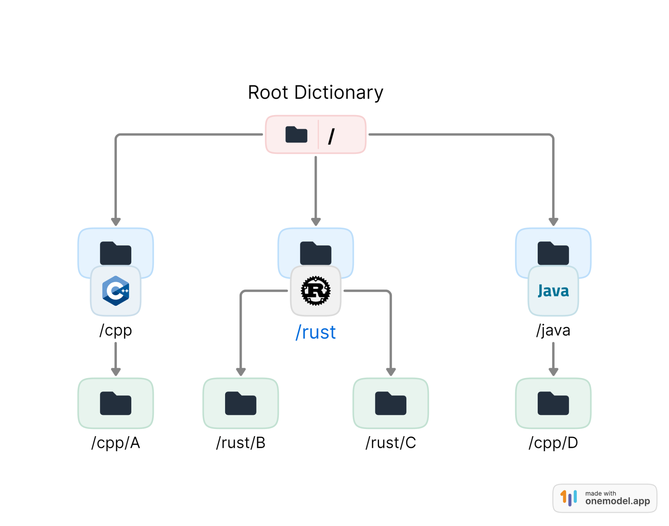
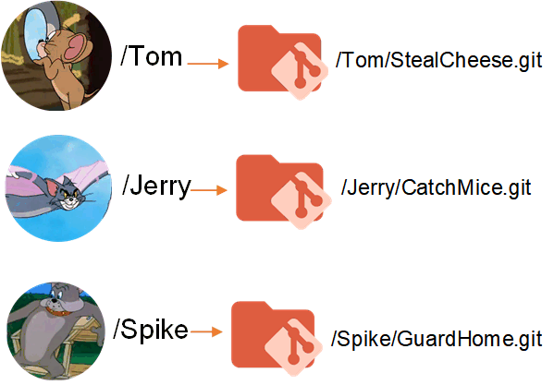
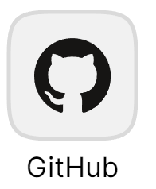
Monorepo
Monorepo VS Polyrepos
Single repository contains all code
Each project or component is stored in a separate repository.
Notes:
Polyrepos allow for finer access control and independent development cycles, but they can struggle with dependency management.

Slide 3

Monorepo
Rachel Potvin and Josh Levenberg. 2016.
Why Google stores billions of lines of code
in a single repository ？ Commun. ACM 59, 7 (July 2016), 78–87.
Piper stores a single large repository and is implemented on top of standard Google infrastructure, originally Bigtable, now Spanner
one billion files
35 million commits
spanning Google’s entire 18-year existence
15 million lines of code were changed in 250,000 files
Notes:
Polyrepos allow for finer access control and independent development cycles, but they can struggle with dependency management.

Slide 4

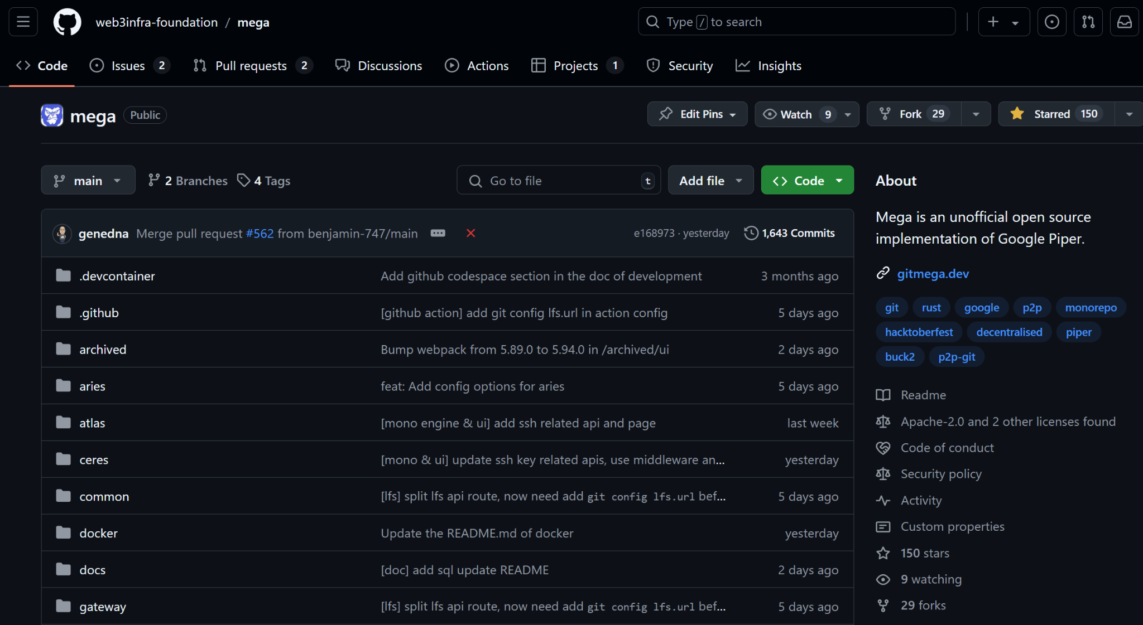
Mega : An unofficial open source implementation of Google Piper.
Unofficial open source implementation of Google Piper.
Supports Git.
Inode Repo
Large-Scale
https://github.com/web3infra-foundation/mega

Slide 5
Git is not enough :
Developors’ Client for Monorepo
Git ❌ 👉 CitC = Cloud-based storage backend + Linux-only FUSE file system.
Partial clone:
reduces time to get a working repository by not downloading all Git objects right away.
Background prefetch:
downloads Git object data from all remotes every hour, reducing the amount of time for foreground git fetch calls.
Sparse-checkout : limits the size of your working directory.
File system monitor:
tracks the recently modified files and eliminates the need for Git to scan the entire worktree.
Commit-graph: accelerates commit walks and reachability calculations, speeding up commands like git log.
Multi-pack-index: enables fast object lookups across many pack-files.
Incremental repack: Repacks the packed Git data into fewer pack-file without disrupting concurrent commands by using the multi-pack-index.
https://github.com/web3infra-foundation/mega

Slide 6
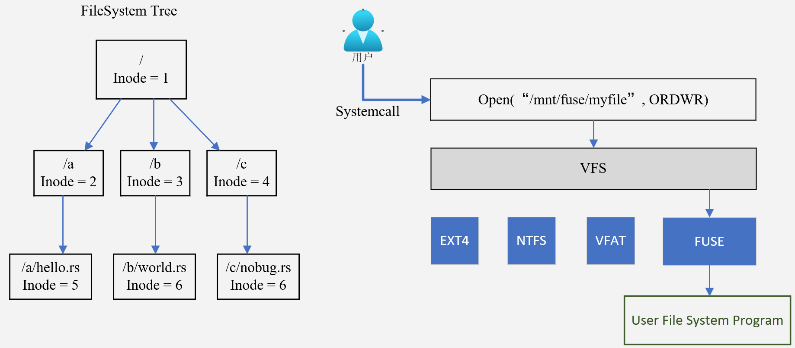
what is FUSE ?
https://github.com/web3infra-foundation/mega

Slide 7
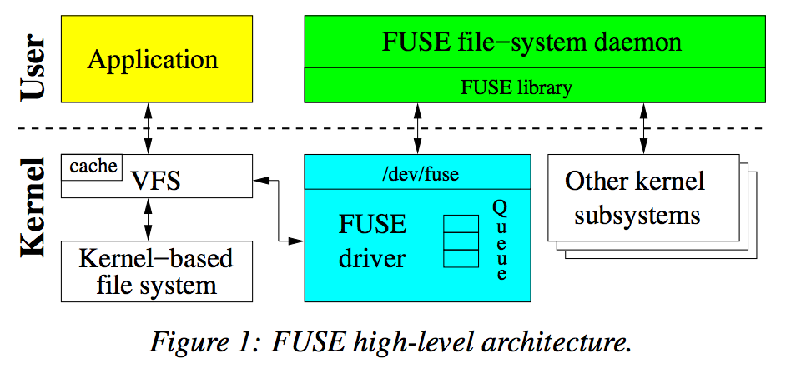

what is FUSE ?
/// FUSE system Interface
int (*lookup)(const char *path, struct fuse_entry_param *e);
int (*getattr)(const char *path, struct stat *stbuf);
int (*read)(const char *path, char *buf, size_t size, off_t offset, struct fuse_file_info *fi);
int (*write)(const char *path, const char *buf, size_t size, off_t offset, struct fuse_file_info *fi);
int (*create)(const char *path, mode_t mode, struct fuse_file_info *fi);
int (*open)(const char *path, struct fuse_file_info *fi);
…………
https://github.com/web3infra-foundation/mega

Slide 8




Industrial Practice
Vfs for Git
microsoft/
Virtual File System for Git: Enable Git at Enterprise Scale
Based on GVFS
Scalar: A set of tools and extensions for Git to allow very large monorepos to run on Git without a virtualization layer
A Scalable, User-Friendly Source Control System. From Meta
https://github.com/web3infra-foundation/mega

Slide 9
Dependency
Which FUSE third-party Crate to choose?
Name | Download Count | Last Update | Stars
zargony/fuse-rs | 186,422 | 7 years ago. | 1.1k
cloud-hypervisor/ fuse-backend-rs | 210,580 | 10 mouths ago | 135
cberner/fuser | 948,510 | 2 mouths ago. | 870
Sherlock-Holo/fuse3 | 86,677 | 4 mouths ago. | 94
Support Async. Interacting with the asynchronous server Axum
https://github.com/web3infra-foundation/mega

Slide 10
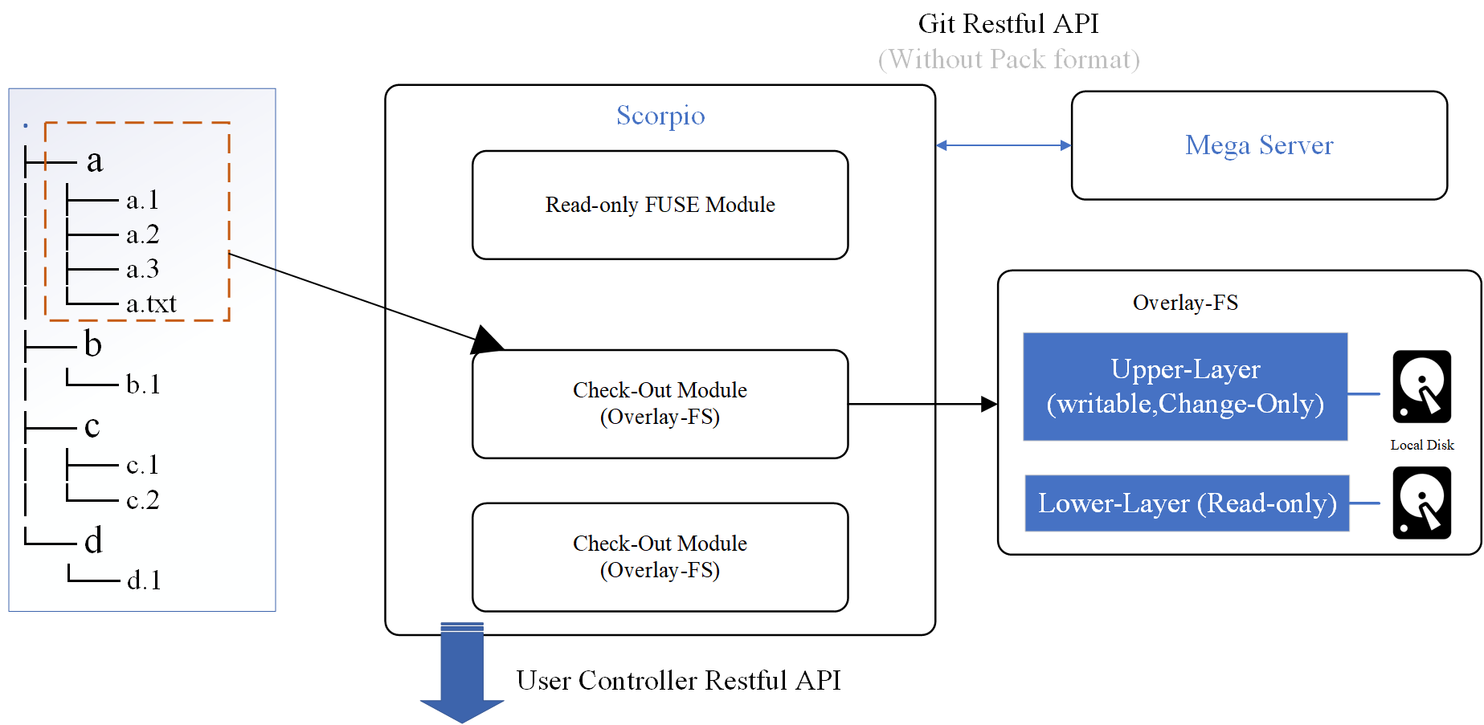
Design of Scorpio
https://github.com/web3infra-foundation/mega

Slide 11
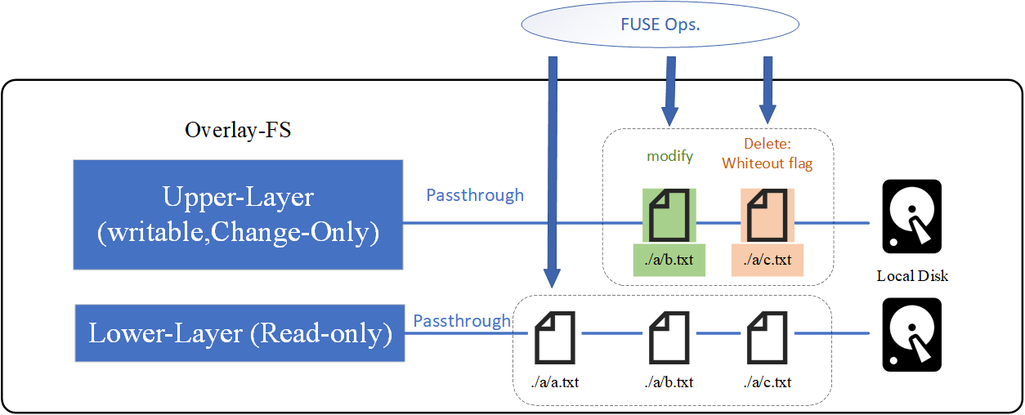
Design of Scorpio
https://github.com/web3infra-foundation/mega

Slide 12
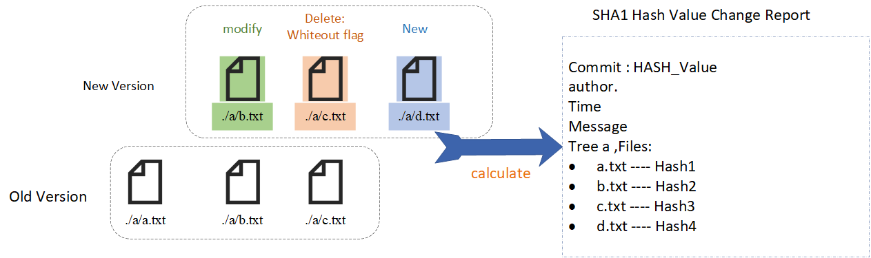
Design of Scorpio
https://github.com/web3infra-foundation/mega

Slide 13
Difficulties and Challenges
Dealing with the complex（File）system. Fix Bug.
Synchronous code to Asynchronous code migration
Beware of performance loss in large-scale scenarios
https://github.com/web3infra-foundation/mega

Slide 14
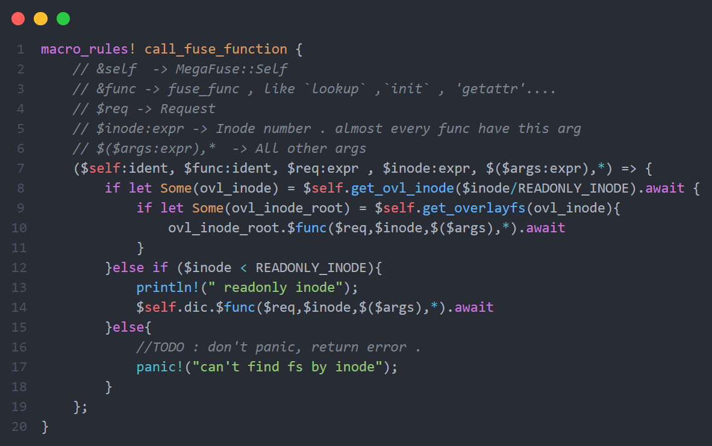
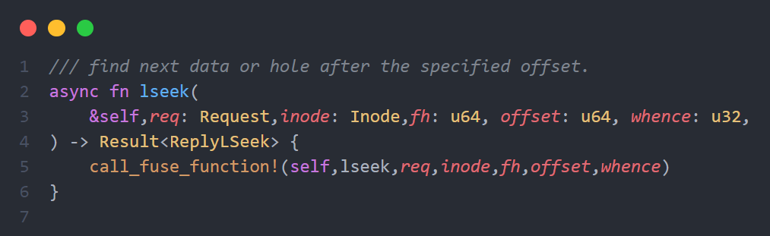
Code…
FS Select by inode.
https://github.com/web3infra-foundation/mega

Slide 15
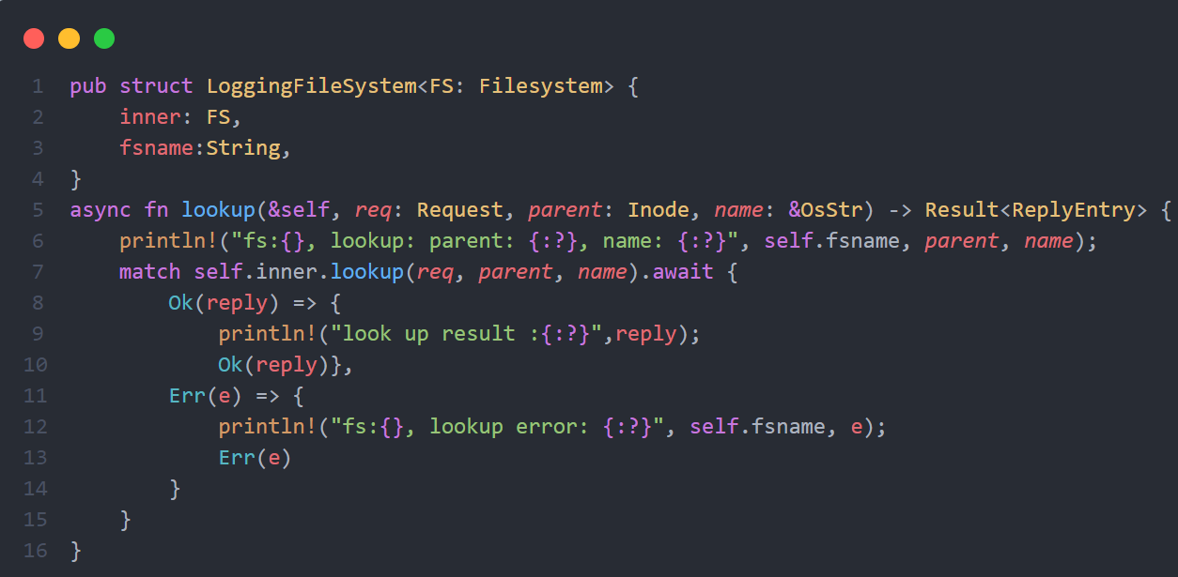
Code…
LogFS ：For Debug,
But FUSE need defines a total of 33 interface functions.
https://github.com/web3infra-foundation/mega

Slide 16
Takeaway
Rust - FUSE .Recommand fuse3
When dealing with a system, pay attention to the documentation.
Macro can play a mighty big role in Rust.
As a Rust newbie, diving right in is the fuel that powers progress!
https://github.com/web3infra-foundation/mega

Slide 17
Future of Scorpio
Collaborating with BUCK2
More adaptive Git File.
More Test.
Full Git Support. ( Git PULL / status / add / Commit / Push )
https://github.com/web3infra-foundation/mega

Slide 18

Thanks.
Web3 Infrastructure Foundation
韩晓阳
https://github.com/web3infra-foundation/mega

