Slide 1

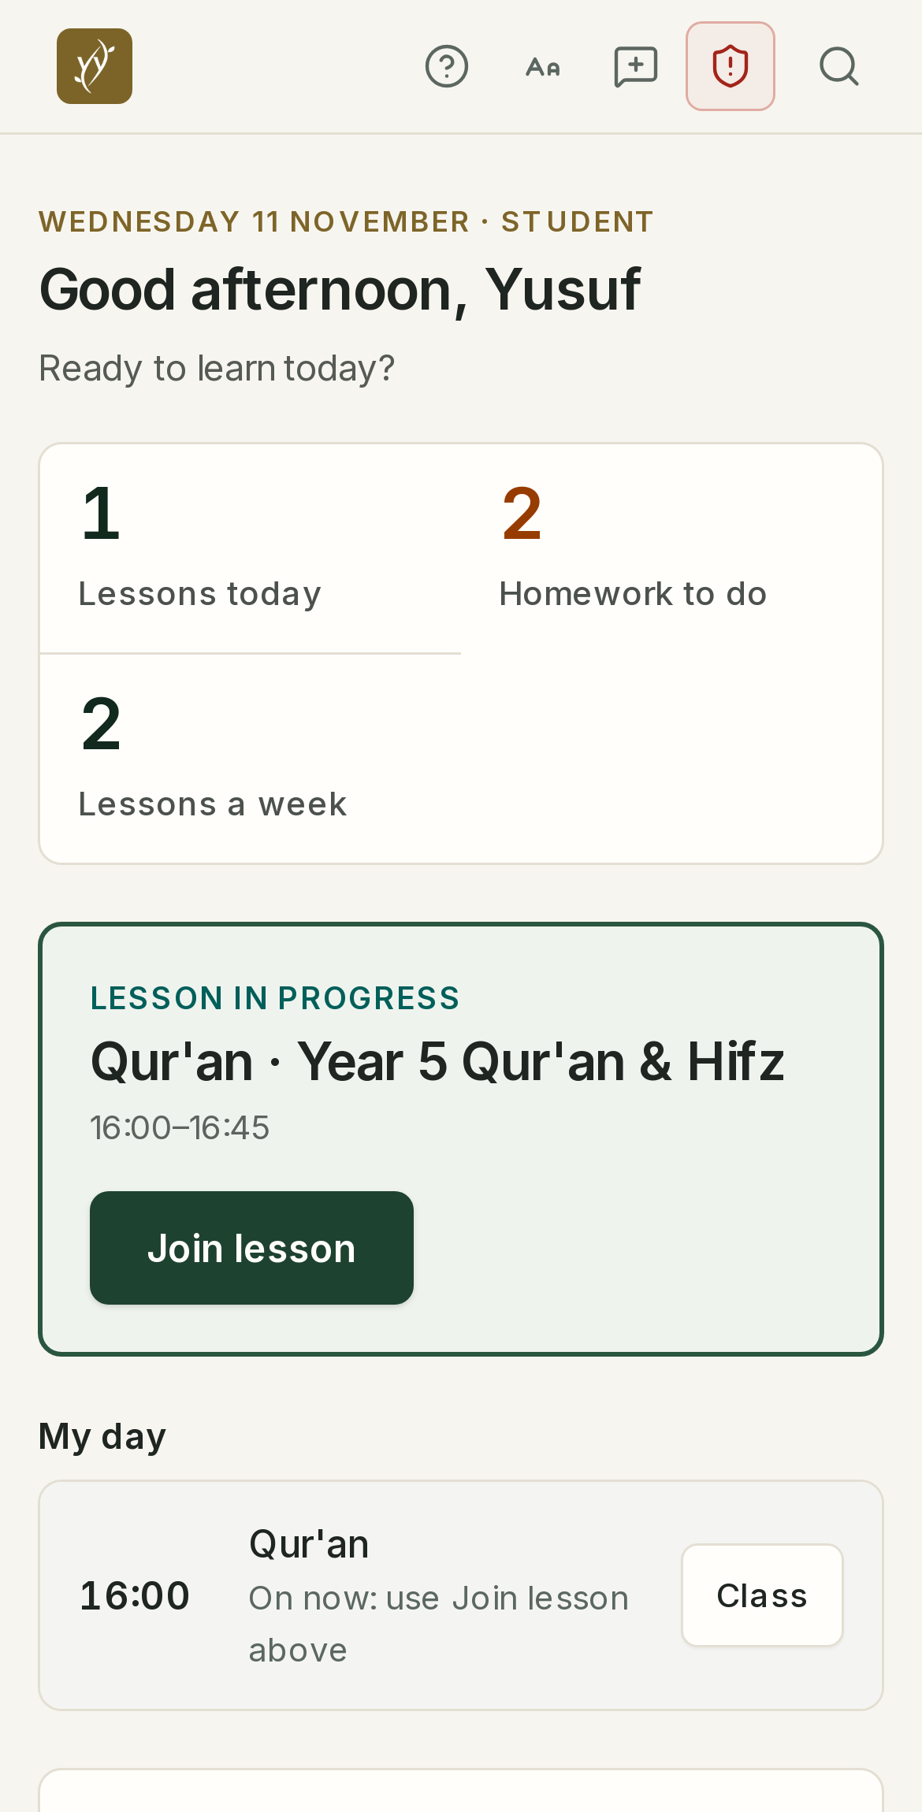
Open evening
A live online Islamic school for Years 1 to 11, opening January 2027
Thursday 26 November, 7:30pm UK
Sunday 6 December, 4:00pm UK
Microphones off, please. Ask questions in the chat at any time.
Notes:
Start at 7:30pm UK time. Assalamu alaikum and welcome. Introduce yourself: [HEADTEACHER NAME], Headteacher. Housekeeping: microphones off, questions in the chat at any time; the host gathers them for the end. We will finish by 8:30pm. On the right is what a pupil sees each morning: their day, and one button to join the live lesson.

Slide 2
One hour, and your questions answered
TONIGHT
1
2
3
4
5
6
7:30pm
7:35pm
7:50pm
7:55pm
8:05pm
8:10pm
Welcome
How we teach
Safety
The portals
Joining
Questions
Who we are and why we started
Values, the school day and what your child learns
How we keep children safe online
A live tour of what parents and pupils see
Fees, key dates and how to apply
Ask anything; we stay until 8:30
Questions: type them in the chat whenever you think of them. The host collects them, and we answer as many as we can at the end. Anything about your own child, we can talk about privately on a free call.
Notes:
Keep this to about 30 seconds. Highlight the live portal tour (step 4): it is the part families usually find most useful. Remind them that private questions about their own child are best on a free call; the link is on the last slide.

Slide 3



Part of the Tarbiyyah family of schools
WHO WE ARE
PRIMARY
SECONDARY · BOYS
GIRLS
ONLINE
Tarbiyyah Primary School
Tarbiyyah Secondary School for Boys
Tarbiyyah Al-Banaat
Tarbiyyah Global Academy
Our primary school, sharing the same faith, values and care.
Our Heston school, rated Good by Ofsted (2025), with high GCSE pass rates.
Our sister school for girls, with the same faith, values and standard of care.
A live, co-educational online school for families anywhere in the world. This is us.
The same faith, values and standard of care, now reaching homeschooling families wherever they live.
Notes:
[Add your founding story here in two sentences: why the Trust opened an online school.] Mention the Secondary School's 2025 Ofsted judgement of Good, and make clear the report is about our sister school, not about TGA, which opens in January. Do not quote figures we have not published.

Slide 4
A real school, taught live, with Islam at its heart
WHY FAMILIES CHOOSE US
15
Live
1 to 11
IGCSE
PUPILS AT MOST
EVERY LESSON
YEAR GROUPS
IN YEARS 10 AND 11
in a class, so every child is known, heard and supported.
taught in real time on Microsoft Teams by a qualified teacher, never a pre-recorded course.
one school from Year 1 to Year 11, with a proper timetable, homework and reports.
Pearson Edexcel International GCSEs, including Islamic Studies.
Tarbiyyah means the nurturing of character and faith. It is in every lesson, not only in Islamic Studies.
Notes:
Four things that make us different from an online course: small classes, every lesson live, one school from Year 1 to Year 11, and recognised qualifications at the end. Subject teachers hold QTS or an equivalent teaching qualification; Qur'an, Arabic and Islamic Studies teachers hold recognised Islamic scholarship plus teacher training or proven classroom experience. Every teacher is assessed on a live online lesson before they join.

Slide 5
The Tarbiyyah Compass spells IHSAN
OUR VALUES
I
H
S
A
N
Ilm
Honesty
Sabr & shukr
Adab
Niyyah
Love of learning: curiosity, good questions and the effort to really understand.
Sidq and amanah: telling the truth, doing your own work, keeping trust.
Keeping going when things are hard, and thanking Allah and others.
Respect and kindness in how we speak, listen and behave, online and at home.
Doing what is right for the sake of Allah, whether or not anyone is watching.
Ihsan is worshipping Allah as though you see Him. Each value is the focus of one half term, and the year ends with all five together. Teachers recognise them with merits, and they appear in every report.
Notes:
In an online school much of a child's conduct happens with no adult in the room, which is why Ihsan, doing right whether or not anyone is watching, is our aim. Give one real example per value of how a teacher reinforces it (for example, Adab: greeting with salam and microphone etiquette). CHECK BEFORE THE EVENT: the owner may change the value words; update this slide if so.

Slide 6
A proper timetable, not a screen all day
A SCHOOL DAY
Years 1 to 2
15
live lessons a week
MONDAY TO THURSDAY
09:00 to 15:00
30 minutes each, about 1.5 hours a day, with guided activities at home
UK time
Years 3 to 6
20
live lessons a week
FRIDAY
45 minutes each
09:00 to 12:00
The afternoon is free for Jumu'ah.
Years 7 to 11
23
live lessons a week
Breaks, prayer and independent tasks are built into every day.
50 minutes each
Notes:
Form time, assemblies and clubs are in addition to these lessons. A four-day live week (Monday to Thursday, with Friday as a structured independent study day) is available for Years 1 to 9. Years 1 to 3 need an adult nearby; most children manage alone from Year 4. Families in other time zones can ask about flexible learning, which is offered subject to availability: do not promise it. UK times suit Europe, North and West Africa, Turkey and the Middle East.

Slide 7
The full curriculum, alongside Qur'an, Arabic and Islamic Studies
WHAT YOUR CHILD LEARNS
PRIMARY
KEY STAGE 3
INTERNATIONAL GCSE
Years 1 to 6
Years 7 to 9
Years 10 to 11
Phonics, early reading, English and maths every day
Science, history, geography, computing, art and design
Qur'an and Tajweed, starting with the Qaidah
Arabic, Islamic Studies and PSHE
English, maths and science (biology, chemistry, physics)
History, geography, computing, art and design
Qur'an and Tajweed, Arabic, Islamic Studies
Study habits that prepare for GCSE
Pearson Edexcel International GCSEs
English, maths, science and Islamic Studies
Two options chosen in Year 9
UK pupils sit exams at Tarbiyyah Secondary School
Notes:
Maths follows White Rose for Years 1 to 9. Homework is kept manageable and tracked in the portal, and termly reports come to parents. GCSE entry fees are paid to the exam centre and are not part of tuition. Families abroad are helped to find an approved centre. History is not offered at GCSE. Avoid naming every option subject in case the list changes; the Learning page on the website has the current list.

Slide 8
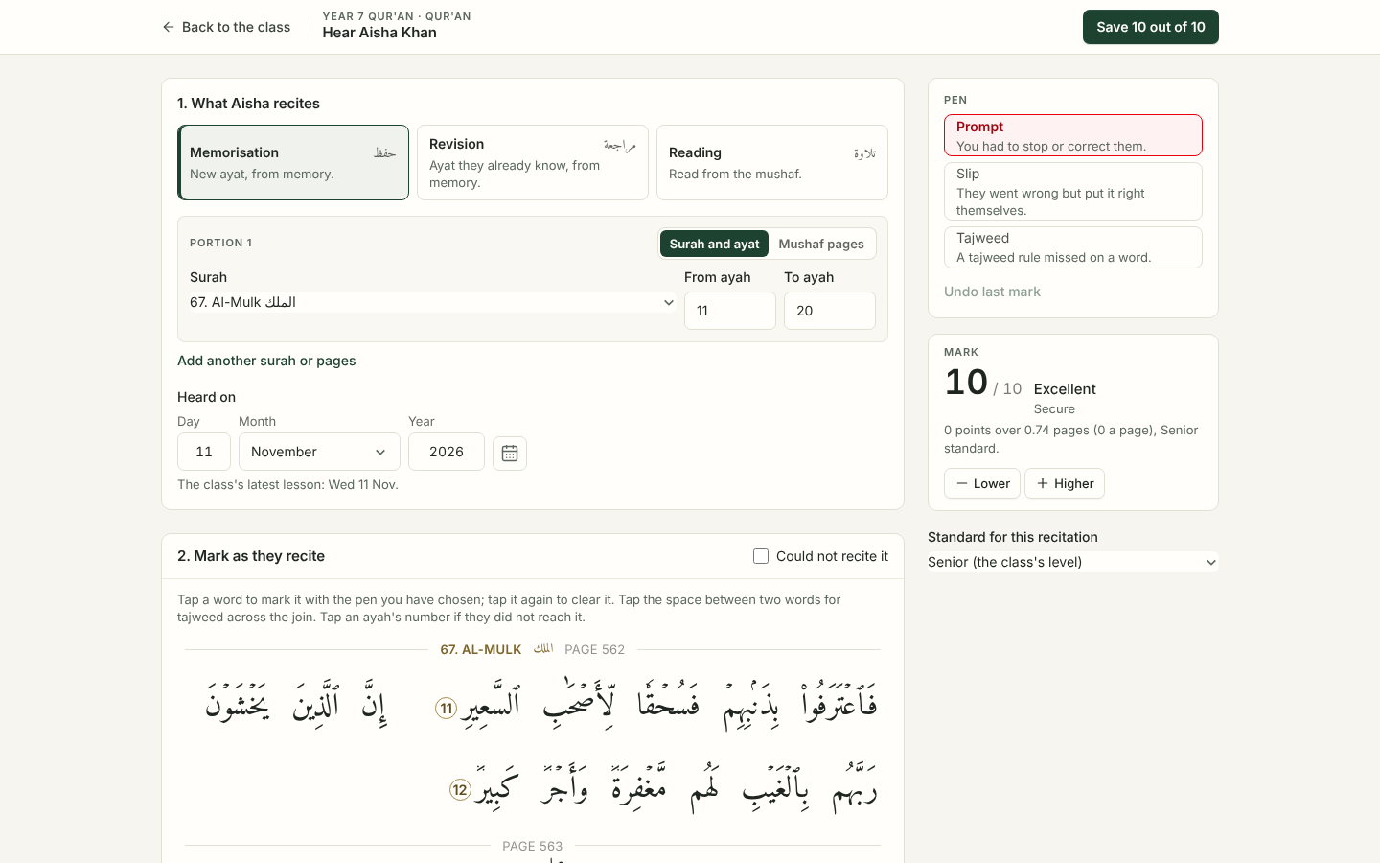
Every recitation heard, marked and shared with you
QUR'AN
1
Heard every week
Pupils recite live to their teacher: memorisation, revision and reading.
2
Marked on the page
The teacher taps each slip or tajweed point on the mushaf as the pupil recites.
3
A fair mark out of 10
Worked out from one school-wide standard, so marks mean the same in every class.
4
You see it too
The mark, the ayat covered and what to practise appear in your parent portal.
Notes:
This is the real teacher screen with made-up data. Explain the three kinds of recitation: memorisation (hifdh), revision (muraja'ah) and reading (tilawah). The Head sets one marking standard for the whole school, so a 9 out of 10 means the same in every class. Families see the marks and what to practise in the Qur'an section of their portal.

Slide 9
Keeping children safe online
SAFEGUARDING
Vetted staff
Named leads
Controlled classrooms
Enhanced DBS checks in the UK and overseas checks for staff abroad. Every teacher is safeguarding trained.
A Designated Safeguarding Lead and a deputy, with clear routes for raising any concern.
Teachers run the meeting, the chat and breakout rooms, with clear camera and conduct rules.
No private pupil chats
Help at home
Report a concern
Pupils message staff only. Staff review messages for safeguarding as part of normal practice.
Guidance on router filtering, parental controls and safe search, and on keeping devices in shared spaces.
A button on every portal page goes straight to the safeguarding team.
Notes:
If the DSL is present, let them present this slide. Concerns about families outside the UK are handled by the DSL with the right local services. The Child Protection and Safeguarding Policy is on the website's Policies page. Pupils cannot message each other privately; they talk in the lesson chat, which staff can see.

Slide 10
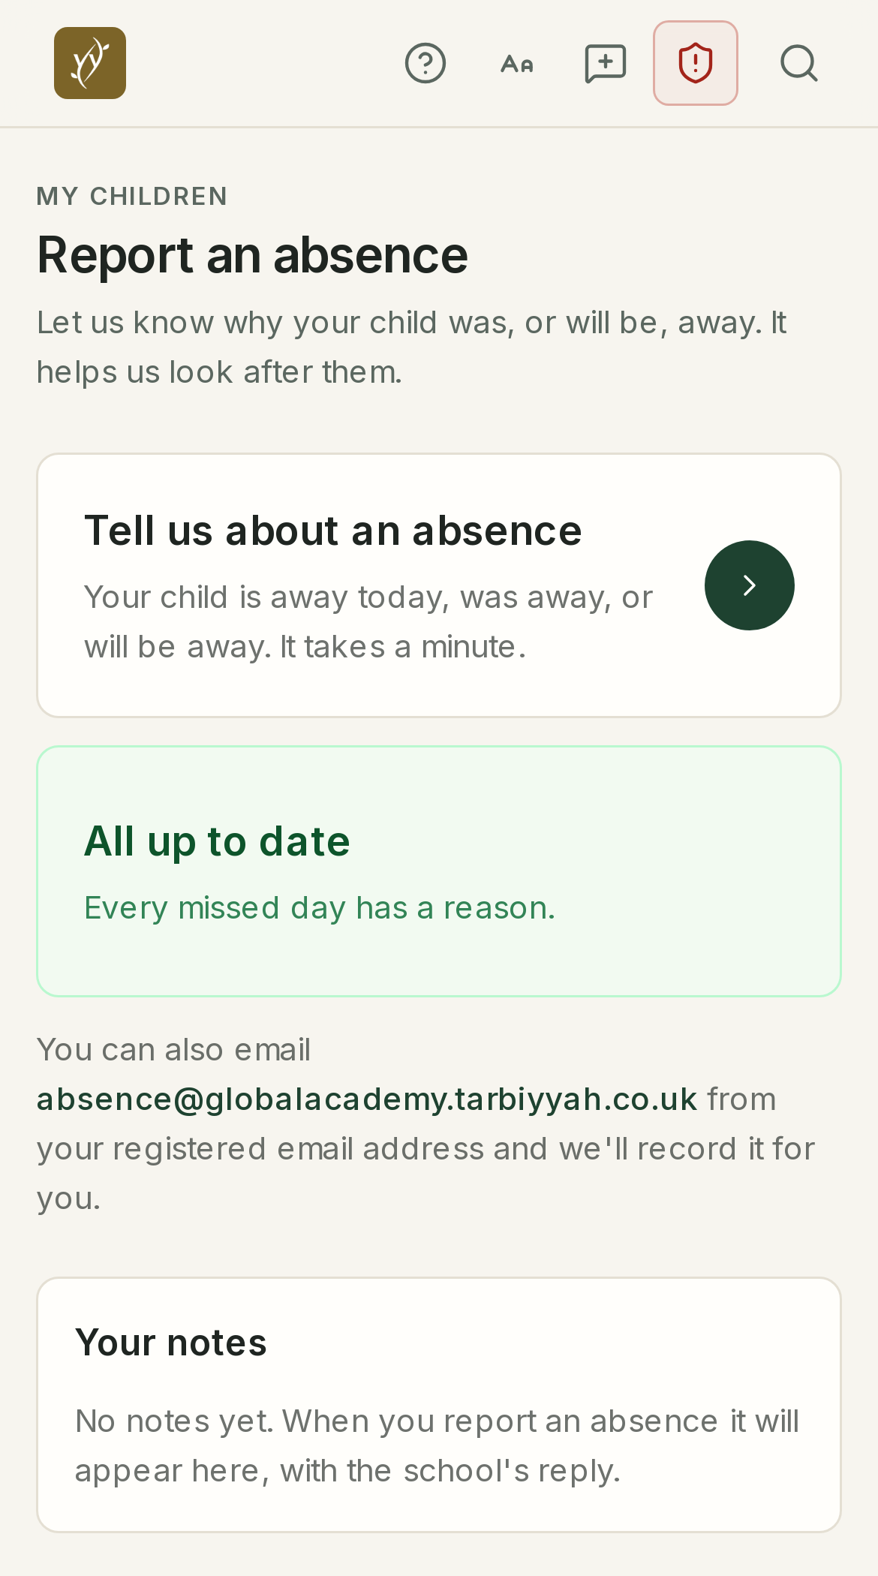
Everything in one place, for you and your child
THE PORTALS
A pupil portal to join lessons and hand in work, and a parent portal to see how they are getting on. Works on a phone, tablet or computer.
Notes:
Introduce the next three slides, then switch to the live demo. All screens are the real portal with made-up demo data.

Slide 11
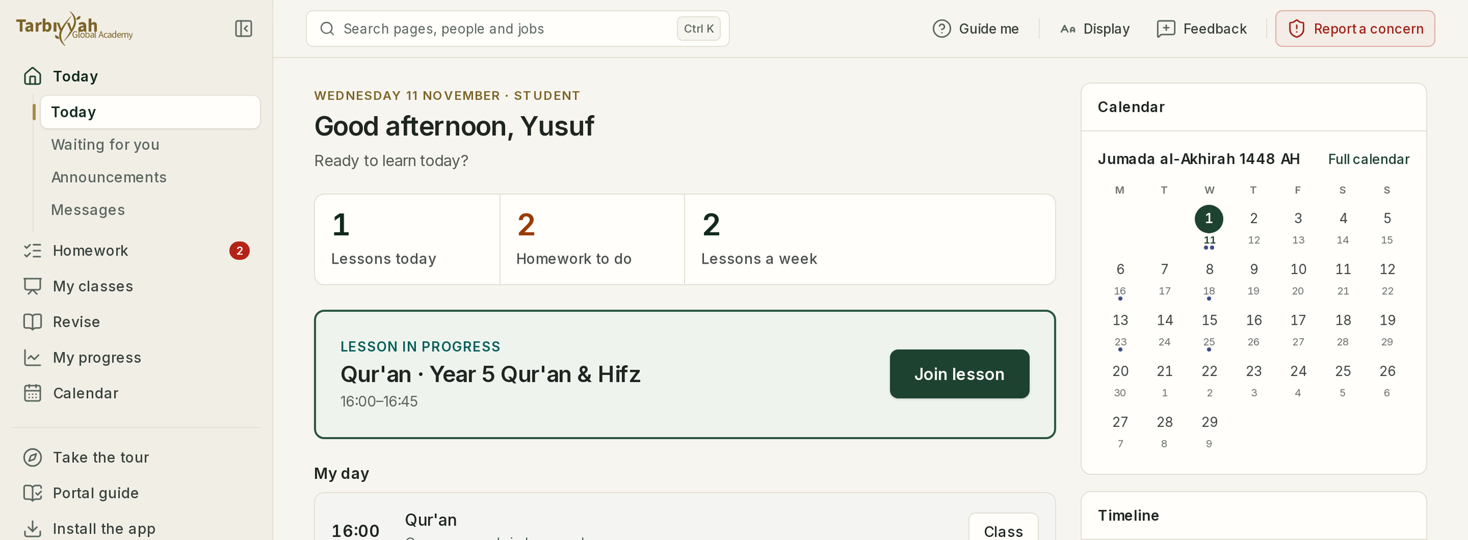
Their day on one screen, and one button to join
FOR PUPILS
Join lesson
One tap opens the live lesson on Teams.
My day
Every lesson today, with its time.
Homework
What is due, handed in online.
Hijri and term dates
Islamic dates on the calendar.
Notes:
What a pupil sees each morning. The green box shows the lesson in progress with the Join lesson button. Younger children can be helped by a parent; from about Year 4 most manage alone.

Slide 12
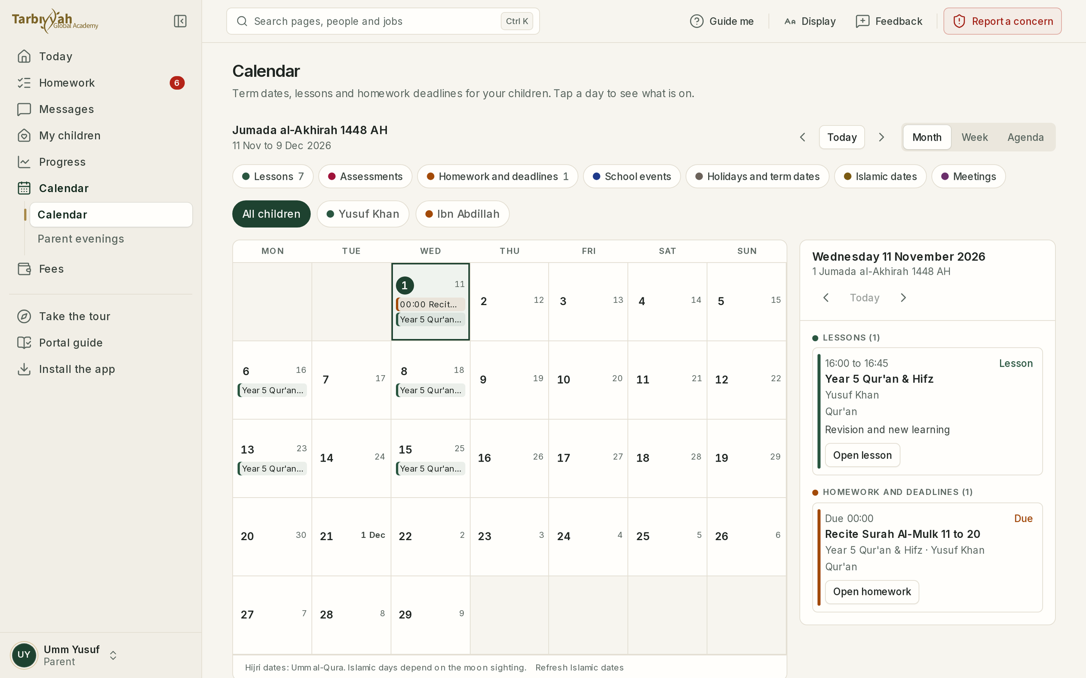
Always in the picture
FOR PARENTS
Lessons, homework deadlines, school events and Islamic dates in one calendar
Report an absence in under a minute
Notes:
Parents also see homework, attendance, merits and behaviour, Qur'an marks, termly reports, messages from teachers, and fees. Absences can be reported in the portal or by email from the registered address.

Slide 13
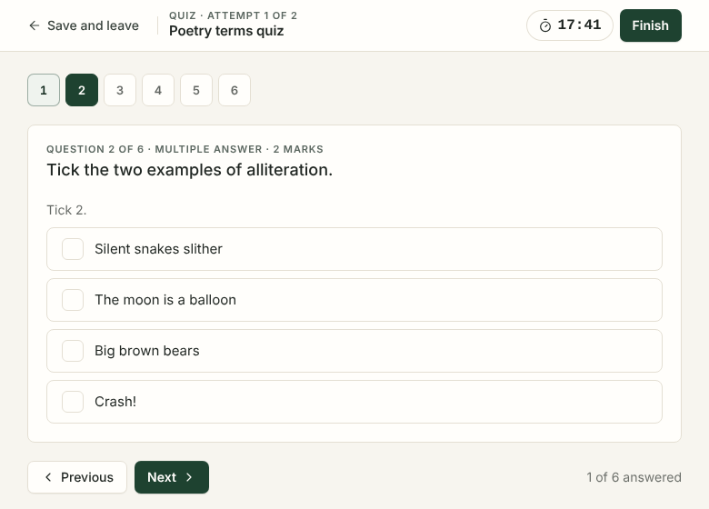
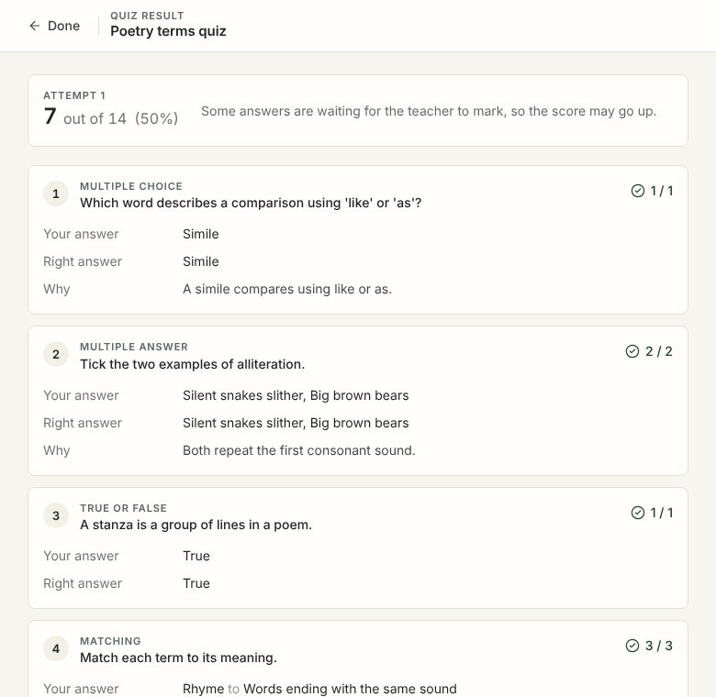
Quizzes that mark themselves, with feedback straight away
LEARNING YOU CAN SEE
Notes:
Pupils sit short quizzes in the portal. Answers save as they go, so a dropped connection loses nothing. Most questions mark themselves, and pupils see the right answer and why. Teachers mark longer answers. Results feed the gradebook and reports.

Slide 14
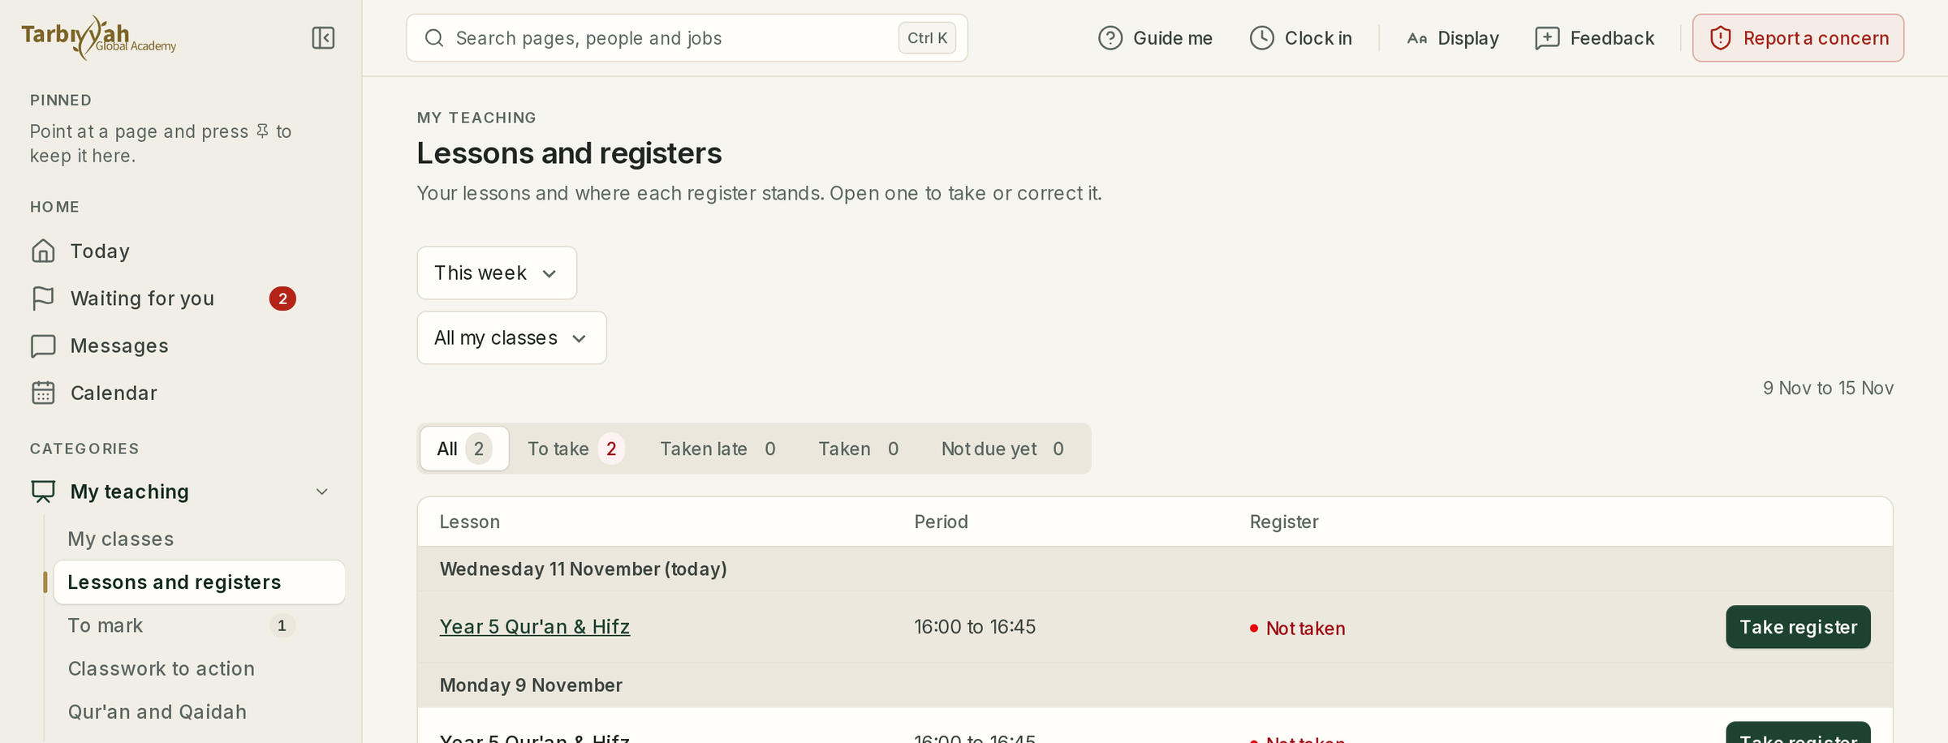
Let's look at it together
LIVE TOUR
Sharing the screen now: a parent's Today page, reporting an absence, messages, and a pupil joining a lesson.
Notes:
Switch to the demo accounts (made-up data only), signed in before 7:15. About 8 to 10 minutes: 1) parent Today, 2) report an absence, 3) messages, 4) pupil Today and Join lesson, 5) homework. If the internet fails, return to slides 11 to 13. The picture shows the teacher's register page, if anyone asks how attendance is taken.

Slide 15
Fees for January to July 2027
FEES
Year group | For the year | 2 payments | 7 monthly payments
Years 1 to 2 | £1,596 | 2 × £798 | 7 × £228
Years 3 to 6 | £2,130 | 2 × £1,065 | 6 × £304.29, then £304.26
Years 7 to 9 | £2,796 | 2 × £1,398 | 6 × £399.43, then £399.42
Years 10 to 11 | £3,000 | 2 × £1,500 | 6 × £428.57, then £428.58
2% off
if you pay for the whole year by 8 January 2027
5% and 10%
off for a second child, and for a third or further child
£150
application fee per child; there is no registration fee
Tuition and digital materials included. Not included: GCSE entry fees, optional books, your device and internet, and a stylus tablet or access to printing.
First payment
on accepting your place, by 8 January 2027 at the latest
Notes:
Every figure is on the website's Fees page. Second payment for the two-payment plan: 28 March 2027. Monthly plan: first payment on acceptance (by 8 January), then the 28th of each month from January to June. Payment is online; details come with the offer. There are no standing orders or bank transfers. CHECK BEFORE THE EVENT: that the online payment link is set up and the application fee is still £150 in Settings.

Slide 16
Six steps from application to the first lesson
HOW TO APPLY
1
2
3
4
5
6
Apply
We review
Assessment
Family call
Offer
Welcome
Online form and documents, about 20 minutes.
We check your details and ask for a school report.
A short supervised online assessment.
A video call with the Headteacher and your child.
Accept within five working days and make the first payment.
Accounts, devices and teachers in induction week.
Offers are normally made within three working days of the family call. Apply at globalacademy.tarbiyyah.co.uk/admissions
Notes:
Documents: photo ID for a parent, the child's passport or birth certificate, proof of address and, if available, a recent school report or homeschool record. Several children go on one form. You can cancel within 14 days of accepting, as the Fees Policy explains.

Slide 17
Places for January are limited
KEY DATES
Sat 12 Dec
Fri 18 Dec
4 to 8 Jan
Mon 11 Jan
TASTER MORNING
APPLY BY
INDUCTION WEEK
FIRST LIVE LESSONS
Children join a real lesson: Years 1 to 6 at 10:00, Years 7 to 11 at 11:15
Later applications are considered while places remain
Accounts, devices and meeting teachers
The founding year begins
Not sure yet? Book your child onto the taster morning, or a free call with us, from the website.
Notes:
Second open evening: Sunday 6 December at 4pm, for anyone who could not come tonight. Encourage the taster morning: it is the best way for a child to see what a live lesson feels like.

Slide 18
Your questions
WEBSITE
globalacademy.tarbiyyah.co.uk
EMAIL
globalacademy@tarbiyyah.co.uk
NEXT STEPS
Taster morning, Sat 12 December
Apply by Fri 18 December
Ask in the chat, or raise your hand
Notes:
The host reads questions in the order they came in. Keep the website's FAQ page open in a tab. Close at 8:30pm with thanks and a du'a, and remind everyone of the taster morning (12 December) and the deadline (18 December). Afterwards, send everyone who registered the taster morning link.

