Slide 1
The Measure of Information Security is Dollars
Bob Blakley
Chief Scientist, Security and Privacy
IBM Tivoli Software

Slide 2
Let’s Get Serious
The business of business is dollars.
If it doesn’t cause dollar losses, it’s not a risk.
If it’s not a risk, it doesn’t get managed.
Today, information security is not a risk.
Until it’s a risk, it won’t get managed.
It won’t be a risk until it’s denominated in dollars.
Until we monetize information security, we’re not serious.
  And we won’t be taken seriously.
  And we shouldn’t.

Slide 3
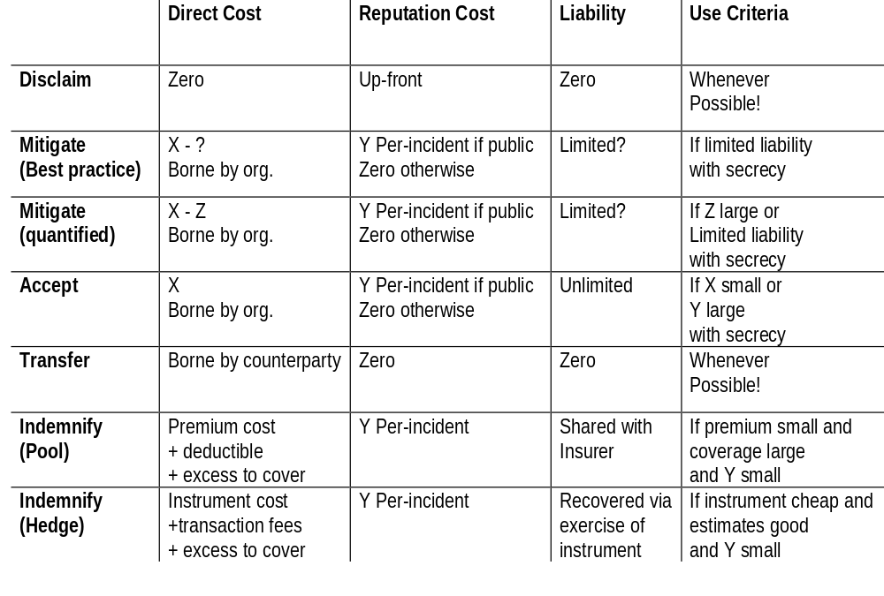
Risk Management Strategies

Slide 4
Opaque Options

Slide 5
Disclaimer
Best option for organization
Worst option for society
  Unconditional transfer of unquantified risk
  No transparency
  No incentive to reduce risk

Slide 6
Transfer
Second-best option for organization
Bad option for counterparty
  especially if consent to transfer is coerced
  but could be offset by cost reductions etc… as incentive
Not a great option for society
  Strong disincentive to transparency
    except in cases of extraordinarily large losses
  Weak incentive to reduce risk
    at least for the organization which creates it

Slide 7
Acceptance
Not a great option for organization
  Unqualified acceptance of unquantified risk
  But reputation damage is manageable to a point
So-so option for society
  Risk borne by organization which creates it
    except in catastrophic cases, in which case government or the financial system takes a hit
  Strong disincentive to transparency
  Moderate incentive to reduce risk
    would be greater if losses were frequent and predictable
    would be greater if secrecy were not possible

Slide 8
Mitigation (best-practice)
Good option for organization
  May limit liability
  Reputation damage manageable to a point
  Some degree of risk reduction
  But: unqualified acceptance of unquantified risk
Not a great option for society
  Strong disincentive to transparency
    often with an explicit shield
  Disincentive to reduce risk
    raises the bar for future best-practice

Slide 9
Transparent Options

Slide 10
Mitigation (Quantified)
Good option for organization
  Quantifies risk
  Reduces risk
  May limit liability
Good option for society
  Reduces risk
  Increases transparency
  Provides data basis for Pooling, Hedging strategies
  Risk borne by organization which creates it
    except for liability limitation

Slide 11
Quantified Mitigation Barriers
Organization
  Reputation risk creates strong disincentive to transparency
  Best-practice regimes create disincentive to improve countermeasures
  Liability limitation creates disincentive to reduce risks
Vendors
  Strong disincentive to transparency
    lost sales
    spectre of product liability
  No clear metrics for effectiveness
    worries about level playing field
  Minimal zeal for quantification
    suspicion that countermeasure effectiveness is low

Slide 12
Pooling
Fair option for organization
  makes risk cost more predictable
    except possibly catastrophic risks
  reward for reducing risk
  but
    excludes reputation damage costs
    may leave residual liability
Questionable option for insurer
  correlated losses possible
  reputation risk creates disincentive to transparency for insured
  need for independent verification of effectiveness of mitigation techniques
Good option for society
  incentives for transparency
  incentives to reduce risk
  risk borne voluntarily by insurers

Slide 13
Pooling Barriers
Underwriter:
  No taxonomy of loss events
  Loss event correlation characteristics suspect
    e.g. virus outbreaks
  Inadequate actuarial data
    magnitude
    distribution (catastrophe coverage vs. health)
    effectiveness of mitigation techniques
  transparency disincentives
    covered (reputation damage) and vendor (product liability)
Covered:
  Reputation Risk
  Residual liability

Slide 14
Hedging
Good option for organization
  transfer risk to third party
  predictable costs
  reward for reducing risk
Questionable option for writer
  market manipulation concern
Questionable option for speculator
  liquidity concern
  market manipulation concern
Good option for society
  risk borne voluntarily by speculators
  incentives to all parties to reduce risks
  incentive to transparency

Slide 15
Hedging Barriers
Writer
  Market manipulation
  Inadequate loss experience data
    magnitude
    frequency
    effectiveness of mitigation techniques
Buyer
  Reputation risk
  Residual liability
  Market manipulation
Speculator
  Market liquidity
  Market manipulation

Slide 16
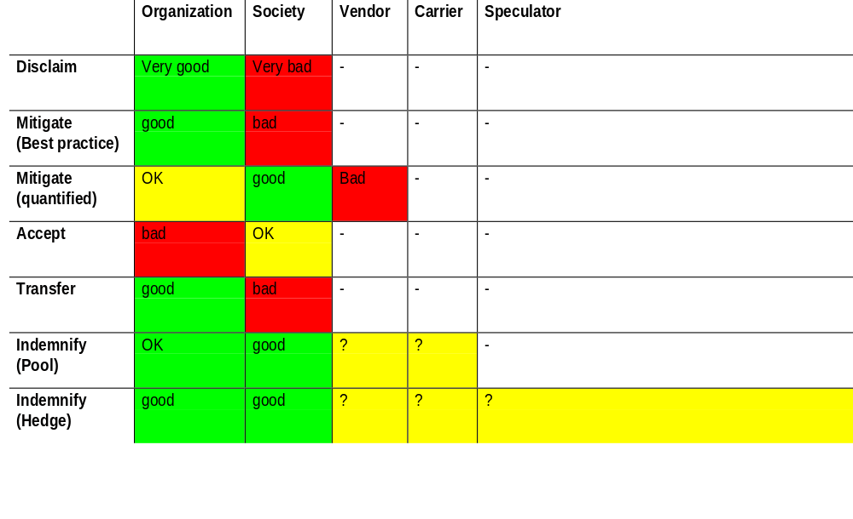
Comparison of Options

Slide 17
The Problem
Pooling and Hedging are both questionable options for carriers today because of inadequate information about losses and about mitigation technique effectiveness
Quantified mitigation would help to solve this problem, but…
  it’s a bad option for both organizations and vendors today because of reputation and liability risks
All the other options are bad for society, but look better to organizations and vendors
  because it insulates them from reputation and liability risks.

Slide 18
Solution Strategies
The critical first step is to increase transparency
  The prerequisite to this is changes in liability rules
    shield laws
    liability limitation contingent on disclosure
The second step is to create markets
  This could be participatory
    vendors could assume limited liability for failures as a market signal of quality
    Insurers could underwrite policies and offer discounts for more effective mitigation
  Or it could be imposed
    A derivative market in observable security qualities could be set up without cooperation of organizations or vendors
      e.g. an “availability futures” market?
      Given potential for manipulation, is this blackmail?

Slide 19
What Might Happen...
Businesses might have to choose between silence and compensation.
Insurers and auditors might start to look much more carefully at business’ information risk posture.
Derivative speculators would certainly look carefully!
Shareholders and derivative speculators might start to sue businesses.
Businesses might start to sue information security providers.
They might start to collect meaningful statistics on countermeasure effectiveness - and use the information to improve effectiveness.
Really risky projects might be cancelled.
Businesses might seriously pursue intruders, and courts might put them in prison.

