Slide 1
Dynamics and Equilibrium of Information Security Investment
Brian Carini
Carnegie Mellon University

Slide 2
Spending and Performance
“The OMB assessed the agencies security performance against the amount they spent on IT security and did not find that increased security spending equals increased security performance”
…
“there is no evidence that poor security is a result of a lack of money.”
-Office of Management and Budget, FY2001 Report to congress

Slide 3
Why is Measuring Return on Security Investment Hard?
Performance of Information security depends on amount invested and the efficiency of that investment
Heterogeneous security requirements
Security dynamics change rapidly with time
Attackers behavior is not independent of defense

Slide 4
A Theoretical Approach to Optimal Security Investment

Slide 5
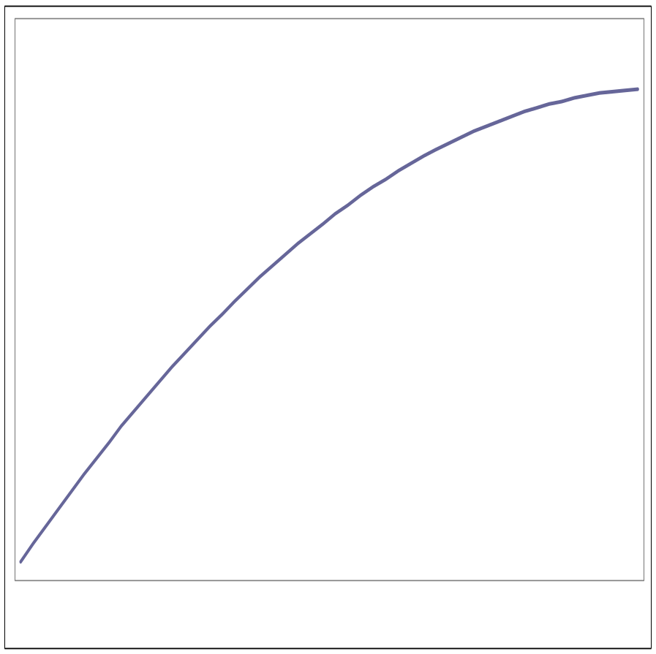
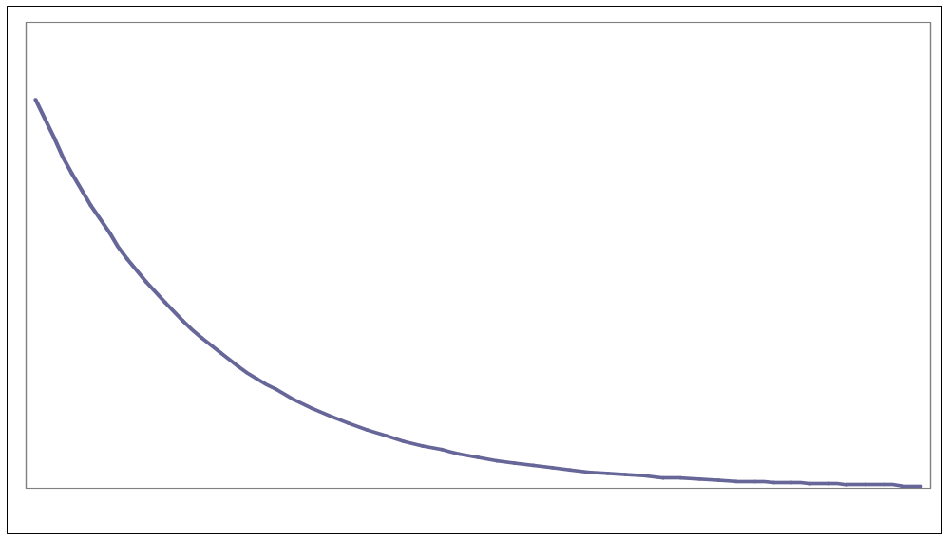
Information Security Performance
Security Performance
Expected Loss
Maximum Level
of Performance
Minimum Expected
Loss
Investment
Investment

Slide 6
Expected Loss Curve
Expected Loss
Assumptions:
Monotonically decreases with price
Subject to diminishing return on investment
Positive for all levels of investment
Security Investment

Slide 7
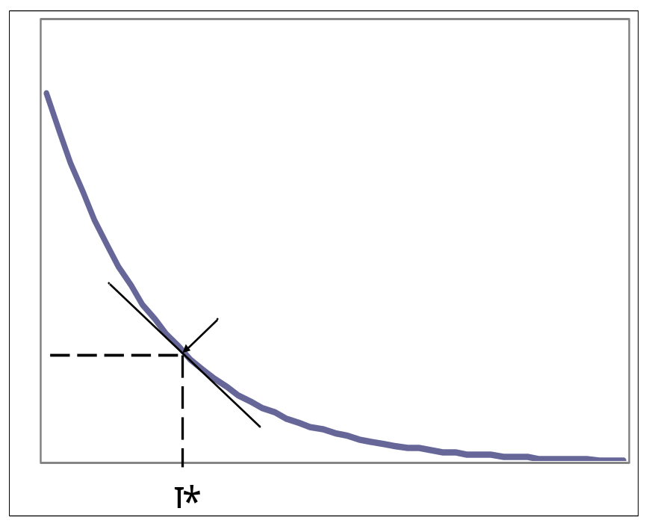
Optimal Level of Investment
Loss
Expected Loss
Marginal Return
on Investment
Optimal ROI
0
Investment
I*
Investment

Slide 8
Information Security:
A Dynamic System
Trends in Attacks (since 1988)
Automation-faster attack tools
Increasing sophistication of attack tools
Faster discovery of vulnerabilities
Increasingly asymmetric attacks
Increasing threat from infrastructure attacks
CERT Coordination Center—April 2002

Slide 9
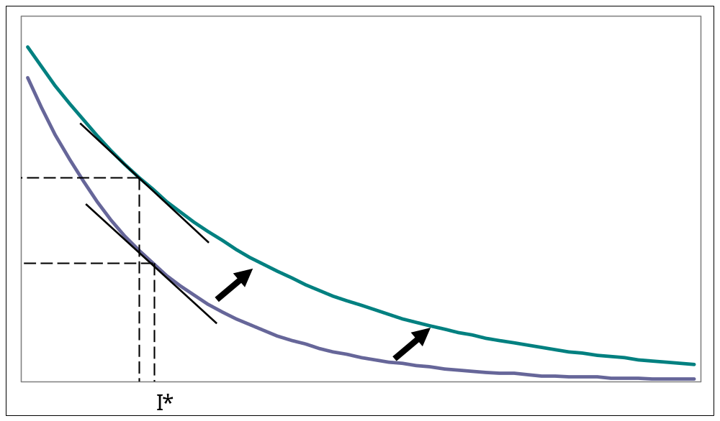
Trends in Attacks
Expected Loss
Security Investment

Slide 10
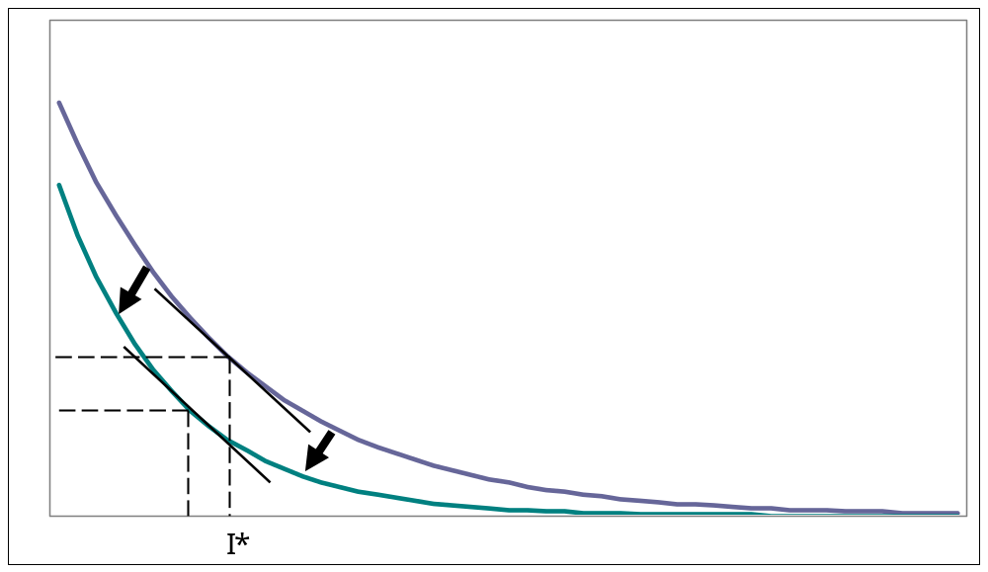
Trends in Defense
Expected Loss
Security Investment

Slide 11
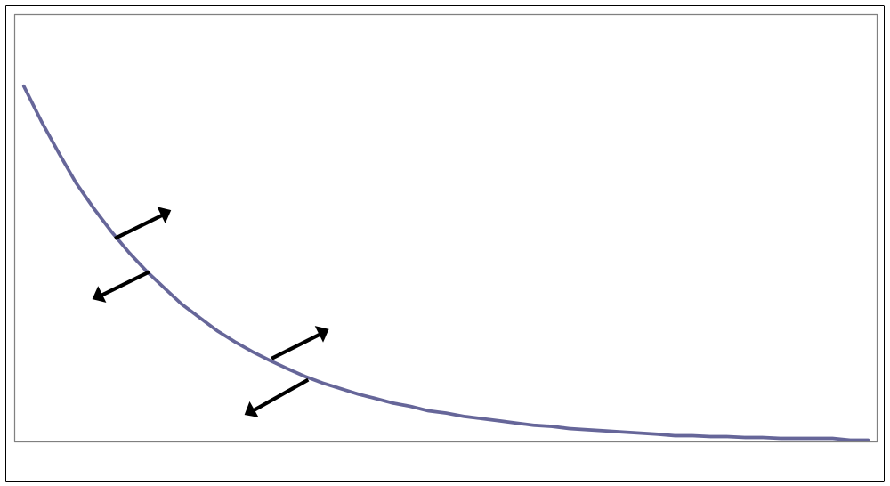
Competing Forces
Loss
Investment

Slide 12
Innovations
Defense
Motivated by High Security Cost
Innovates Defense
Lower Security Costs
Increases Reliance on IT
Attack
Motivated by Increased Impact or Payoff
Innovates Attacks
Increases Losses
Increases Security Costs

Slide 13
An Equilibrium Cost Curve?

Slide 14
Conclusion…

Slide 15
Other Interesting Topics
Information Security as a Public Good
Principle – Agent Problems

Slide 16
The End

Slide 17
Other Considerations
Negative ROI on ideal
investment range
Multiple maximums
on investment

Slide 18
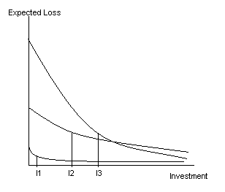
The Problem of
Heterogeneous Loss Curves
ROI estimates are system specific:
Size and Complexity
Degree of Openness, Connections
System Requirements

