Slide 1
Improving Information Flow in the Information Security Market
May 16, 2002
Dr. Carl E. Landwehr
Senior Fellow
Mitretek Systems, Inc.*
clandweh@nsf.gov
+1 703-292-8910
* Currently on assignment to the National Science Foundation

Slide 2
Why information about security properties is hard to obtain
Security is hard to demonstrate -- depends on systems not doing what they shouldn’t, not just doing what they should. Unless attacked, “secure” and “insecure” systems can behave identically
Security is not a stable property -- small changes in systems can have big effects on security
Security properties don’t compose well -- two secure components connected inappropriately will be insecure.
Security is a property of the whole system, not just the components
Notes:
Mention “partnership,” need to cooperate, develop appropriate policy for data sharing

Slide 3
A little history of computer security
TCSEC Product
Development
“Penetrate and Patch”
Period
TDI
Published
TNI
Published
Anderson Rept:
Reference
Monitor Concept
Orange Book
Published:
TCB Concept
Federal Crit.
First Draft
RISOS,
PAP Projects
NCSC
Founded
Common Crit.
First Draft
V. 1.0
Ware Rept
1970
1980
1990
2000
ADEPT-50
MULTICS
SCOMP
KSOS
DEC
VMM
Sec Kernel
You are here!
AFDSC
MULTICS (AIM)
First
Evaluations
Completed
Security
Profiling
Timesharing
Demonstrated
Common Criteria
Int. Std.
Security Kernel
Experimentation
Common Criteria

Slide 4
The Setup
By 1980, DoD (e.g., Steve Walker) recognized
  it would not dominate the computer market and hence could not dictate to producers
  it wanted machines available with better security than the market would provide
  it could not afford custom computers for all systems with security requirements
But it also believed
  products with better security would not cost more to manufacture, once developed
  the security features they wanted could live within the commercial products and not interfere
So the trick was to persuade the companies to invest in better security even though the primary market didn’t care

Slide 5

The Strategy
The basic idea:
  provide “Consumer Reports” like information about the security (or lack thereof) of computer systems
  provide a market for more secure computers by requiring DoD systems to procure computers that did well in the ratings
Intended result: gradual improvement in built-in security in commercial products, availability of some high assurance systems for government needs
Precedent: procurement of crypto gear by NSA
  Endorsed Crypto Products List
  Preferred Products List (PPL) [TEMPEST]
  Degausser Qualified Products List

Slide 6
Implementing the strategy
Needed:
  basis for evaluations -->
  organization to do the evaluations: NCSEC, subsequently NCSC, originally aimed at NBS (NIST), landed at NSA
  industry cooperation to submit systems for evaluation
More carrots for industry:
  Only systems submitted voluntarily would be evaluated
  Government would bear the evaluation cost (though vendor must produce evidence required)
TCSEC
Notes:
When presenting, do some foreshadowing
Find some nuggets for this
Mention DARPA survivability work

Slide 7
What happened: evaluations and criteria
1981: NCSEC/NCSC established
1983: initial evaluation criteria published
1984: initial evaluations completed:
  RACF-MVS--C1 ACF2-MVS/SP--C2 SCOMP- A1)
2000: Last TCSEC evaluation completed:
  Sybase Adaptive Server Anywhere, v.7.0.0 Sept. 2000 [C2]
Total of 85 evaluation certificates issued; 29 more initiated but not completed (withdrawn?)
Today: in US, 6 firms are in business doing evaluations under the Common Criteria

Slide 8
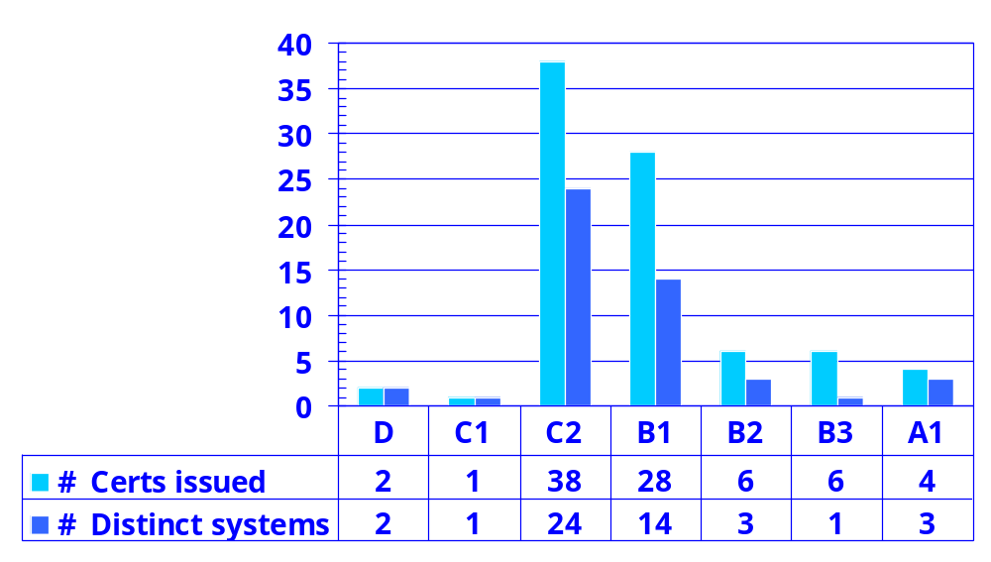
TCSEC Completed Evaluations by Class 1984 - 2000
Data from Historical EPL archive, www.radium.ncsc.mil

Slide 9
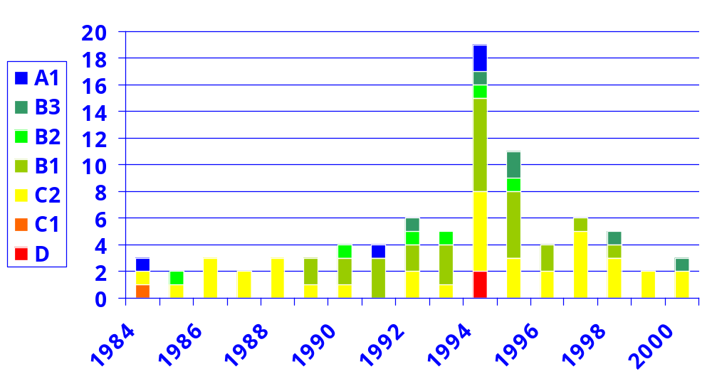
TCSEC Evaluations by Year and Class
{What happened in 1995-6?}
Data from Historical EPL archive, www.radium.ncsc.mil

Slide 10
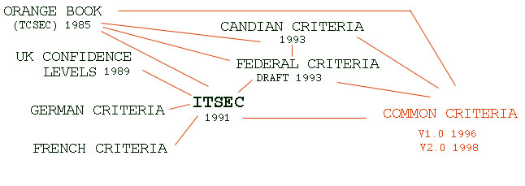
Globalization: evolution of evaluation
UK criteria and CLEFs
  unbundle the feature and assurance requirements
  put the evaluations in the commercial sector
    and make the developer pay for them
German, French criteria and finally “harmonised” European criteria become ITSEC
US: Federal criteria
Common criteria

Slide 11
Why it hasn’t worked as planned
Evaluations took too long
  “criteria creep”
  vendor drag - slow response
  startup effects: perverse incentives for uncompleted evaluations
  re-evaluation needed of new releases, hardware [RAMP]
  evaluation leadership lost sight of objective?
Inadequate procurement pull
  not enough evaluated products to assure competitive procurements
  systems, not products, were procured
  no mechanism to evaluate “GOTS” products
  networking omitted
Structure of the criteria vs. products in the market
  bundling of features and assurance requirements

Slide 12
Some lessons
Information about product security properties is hard to obtain
  difficult to quantify and assess
  time consuming to obtain with confidence
  unstable in the face of system changes
Customers have historically preferred newer systems with more features and less certain security properties to holder systems with fewer features and better established security properties

Slide 13
Is the market for computer security products characterized by asymmetric information?*
Security is not a visible property
Seller likely knows more about true security than buyer
But even the seller may not know the security properties of the product (e.g., 802.11B, XP, etc.)
* [if it is, could the economists here please help us figure out how to exploit the situation for mutual benefit?]

Slide 14
Possible strategies
Treat security as a hidden variable and seek readily assessable variables as indicators (e.g., certify software is free of specific classes of flaws, such as buffer overflows, or assure some properties via proof-carrying-code)
Improve availability of information by opening source
Provide better reporting of actual security incidents, losses, and flaws
Notes:
Emphasis need to front-end the security design for better and more cost effective protection

Slide 15
What’s the effect of opening source?
Can the Customer:
Closed Source
Open Source
Apply automated tools to analyze source code for weaknesses?
No
Yes
Employ expert reviewers to find flaws in source?
No
Yes
Determine the compilers and linkers used to generate the binaries?
No
Yes
Apply automated techniques to create more diverse / resilient binaries?
No
Yes
Develop and apply fixes to source expeditiously?
No
Yes

Slide 16
How much would opening source help?
Security is not free in either open or closed source case
Historically, incentives have not been there to generate investment in security by large vendors
Opening source opens new possibilities for customers to invest in security of components they care about
But the real issue is whether customers are sufficiently interested in the added information to generate it and to use it in purchase decisions

Slide 17
Why isn’t there better reporting?
Current widely available information on security incidents and attacks:
  annual CSI/FBI report on incidents and losses
    highly aggregated and self-reported
  CERT type announcements of flaws/remediation
    highly specific, but technical detail often removed and incident/loss data not present
Difficulties in improving reporting:
  commercial disincentive to publicize losses, with no countervailing regulatory or other incentive
  concern about government/others inability to prevent disclosure of confidentially reported data
Possible avenues:
  develop enforceable information sharing protocols?
  require loss disclosure?

Slide 18
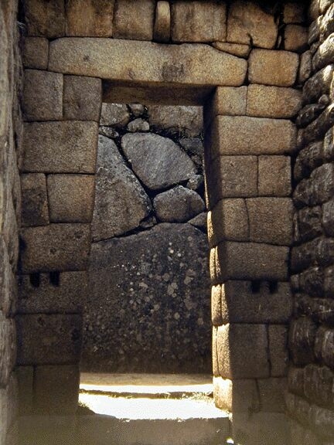
Are we paying too much for security?
Risk of loss depends on the level of threat
Pay for prevention vs. pay for cure

