Slide 1
Quantitatively Differentiating System Security
Stuart Schechter
Harvard University
May 17, 2002

Slide 2
Do Consumers Want More Secure Products?
We must first answer their questions
Is one product more secure than another?
Which product?
Is the extra security worth the price?

Slide 3
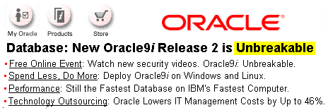
Differentiating Security
The State of the Art

Slide 4
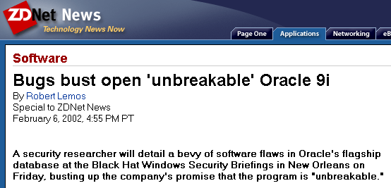
Differentiating Security
The State of the Art?

Slide 5
Differentiating Security
Ask the Experts
Is one product more secure than another?
  “Sure.”
Which one?
  “I think it’s probably…”
Should I care about the difference?
  Are you asking Ross or Bruce?
Without a metric for security, we only have heuristics.

Slide 6
The Metric: Cost To Break (CTB)
Familiar from the crypto world
Can be measured economically
Lower bounds have been measured economically by RSA & others

Slide 7
Bootstrapping Markets for Vulnerabilities
Camp & Wolfram
  Security is externality
  Consumers won’t pay for
  Government should issue security credits
Are consumers unwilling to pay for security or do they not know how to buy it?

Slide 8
Proving Your Product is More Secure
Your product costs more to break into
Your CTB is higher
No need to measure
exactly – use bounds
CTB ($)
Lower(CTB(yours))
Upper(CTB(theirs))

Slide 9
Measuring Competitor’s CTB
Find an upper bound
Offer reward for first reported exploit in competing product
Publicly trusted third parties verify exploit
Exploit need not be revealed to competitor

Slide 10
Measuring Your Product’s CTB
Find a lower bound
Set reward to desired CTB
Offer reward for ALL exploits reported
Repair exploits immediately
Expensive

Slide 11
What you can claim
Is one product more secure than another?
  Yes
Which one?
  Mine
Is the extra security worth the price?
  Is security worth the difference in CTB?

Slide 12
Measuring Your Product’s CTB
(without paying too much)
Offer low reward
Raise reward until exploits reported or until desired CTB reached
Repair vulnerability
Go to step 2

Slide 13
Future Work
Establish cost bounds for finding exploits using CTB
Generalize CTB for all software defects
Use of CTB from earliest testing, to release of upgrades, to product retirement

Slide 14
Conclusion
Differentiation key to selling security
Metrics are key to differentiation
CTB allows you to answer key questions
  Which product is more secure?
  Should I care?
CTB can be measured with adequate precision

Slide 15
Acknowledgements
Jason Woodard
Michael D. Smith
David Molnar
Edward Naim
L. Jean Camp
Adam Brandenburger

