Slide 1
Towards an Economic Analysis of Trusted Systems
Joan Feigenbaum
with D. Bergemann, S. Shenker, and J. Smith

Slide 2
Content Providers and the Internet:
A Love-Hate Relationship
Computers and digital documents drastically lower the costs of content creation and reproduction.
Internet drastically lowers the cost of content distribution.
Vast amounts of content can be delivered to vast numbers of consumers at very low cost to providers.
⇒

Slide 3
Love-Hate Relationship, cont.
Once content is transferred from provider’s computer to consumer’s, provider loses control over it.
Low-cost reproduction and distribution can be done by anyone, not just content “owners.”
Low costs and high volume don’t necessarily lead to high profits.
⇒
Content providers’ ideal world is one of (almost) pre-Internet-era prices and Internet-era costs.

Slide 4
Trusted Platforms
Informal defn.: Networked computers that can prove to each other that they are running only authorized software. Proofs are achieved by hardware-supported, cryptographic protocols.
Examples: TCG, Microsoft’s NGSCB
Could enable remote control of data after it’s been transferred to another machine.
Applications
  Copyright enforcement / content businesses
  Privacy protection
  Security-policy enforcement generally
?
?

Slide 5
Multidisciplinary Study
Technology: How to design, build, and mass-produce trusted platforms cost-effectively?
Policy: Is remote control of data socially desirable and ethically sound?
This talk: Economics
  Would trusted platforms be widely adopted?
  Are there economically better, technologically feasible alternatives?

Slide 6
A Two-Sided Market
Trusted platforms must be adopted by
  Content providers
  Content consumers
Each market has externalities.
  Provider cares about how many consumers are using a particular platform.
  Consumer cares about how many providers are producing for a particular platform.
The study of such markets is relatively recent.

Slide 7
Model
Section 2 of paper contains basic trusted-platform market model.
Derives parameterized expressions for
  content providers’ revenue
  platform vendor’s revenue
  consumers’ net utility
No conclusions yet, just open questions

Slide 8
Open Research Questions
Platform-market structure and governance:
  One platform
    Proprietary technology, one vendor
    Industry-consortium technical standard, multiple vendors
    Academic technical standard, multiple vendors
  Multiple competing platforms
Multihoming:
  Does platform competition increase efficiency?
  Incentives for interconnectivity and interoperability?

Slide 9
Open Research Questions, cont.
Timing and uncertainty:
  Dependence on distribution of consumers’ valuations
  Will high-value content providers be early adopters?
  Will this determine the structure of the platform market?
Information asymmetry:
  Will platform vendors reveal security vulnerabilities?
  See related work by Schechter and Smith.

Slide 10
Alternative to Trusted Platforms
Consumer can use the content in three ways.
  Authorized use only (utility u_{a} )
  Flexible private use (utility u_{p} )
  Uncontrollable network use (utility u_{n} )
0 < u_{a}< u_{p}< u_{n}< ∞
Future utility is discounted with factor δ ∈ (0,1).

Slide 11
Alternative to Trusted Platforms, cont.
Monitoring infrastructure:
Stochastically observe network use.
Unauthorized action can be detected with probability q.
Once caught, the user is forced to adopt a trusted platform (i.e., is denied even flexible private use).

Slide 12

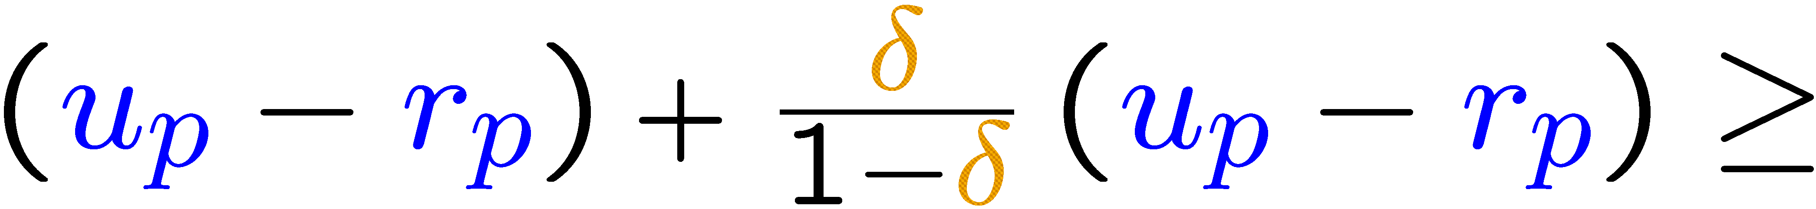
Pricing Constraints
Participation constraint:
(r_{a} ≡ price for authorized use ; r_{p} ≡ price for flexible private use)
Incentive constraint:

Slide 13
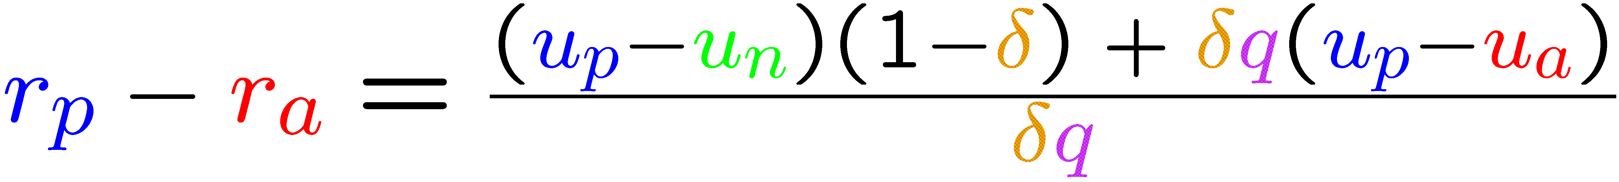
Potential Advantage of Monitoring
The price difference
will be positive if
This is achieved when either δ or q is sufficiently high.

Slide 14
Conclusion
If the detection probability q is high enough, the content provider is better off allowing flexible private use and monitoring (imperfectly) for public abuse.
Model was developed before iTunes was released but may partially explain iTunes’ success.
Policy question:
Will users prefer monitoring to copy prevention?
Technical question: How to make q high enough?

