Slide 1
Software Diversity for Information Security
Gaurav Kataria
Carnegie Mellon University

Slide 2
The Problem?
Many networked machines running software with shared vulnerabilities
Vulnerabilities present in software with large critical mass invite a larger number of attacks
Attacks propagate over networks
Diversification – the use of software with fewer shared vulnerabilities – is an approach to mitigate the risk of correlated failure

Slide 3
Correlated Failure
Vulnerable Links
Various
Applications
Nodes within organization are interconnected and equally vulnerable

Slide 4
Too much uniformity
-monoculture
According to market researcher OneStat.com, Windows now controls 97.46% of the global desktop operating system market, compared to just 1.43% for Apple Macintosh and 0.26% for Linux.
Microsoft Internet Explorer has 87.28% browser market share compared to 8.45% for Firefox and 1.21% for Apple’s Safari.

Slide 5
Why uniformity?
Homogeneity has “network effects”
Network effect is the positive externality from consuming a software that others use due to
  Better connectivity
  Integration
  Support etc.

Slide 6
But..
Homogeneity means putting all your eggs in one basket…
…if one node fails then so will others

Slide 7
How can diversity be introduced?
Choosing a different product?
  Linux vs. Windows vs. MAC OS?
  IE vs. Firefox
  Outlook vs. thunderbird
Different builds using different components
  MIME-handler and email header processors in mail clients?
Sensor network nodes distributed with multiple OS’s in ROM?

Slide 8
Diversity: Definition
Two software choices
  Incumbent software 1
  Competing software 2
Diversity defined in percentage terms
  The firm may choose to have x₁ proportion of its systems on incumbent software 1, while having the remaining 1-x₁ on the competing software 2
50% diversity implies half nodes running software 1 and the other half running software 2

Slide 9
Diversification Strategy
Model Correlated Failure
  Beta-binomial distribution
Estimate Loss due to an Attack
  Downtime is crucial economic loss
  Mean time to recover as a metric for loss
Security Investment Tradeoffs
  Service capacity or preparedness
  Network configuration
Notes:
Most important slide

Slide 10
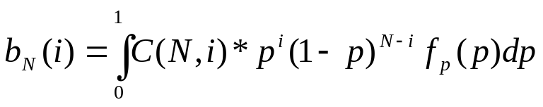
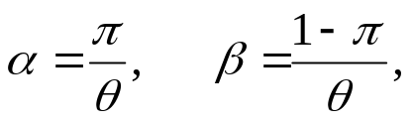
Modeling Correlated Failure
General randomized Binomial distribution
The intensity function f_{p}(p) gives the probability distribution that a fraction of all nodes will fail
The node failure distribution is beta-binomial when f_{p}(p) follows beta distribution with parameters:
Where,
π is the (expected) probability of computer failure in an attack, θ ε (0, infinity) is the correlation level

Slide 11
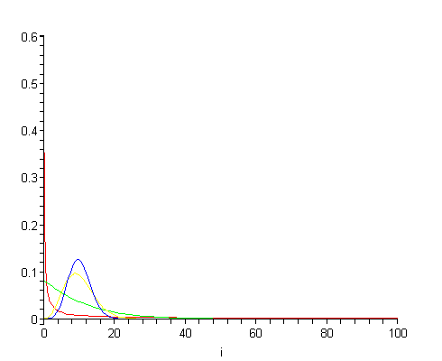
Beta-binomial
α = 0.1 and β = 0.9 (high corr.)
α = 1 and β = 9
α = 10 and β = 90
α = 100 and β = 900 (low corr.)
B_{N}(i)

Slide 12
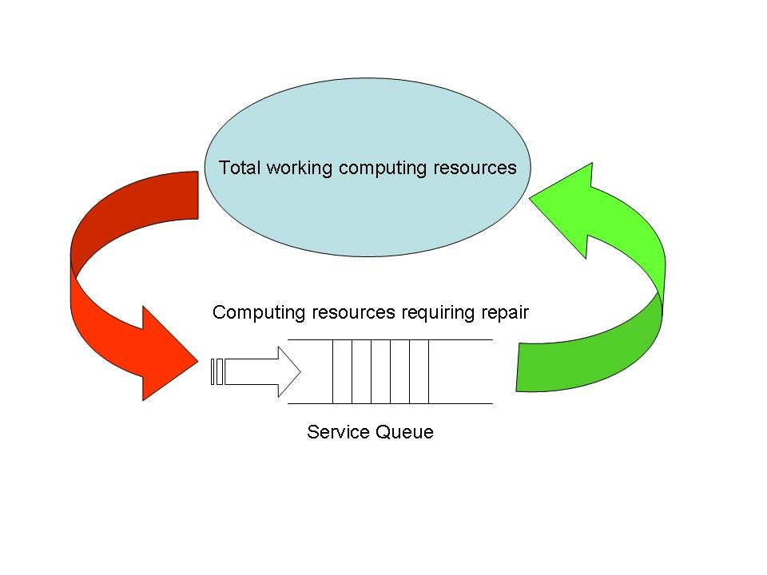
Security Cost
At any time some computers are affected by worms, viruses, software bugs etc. and require servicing.

Slide 13
Loss from an Attack
= Expected Repair Time
M/G/1 queue
  M (memoryless): Poisson arrival process, intensity λ, which captures the arrival rate for attacks
  G (general): general service time distribution, mean E[S] = 1/μ, which captures the service time to bring all infected systems back to normal status
  1 : single server, load ρ = λ E[S] (in a stable queue ρ is always less than 1)

Slide 14
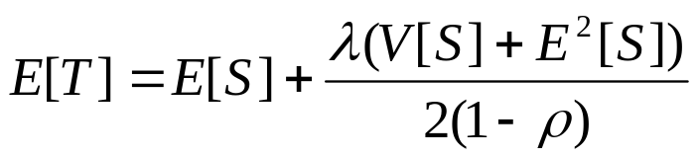
(Contd.)
Loss from an Attack
Mean time to bring every node up is given by Pollaczek-Khinchin mean formula
Note:
  Mean downtime depends only on the expectation E[S] and variance V[S] of the service time distribution but not on higher moments, and
  Mean value increases linearly with the variance.

Slide 15
Number of Attacks
Attack arrival modeled as a Poisson process with arrival rate λ
λ, may depend on many factors including
  type of software
  industry where it is used
  inherent security level of software
  market share of the software product
    Economies of scale in attack
Let mλ be mean # of attacks against software 2

Slide 16
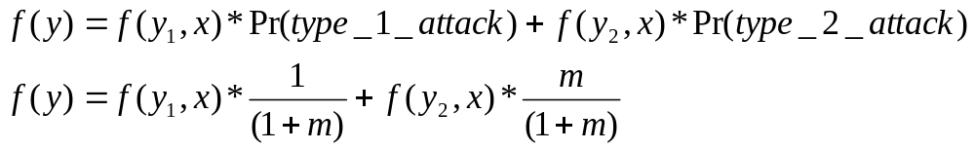
Loss Reduction Via Diversity
Where,
  y = # of computers affected by attack on either type of software
  y₁ = # of computers affected by attack on incumbent software
  y₂ = # of computers affected by attack on competing software
Individual f(y,x) are given by Beta-Binomial distribution

Slide 17
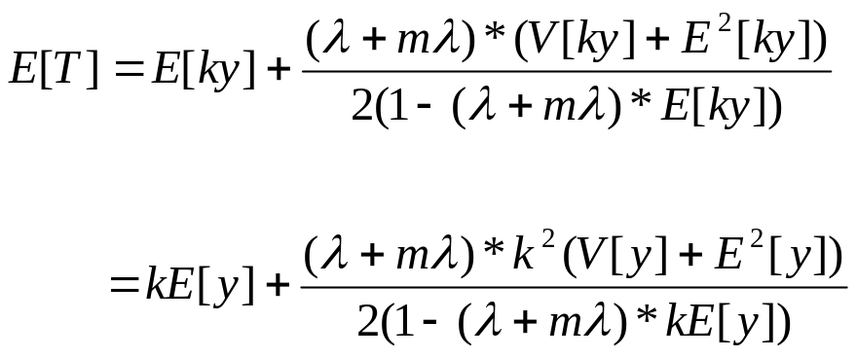
(Contd.)
Loss Reduction Via Diversity
Where,
Service time S = k*y, where k is the measure of service capability; by investing in the IT department’s capacity a firm can decrease service time by decreasing k.
λ+mλ = total number of attacks faced; 1/1+m are of type 1 and m/1+m of type 2.

Slide 18
Variables of Interest
Diversity (x)
Service capacity (k)
Network configuration (θ)

Slide 19
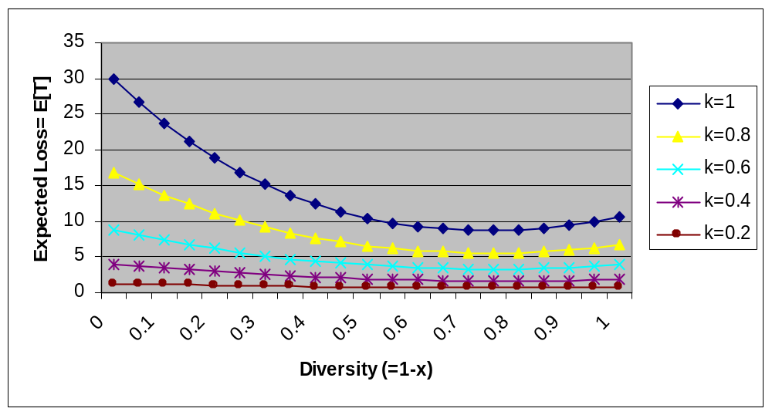
Diversity vs. Service Capacity
m is kept constant at 0.5 i.e. software 2 receives half as many attacks as incumbent software 1;
π = .05 (5% probability of failure)
Investment in service capacity offsets investment in diversity

Slide 20
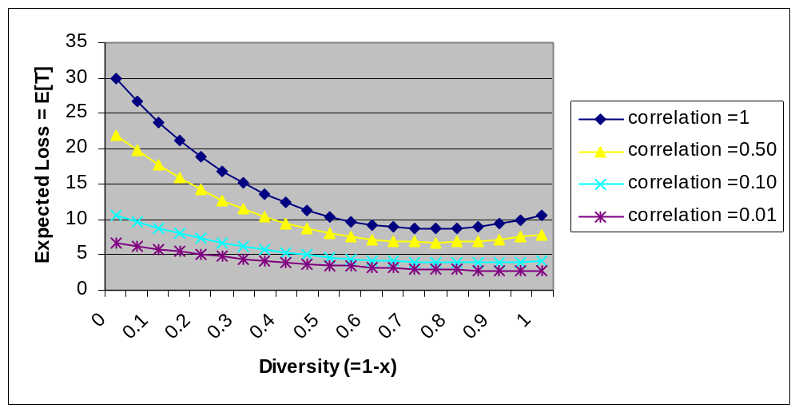
Diversity vs. Network Config.
m is kept constant at 0.5 i.e. software 2 receives half as many attacks as incumbent software 1;
π = .05 (5% probability of failure)
Investment in network config. offsets investment in diversity

Slide 21
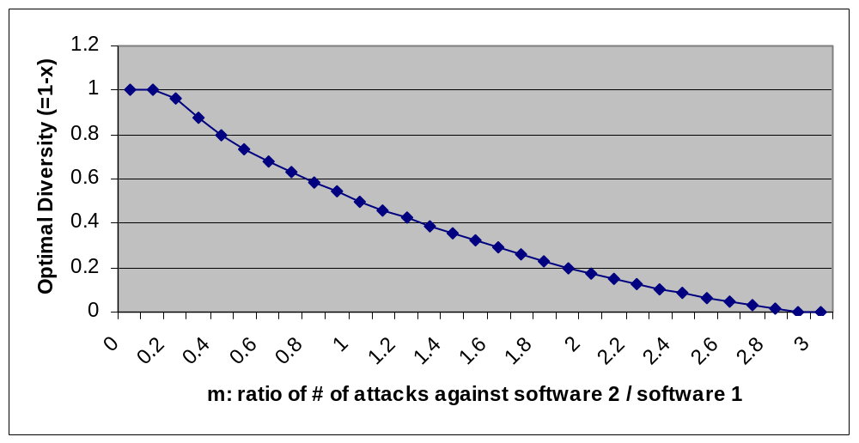
Optimal Diversity
π = .05 (5% probability of failure); k = 1; θ = 1, λ=0.1.
Optimal diversity (i.e. optimal proportion of software 2) declines as software 2 receives more attacks vis-à-vis software 1

Slide 22
Future Research
Game-theoretic decision models for distributed network partition
  Graph coloring approach
  Each agent decides its color taking into account both the benefits and costs of being the same color as its neighbors
  Additional costs may be imposed by network administrator (social planner)
Market Equilibrium
  Strategic interaction
  Role of government and industry groups

Slide 23
Questions?

