Slide 1
Pricing, Innovation and Product Line Strategies for Security Software:
Theory and Evidence
Anindya Ghose
(joint with Arun Sundararajan)
Leonard Stern School, New York University
June 02, 2005
4th Workshop on Economics of Information Security

Slide 2
Overview of Paper
Motivation: Relate security software attributes to pricing
Customer attributes/ownership, quality drivers and demand patterns
Frequent updates and variable cost structure
Method: Theory + Large-scale empirical study
Simple new economic model of bundling horizontally differentiated software components.
Gather panel of data on software demand and pricing
Test predictions of new theory
Data: E-Commerce
Internet sales growing fast: 9% of retail software industry sales.
Security software market achieved $10.1 billion in revenue in 2004 (IDC)
Notes:
For bullet 2
Versioning is optimal? Lots of theory, no evidence
Software sellers seem to use both strategies equally frequently. Why?
There is a fair amount of mixed bundling despite theory to the contrary
A large fraction of price variation in consumer software is delivered by changing rebates rather than real price

Slide 3
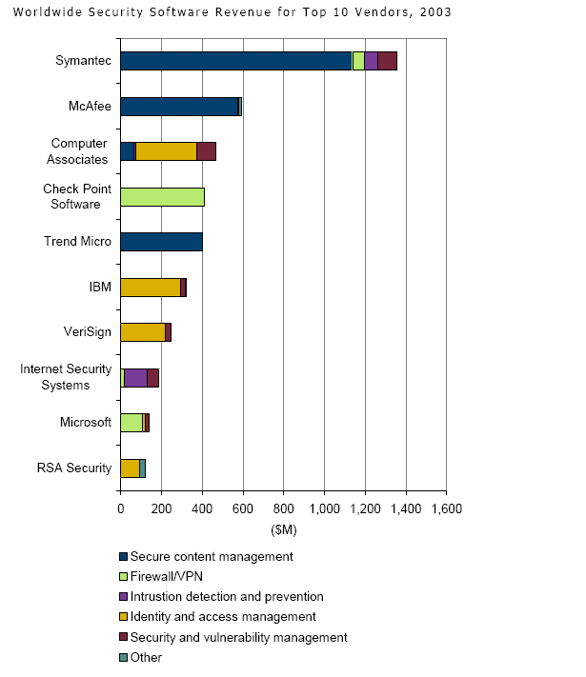
There is also a large “hidden” market (Windows firewall, GMail spam filter…)

Slide 4
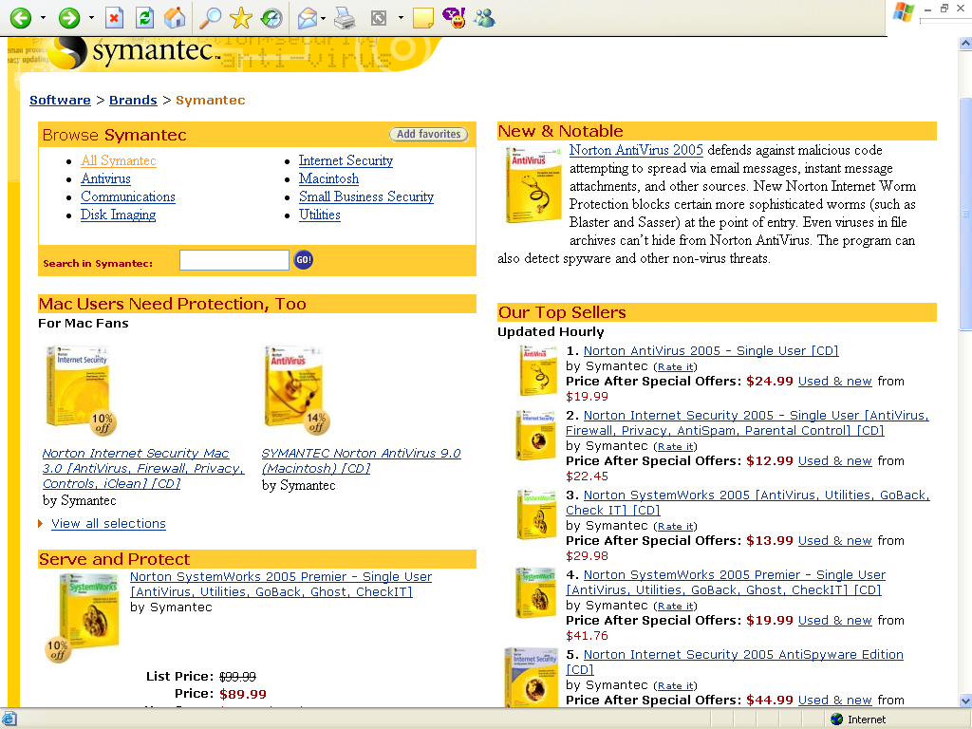

Slide 5
Related Prior Work
Early work on bundling (Adams and Yellen 1976, McAfee, McMillan and Whinston 1989) ignores effects on entry and innovation.
Recent work (Bakos and Brynjolffson 1999, Nalebuff 2004) suggests that by deterring entry or by lowering incentives for firms to enter an industry, bundling can suppress innovation.
Security Software Industry
  Identifying vulnerabilities and delivering timely solutions to existing customers is the critical driver of quality.
  Innovation by incumbents is of paramount importance.

Slide 6
Unique Aspects of Security Software
Customers often get free substitutes for components of security software suites, which are bundled with unrelated products.
  Google’s GMail has a sophisticated spam filter.
  Windows XP is sold bundled with a fairly effective personal firewall. (PC World 2004)
Demand-side effect: A random fraction of consumers have low (or no) willingness to pay for certain components, independent of their preferences for the functionality provided by this component.

Slide 7
Unique Aspects of Security Software
Vendors incur security related development costs
  Antivirus software updates the virus definition files on each of its clients using its Live Update functionality very frequently.
  Spam blockers (such as PanicWare's MailWasher) include subscriptions to spam databases that frequently update the gateway filters (Bayesian or neural networks) on their clients. (prevent false positives and false negatives).
Cost-side effect: Higher variable costs incurred by vendor due to security updates

Slide 8
Results
Theoretical Results
Mixed bundling (MB) is optimal relative to pure bundling or components.
MB leads to higher incentives for innovation by incumbent firms creating and maintaining security software.
Discount on bundle and its demand relative to the demand for the component is
  strictly increasing in the variable cost
  strictly decreasing in the fraction (r) of customers who have an outside substitute for a security component.
Demonstrate the optimality of mixed bundling relative to pure bundling.
Pricing of bundles with respect to components
  Relative discounts
  Relative demand.
Empirical Evidence

Slide 9
Model (Firm)
A monopolist sells two security software components, I and II.
The monopolist makes two choices:
  Innovation level for its software, which results in a chosen level of quality s
  Pricing strategy given a fixed choice of s in previous stage.
Fixed cost F(s): development costs of components and costs associated with maintaining the infrastructure associated with updates at a quality level s.
Variable cost has two aspects:
  Base cost c₀ which includes the costs of the CD, manual, packaging, shrink-wrapping and distribution.
  Update cost c_{U} representing the expected variable costs that a firm incurs over the lifetime of the installation.

Slide 10
Model (Consumers)
Each consumer is indexed by a parameter x which is uniformly distributed on the interval [0,1].
If the quality level of the seller's software is s, the maximum utility that a consumer with index x gets from component I is s(1-x), and from component II is s[1-(1-x)].
A fraction r of consumers own a perfect substitute for component I, and an equal fraction r of consumers own a perfect substitute for component II.
The realization of these random fractions segments consumers into four groups.

Slide 11
Consumer Segmentation
s
s
0
x
1
0
x
1
Segment 1: Willing to pay for both components
Segment 2: Willing to pay for component I
s
s
0
x
1
0
x
1
Segment 3: Willing to pay for component II
Segment 4: Not willing to pay for either
1st segment: Consumers whose WTP for each component is determined by x. Segment size is (1-r)².
2nd and 3rd segments: Consumers whose WTP for one component is determined by x, and whose WTP for the other component is zero. Size is r(1-r).
4th segment consists of those consumers whose WTP for both components is zero.

Slide 12
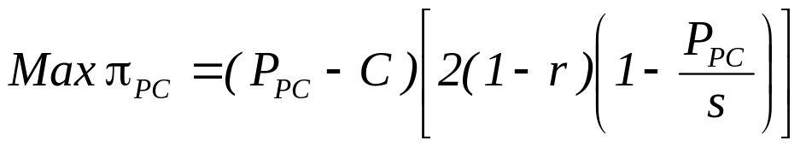
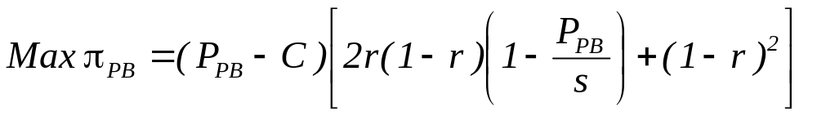
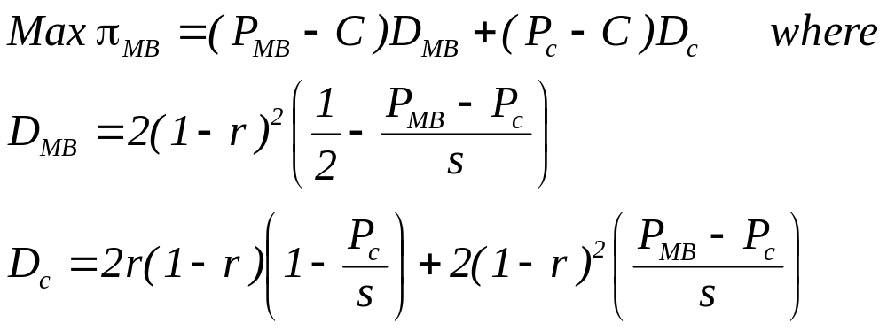
Firm Optimization Problem
Pure Component Pricing
Pure Bundling
Mixed Bundling

Slide 13
Testable Implications from Model
If r>0, the optimal pricing strategy involves mixed bundling.
If the cost of updates C_{U} > 0, then the variable cost of security software is higher than the variable cost of standard application software.
The higher the cost of updates C_{U},
  the greater the discount offered on bundled suites of security software.
  the higher the demand for the bundle relative to the demand for components.

Slide 14
Data Set
Scope of data set
Several popular titles across Utilities: Virus Protection, OS, Internet Utilities, PC Maintenance, Partition etc.
October 2004-May 2005
Primary data source: Amazon.com
Gathered using Java spider from XML/HTML data feed.
Granularity: 6-hour intervals
Primary Market: Price, Salesrank, Product release date, rebate terms, customer ratings, reviewer details.
Secondary Market: Competitive Prices, Product Conditions, Seller details.
Auxiliary data sources
Buy.com: demand/price for benchmarking purposes.

Slide 15
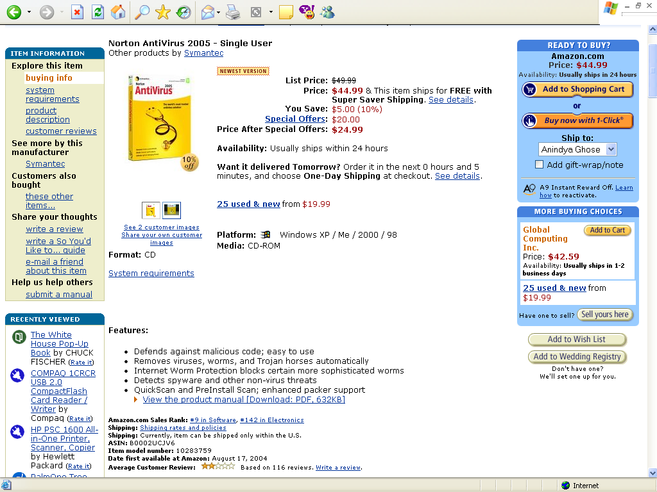

Slide 16

Demand Estimation
Unavailability of actual demand data
Recently used (Chevalier & Goolsbee 2003; Brynjolfsson, Hu & Smith 2003)
“fix” relating demand Q_{i} to salesrank R_{i}:
Our approach: Link Salesrank directly to economic measures
Demand elasticity
We present this analysis for different bundles of 3 of our brands: Norton, McAfee and Adobe.
A few examples: Spamkiller, Anti-Virus, Utilities 8.0, Ghost 9.0, Partition Magic, Personal Firewall, Anti-Spyware, Photoshop.
Notes:
Estimating beta is easier – directly from the data. Estimating alpha is harder because one needs actual demand data from a vendor, and the ability to

Slide 17
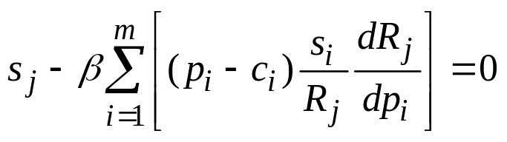
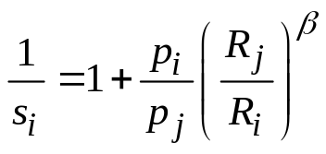
Price-Cost Markup Estimation
Relating price and demand to variable cost
Based on Hausman’s (1994) extension of the Lerner index: optimal oligopoly pricing under the Nash-Bertrand assumption
Our approach: Link Salesrank directly to economic measures
Estimating markups (to get unit variable cost) where
Notes:
Estimating beta is easier – directly from the data. Estimating alpha is harder because one needs actual demand data from a vendor, and the ability to

Slide 18
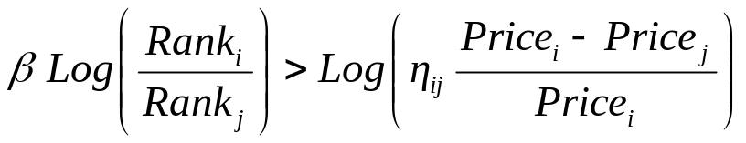
Results
Bundles vs. Components
Cross-price elasticities between bundles and components (0.2-0.3).
Cross-price elasticities between components and bundles (0.3-0.6).
Example: McAfee Bundle vs. Components
  8.1% and 1.5% of bundle revenues were cannibalized by the individual components, McAfee VirusScan and McAfee Firewall, respectively.
  Bundled suite cannibalized 9% and 2% of McAfee VirusScan and McAfee Firewall revenues, respectively.
  Ratio of the total revenues of McAfee VirusScan and McAfee Firewall to that of the bundle, was approximately 15.1
Notes:
For bullet 2
Versioning is optimal? Lots of theory, no evidence
Software sellers seem to use both strategies equally frequently. Clarify that a “version” is like professional vs. standard, while a generation is like office 2002, office XP.
There is a fair amount of mixed bundling despite theory to the contrary
A large fraction of price variation in consumer software is delivered by changing rebates rather than real price

Slide 19
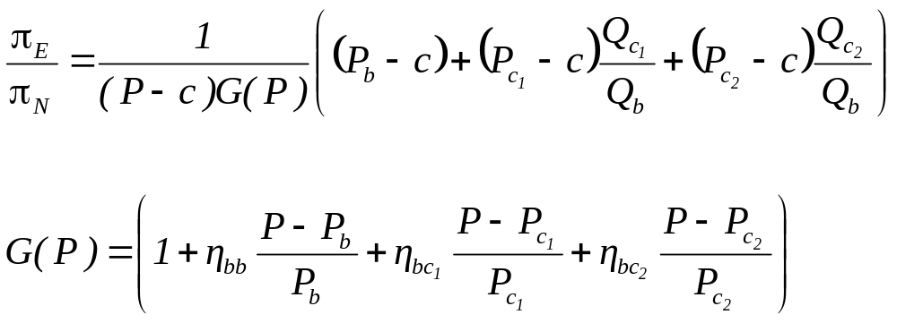
Proving the Optimality of Mixed Bundling
Mixed Bundling vs. Pure Bundling
Notes:
For bullet 2
Versioning is optimal? Lots of theory, no evidence
Software sellers seem to use both strategies equally frequently. Clarify that a “version” is like professional vs. standard, while a generation is like office 2002, office XP.
There is a fair amount of mixed bundling despite theory to the contrary
A large fraction of price variation in consumer software is delivered by changing rebates rather than real price

Slide 20
Results & Implications
Theoretical Results
Mixed bundling (MB) is optimal relative to pure bundling or components.
Innovation under mixed bundling is always higher than that under pure component pricing.
Further for r >r* , innovation under mixed bundling is higher than that under pure bundling.
  Leads to higher incentives for innovation by firms creating and maintaining security software.
Discount on bundle is increasing in variable cost, and decreasing in the fraction (r) of customers who have an outside substitute for a component.
Demand for the bundle relative to the demand for component increases in the variable cost, and decreases in r.
Empirically demonstrate the optimality of MB relative to PB.
Lower price-cost margins for security software
Pricing of bundles with respect to components (Relative discounts)
Demand of bundles with respect to components (Relative discounts)
Empirical Evidence

