Slide 1
Digital Rights Management and the Pricing of Digital Products
Yooki Park
and
Suzanne Scotchmer
Workshop on the Economics of Information Security
KSG, Cambridge, MA
June 2, 2005

Slide 2
Outline of Talk
DRM: A circumvention hypothesis
The price-moderating effect of the circumvention threat:
  The Monopoly Case
  The Duopoly Case
Will vendors make the optimal choice to share?
Cost-Sharing and Independent Pricing
Collusion through Technology

Slide 3
A Circumvention Hypothesis:
DRM sets the cost of circumvention
(but does not protect in any absolute sense)
Mass circumvention (internet) is detectable, avoidable.
The conceit in this paper:
Content will eventually be given away for free (unprotected) but the ability to “render” it is protected.
Business Models:
Who sells the ability to “render,” and what is the relationship with the content provider? Third party? Self? How is the cost of protection covered, and how does it relate to payments for content?
We consider a wholly owned subsidiary.

Slide 4
Outline of Talk
A circumvention hypothesis
The price-moderating effect of the circumvention threat:
  The Monopoly Case
  The Duopoly Case
Will vendors make the optimal choice to share?
Cost-Sharing and Independent Pricing
Collusion through Technology

Slide 5
Monopoly: the price-reducing effect of a threat of circumvention
Model: e = strength of protection = cost of circumvention
Cost of protection = K(e) No-hacking constraint: p ≤ e
Reducing the price from the monopoly
price has no effect on revenue,
but reduces the cost of protection.
p*

Slide 6
Welfare Implications of DRM
DRM might increase profit and consumer welfare.
Protection may last longer, but DRM is costly.
With equal total revenue, less DWL:
p
p
p*
p*
~
p
~
p
~
~
x(p*)
x(p)
x(p*)
x(p)

Slide 7
Outline of Talk
A circumvention hypothesis
The price-moderating effect of the circumvention threat:
  The Monopoly Case
  The Duopoly Case
Will vendors make the optimal choice to share?
Cost-Sharing and Independent Pricing
Collusion through Technology

Slide 8
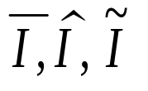

Pricing with DRM
Comparisons
 | Legal Enforcement | Separate DRM | Shared DRM
Independent pricing | Î | I
Joint pricing |  | C | J
Assume: The no-hacking constraint with shared protection p₁+p₂ ≤ e .

Slide 9
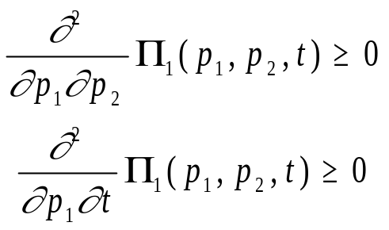
The General Monotone Comparative Statics Argument
p₁
p₂(p₁,t)
p₁(p₂,t)
Suppose that the “own” second derivative is larger in absolute value than the cross partial. This also gives uniqueness.
p₂

Slide 10
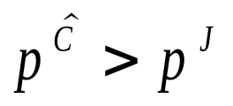
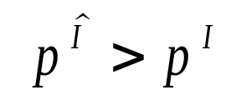

Oligopoly: the price-reducing effect of a threat of circumvention
 | Legal Enforcement | Separate DRM | Shared DRM
Independent pricing | Î | I
Joint pricing |  | C | J
Collusive Pricing: Supermodular payoff functions
Independent Systems: Supermodular payoff functions

Slide 11
Outline of Talk
A circumvention hypothesis
The price-moderating effect of the circumvention threat:
  The Monopoly Case
  The Duopoly Case
Will vendors make the optimal choice to share?
Cost-Sharing and Independent Pricing
Collusion through Technology

Slide 12
Will vendors make the optimal choice whether to share? (no)
The private versus the public interest:
Reducing costs of protection is good for everyone.
(But sharing might not reduce costs.)
Vendors want to raise price, while it is (possibly) in the public interest to lower price.
Because of this conflict, vendors will not make the optimal choice whether to share.

Slide 13
Outline of Talk
A circumvention hypothesis
The price-moderating effect of the circumvention threat:
  The Monopoly Case
  The Duopoly Case
Will vendors make the optimal choice to share?
Cost-Sharing and Independent Pricing
Collusion through Technology

Slide 14
Cost Sharing and Independent Pricing
Must pricing be collusive, p^{J}?
With independent pricing, equilibrium prices depend on how costs are shared:
Cost-sharing schemes:
(1) Fixed cost shares
(2) Revenue-based cost shares;
firms set prices; revenue can be monitored.
(3) Demand-based cost shares;
firms set prices; total revenue is not monitored.

Slide 15
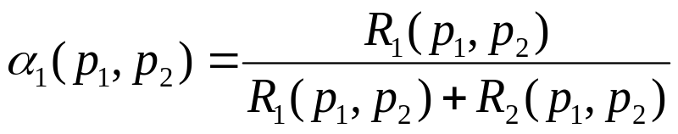
Revenue-based cost sharing
Revenue share of firm 1:
Why does the pursuit of profit generally break collusion?
A price reduction increases the firm’s revenue by stealing business from the rival.
But with cost sharing, the increase in revenue (generally) also increases the cost share .
Revenue-based cost sharing can be collusive, despite independence in price setting.

Slide 16
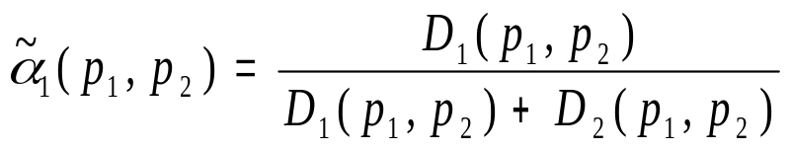
Demand-based cost sharing
….Makes collusion even harder to sustain.
A reduction in price increases the cost share even more than with revenue-based cost sharing
Firms will prefer demand-based cost sharing to revenue-based cost sharing.

Slide 17
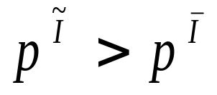
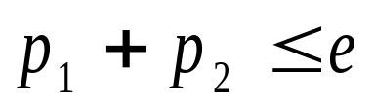
Pure effects of cost sharing (given K):
Does higher K (protection cost) lead to higher prices?
Compare: (1) demand-based cost sharing with (2) fixed cost shares and (3) revenue-based cost sharing
Monotone comparative statics:
But what happens when the no-hacking constraint is imposed? Constrain prices at p^{J} ?
Notice that higher prices require higher protection
Protection can be used to constrain prices downward but not upward.

Slide 18
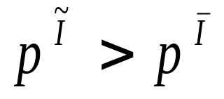
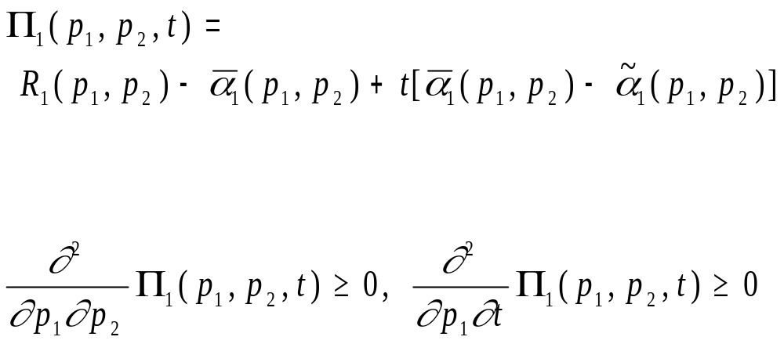
Comparative statics argument
Revenue-based cost sharing is t=0
Demand-based cost-sharing is t=1

Slide 19
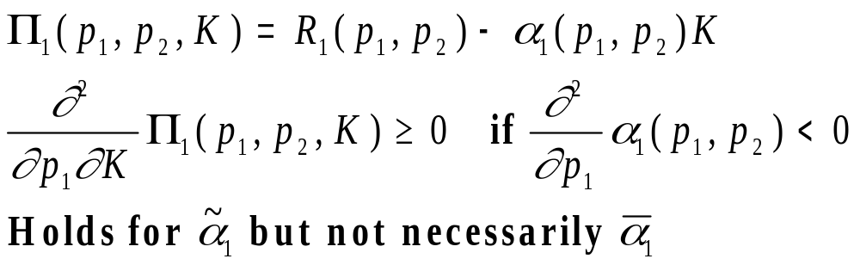
Pure effects of cost sharing:
Effect of K (protection cost) on the equilibrium prices (assuming no hacking)

Slide 20
Why might cost-sharing not support the collusive prices p^{J}?
The most interesting case is when the collusive price is above the price sustainable with perfect legal enforcement.
At p^{J} a reduction in price increases revenue.
A reduction in price increases the cost share.
Which dominates?
The level of protection sets of price cap but the firms might find an equilibrium at lower prices.

Slide 21
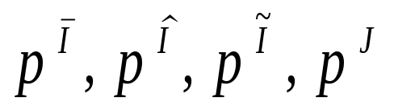
Collusion through Technology
Competitive objective is unclear:
Demand-based cost-sharing is best for collusion. (Constrain prices through the protection level.)
Technology determines whether collusion is possible.
(1) DRM to enforce a single price?
(2) Create a veil that allows demand (downloads) to be
monitored, but not revenue?
(4) Distribute content for zero price, pay for “rendering.”
(5) Privacy concerns?
(Keep the download records out of the hands of the
DRM subsidiary?)
Would not want to overcome a single monopoly price by
allowing rebates on the side/
Requires too much information.

