Slide 1
An Economic Analysis of Software Market with Risk-Sharing Contract
Byung Cho Kim
Pei-Yu Chen
Tridas Mukhopadhyay
Tepper School of Business
Carnegie Mellon University

Slide 2
Agenda
Introduction
Research Questions
Model
Results
Conclusion
Future Work

Slide 3
Introduction
Ernst & Young “Global Security Survey 2002”
  40% confident they would detect a system attack.
  40% do not investigate information security incidents.
  75% experienced unexpected unavailability.
FBI/CSI survey 2002
  90% have been victimized by a cyberattack or security breach in the preceding 12 months.
  Average estimated loss ≈ $2 million per organization.
Average bank robbery loss ≈ $3000

Slide 4
Problem: Technical or Economic?
National Research Council
  Customers
    Ineffective security options
    Low consumer’s awareness
  Vendors
    Low level of demand
    High cost to increase quality
Fisk (2002)
  Well known techniques → most attacks are entirely preventable.
  Not sufficient incentive for the vendors

Slide 5
Proposed Solution
Risk-sharing contract between
  Software Vendor
  Customers (Organizations or Firms)
Why interesting?
  Rather voluntary than mandatory.
  May create an incentive for the vendor to improve quality.
Two Views on Security Software Liability (IEEE Security and Privacy, 2003)
  Ryan supports software liability
  Heckman argues that some other mechanisms should be used.
Risk-Sharing
  Fisher (2002): Some companies are already demanding liability clauses in contracts with vendors.
  Karl Keller, President, IS Power Inc.: “Contractual liability is a great motivator. I’m encouraged that liability for vulnerabilities is entering to contracts.”

Slide 6
Research Questions
What is the economic implication of risk-sharing mechanism in various scenarios?
How does risk-sharing affect vendor’s decision on quality?
Do the software vendors have any incentive to share the risk with their customers? If so, how much?
Is government’s subsidizing policy effective in terms of quality improvement?
How about government’s regulation on risk-sharing?

Slide 7
Model
Players
  Software Vendor
  Customers (Organizations or Firms)
Stages
  Stage 1: Vendor decides optimal quality and risk-sharing proportion simultaneously.
  Stage 2: Vendor chooses optimal price.
  Stage 3: Customers decide whether or not to buy the product.

Slide 8

Customer’s Utility Function
Expected Utility
  V: functionality
  q: security quality, q ∈ [0,1]
  r: vendor’s risk-sharing proportion, r ∈ [0,1]
  K(q): expected loss when q-quality software is installed,
  K’(q) < 0 and K’’(q) > 0
  p: unit price of the software
  θ: leading coefficient capturing customer heterogeneity,
  θ ~ Uniform[0,1]

Slide 9
Vendor’s Profit Function
Expected Profit
  D(p,q,r): demand for the product
  C(q): fixed cost of producing q-qualilty software,
  C’(q) > 0 and C’’(q) > 0
  Marginal cost of production is assumed to be zero.

Slide 10
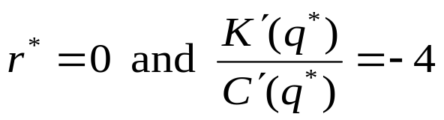
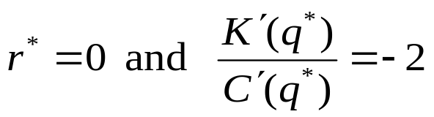
Scenario 1: Monopolist vs. Social Planner
Monopolist
Social Planner
Monopolist vs. Social Planner
C(q)
Cost
Expected Loss
K(q)
0
qm
qs
1
Quality

Slide 11


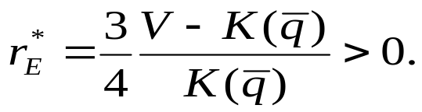
Scenario 2: Incumbent and Entrant
Monopolist-like incumbent that shares no risk.
Entrant who may want to share some risk.
The entrant has an incentive to introduce positive risk-sharing to alleviate competition. The optimal level is

Slide 12
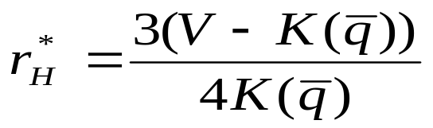
Scenario 3: Quality Differentiation by Risk-Sharing
Vendors differentiate their products by offering different levels of risk-sharing.
Then the total values offered to the customer are
In equilibrium, risk-sharing acts as a differentiator that one firm will share positive risk,
and thus offer higher value to customers, while sharing no risk is the optimal choice for the other firm.

Slide 13
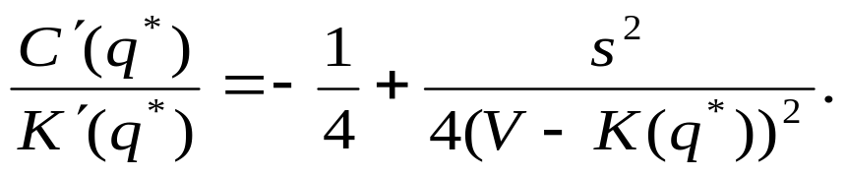
Policy Implication: Government’s Subsidy
s: government’s subsidy for each customer.
At equilibrium in monopoly case, r=0 and
The monopolist reduces the quality of its product when government subsidizes the customers. In terms of quality improvement, government’s subsidizing policy makes the problem worse in monopoly case.

Slide 14
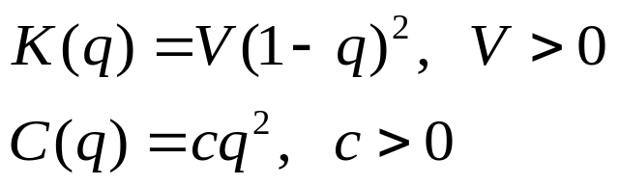
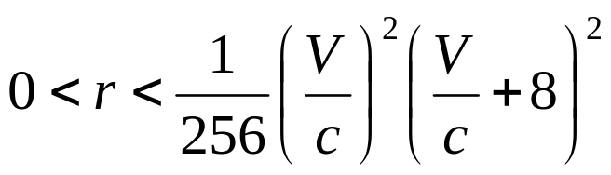
Policy Implication: Government’s Regulation
r: risk-sharing level regulated by the government
Assumptions
q increases when
The range of regulation increases as the proportion of V to c increases.

Slide 15
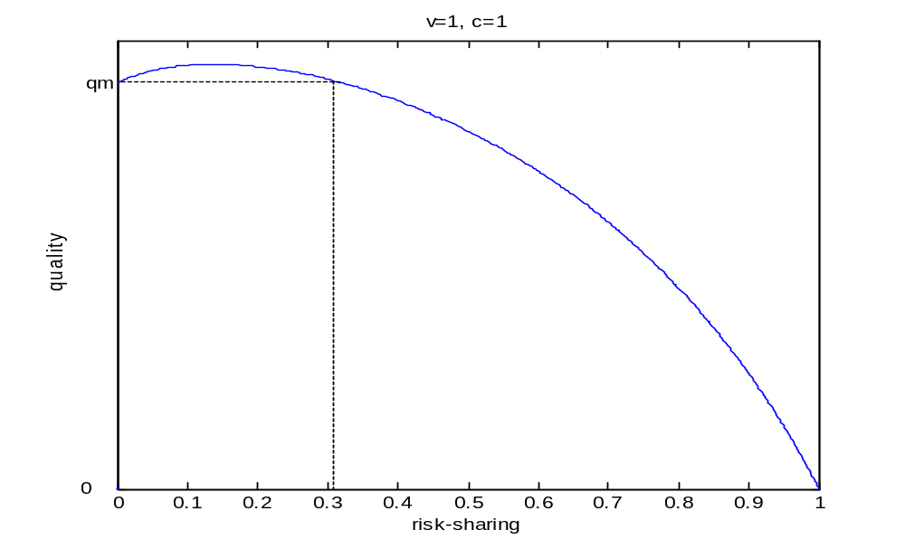
Policy Implication: Government’s Regulation

Slide 16
Conclusion
Our paper analyzes the software market in economic perspective and suggests a theoretical framework to improve the state of security.
Our model provides evidence of under-provided quality of software under monopoly as what has been observed in the market.
Unlike monopoly, vendors have incentive to share the risk in duopoly scenarios.
In terms of quality improvement, government’s subsidy may make the problem worse in monopoly case.
A certain level of regulation on risk-sharing creates an incentive for the monopolist to increase security quality. However, imposing too much risk-sharing may discourage the monopolist.

Slide 17
Future Work
Consider network externalities, and endogenize probability of successful attack.
Consider more flexible contract structure.
Compare the risk-sharing mechanism to other proposed solutions by researchers and practitioners, such as legal liability and cyberinsurance.

