Slide 1
How To Disclose Software Vulnerabilities Responsibly?*
Huseyin Cavusoglu Ph.D., Tulane University
Hasan Cavusoglu Ph.D., U. of British Columbia
Srinivasan Raghunathan Ph.D., U. of Texas @ Dallas
*Best Paper Nominee at the Workshop on Information Technology and Systems, 2004

Slide 2
Introduction
Vulnerability in software is the major reason for insecurity
  20 flaws per thousand lines of code (Dacey 2003)
  Exponential increase in vulnerabilities
    171 in 1995 to 3784 in 2003
Fully secure software is unlikely
  Blaming software vendors is not a solution, vulnerabilities are inevitable
95% of breached could be prevented by keeping systems up-to-date with patches (Dacey 2003)

Slide 3
Vulnerability Life Cycle
Discovery of Vulnerability
  Malicious Users (i.e., Hackers)
  Benign Users
    Software users, Security firms, Security researchers
Disclosure of Vulnerability
  How should a benign user disseminate vulnerability information?
    Should it be kept secret?
    Should the public be informed immediately?
Patching of Vulnerability

Slide 4
The Issue
What constitutes the Responsible Vulnerability Disclosure Process?
  How should a vulnerability identifier disclose vulnerability information to appropriate people, at appropriate times, through appropriate channels?
No consensus on the process
  CERT sets a 45-day grace period
  OIS sets a 30-day grace period
  Security firms follow their own guidelines
    eEye Digital Security, Across Security, BindView, CYBSEC

Slide 5
Characteristics of Disclosure Mechanisms:
A Historical Perspective
Full Vendor Disclosure
  Promotes secrecy
  Gives full control of the process to the vendor
Immediate Public Disclosure
  Promotes transparency
  Gives the vendor a strong incentive to fix the problem
  Allows vulnerable firms to take intermediate measures
Hybrid Disclosure
  Promotes both secrecy and transparency

Slide 6
Motivation
Multitude of disclosure mechanisms creates chaos and confusion on vendor side (Shepherd 2003)
US Government emphasizes the need for pre-designed responsible vulnerability disclosure process (Chambers and Thompson 2004)
  US DHS is considering mandating a centralized vulnerability disclosure process (Fisher 2003)
Software vendors and security firms have already begun to develop a unified framework for vulnerability disclosure
   converge is necessary and somehow unavoidable

Slide 7
Research Questions
Which disclosure process is the responsible disclosure process?
  i.e. what should be the grace period?
What happens if a vulnerability affects more than one vendor?
Should the coordinator promote early discovery of vulnerabilities?
Does early warning system to selected firms improve social welfare?

Slide 8
Literature Review
Life-cycle model of vulnerability handling process (Laakso et al. 1999)
Communication structure between identifier & vendor (Havana, 2003)
Empirical analysis of vulnerability life cycle (Arbaugh et al. 2000)
Legal perspective on vulnerability disclosures (Preston and Lofton 2002)
Vulnerability discovery process (Kannan and Telang 2005)

Slide 9
Literature Review
Analysis of disclosure mechanisms (Cavusoglu et al. 2004a, Cavusoglu et al. 2004b)
Timing of Vulnerability Disclosure (Arora et al. 2004)
  No solution of sequential game, only second stage reaction
    Vendor always patches after the end of the grace period
    (not realistic and does not tell how much time should be given)
  Inappropriate modeling assumptions
    Hackers cannot find vulnerabilities before benign users
    All vulnerable systems are attacked instantly upon disclosure, but damage cost is still time-dependent
    No protection possible after disclose but before patch release
    No change in attack rate before and after disclosure
      Therefore, impact of disclosure policy on vendor is not clear
  More specific results with a more general model are not possible
  Multiple vendor, early discovery, early warning are not addressed

Slide 10









Responsible Vulnerability Disclosure
EUREKA !
IFRAME vulnerability
Determine
Risk
Set
Deadline
Verify
Before deadline
Vendor
inform
inform
Identifier
Coordinator
IFrame
Deadline
Windows has IFRAME vulnerability
Time is up!
Coordinator
Public
Announcement

Slide 11
Methodology
Game-theoretical modeling
  Sequential game between coordinator and vendor
Coordinator minimizes total expected social loss
  Cost to software vendor (patch development cost)
  Damage to software users
  Workaround cost
Vendor minimizes its cost
  Patch development cost
  Reputation cost

Slide 12
Model
0
t₀
p
t₀+T
p
time
The software is introduced to market
The vulnerability is identified by benign user
The patch is released by the vendor (Case 1)
The end of grace period set by the Coordinator
The patch is released by the vendor (Case 2)
Attack rate
  Before public disclosure: a
  After public disclosure: ak where k>1
Likelihood of exploitation
  Before public disclosure: δ where 0<δ<1
  After public disclosure (no patch): δγ where 0<γ<1

Slide 13
Objective Functions
Vendor
  Min (Patch development + Reputation)
    Patch development: ε₁-ε₂(p-t₀)
    Reputation cost: β*( # of affected firms)
Coordinator
  Min (Patch development + Total damage to users + Workaround cost)
    Damage to a firm of type θ where 0<θ<1: Dθ
    Workaround cost per firm: s

Slide 14
Proposition 1: (Vendor’s Reaction)
Unless the change in the successful exploitation rate after the public disclosure of the vulnerability is higher than the vendor’s benefit-to-cost ratio of patching at the time of public announcement (γk<Ω), the vendor disregards the vulnerability if given a finite grace period
  Threat of public announcement may not be effective (i.e., setting a grace period does not necessarily force the vendor to release a patch)

Slide 15
Vendor’s Best Response When It Releases a Patch (γk>Ω)
T
 /
 /
t₀
2
3
t₀+T
1
t₀
 /

Slide 16
Proposition 2: (Vendor’s Patch Release Time)
When the vendor cannot ignore the vulnerability (γk>Ω), it waits for the release of the patch if the discovery time of the vulnerability (t₀) is earlier than tolerance level of the vendor (Ω/α), and release the patch immediately, otherwise
  Vendor’s self-interest, rather than coordinator’s threat of public disclosure, can determine patch release time

Slide 17
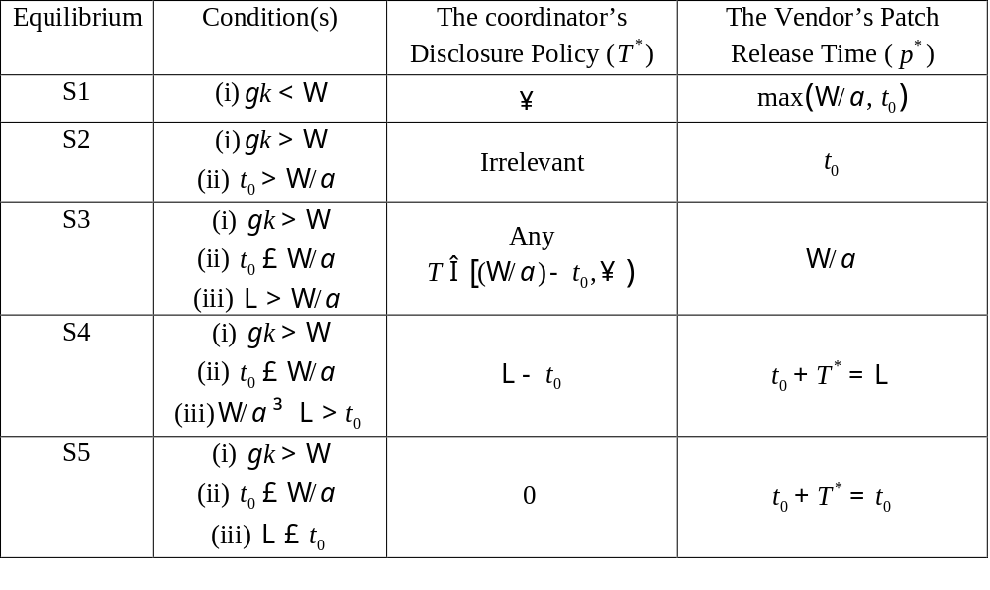
Responsible Disclosure Policy in Single Vendor Case
Full Vendor
Hybrid
Hybrid
Immediate
Public

Slide 18
Multiple Vendor Case
Same vulnerability can be associated with products of more than one vendor
  Vulnerability in a common standard
  Vulnerability in open-source software
Patch release decision of a vendor can create negative externality for other vendors
Should the coordinator set a longer or shorter grace period? (Schiller 2002)
Should the coordinator set a grace period considering the vendor that will patch the latest or earliest? (Schiller 2002)

Slide 19
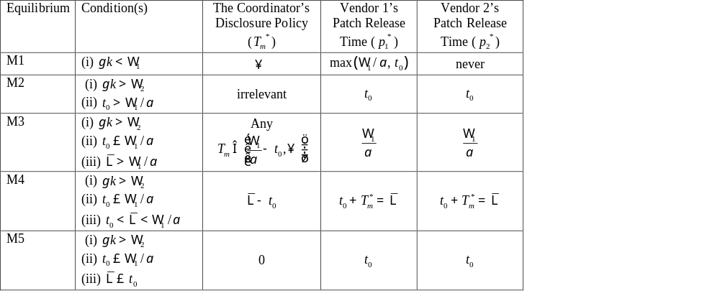
Responsible Disclosure Policy in Multiple Vendor Case
Full Vendor
Hybrid
Hybrid
Immediate
Public

Slide 20
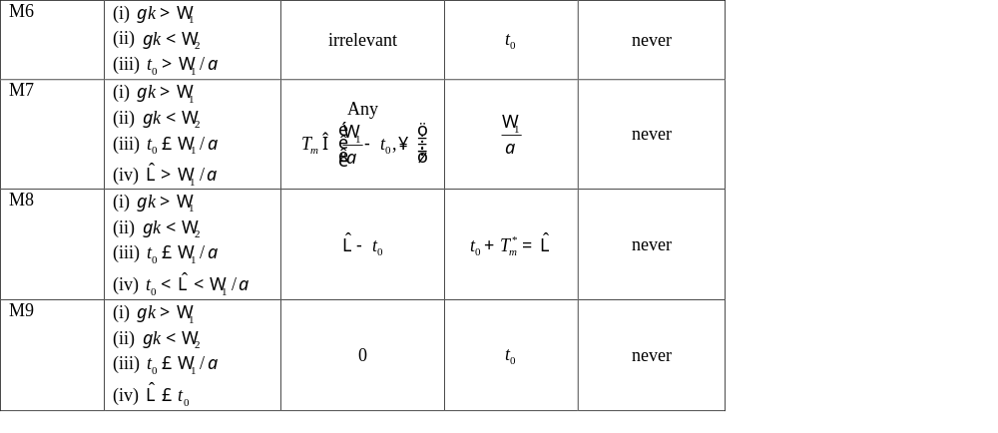
Responsible Disclosure Policy in Multiple Vendor Case (cont’d)
Hybrid
Hybrid
Immediate
Public

Slide 21
Proposition 3: (Multiple Vendor Case)
Optimal disclosure policy of the coordinator may not guarantee the release of a patch from both vendors in the multiple vendor case

Slide 22
Proposition 4: (Vendors’ Reactions to Disclosure Policy in Multiple Vendor Case)
If a vendor in the single vendor case is to share the vulnerability with a vendor that has less incentive than itself, the disclosure policy of the coordinator cannot prevent the original vendor from releasing its patch
If a vendor that can be motivated to release a patch under full vendor disclosure in the single vendor case is to share the vulnerability with a vendor that has more incentive than itself, the disclosure policy of the coordinator forces the original vendor not to release its patch

Slide 23
Proposition 5: (Coordinator’s Disclosure Policy When Both Vendors Release a Patch)
The coordinator does not consider how tolerant each vendor is when setting its disclosure policy. Having a high- (low-) incentive vendor share the same vulnerability with a low- (high-) incentive vendor does not necessarily lead to a longer (shorter) grace period to accommodate the second vendor

Slide 24
Corollary 2: (Comparison of Coordinator’s Disclosure Policies in Single and Multiple Vendor Cases)
The grace period in the multiple vendor case is within the range of two grace periods provided to vendors individually when they are the only vendor affected. In other words, T_{i}T_{m} T_{j}

Slide 25
Proposition 6: (Coordinator’s Disclosure Policy When Only a Vendor Releases a Patch)
When the high-incentive vendor shares the same vulnerability with the low-incentive vendor that ignores the vulnerability, the coordinator does not necessarily give a longer or shorter grace period
  Coordinator may extend the grace period even if it knows that the low-incentive vendor will not release any patch at all

Slide 26
Early Discovery of Vulnerabilities
Social planner can motivate benign users to identify vulnerabilities earlier through some incentive mechanisms
What is the impact of vulnerability discovery process in vulnerability disclosure process?
  How does early discovery change the disclosure policy of the coordinator and patch release decision of the vendor?
  Does social welfare improve if vulnerabilities are discovered earlier?

Slide 27
Proposition 7: (Effect of Early Discovery on Vendor’s Patch Release Time)
If the discovery of vulnerability occurs earlier, the vendor releases the patch no later than when it would release otherwise
  Early discovery does not enlarge the exposure window to the vulnerability
  Vulnerabilities are fixed earlier if they are identified earlier

Slide 28
Proposition 8: (Effect of Early Discovery on Coordinator’s Disclosure Policy)
If the discovery of vulnerability occurs earlier, the coordinator does not shorten the grace period

Slide 29
Proposition 9: (Effect of Early Discovery on Social Welfare)
The society is always better off with an early discovery of the vulnerability
  the social welfare can be improved without reducing the grace period if vulnerabilities are discovered earlier
  the social planner should consider both monetary and non-monetary incentive schemas to get benign users to exert more effort to identify vulnerabilities earlier

Slide 30
Early Warning System to Selected Firms
CERT informs members of ISA about newly discovered vulnerabilities
  can be beneficial to prevent damage to critical infrastructure
  might discourage vendors to develop patches promptly
  can cause more harm than good if vulnerability knowledge is leaked prematurely
Does society gain from such an arrangement?

Slide 31
Corollary 2: (Effect of Early Warning System on Patch Release and Grace Period)
When the coordinator implements an early warning system to selected users
the vendor has more incentive to postpone the release of its patch
the coordinator has more or less incentive to allow more time for the release of the vendor’s patch

Slide 32
Proposition 10: (Effect of Early Warning System on Patch Release Time)
If the vendor has incentive to release its patch immediately when there is no early warning system, the vendor releases its patch later with an early warning system
If the vendor does not have incentive to release its patch immediately when there is no early warning system, the vendor releases it patch earlier or later with an early warning system

Slide 33
Proposition 11: (Effect of Early Warning System on Social Welfare)
The use of an early warning system by the coordinator does not necessarily improve the social welfare
  Even with no leakage

Slide 34
Significant Results of Our Study
None of the policies is optimal all the time
Characteristics of vulnerability and vendor’s incentive determine optimal (responsible) vulnerability disclosure policy
Full vendor disclosure may motivate vendor
Coordinator’s disclosure policy might be irrelevant
Grace period does not necessarily increase or decrease when there is a common vulnerability
Early discovery improves social welfare
Early warning system is not always beneficial

Slide 35
Discussions and Implications
Benign users should be encouraged to discover vulnerabilities
Liability in Security is another mechanism to motivate the vendor to act responsively
The one-size-fits-all kind of a disclosure policy is not a solution
Full Public Disclosure is not optimal all the time
  but can have an indirect effect by encouraging vendors to develop better software with less bugs in the long run
Vendors should be encouraged to work together to develop patches for common vulnerabilities
Main contribution lies in understanding the intricate relationship between various stakeholders and in determining the dynamics of optimal disclosure

