Slide 1
Cyber Insurance and IT Security Investment:
Impact of Interdependent Risk
Hulisi Ogut, UT-Dallas
Srinivasan Raghunathan, UT-Dallas
Nirup Menon, UT-Dallas

Slide 2
Introduction
The scale and scope of hacker and virus attacks on computer systems is increasing
Two ways to minimize losses from security breaches
  Make security investment
  Buy cyber insurance

Slide 3
Introduction
IT Security decision of firms are interdependent because of networks
  if a hacker penetrate one company, she has easy access to shared trust partner’s IT assets through connection
Cyber insurance market is immature because
  lack of actuarial data
  few insurance firms provide cyber insurance product

Slide 4
Research Question
How the interdependence impacts decision of the firms
  to invest in IT security ?
  to buy cyber insurance coverage?

Slide 5
Assumptions & Firm’s Decision
Key Assumptions
  Firms are risk averse and CARA is assumed.
  The firms’ investments in IT security affect the probability of breach of any firm in network
    Investments exhibit declining returns
The Firm’s Decision
  Firm decides simultaneously on the level of insurance taken and IT security investment

Slide 6
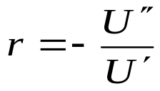
Notation
Decision Variable
  z₁: IT security investment level for firm 1
  I₁ :Insurance coverage taken by the firm 1
Model parameters
  U: utility function of firm
  p(z₁): Probability of breach from firm 1’s own resources
  B₁(z₁,z₂): total probability of breach for firm 1

Slide 7
Notation (Cont’d)
  π₁: Premium paid for each dollar of coverage for firm 1
  L₁: Loss amount firm 1 incurs if breach occurs.
  W₁ : Initial wealth of firm 1

Slide 8
Breach Probability
First consider two firms
A firm can suffer two source of attack
  Direct attack occurs with probability p(z₁)
    when the source of breach is the firm’s itself
  Indirect attack occurs with probability qp(z₂)
    when a hacker gain access to firm’s IT asset after breaching other firm
    q indicates degree of interdependence
  Total breach probability of firm 1 is
  B₁(z₁,z₂)=1-[1-p(z₁)][1-qp(z₂)]

Slide 9
Illustration of Total Risk to Firm 1
B₁(z₁,z₂)=p(z₁)+qp(z₂)-qp(z₁)p(z₂)
q.p(z₂)
p(z₁)

Slide 10
Model
Breach occurs with probability B₁(z₁,z₂)
  Firm 1 incurs loss of L
  It will be paid by coverage amount I₁ if firm 1 paid
  premium amount π₁I₁
  if firm 1 invest z₁ amount to IT security, in this case, the utility of firm 1 will be
U(W- L+(1-π₁)I₁-z₁)
Breach does not occur with probability 1-B(z₁,z₂)
  The utility of firm 1 in this case will be
U(W-π₁I₁-z₁)

Slide 11

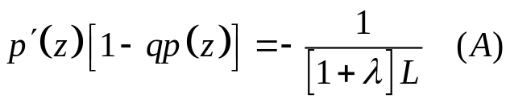
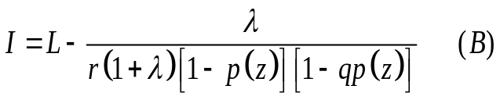
Solution to z and I
The price of insurance is given by
Firm 1 maximizes its expected utility
A firm’s IT security spending is solution to
The amount of insurance coverage taken by is

Slide 12
Solution Procedure
Equation A can be solved to obtain the optimum investment level first
Optimum insurance coverage can be obtained by plugging optimum investment level to the Equation B
Firm can manage IT security risk through by first reducing the risk through investments.
Manage the residual risk through insurance

Slide 13
Proposition 1
All else kept constant, the level of IT security investment and the amount of insurance coverage are lower as interdependency (q) increases

Slide 14
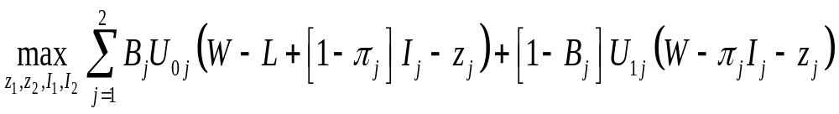
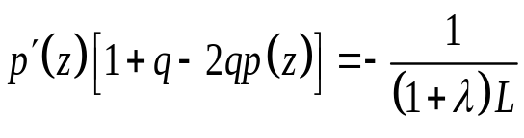
Joint Solution for Two Firms
Assume that firms are identical with equal pareto weights across the two firms
The solution to the IT security investment

Slide 15
Proposition
All else kept constant,
  the joint choice of IT security investment is higher than the firm’s individual choice of IT security investment and
  joint choice of insurance coverage taken is higher than the firm’s individual choice of insurance coverage taken

Slide 16
Information Sharing as a Mechanism to Increase Investment and Insurance
Information sharing reduces direct attack probability but not interdependency
  IT security investment increase because marginal benefit from IT security investment increases under information sharing.
Information sharing reduces interdependency but not direct probability
  As interdependency (q) decreases, IT security investment and insurance increases.

Slide 17
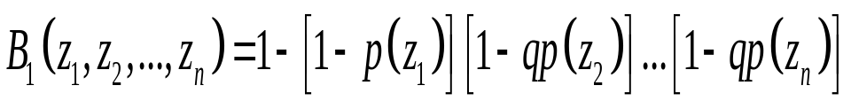
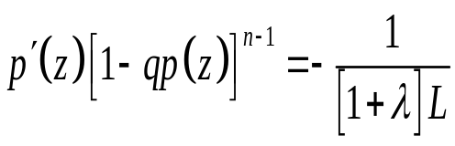
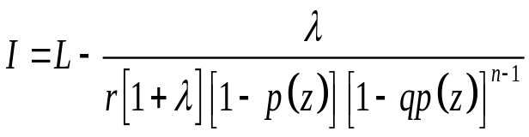
Generalization to Several Interdependent firms
The probability of breach for firm 1 in the n firm case is
For identical firm case, the level of IT security investment is
The amount of insurance is then given by the

Slide 18
Proposition 5
For identical firms , as the number of firms (n) increases,
  IT security investment level for individual firm will decline
  probability of breach will decreases
  cyber insurance level taken will decreases.

Slide 19
Conclusion
As interdependency increases,
  IT security investment decreases
  Cyber insurance coverage taken decreases
The increase in the number of firms has the same affect with interdependency.
Joint solution implies higher IT security investment compared to individual solution

